Slide 1


Increase Your Security And
Productivity with Sangfor IAG
Aug 2022
Eugene Yew
Product Marketing Manager for IAG
www.sangfor.com
Sangfor Technologies Inc.

Slide 2
Version
Date | Remarks | Author
6-Aug-2022 | Revamp whole IAG main slides with better elaboration. | Eugene Yew
8-Aug-2022 | Added existing materials for other explanation. | Eugene Yew
Notes:
a. Slide deck design for presenting information on old and new solution pillars.
b. You may remove and replace any slide that you deem appropriate for your presentation style.
c.

Slide 3
Agenda
PART
1
PART
2
PART
3
PART
4
PART
5
PART
6
Challenges
Solution Pillar
What’s New?
Case Study
New Pricing Bundle
Takeaways

Slide 4



Challenges
Traffic are encrypted
User without identity
Malware infection
Malicious content
Bypass visibility and control
An IP is not an identity
Inability to track users
End users are entry points
Inappropriate Internet Access
Data Exfiltration
Miuse of web applications
Bandwidth saturation
Miuse of corporate data
Innocent victim and monetary gain
Outdated anti-malware signatures
Unauthorized internet access

Slide 5
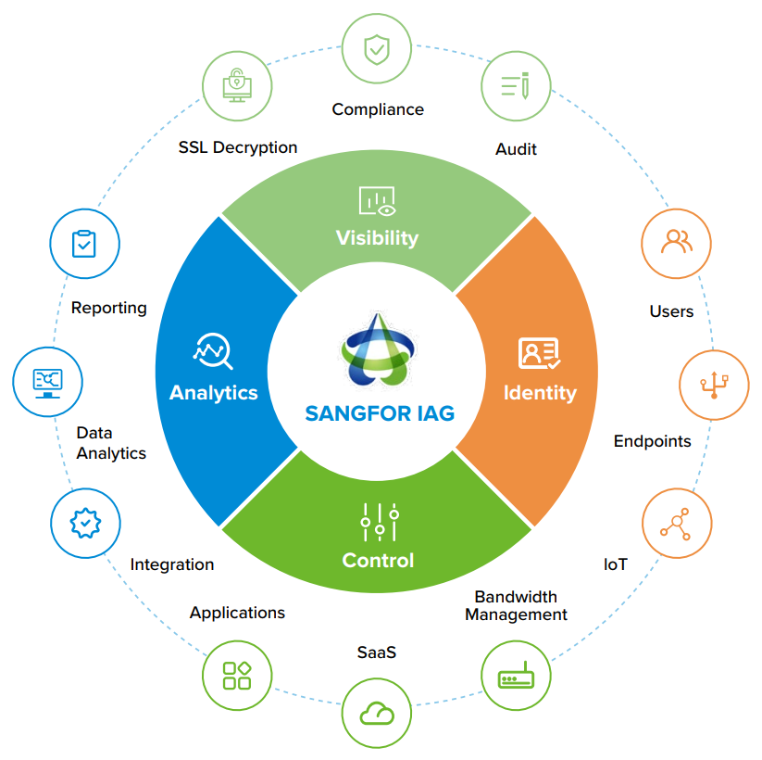
Solution Pillar
Value Differentiator
Gain full visibility
Unveil user identity and analytics
Take full control

Slide 6



Solution Pillar - Visibility
SSL Decryption
Man-in-the-middle decryption
Compliance
Enforce compliance policies and regulations
Audit
Protect business and monitor data is not outside of your organization
Visibility
IAG
Analytics
Identity
Control

Slide 7
Solution Pillar - Identity
Users
Know “who” is the user
Endpoints
Users associated with onboarding endpoint
IoT
Discover and remediate on unknown devices
Visibility
IAG
Analytics
Identity
Control

Slide 8
Solution Pillar - Control
Applications
Control access to inappropriate applications
SaaS
Identify, block and limit usage of web applications
Bandwidth
Prioritize business traffic for critical applications
Visibility
IAG
Analytics
Identity
Control

Slide 9
Solution Pillar - Analytics
Reporting
Validating security policies and regulatory compliance in audits
Data Analytics
Discover and impose security polices according to trend and usage
Integration
Working with Sangfor ecosystems and third party vendors
Visibility
IAG
Analytics
Identity
Control

Slide 10
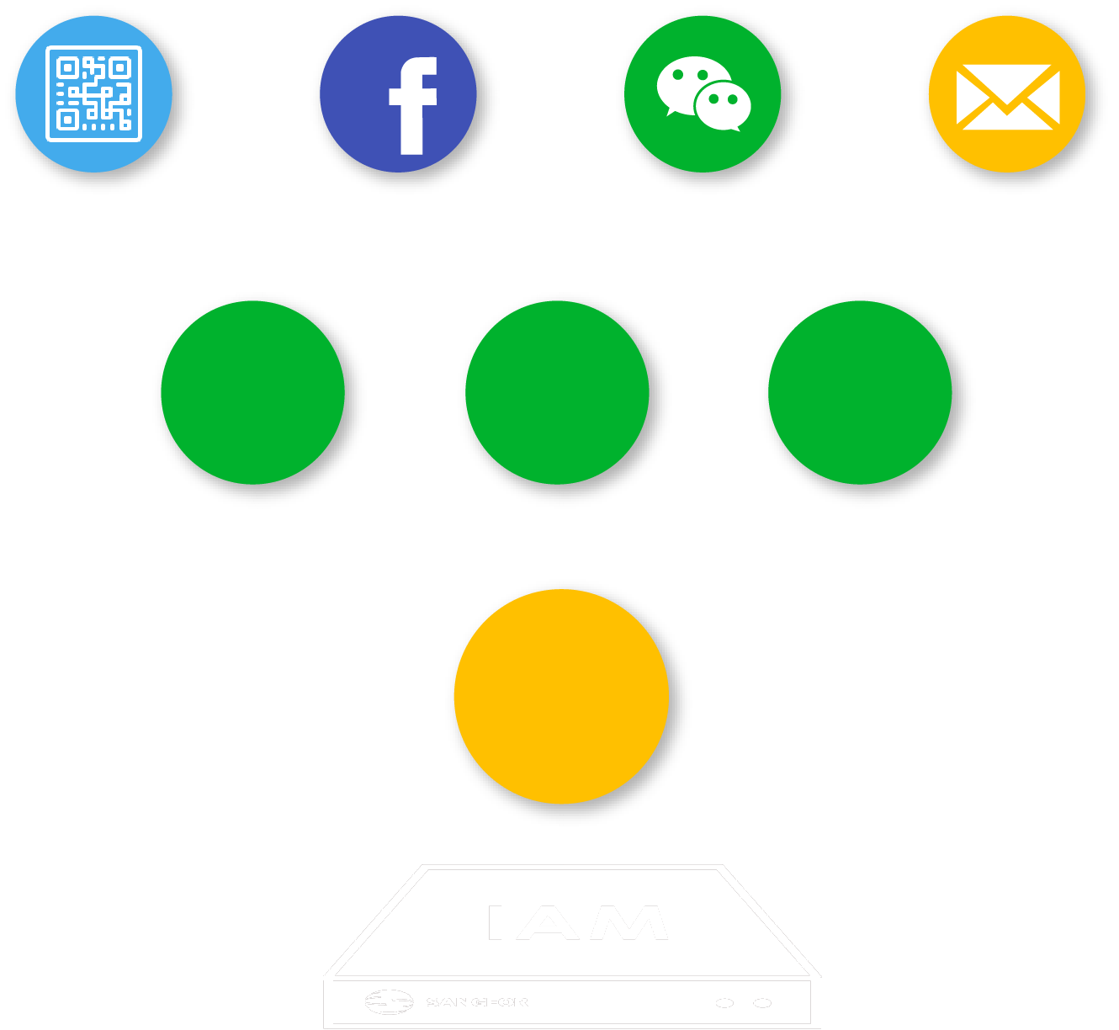
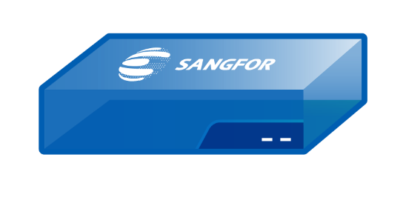
Solution Pillar – User Authentication (Identity)
User Identity
Authentication method
Policies based on identity
Rogue users and innocent victims
3^{rd.} Party Server
SSO
Self-
Register
AD SSO
Portal
Auth.

Slide 11

Solution Pillar – Bandwidth Management (Control)
Intelligent P2P Traffic Control
Control P2P traffic by restraining upload traffic
Dynamic Traffic Control
Allow idle bandwidth occupy by limited channel to improve experience
Granular Quota Control
Daily and monthly traffic quota

Slide 12

Solution Pillar – Audit (Control)
Monitor user internet activities
Prevent abuse of data
Exclude banking transaction and payment
Achieve Internet compliance

Slide 13











Solution Pillar – Shadow IT (Control)
SaaS Analysis
Policy Enforcement
Not allowed in company
Status: Unsanctioned
Sanctioned and Unsanctioned Apps
Determine security risks
Policy Control and Blocking
Setup control policy and block this app if require
Application Control
Determine access control for applications
Block Apps
Account Control
Analysis
Evaluation
Discovery
Status: New
Application Control
Allowed in company
Status: Sanctioned
Content identification

Slide 14
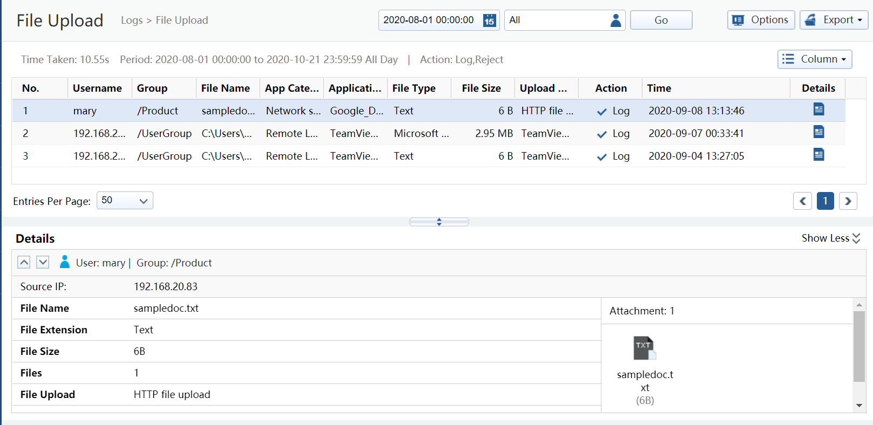
Solution Pillar – Report Center (Analytics)
Report Center
Compliance
AUP Violation
User Investigation

Slide 15
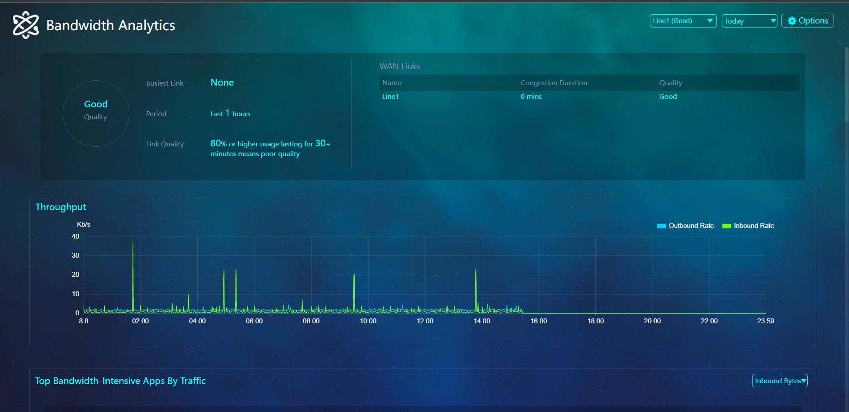
Solution Pillar – BI (Analytics)
Business Intelligence
Single Pane of Glass
Overall Assessment
Bandwidth Analytics, Electricity Waste Analytics,
Leased Line Analytics
Notes:
Note: Discontinue on Event Analytics and Internet Access Analytics.

Slide 16
What’s New?
Traffic-based
Ingress Client-based
ICAP inspection mode and type (integration)
Forward proxy optimization
Endpoint
Security Posture
ICAP
Optimization
01
02
03
04
05
SSL Decryption
Proxy Avoidance
Protection
SAML 2.0
Decryption via Ingress Client
Support Third-party Authentication System
User authentication
Protection via Endpoint Secure
Application control

Slide 17
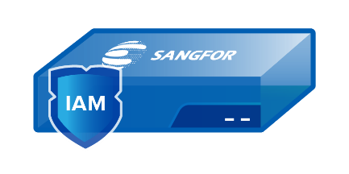


What’s New? – SSL Decryption
80%
IAG performance degradation reduction
20%
IAG performance degradation reduction
80%
20%

Slide 18
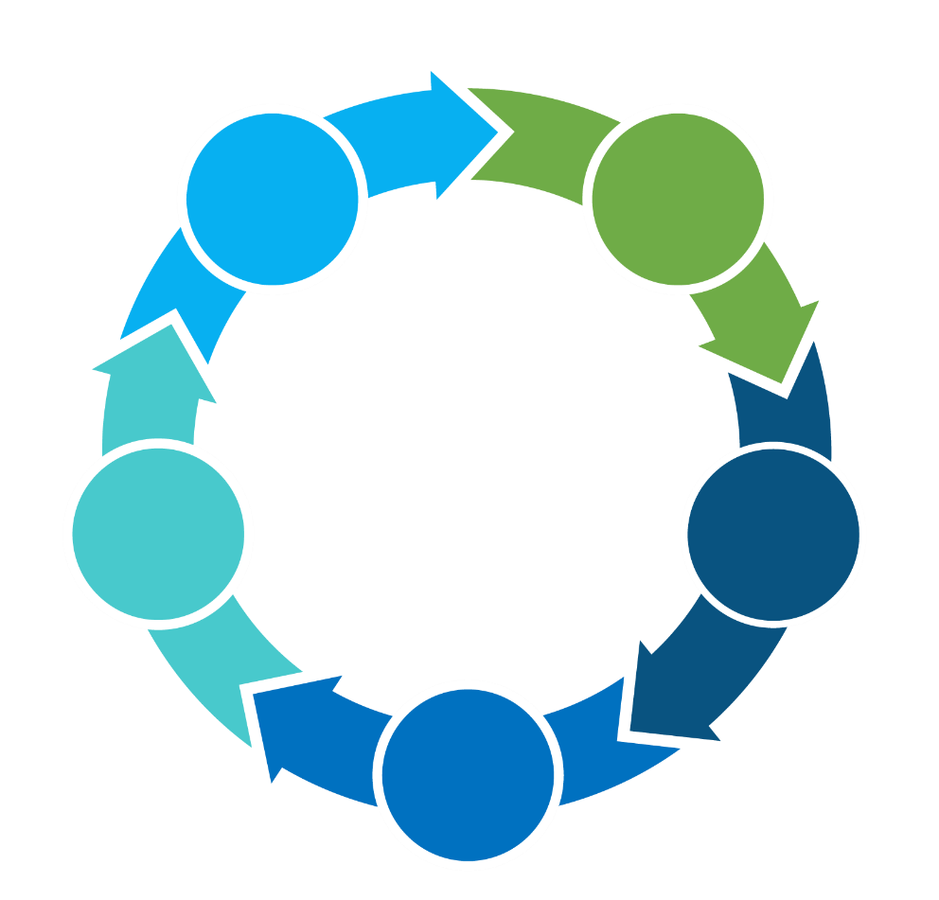

What’s New? – SSL Decryption
Certification distribution
Supports all deployment modes
01
02
Ingress Client
Support TLS 1.3
05
03
Uncloak hidden applications
04
Small footprint: Average CPU 5%

Slide 19



What’s New? – SSL Decryption
IAG Decryption
Ingress Client Decryption
1
2
1
2
Internet
Internet
Client
Man-in-the-middle
Server
Client
Sangfor
Ingress Client
Server
Solution benefits:
No need to install ingress client
Any operating system can be used
Solution benefits:
Performance gain on IAG
Content audit capabilities
Ingress client comes with certificate distribution
*Comes with Essential bundle license

Slide 20




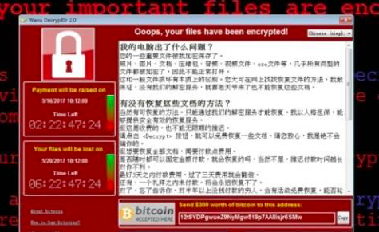




























What’s New? – Endpoint Security Posture
Sangfor Integration
Identity
Threat
Security threats and risk
3. Endpoint Compliance Check
IoT
NGAF
Endpoint Secure
Who
Authentication/Bypass Authentication
Cyber Command
Portal
4. Remediation
。。。
Access
Legal
Endpoint
Wi-Fi Integration
Illegal
External
1. Discovery
2. Authentication
5. Control
  Audit
Sangfor IAG key distinguisher for securing users and endpoints

Slide 21


What’s New? – Endpoint Security Posture
Endpoint Check (Ingress Client)
Antivirus Check (Traffic Based)
Benefits
Benefits
Reduce attack surface
Identify and implement access control
Identify rogue device
Less intrusive with fast remediation
Endpoint Telemetry
Enforce compliance
Single vendor with unified management

Slide 22
What’s New? – Endpoint Security Posture
OS version
Process/file/task
Registry
Unauthorized internet access
Patch verification
Login domain
Windows account
Change IP/MAC prevention
Anti-virus signature verification
Deny/Allow IP access control
Software installation inspection
Anti-virus update
Botnet (Neural-X)
Bitcoin mining (Neural-X)
Endpoint Check
(Ingress Client)
Antivirus Check
(Traffic Based)

Slide 23











What’s New? – Proxy Avoidance Protection
Users with Proxy Tools
Normal Users
Bypass company security perimeter
Away from malicious content
Highly secured
Undetectable access to malicious content Include viruses, phishing, illegal, etc.
Ensure compliance
Stealthy installed spyware, RAT Information leakage & more damage in the shadow
Full traffic visibility
Violate compliance/law
Bandwidth abuse

Slide 24











What’s New? – Proxy Avoidance Protection
Block proxy avoidance tools both in the network and at the agent
Increase productivity in the workspace
Unparalleled visibility and control of applications
Regain misused bandwidth
Fortify your perimeter defense
Sangfor IAG Sangfor NGAF

Slide 25


What’s New? – Proxy Avoidance Protection
+
Sangfor IAG Sangfor NGAF
Agent-based anti-proxy
Network-based anti-proxy
Endpoint Secure block any potential anti-proxy
Integration between IAG/NGAF and ES manager
Application signatures
Application signatures
Whitelisting and blacklisting

Slide 26
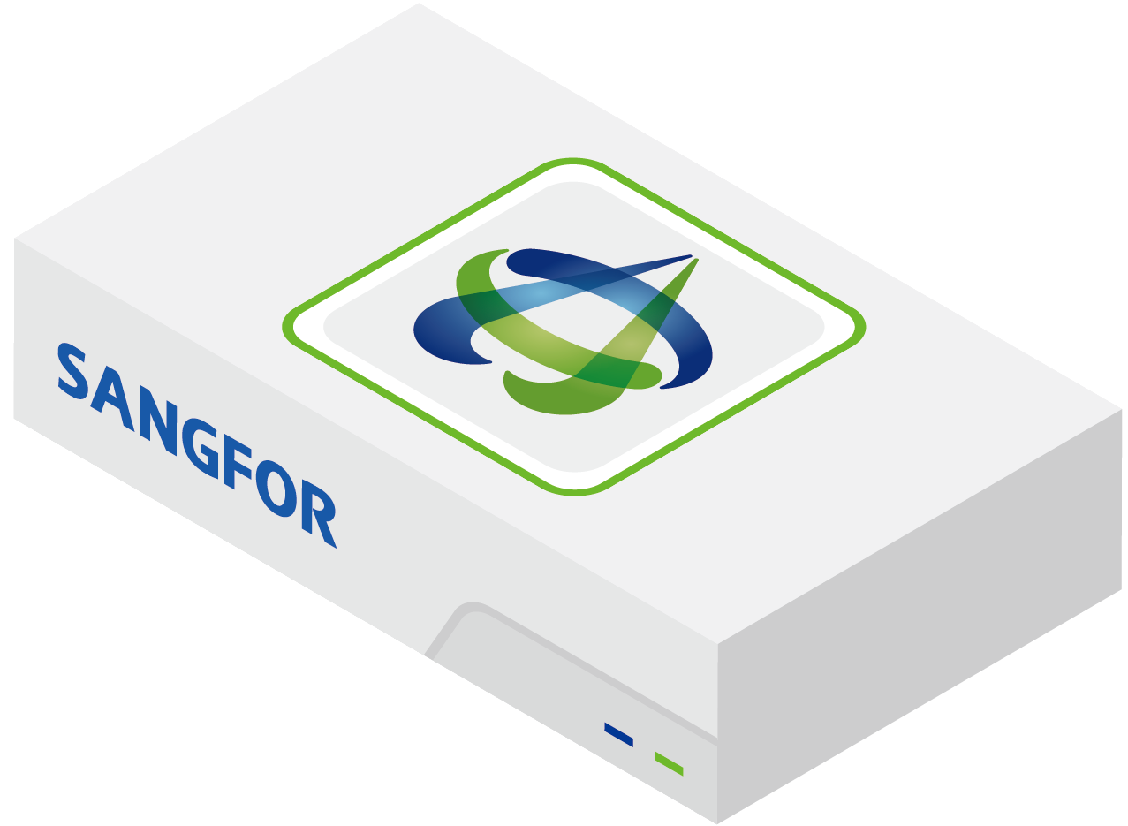






What’s New? – ICAP Optimization
Modified HTTP Response
HTTP Response
HTTP Request
ICAP Client
Modified HTTP Request
Internal user
ICAP Request
(Perform Modified HTTP Request)
ICAP Response
(Perform Modified HTTP Response)
ICAP Server
Anti-Malware Engines
Data Sanitization Engines
Unknown Threat Detection Engines

Slide 27
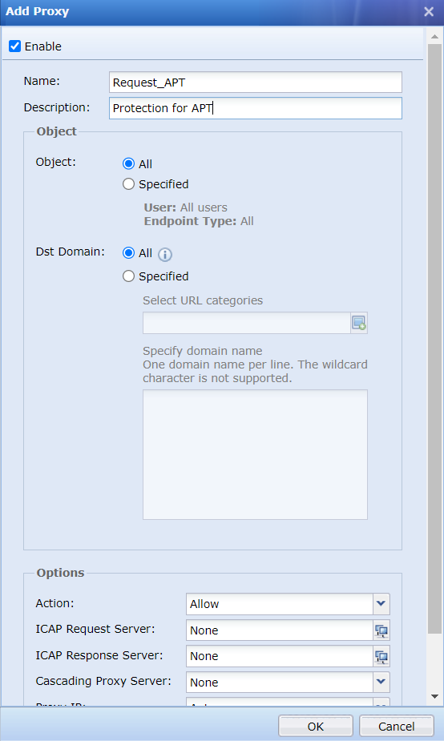
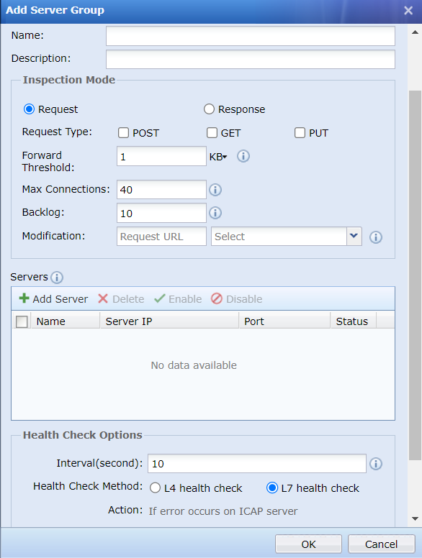
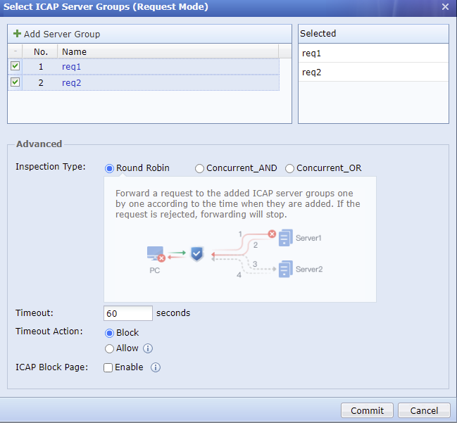
What’s New? – ICAP Optimization
Layered protection and automate inspection with external cybersecurity solutions

Slide 28
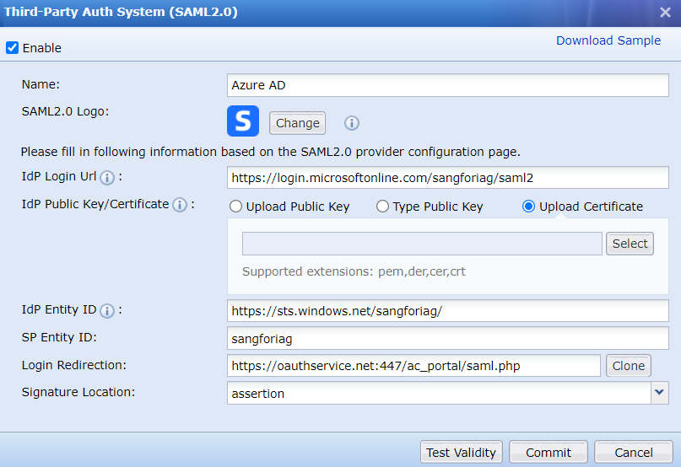
What’s New? – SAML 2.0
Unified user database with third-party vendors

Slide 29

Case Study - Retail
Customer Overview
private-owned conglomerate with holdings in the jewellery business and was listed on the mainboard of stock exchange of HK.
Extensive retail of network in China, Japan, SEA and US.
Focus on diverse customer segments by catering to different lifestyles, personalities as well as customers’ different life stages.
Business Challenges
Support issues from Microsoft on Forefront TMG.
Facing high consumption of bandwidth on critical applications.
Priority on video conference due to pandemic i.e Webex, Zoom, Ding Talk, Tencent Video.
Reporting capabilities to know which applications are running.
Sangfor Solution
Each branch offices run IAG with designated bandwidth policies
Give first priority to critical applications and pool of remaining bandwidth for less critical applications.
Effective user/group policy to determine the surfing quota and bandwidth usage.
Key Values
Critical applications and other applications run seamlessly without saturating internet bandwidth.
Predefine policies in place in the event to determine bandwidth adjustment according to the demand of bandwidth.
Detail reporting on each user/group access and applications within their network.

Slide 30

Case Study - Government
Customer Overview
EGAT is a state enterprise managed by the Ministry of Energy responsible for electric power generation and transmission as well as bulk electric energy sales in Thailand.
Responsible to generate, transmit and sell electric energy to Metropolitan Electricity Authority (MEA) and Provincial Electricity Authority (PEA) that further distribute and retail electricity to customers.
Business Challenges
Use Allot to replace PacketShaper and planning to replace all PacketShaper across all branches.
High OPEX in Allot solution after implementation and tight timeline to ensure seamless solution in place.
Have specific requirements to ensure operation in the datacenter, disaster recovery center, and branches are uninterrupted.
Sangfor Solution
Granular control on application bandwidth consumption and well-defined user policy to prevent network congestion and Internet outage.
Seamless integration with controller to redirect user authentication within Sangfor IAG.
All IAG appliances configuration and management will be centralized control within Sangfor Central Manager.
Key Values
All critical Internet applications bandwidth will be given the highest priority based on user and group identity while non-productive applications will be capped at an assigned pool of available bandwidth.
All existing controller wireless authentication and wired network will be centralized managed and authenticate within Sangfor IAG to provide a single pane of glass management.
Provide secure and integrated identity solution access to internet facilities with active directory SSO.

Slide 31

Case Study - BFSI
Customer Overview
Maybank is Malaysia's largest bank by market capitalisation and total assets and one of the largest banks in Southeast Asia.
Maybank is the largest public listed company on Bursa Malaysia, the Malaysian stock exchange, with a market capitalisation of US$23.7 billion as of 31 December 2019.
Business Challenges
PacketShaper are running on EOL and weak support from Broadcom (Symantec/Bluecoat).
Administrator spend too much time on fine tuning on existing bandwidth management policies.
Incapable to operate and manage multiple PacketShaper as administrator heavily rely on vendor assistance.
Sangfor Solution
Each branch offices run IAG with designated bandwidth policies
Give first priority to critical applications and pool of remaining bandwidth for less critical applications.
Effective user/group policy to determine the surfing quota and bandwidth usage.
Key Values
Critical applications and other applications run seamlessly without saturating internet bandwidth.
Sangfor act as a trusted advisor to Maybank and provide support with remediation.
Sangfor provides necessary enablement to Maybank on key management and operation of IAG.

Slide 32
PART 3
New Pricing Bundle

Slide 33


New Pricing Bundle
Reduced complexity of license
selection
More appealing and better pricing
Better pricing competitiveness

Slide 34
New Pricing Bundle
Essential Bundle
Premium Bundle
50%
70%
Hardware
Hardware
Anti-Malware Protection (Known & Unknown)
Basic SWG with URL filtering

Slide 35

New Pricing Bundle - Breakdown
 | Essential | Premium
Bandwidth Management
User Authentication
Traffic Control
Content Audit
Proxy Avoidance
Endpoints Management
Report Center
Link Load Balance
Support Services
Sangfor URL Database
Anti Malware (Engine Zero)
Threat Intelligence (Neural-X)

Slide 36
Conclusion – Key Takeaways
01
02
03
Gain Visibility and Control over your network
Proactive rather than reactive security approach
Empower your network with continuous monitoring and protection

Slide 37
THANK YOU
Eugene Yew
Product Marketing Manager IAG
Sangfor Technologies
eugene.yew@sangfor.com
www.sangfor.com
Sangfor Technologies Inc.

