Slide 1

Sangfor WANO Compare with Cisco WAAS
Sangfor Technologies
www.sangfor.com

Slide 2











Intelligent WAN Solution Components
AVC
Private
Cloud
MPLS
Virtual
Private
Cloud
3G/4G-LTE
Branch
Internet
WAAS
PfR
Public
Cloud
Control & Management Automation
Transport
Independent
Intelligent
Path Control
Application
Optimization
Secure
Connectivity
Consistent operational model
Simple provider migrations
Scalable and modular design
IPsec routing overlay design
Dynamic Application best path based on policy
Load balancing for full utilization of bandwidth
Improved availability
Application visibility with performance monitoring
Application acceleration
and bandwidth optimization
Certified strong encryption
Comprehensive threat defense
Cloud Managed Security for secure direct Internet access
Notes:
The cisco iwan solution is built on 4 pillars.
The first I have just mentioned is DMVPN. A secure tunnel technology that allowing for TRANSPORT INDIPENDENCE.
Next is INTELIGENT PATH CONTROL through the use of performance routing. PFR
Third is APPLICATION OPTIMISATION through the use of WAAS and AVC
Fourth is SECURE CONECTIVITY.

Slide 3



Flexible Secure WAN Design Over Any Transport
Transport-Independent
Flexible
Secure
Simplifies WAN Design
Dynamic Full-Meshed Connectivity
Proven Robust Security
Easy multi-homing over any carrier service offering
Single routing control plane with minimal peering to the provider
Consistent design over all transports
Automatic site-to-site IPsec tunnels
Zero-touch hub configuration for new spokes
Certified crypto and firewall for compliance
Scalable design with high- performance cryptography in hardware
MPLS
WAN
ASR 1000
ISR-G2
Branch
Internet
Data Center
ASR 1000
Notes:
DMVPN allows for the establishment of dynamic full-mesh tunnels with proven robust security over any transport.

Slide 4
PfR Enhances Classical Routing
Classical
PFR with AX License
Topological state
Least cost path
Static user preference
Application-aware
Policy controlled
Measured performance
PATH CONTROL
Delay
Jitter
Bandwidth
Path cost
Interface state
+
METRICS
Responds To:
Link and node state changes (up/down)
Responds To:
Measured performance changes (degradation)
ADAPTIVE
Notes:
So what enhancements does PFR bring over classic routing.
As you can see here on the right PFR contains all of the classic routing components as well as Delay, Jitter, and actual throughput. It is application aware and can be policy driven.

Slide 5







Intelligent Path Control with PfR
Voice and Video Use-Case
Voice/Video take the best delay, jitter, and/or loss path
MPLS
Private Cloud
Branch
Internet
Virtual Private
Cloud
Other traffic is load balanced to maximize bandwidth
Voice/Video will be rerouted if the current path degrades below policy thresholds
PfR monitors network performance and routes applications
based on application performance policies
PfR load balances traffic based upon link utilization levels
to efficiently utilize all available WAN bandwidth
Notes:
PFR monitors the WAN performance and routes applications based on policy.
As you can see here PFR directs the Voice and Video traffic over the MPLS network for the best delay, loss and jitter figures and directs the remaining traffic across both MPLS and internet to attain optimal performance.

Slide 6











Make your IWAN Application Aware- Add Cisco Application Visibility and Control (AVC)
Users/
Machines
Public
Cloud
Proliferation
of Devices
Private
Cloud
Branch
DC/Headquarters
No Probes
Smart Capacity
Planning
Business Aligned Privacy Enforcement
  Rich data collection – Flexible NetFlow
  No additional hardware,
  AX license on Plafrom
  Many reporting tool options
  Per-application per-site level reporting
  Better information improves planning accuracy
  Intuitive application policies
  Identify specific products and applications within http traffic
Cisco AVC
60% of IT Professionals Cite Cloud Performance as Key Challenge
Notes:
This is both a huge security problem and makes providing the best possible performance to those applications that are important to your business impossible. So what’s the solution?
Cisco’s Application Visibility and Control; or (AVC) for short.
There are no probes, and no additional hardware AX licenses.
with NBAR2 functionality you can get a per-application per-site level of reporting.
With AVC you can write intuitive application policies.

Slide 7




























Performance Collection & Exporting
Integrated performance monitoring and advanced metrics for different type of applications and use cases
Advanced Monitoring
Voice and Video Performance
(Media Monitoring)
Critical Applications Performance
(Application Response Time)
30% of traffic is voice and video
40% of traffic is critical applications
Basic Monitoring
What applications, how much bandwidth, flow direction?
(NBAR2 and Flexible Netflow)
HTTP
HTTP
Notes:
So what can we actually see? Everything at the bottom can be seen BY AVC. Now based upon that what we can learn here at the top. In combination with NetFlow, which I will cover a bit later this gets even better.

Slide 8
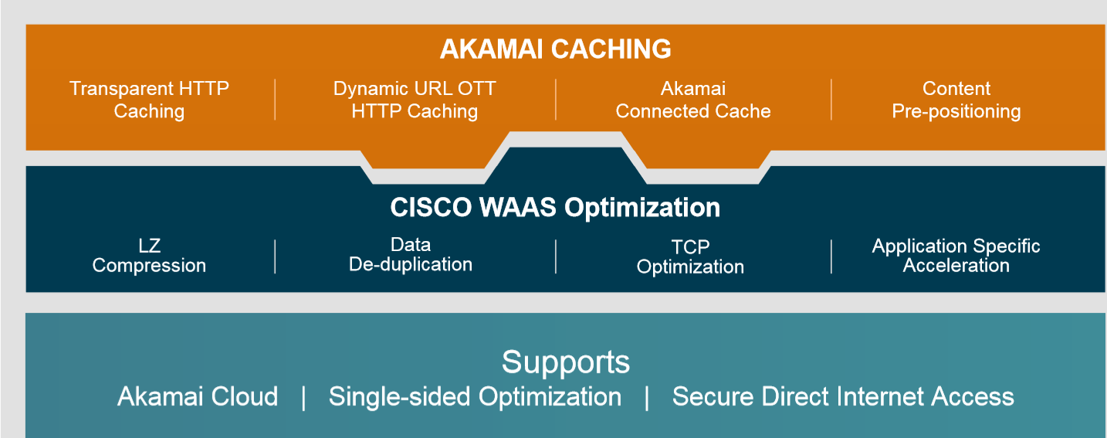
Key Function with WAN Optimize
Notes:
Less than 40% of enterprise Internet connections today are secured using next-generation firewalls (NGFWs). By year-end 2018, this will rise to at least 85% of the installed base, with 90% of new enterprise-edge purchases being NGFWs as more enterprises realize the benefits of application and user control.
-Gartner: Gartner Magic Quadrant for Enterprise Firewalls. 2015
Organizations already equipped with best-of-breed firewalls and IPSs might view WAFs as an exponential investment for incremental benefits. However, IPS protections against Web vulnerabilities are too general; often limited to known vulnerabilities from off-the-shelf third-party libraries and frameworks.
-Gartner: Web Application Firewalls Are Worth the Investment for Enterprises, 2014

Slide 9
Key WANO function Compare with Sangfor
Cisco
Adaptive DRE Cache
TCP Flow Optimizations
Sangfor
Byte Level Cache
Sangfor HTP and Relate
HTTPS/HTTP Base Support(Support up to TLS1.0)
LZ Compression
Object Cache(Support TLS1.2)
HTTPS/HTTP Base Support (Support up to TLS1.2
Dynamic Compression base on file type

Slide 10
Different between Cisco WAAS and Cisco Akamai License
Cisco Wide Area Application Services (WAAS) encompasses compression, optimization, and deduplication technologies - byte-level cache
The WAAS device do basically byte caching and deduplication (DRE) but not a HTTP protocol / context aware caching
Akamai: Caching places frequently accessed content in local devices so users avoid WAN delays and congestion
Wide Area Application Services (WAAS) WAN optimization products. The Cisco-Akamai partnership is aimed at helping enterprises reduce the bandwidth demands of rich media content consumed at branch offices and retail locations, particularly content from cloud providers. - object cache

Slide 11
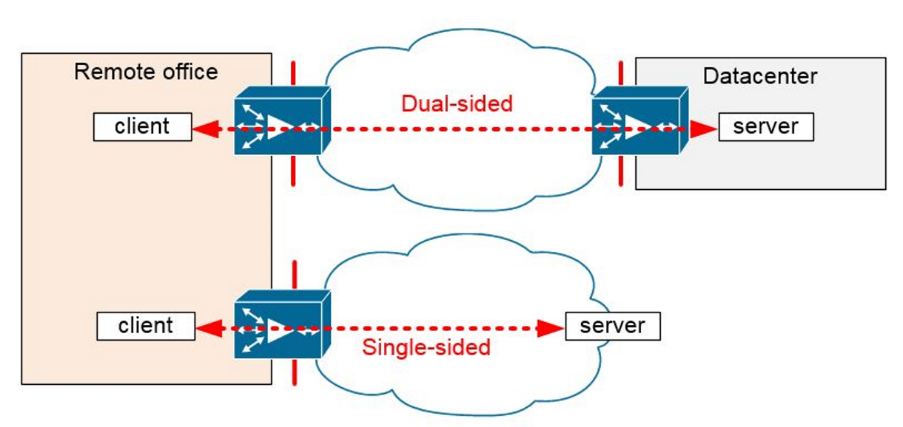
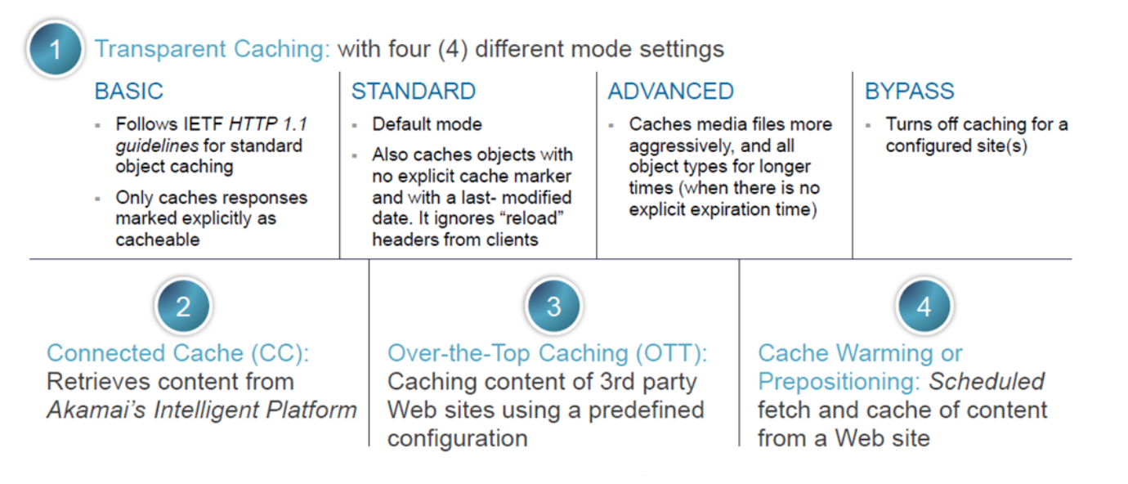
Akamai
HTTPS Support
HTTP Support
For the Cloud Application and Rich-Content

Slide 12
Which Product Support Cisco WAAS and Akamai
WAVE (WAAS) Hardware
Cisco WAVE 294/594/694/7541/7571/8541 appliances
ISR Route
Cisco 4000-AX Application Experience Routers ● Cisco 3900-AX Application Experience Routers ● Cisco 2900-AX Application Experience Routers ● Cisco 1900-AX Application Experience Routers ● Cisco 800 Series Integrated Services Routers (ISRs) with an AX Feature Set software licensing option
● Cisco ASR 1000 Series Application Services Routers with AX bundles

Slide 13
Compare with lowest module:
 | Cisco4321 | WAVE-294-K9 | S4000
Hardware | $3,495.00 | $6,500.00 | 1900
Option to Support WAAS | $3,000.00
Akamai License | $1,200.00 | $1,200.00
 | $7,695.00 | $7,700.00 | $1,900.00

Slide 14
How to guide customer
Information :
Exist Route brand - to review the customer need PO new Hardware or not.
Guide:
Guide from TLS1.2 , Coz if Cisco want to support have to add a license
Guide from Application Control and visibility , Cisco weak Point and need a License as well.
Technical Part:
Sangfor weak point: object cache / Central Management
Cisco Week point : if exist Route cannot support WAAS, their need to replace it, cannot development as a bridge mode from Cisco ISR.

Slide 15


Thank you !
Darrel Wang
Presales Manager
Darrel@sangfor.com
www.sangfor.com
Sangfor Technologies (Headquarters)
Block A1, Nanshan iPark, No.1001
Xueyuan Road, Nanshan District,
Shenzhen, Guangdong Province,
P. R. China (518055)

