Slide 1
Sangfor MCP DataCenter
深信服科技

Slide 2
Overview
Standard operation procedure
Action point
Agenda

Slide 3
Overview
Managed Cloud Service means customers or companies can focus on their core business, applications and other new products, and landing new customers. They don’t need to pay more ops engineers and system administrators or other experts to manage IT. They can leave it all to a trusted partner. That means we, Managed Cloud Provider, need to consider how to provide reliable, convenient and professional to our customers.
Network & Rack Planning
Managed Service
Reliability

Slide 4
Standard Operation Procedure
Output
Information
collection stage
Data center information collection
Rack diagram
Data center export network planning
Data Center Rack Diagram
Data Center Information Confirmation Table
Work Schedule Table
Network planning stage
IP/VLAN Planning
Network connection plan
Network interface planning &naming
IP Address Assignment Table of the XX Data Center
Network Planning Table for Data Center
Device/Label preparation
Put device on rack
Connection check
Label Overview
Label Print Table
Accessory Quantity Calculation Tool
Preparation stage
Cluster Configuration
Management Platform
Configuration
Management Platform Deployment
SCP Platform Deployment Guide
DNS/NTP/VPN/AF Configuration
SCP Authorization Configuration
Deployment stage
VPC Check & Test
Management Feature Test
Checklist
SCP Delivery Checklist
Documents Delivery
Overview
Test & Check stage

Slide 5


Reliability
Data center environment
Network bandwidth & IP resource
Two circuit feedings
Backup power supply
UPS
Air circulation system
Water chilling unit
Fire protection system
Security & Network system
Plenty of standard 42U rack
...
At least 2 operators providing dedicated network line to datacenter or BGP bandwidth
At least 50M for each dedicated line with redundant (According to future business to expansion)
At least 32 IP addresses from each operators(Adaptive by business)
Relative license
Notes: domestic market we need to get Internet License from regulator before the customer business released.
TIM
WindTre
Tier3+

Slide 6
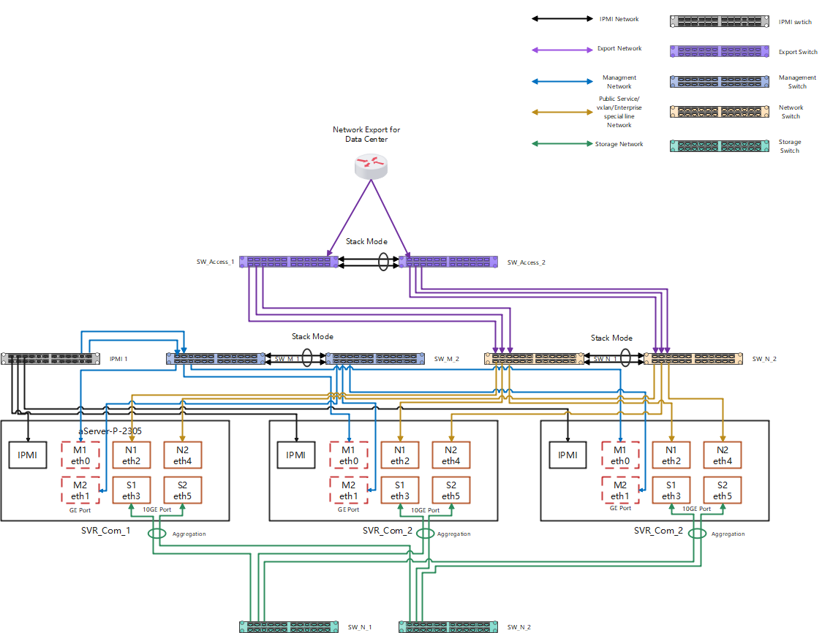
Network & Rack Planning
Network Planning
IPMI network(1GE switch)
Manage network(2*1GE switch)
Storage network(2*10GE switch)
Traffic network(2*10GE switch)
*Traffic network contains VXLAN, business, managed, and public service networks, and corporate leased line

Slide 7
Rack Planning
MDF
MDF
MDF
MDF
MDF
MDF
MDF
MDF
MDF
MDF
MDF
MDF
MDF
IPMI TOR
IPMI TOR
MDF
MDF
Traffic TOR
Traffic TOR
Traffic TOR
Traffic TOR
Storage TOR
Storage TOR
Storage TOR
Storage TOR
Storage TOR
Storage TOR
Manage TOR
Manage TOR
Manage TOR
Manage TOR
Traffic Core
Traffic Core
2U Server
2U Server
4U Server
4U Server
2U Server
2U Server
Maximum
10 devices
2U Server
2U Server
4U Server
4U Server
Storage Core
Storage Core
SAN
……
……
2U Server
2U Server
……
……
Max: 5
devices
2U Server
2U Server
2U Server
2U Server
Manage Core
Manage Core
SAN
2U Server
2U Server
4U Server
4U Server
2U Server
2U Server
4U Server
4U Server
2U Server
2U Server
POD
POD
Cabling standardization, independent of upper-layer Traffic, and horizontal expansion of resources according to POD;
Deploy switches of the same Traffic type across the rack to ensure reliability

Slide 8
Network & Rack Planning
Rack Planning
Put switches in the top space of the rack, and each rack can put up to 4 (1U) switches.
Stacked switches are placed in different racks
Place 1U space between two devices
Each rack houses a maximum of 10 sets of 2U servers (upper limit of PDU current)
Each group of 7 switches corresponds to a group of 3 racks
Core switch or aggregation switch Depending on the scenario

Slide 9
Managed Service
Standard service
VPC managed service
Expert Service
Delivery
service
Basic
service
7*24 O&M Team
Onsite(3 persons at least)
Replacement of spare parts and wires
Simple troubleshooting
Equipment and device installation and removal
Providing remote control
Remote(1 team with HQ support)
Parameter configuration
Troubleshooting

Slide 10
Action Plan
Make sure the data center environment can meet our requirements
Confirm the how many resource we’re going to put in the bucket.
Planning the Network and Rack resource
……

Slide 11





Slide 12
SANGFOR TECHNOLOGIES INC.

