Slide 1


Trifecta Effect
Identification, Assessment
and Enforcement for Asset
Management
Eugene Yew | Product Marketing Manager
eugene.yew@sangfor.com
Sangfor Technologies
www.sangfor.com
Sangfor Technologies Inc.

Slide 2
Contents
PART
1
PART
2
PART
3
PART
4
Challenges & Trends
Unified User & Network Management
Use Case
Takeaways

Slide 3
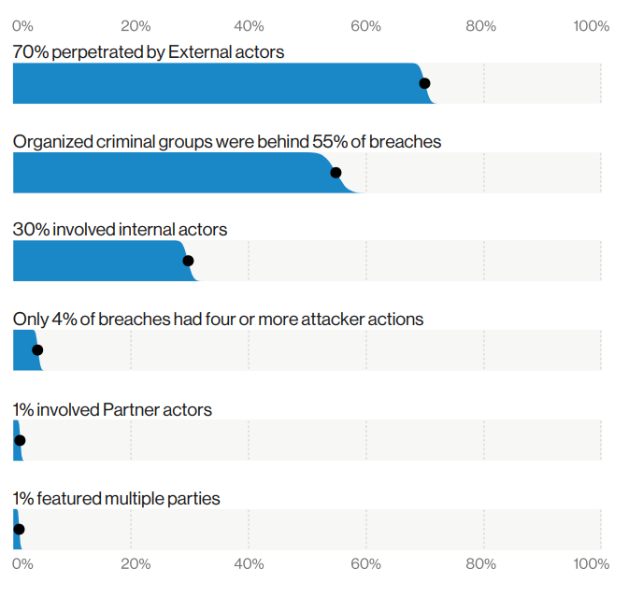
Asset Landscape
Who’s behind the breaches?
30% of breaches are internal threat
Disgruntled employee, unintentional and Accidental victim
Lower barrier to entry with anonymity and Crimeware-as-a-service (CaaS)
*Sources: Verizon on data breach investigations report 2020

Slide 4
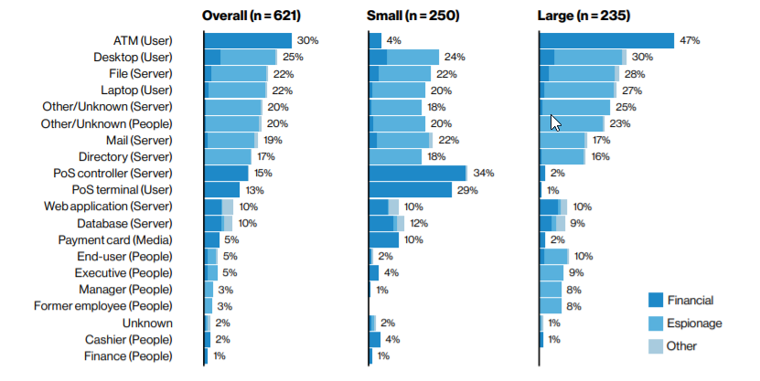
Asset Landscape
Varieties of compromised assets
Size does not matter
Attacks derived from user device & people
*Sources: Verizon on data breach investigations report 2020
Notes:
1. Organizations regardless of size are troubled with attacks on User devices and People (social attacks)

Slide 5



Complexity of Modern Digital Workplace
Data
Tools
Inaccurate
Incomplete
Disjointed info
Limited capabilities
Too many to keep
Assets
People
Processes
Risks
Visibility
Siloed teams
Skills disparity between different teams
Error prone
Labor intensive
Manual

Slide 6
Why It Matters?
A single
packet
to crash device
Challenging to identify vulnerable devices
Fixes not available and large scale deployment are impossible
No
silver bullet
Notes:
Example for broad attack such as smurf attack and it could be easily bring down any critical servers and endpoint devices without being notice in advance.
Asset identification or unpatched system discovery is a daunting task.
In most cases, organization IT team not able to deploy any single patch without any UAT or system testing before running in production system, let alone for large deployment. It is extremely difficult and requires different team to evaluate this.
There is no fool prove on protected system that is not susceptible to any form of attacks.

Slide 7



What Could Happen?
Information Leak
Denial of Services (DoS)
Malware Payload
Notes:
Example of possible attacks, these are classic example and many more than this.

Slide 8
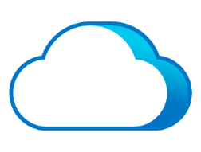

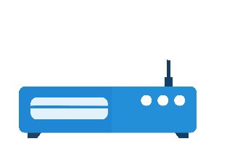
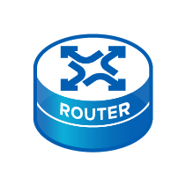
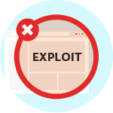
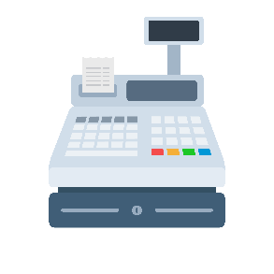
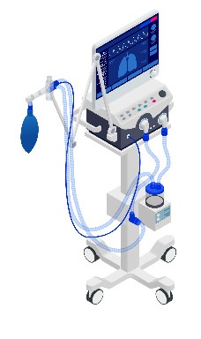
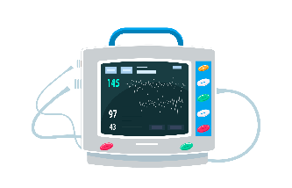

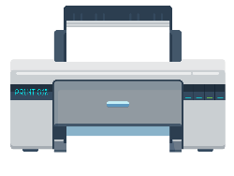



The Threat of IoT and Endpoint
Internet
Retail premise
Healthcare premise
Notes:
IOT devices or unknown endpoint devices are the entry point for most cases
Majority of security solutions emphasis on critical servers, endpoint, database and etc, but literally non-exists for IOT devices
Organization also face challenge to acquire new solution due to cost effectiveness and managing siloed solutions
What you really need is simplify user and network management especially any possible unknown and onboarding devices widen attack surface.

Slide 9



Trifecta Force
SWG Unified User & Network Management
Identification
Evaluation
Enforcement
Asset identification and associated users
Risk assessment and exposure
Access control and compliance check
Asset Management & Endpoint Compliance Check
Notes:
These are few factors involve and ideally revolving identification, evaluation and enforcement criteria.
SWG is the foundation solution and allow organization to have holistic solution to uncover even more possible threats.
Asset management & endpoint compliance check is used for this purpose and allow any organization to gain unparallel visibility across your network without having to use different siloed solutions and team disparity.

Slide 10



Unified User & Network Management
SWG
Endpoint Discovery
Asset Management
Endpoint Classification
Endpoint Check

Slide 11


Endpoint Discovery
Benefits
Quick search for any unknown devices
No software $=$ hassle free
Low maintenance
Notes:
Utilize fingerprinting (OS, port open, vendor endpoint)
Identify IP address pool (online, offline, available)

Slide 12

Endpoint Classification
Benefits
Increase visibility to onboarding device
Identify device which is previously unknown
Notes:
Automated IOT categorization
6 categories with customization
Ways to filter and export
Identify device to user identity

Slide 13


Best of Both Worlds
Benefits
Reduce attack surface
Endpoint Check
(Ingress Client)
Identify rogue device
Endpoint Telemetry
+
Single vendor with unified management
Benefits
Antivirus Check
(Traffic Based)
Identify and implement access control
Less intrusive with fast remediation
Enforce compliance
Notes:
Endpoint Check
Rule design based on 13 category
Patch, process, access control, external device control, anti-defacement, anti-virus software and etc
Allow notification and action taken
Antivirus Check
Application recognition based on traffic
Separated by personal software and enterprise software
Allow notification and action taken

Slide 14

Use Case – Healthcare
Business Challenge
Identify, classify and manage connected devices in the network
Visibility on medical devices and others
Secure BYOD and guest endpoints
Results
Automated discovery and classification
Remediation on non-compliance devices
Optimized asset inventory and reporting
Notes:
Classic example of using medical equipment that might not be identify and recognize in the network
Inability to track and identify any possible non-compliance devices
Enforce compliance is only possible with visibility and control in the network

Slide 15

Use Case – Retail
Business Challenge
Reduce security risks and exposure
Visibility on connected devices
Secure internet access of IoT devices
Results
Improve visibility on IP connected devices
Unified user and network management
Zero configuration on endpoint devices
Notes:
All retails will have POS system, barcode scanner and surveillance camera which create possible surface attack.
Ensure system uptime and security protection is our utmost important factor to ensure safety net is in place.

Slide 16

Use Case – Enterprise
Business Challenge
Prevent rogue devices or noncompliant access to network
Reduce potential attack surface from employees, guests & contractors
Results
Rapid time to enable comprehensive visibility
Improve device compliance without any business interruption
Discover and block unknown devices
Notes:
Any organization need to ensure safety blanket to ensure your system is safe and protected against possible intrusion i.e malware attacks due to unpatched system from guests & contractor
A classic example of utilizing both endpoint check and traffic based solution to tackle this problem.
Endpoint check is used for employees and traffic based solution can be used on guests & contractors (do not need to ask their permission to install anything as it is agentless)
Ensure company acceptance use policy and compliance are maintain without having to rely on multiple vendors’ solutions.

Slide 17
Takeaways
01
02
03
Increase visibility, identify, control and analytics
Simplify unified management for user and device
Continuous assess, monitor and remediate to reduce risks

Slide 18

Next Weekly Security Webinar
Title: US Colonial Pipeline attack: Everything you need to know
Date: 25th May 2021 ｜ 16:00
Colonial Pipeline is the largest oil product pipeline operator in the United States, and the recent Ransomware attack forced shutdown of all their operations.
This cyber attack is just the latest in a long series of serious ransomware and malware attacks, and we can't help but envision a world in the not-too-distant future where ransomware attacks impact all our daily lives. Ransomware is booming and now targeting all kind of industries, including critical infrastructure, healthcare and government.
Participate in this webinar to learn more about this recent attack, how it unfolded, its impact and what your organization can do to prevent such cyber-attacks.

Slide 19
THANK YOU！
Eugene Yew
Product Marketing Manager (IAG & Sangfor Access)
Sangfor Technologies
eugene.yew@sangfor.com
www.sangfor.com
Sangfor Technologies Inc.

