Slide 1


Stop Panicking
and Love SSL Decryption
with Augmenting Audit
IAM Update: 13.0.8
Eugene Yew | Product Marketing Manager
www.sangfor.com
Sangfor Technologies Inc.

Slide 2
Contents
PART
1
PART
2
PART
3
PART
4
Challenges
Repercussions
Enhancement
Conclusion

Slide 3
PART 1
Challenges

Slide 4



Challenges - Facts
90% of web traffic is encrypted
Encryption = Danger
Data Exfiltration
Malware infections and malicious content infiltration
Undetected
Threats
data and intellectual property exposed
Notes:
90% encrypted based on latest google transparency report
Enjoy privacy but this introduce another problem where organization cannot see what is running i.e productivity, unnecessary applications and etc. However, this inevitably creates a blind spot in the corporate defences when security applications fail to detect malware disguised as secured packets.
3. Web-based emails and file sharing services have default encryption settings, which means that insiders can discreetly send sensitive data and files outside of the organisation without being detected.
Being Ironic, while employees are the greatest asset in any organisation, they can also be the biggest threat

Slide 5

Challenges – Visibility for SSL
More enterprise traffic is being encrypted
Productivity issues
C&C Attacks
80% performance degradation of security appliances due to SSL
33% of malware uses encryption
Notes:
Productivity such as O365, Google apps, Salesforce and moving to SAAS.
Productivity - Improves workforce performance but introduce lack of visibility
- 80% performance degradation due to SSL from nsslabs
33% malware uses encryption based on Gigamon.
Malware such as Robbinhood causing 13 bitcoins about USD 100K. The creator of ransomware even offer to decrypt 3 files for free to show their sincerity.

Slide 6

Challenges – What is Visible Without SSL Decryption
Traffic Identification
Discover who is causing issues and where they are.
Bandwidth
IP Address
How much bandwidth is used for productive or non-productive activities?
Source, destination, port and protocol

Slide 7



Challenges – What you see with SSL Decryption
File Type
Data Type
Audit
Transfer EXE, RAR and
important company documents
Type of files sent
Exposure of organization assets
Applications
Internet Activities
Hidden Threats
Productivity
Violation of organization AUP
Insider employee threats
Notes:
File type example: docx, xls, pdf and etc
Data type example: string, numbers, boolean

Slide 8


Challenges – With/Without SSL Decryption
Comparison
Useful, but not good enough
IP Address
Traffic Identification
Bandwidth
Hidden Threats
Audit
Internet Activities
Almost 65% important encrypted traffic passes through
Data Type
Applications
File Type
Notes:
From the previous use case for both with and without SSL Decryption, we can see what sort of information and protection presence in practical environment.

Slide 9
PART 2
Repercussions

Slide 10
Repercussions – Implementing SSL Decryption
1
2
3
4
Privacy Law
Oversize
Policy Maneuver
Dedicated SSL Decryptions
Not allow to decrypt and inspect traffic
Unnecessary additional cost
of around 30-40%
Disable and enable features
ADC, NGFW and Proxy
Notes:
It is not correct to say “I cannot do SSL decryption because of data protection act/GDPR”, in fact, it is more accurate to say “Data protection requires us to do it anyway”.
3. Majority of customers eventually leave SSL decryption and enable protection profile without any sort of visibility.

Slide 11
PART 3
Enhancement

Slide 12
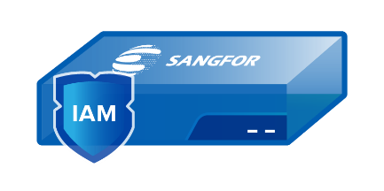


Enhancements – Ingress Client with SSL Decryption
80%
IAM performance degradation reduction
20%
IAM performance degradation reduction
80%
20%

Slide 13
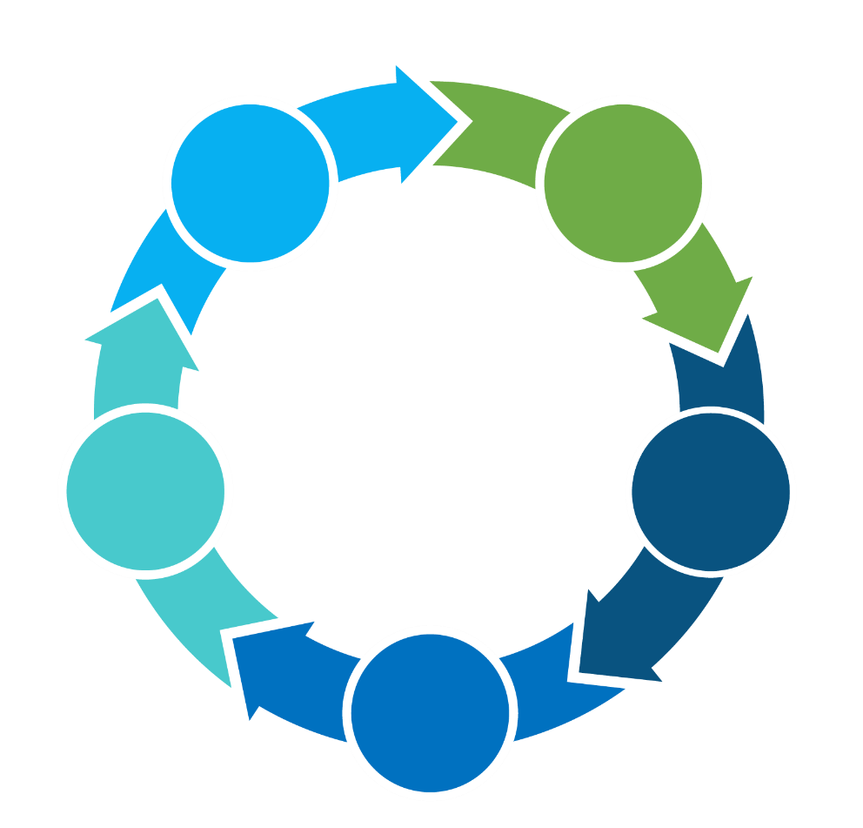
Enhancements – Ingress Client Key Benefits
Certification distribution
Supports all deployment modes
01
02
Ingress Client
Support TLS 1.3
05
03
Uncloak hidden applications
04
Small footprint: Average CPU 5%
Notes:
TLS
Symantec, McAfee and Fortinet support TLS 1.3
Based on shodan.io, 1.5 million websites uses TLS 1.3. Big CDN take up from Akamai, Cloudflare and Incapsula
Like Barracuda WAF support TLS 1.3, it does not support within their WSG product line

Slide 14

Enhancements – Encrypted Application Visibility
Customer Pain-Points
No visibility into what encrypted applications are running in their corporate network
The report does not show who, what, how, when and where criminals gain access
Business Benefits
IAM will track down each productivity usage or unwanted application running in the networks
IAM will pinpoint who, what, how, when and where applications are being used
IAM protects organizational AUP

Slide 15
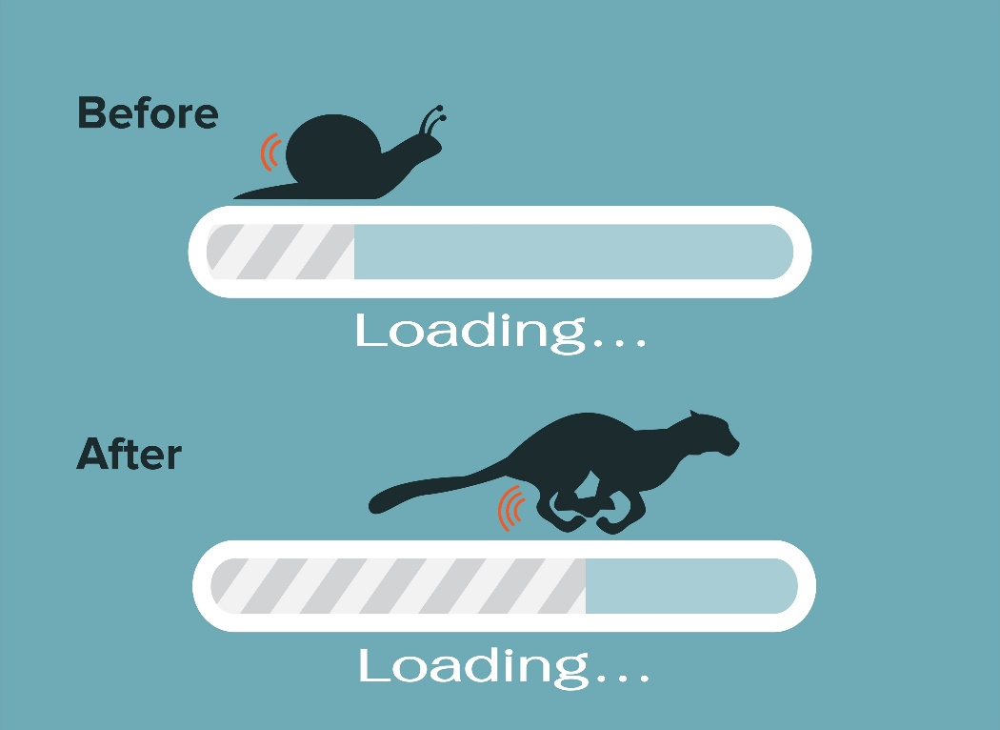
Enhancement – Slowness Due to Performance
Degradation
Customer Pain-Points
Slow network traffic as most defensive protections are running on the same solutions
Lack of organizational employee behavior analysis
Business Benefits
IAM offloads certain features and balances security postures between existing security solutions
IAM performs authentication, application control and compliance.

Slide 16

Enhancements – Audit Optimization
Better Categorization
Content and Attachment
Promote AUP

Slide 17

Enhancement – Users WFH
Customer Pain-Points
Tracking down employees whom perform AUP violations
No way to track internet usage of remote workers
Business Benefits
IAM identifies employees who breach regulations
Educating employees about organizational internet access policies
Protect organization’ assets and intellectual property
Apply online or offline

Slide 18

Enhancement – Data Violation and Privacy
Customer Pain-Points
Data exfiltration
Disgruntled employees trying to sell organizational info to competitors or third party for personal gain
Worry about legal risks due to privacy laws
Business Benefits
Monitoring employee activities
Prevent abuse of data
Ability to achieve corporate AUP and compliance
Exclude banking transaction and payment

Slide 19
Enhancements – Ingress Client Competition
Comparison
Sangfor | Vendor B | Other Vendors
Ingress Client | WSA | N/A
SSL Decryption, Endpoint Check and Audit | SSL Decryption and URL Filtering | N/A
Small Footprint | Small Footprint | N/A
TLS 1.3 | TLS 1.2 | N/A
Offline Audit | N/A | Around 50% availability

Slide 20



Conclusion - Values
Better Value & Better Cost Of Ownership
NGFW SWG
Universal Cross-market Arena
Notes:
2. Allowing NGFW to do its SDWAN, firewall perimeter defense. SSL performance degradation running at the NGFW and let SSL traffic pass through without inspected.
Proxy based inspection allow better detection and granular control stream based inspection.

Slide 21

Conclusion – Takeaways
01
02
Visibility is
a must
Performance
Offset
Better breed of security and lower cost
Better
Compliance
03
04

Slide 22



Contact Sangfor Today
13.0.8 will be launch on 20th Oct. Demo video and documentation will be released soon
For evaluating IAM 13.0.8
Please contact us for more info
marketing@sangfor.com

Slide 23
THANK YOU
Eugene Yew
Product Marketing Manager (IAM/CASB)
Sangfor Technologies
www.sangfor.com
Sangfor Technologies Inc.

