Slide 1


A Secure Internet
Gateway is Vital for Your Security Posture
Eugene Yew
Product Marketing Manager (IAM/CASB)
Sangfor Technologies
www.sangfor.com
Sangfor Technologies Inc.

Slide 2
Agenda
PART
1
PART
2
PART
3
PART
4
PART
5
Key Objectives
Challenges
Recommendations
The Sangfor Approach
Conclusion

Slide 3
PART 1
Key Objectives

Slide 4



Key Objectives
Minimize
Intrusion
Identify Threats Landscape
Harmony Between Security & Productivity

Slide 5
PART 2
Challenges

Slide 6



Challenges
Policies Too Loose or Stringent?
Encryption Everywhere
Prone to Error
Enabling SSL decryption greatly reduces appliance performance
Equifax, Capital One, New Zealand Gun Buyback Scheme

Slide 7
Challenges – Facts
“ ”
Inspecting SSL traffic impacts both overall throughput and the average number of transactions per second for NGFWs.
Source: NSSLABS

Slide 8
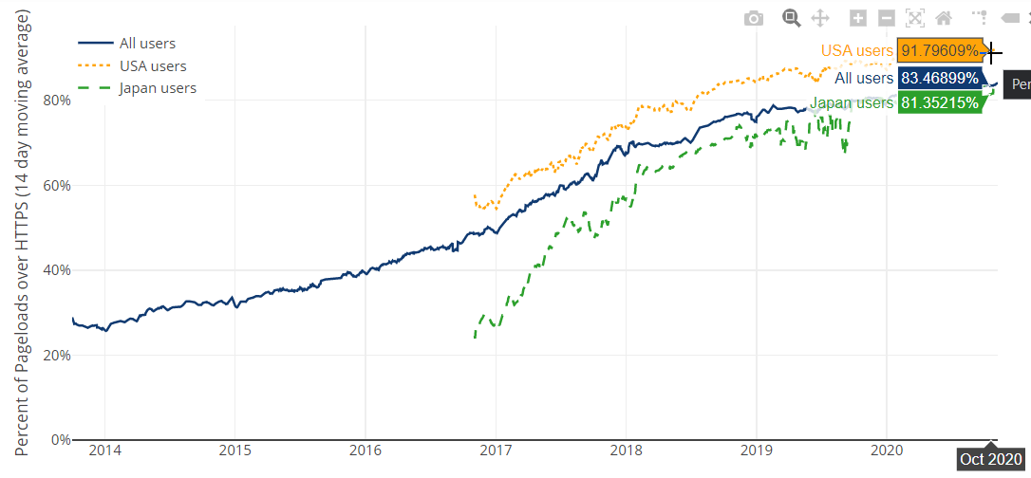
Challenges – Facts
Source: Firefox Telemetry

Slide 9
Challenges – Facts
Personal Activities Performed on Work-lssued Devices
Check/respond to personal email
Read news stories
Research (new products, travel destinations, and more)
View/post to social media
Shop online
Stream media (music, videos, and more)
By workers
By workers' friends and family
Play games
0% 10% 20% 30% 40% 50% 60% 70% 80% 90% 100%
Percentage of workers who use (or permit use of) employer devices for personal tasks
Source: Proofpoint
Notes:
About 50% of respondent said they give friends and family access to their employer-issued devices. While the motives behind this may be harmless i.e the most common reason is to check/respond email, you just never know what someone might mistakenly click on.

Slide 10
Challenges – Facts
The most frequent incidents targeting SMBs
DDoS attacks
38%
Ransomware attacks (2019)
38%
Targeted attacks
38%
Incidents involving non-computing. Connected…
38%
Incidents affecting suppliers that we share data with
38%
Physical loss of BYOD devices (2018-19)
41%
Physical loss of company owned mobile devices …
42%
Physical loss of company owned devices or media…
42%
Inappropriate sharing of data via mobile devices
43%
Malware infection of BYOD devices （2018-19）
47%
Malware infection of company owned devices …
49%
Inappropriate IT resource use by employees
50%
Source: Kaspersky

Slide 11
PART 3
Recommendations

Slide 12


Recommendations
Visibility
Inspect all traffic
Decryption at both gateway and client side
Certificate handling
User identity is imperative

Slide 13


Recommendations
Reduce Attack Surface
File Blocking
URL/Content Filtering Profiles
Network Segmentation

Slide 14

Recommendations
Prevent Known Threats
Enforce system check and patches
Malware detection

Slide 15


Recommendations
Detect Unknown Threats
Machine learning and AI-based computing
Analytics

Slide 16


Recommendations
Enable Forward Proxy
Limit Access
Granular control across all traffic

Slide 17


Recommendations
Simplify auditing while ensuring productivity
Audit both content and attachments
Safe enablement of trusted applications

Slide 18


Recommendations
AUP and compliance review
Review and amend based on stakeholder discussion
Educate and promote employee efficiency

Slide 19
PART 4
The Sangfor Approach

Slide 20

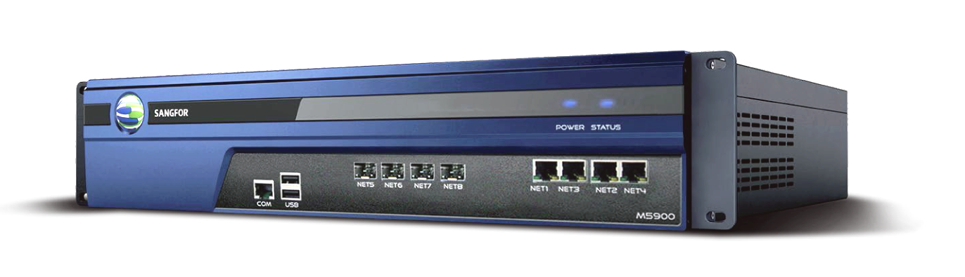

The Sangfor Approach
Visibility in SSL
Productivity & Audit Monitoring
User Authentication & Control
Endpoint Check
Application Identification
TI & Security Analytics
Granular Reporting

Slide 21










The Sangfor Approach – Improve Visibility
and Control
SSL Decryption
User Identity
App Control & BM

Slide 22





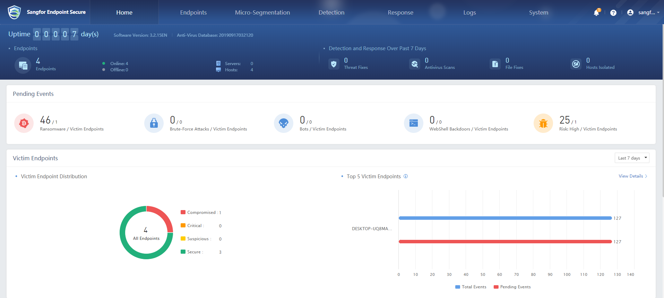


The Sangfor Approach – Strengthen Security Posture
SSL Decryption
User Identity
App Control & BM
Endpoint Secure Manager
XDDR

Slide 23






The Sangfor Approach – 360 Holistic Protection
SSL Decryption
Neural-X
User Identity
Cyber Command
App Control & BM
STA
Tiara & MDR
XDDR
Endpoint Secure Manager
TI & Analytics

Slide 24



Conclusion – Key Takeaways
Visibility
Identity
Control
Analytics

Slide 25
Next Weekly Security Webinar
17th November 2020 16:00 (GMT +8)
Securing Your Internet Gateway is Vital for Security Posture
An unsecured Internet gateway is an open door for attackers and those with malicious intent. Join Sangfor experts to learn about good governance of security policies and how they can integrate seamlessly into a customer environment while enabling the enterprise to achieve an optimal balance between security, compliance and employee productivity and efficiency.

Slide 26
THANK YOU
Eugene Yew
Product Marketing Manager (IAM/CASB)
Sangfor Technologies
eugene.yew@sangfor.com
www.sangfor.com
Sangfor Technologies Inc.

