Slide 1


Lessons Learned From Data Breaches
To Better Protect Yourself
Eugene Yew | Product Marketing Manager
eugene.yew@sangfor.com
Sangfor Technologies
www.sangfor.com
Sangfor Technologies Inc.

Slide 2
Contents
01
What is a Data Breach
02
Recent Case Studies
03
Lessons Learned

Slide 3
What is a Data Breach?
Indicators of a Data Breach
01
Compromised account
04
Unauthorized disclosure
02
05
Compromised access
Unauthorized acquisition
03
06
Unauthorized access
Loss of control

Slide 4





Common Causes of Data Breach
Weak Credential
Excessive Permissions / Backdoor
Malware
Social Engineering
Insider Threats
Human Error

Slide 5
How Many Data Breaches Occur?
Starting from 2005 to 2019, the data breaches continue to grow tremendously.
Legend
Card – Fraud involving debit/credit cards
Hack – Hacked by outsider or malware
Insd – Insider
Phys – Physical
Port – Portable device
Stat – Stationary computer loss
Disc – Unintentional disclosure
Unkn – Unknown
Source: Privacy Rights Clearinghouse

Slide 6



Data Breach Statistics
314 days average lifecycle of a
data breach
95% higher average cost of a breach to an organization without security automation
30% number of companies who experienced a breach will encounter another within two years
USD $8 Million average cost of a breach
25% breaches caused by hackers which cost 25% more than ones caused by human error

Slide 7

Data Breach Impacts
Lost of business (revenue, brand, customer trust) is the largest cost factor
The faster breach is identified and contained, the lower the cost to recover
An IR plan and an IR team are the largest factors in reducing cost of a breach
The larger the breach experienced, the less likelihood another breach will occur
Sources: IBM cost of a data breach report, Verizon data breach investigation report,
Varonis data breach statistics.

Slide 8

Case Study: Canva
Who is Canva?
What happened?
Graphic design platform provider
Social media, presentations, posters, documents
Estimated 1500 employees
Profile database of 139 million users was accessed
Attacker group GnosticPlayers also caused data breaches at Dubsmash, MyFitnessPal, and Zynga

Slide 9
Case Study: Canva
User profile detail
was exposed
Access to password protected
and Google token
What
Went
wrong?
Misleading Initial email communication circulation
Access to partial credit card and payment data
Notifying users to change password and forcefully reset password
4 million accounts subsequently
successfully decrypted

Slide 10
Case Study: Canva
Notifying their
users
Prompting users to change password and reset Google token
Layered defense
01
01
02
Regular security audit
05
02
Security automation
What went right?
Things
can be prevent
04
03
Investing in password manager
Coordinating and share info with partners
IR Team and response plan
04
03
Access
control

Slide 11

Case Study: Marriott
Who is Marriott?
What happened?
One of largest hotel chain in the world
Hotel, residential and timeshare
Estimated 122,000 employees
5.2 million records of guests are exposed
Suspicious activity and insider-caused security breach

Slide 12
Case Study: Marriott
Employee account was compromised
Undetected abuse of account
on suspicious activity
What
Went
wrong?
Data decryption from
guest data
Data exfiltration
Privileged access from
unknown hosts
System inherited compromised
and have not migrated into
Marriott reservation system

Slide 13
Case Study: Marriott
Web portal to
check validity of
user data breach
Minimized attacker
dwell time
01
02
01
02
Layered defense
Security automation
06
03
What went right?
User behavior with augmented audit
Things
can be prevent
Access control
05
04
04
03
Continuous threat
detection
and response
Proactive
closed-loop
approach
Implemented heightened monitoring
Related login credentials were disabled

Slide 14

Case Study: Equifax
Who is Equifax?
What happened?
Consumer credit reporting agency
Credit monitoring and fraud prevention services
Over 800 million consumers and 88 million businesses
12,000 employees
148 million personal data exposed
Whopping of USD 1.4 billion on cleanup costs

Slide 15
Case Study: Equifax
Warned of Apache Struts vulnerability and did not patch
Lack of visibility and
transparency
What
Went
wrong?
Data exfiltration
Lateral movement
Use different website
domain of
equifaxsecurity2017.com
Not aware of security tools are
not working due to security
certificate expiration

Slide 16
Case Study: Equifax
Layered defense
Admitted delay
and notify affected consumers
Notified of
suspicious
activity
01
Vulnerability assessment
08
02
Security
automation
01
02
Proactive closed-loop approach
Things can be
prevent
Access
control
What went right?
07
03
04
03
Asset management
06
04
User behavior with
augmented audit
Conduct forensic investigation
Took application offline
05
IR Team and response plan

Slide 17
Lessons Learned
01
Data breaches are increasingly bigger and expensive
05
Public response and response plan are vital
02
06
Data breach impact on customer retention is getting larger
Regular security assessment and audit to strengthen your security posture
03
Slow response to data breach increases costs
07
Automating security with IR team and services reduce potential cost of breach
04
Data breach occur no matter the size of company and sector
08
Network segmentation, user access control and minimizing attack surface to limit the chance of a breach

Slide 18














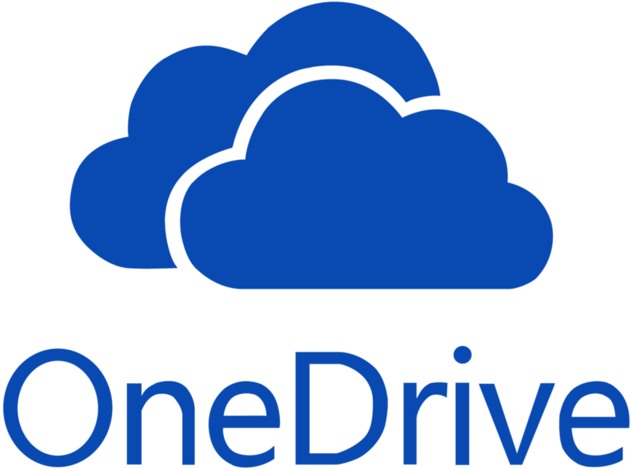









Sangfor XDDR Synergy
Sangfor
Access
Security Infrastructure
NGAF
IAG
NGAF
IAG
Authentication
/Authorization
Access
Control/DLP
Public/Private HCI
IAG
SWG/CASB
ES
Cloud/SaaS
IAG
Coordinated
Response
Access
Control/DLP
Remote
SSL VPN
ES
SSL VPN
ES
SSL VPN
ES

Slide 19

Q&A Session
Lessons Learned From Data Breaches To Better Protect Yourself
www.sangfor.com
Sangfor Technologies Inc.

Slide 20

Next Weekly Cloud Webinar
Title: It’s Time to Upgrade Your IT Infrastructure! What next?
Date: 22nd June 2021｜16:00
It’s Time to Upgrade Your IT Infrastructure!...What next? IT infrastructure is a vital part of any size business, and has a huge impact on operations and company success. It’s vital to have a secure and efficient infrastructure to keep up with constant changes in business, technology and best practices. Upgrading your IT Infrastructure can be a daunting task.
How do you know when it’s the right time to upgrade, and how to get started? Join Sangfor experts for a webinar, where we will conduct an in-depth discussion of warning signs that it’s time to consider upgrading your company IT. Sangfor HCI is the solution you need to effectively build a simple, secure, reliable and cost-efficient IT infrastructure for your business.
www.sangfor.com
Sangfor Technologies Inc.

Slide 21

Lessons Learned From Data Breaches To Better Protect Yourself
Lucky Draw
www.sangfor.com
Sangfor Technologies Inc.

Slide 22
THANK YOU!
Eugene Yew | Product Marketing Manager
eugene.yew@sangfor.com
Sangfor Technologies
www.sangfor.com
Sangfor Technologies Inc.

