Slide 1


Continuous Asset
Monitoring to accelerate
remediation
Eugene Yew | IAG Product Marketing Manager
Sangfor Technologies
www.sangfor.com
Sangfor Technologies Inc.

Slide 2
Agenda
PART
1
PART
2
PART
3
PART
4
PART
5
IAG & Pricing Bundle
Challenges
Continuous Monitoring & Remediation
Use Case
Key Takeaway

Slide 3



IAG Focus Point
Visibility - Uncover any passing traffic
Identity - User Identity
Control - Application, bandwidth, audit and other security content aspects
Analytics - Holistic view of logs and reporting
Visibility
IAG
Control
Identity
Analytics

Slide 4
IAG
Key messages
Solution offering close integration with other Sangfor ecosystem
Zero Impact
Changes only apply to new shipment
01
02
Marketing Launch
22nd Mar 2021 – Marketing announcement to public
31st Mar 2021 – IAG 13.0.15 GA
1st April 2021 – IAG shipment
Collateral Materials
Ensure necessary materials and seamless transitions
06
03
IAG
Product Changes
Product Logo, appliances packaging, physical appliance front panel, WebGUI interface related and etc
05
04
Logistic Preparation
Ensure seamless appliance shipment

Slide 5


New Pricing Bundle
Reduced complexity of license selection
More appealing and better pricing
Better pricing competitiveness

Slide 6
New Pricing Bundle
Essential Bundle
Premium Bundle
50%
70%
Hardware
Hardware
Anti-Malware Protection & Threat Intelligence
Basic SWG with URL filtering

Slide 7

New Pricing Bundle - Breakdown
 | Essential | Premium
Bandwidth Management
User Authentication
Traffic Control
Content Audit
Proxy Avoidance
Endpoints Management
Report Center
Link Load Balance
Support Services
Sangfor URL Database
Anti Malware (Engine Zero)
Threat Intelligence (Neural-X)

Slide 8
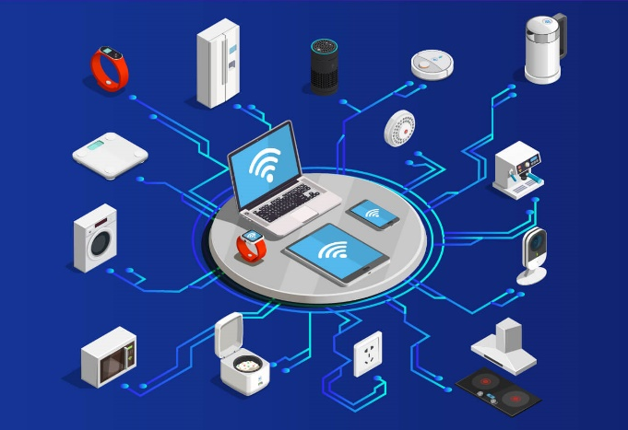
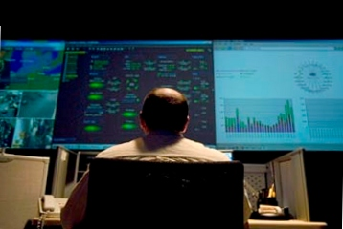

Challenges
Increase devices and platform diversity
Complexity of IT operation
Unknown & Non-traditional device
Notes:
Increase devices and platform diversity
Innumerable IOT device OS
Unable to get agent into devices
Complexity of IT operation
Assets are critical and can be barely identify, classify and take actions
Unknown & Non-traditional device
Increase attack surface as IOT threats involving
May cause service disruption and revenue loss

Slide 9



Consequences of Not Doing Discovery
Longer
resolution times
Failed to rectify and remediate
Increase security risks
Notes:
No visibility on incoming user and onboarding device
Inability to detect possible breach or threat
Onboarding device might be not safe

Slide 10

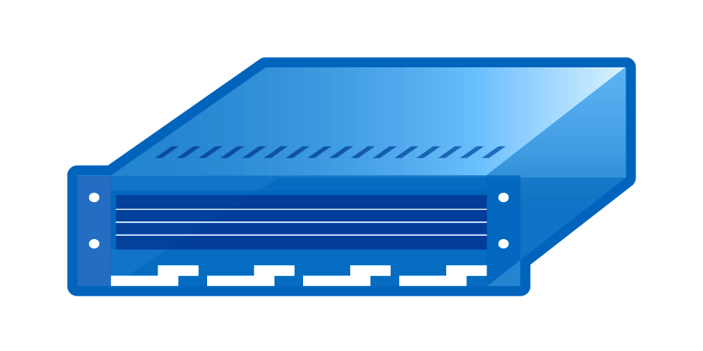
Challenges in Asset Discovery Methodology
Agent-based asset discovery
Agentless-based asset discovery
API-based asset discovery
Pros
Granular control
Run locally without credential
Pros
No software
Low maintenance
No vendor lock-in
Pros
No impact on environment
Seamless data aggregation
Cons
Users resistance to install
Unsupported due to variety of OS involved
Cons
False positive detection
Intensive scanning
Cons
Script customization
Some are proprietary and open

Slide 11


Continuous Monitoring & Remediation
Endpoint Discovery
Asset Management
Endpoint Classification
Endpoint Check
Notes:
Delivers agentless visibility and continuous monitoring of connected IOT devices
Easier to detect and identify all IP connected endpoint devices in real time
Send alert to IT personnel and flag violations for any remediation actions

Slide 12

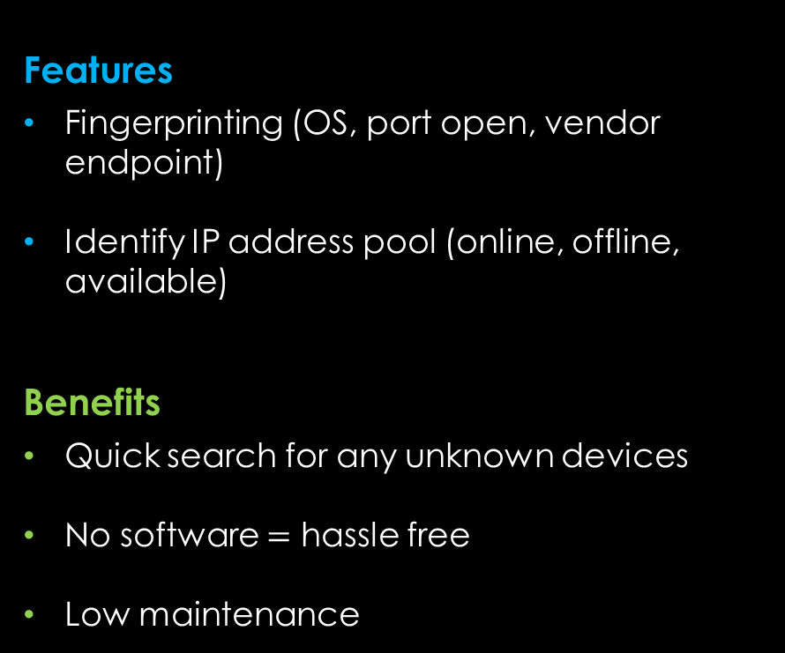
Endpoint Discovery
Features
Fingerprinting (OS, port open, vendor endpoint)
Identify IP address pool (online, offline, available)
Benefits
Quick search for any unknown devices
No software $=$ hassle free
Low maintenance
Notes:
Default frequency scanning is 300 seconds

Slide 13

Endpoint Classification
Features
Automatic IOT categorization
6 categories with customization
Ways to filter and export
Identify device to user identity
Benefits
Increase visibility to onboarding device
Identify device which is previously unknown

Slide 14
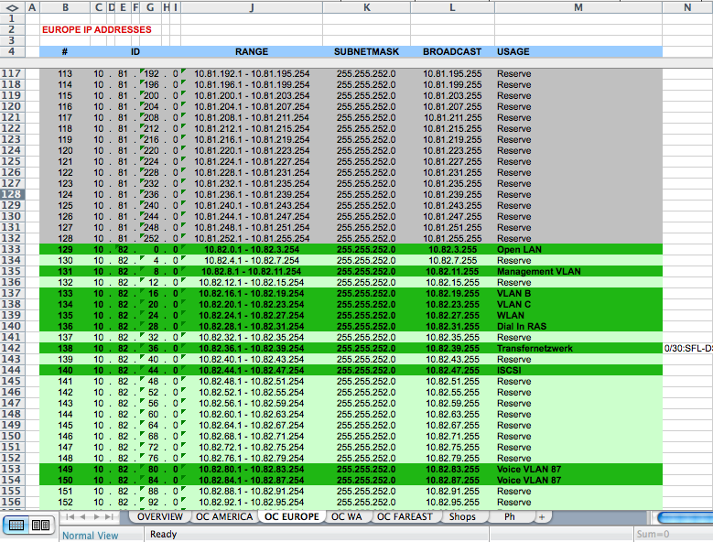
Excel VS Asset Discovery
Excel inventory update is not part of asset discovery solution
Manual processes
Labour intensive
Unable to keep up with constant changes
Error prone

Slide 15
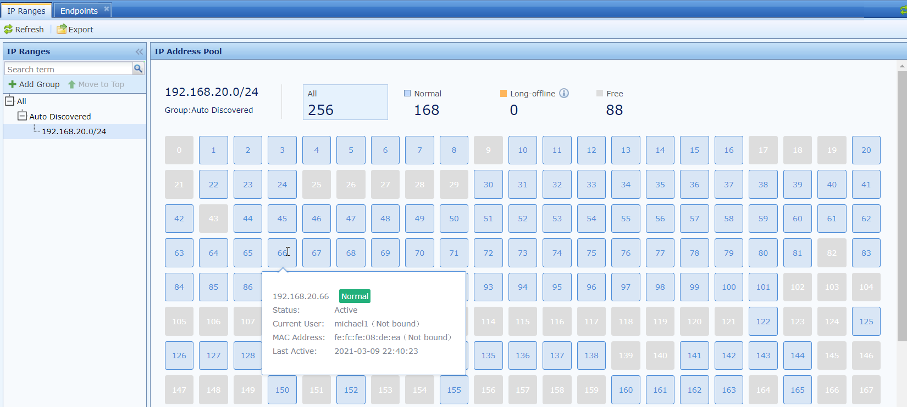
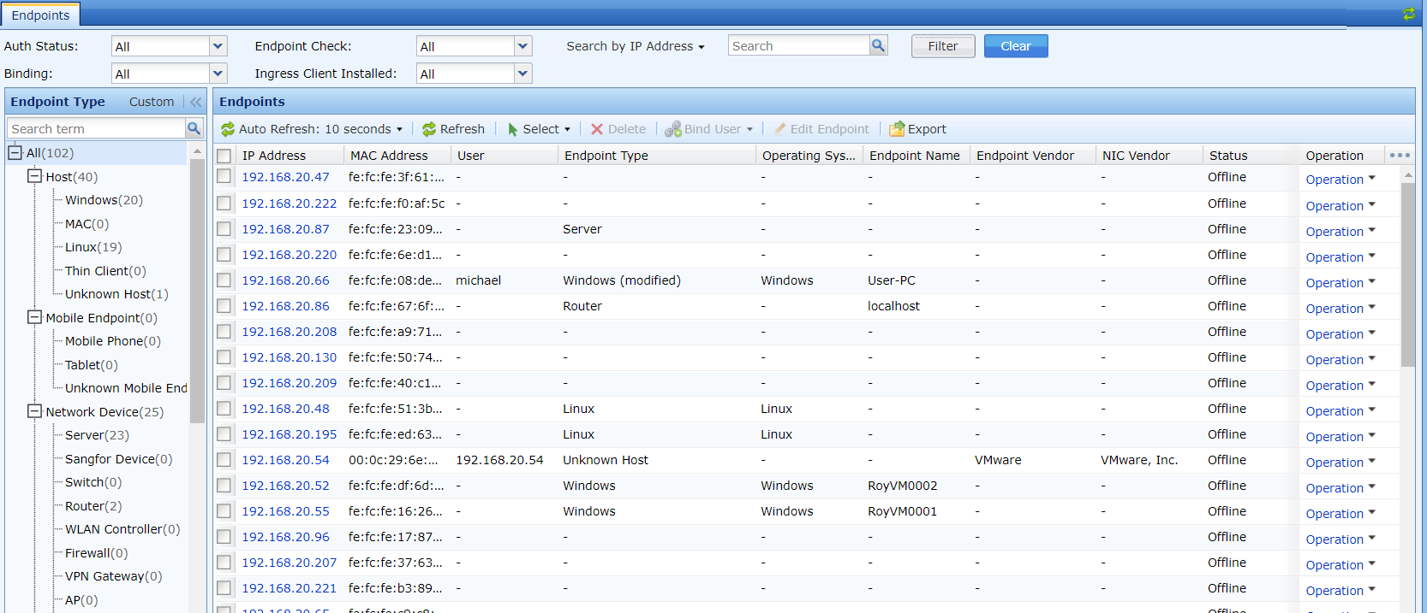
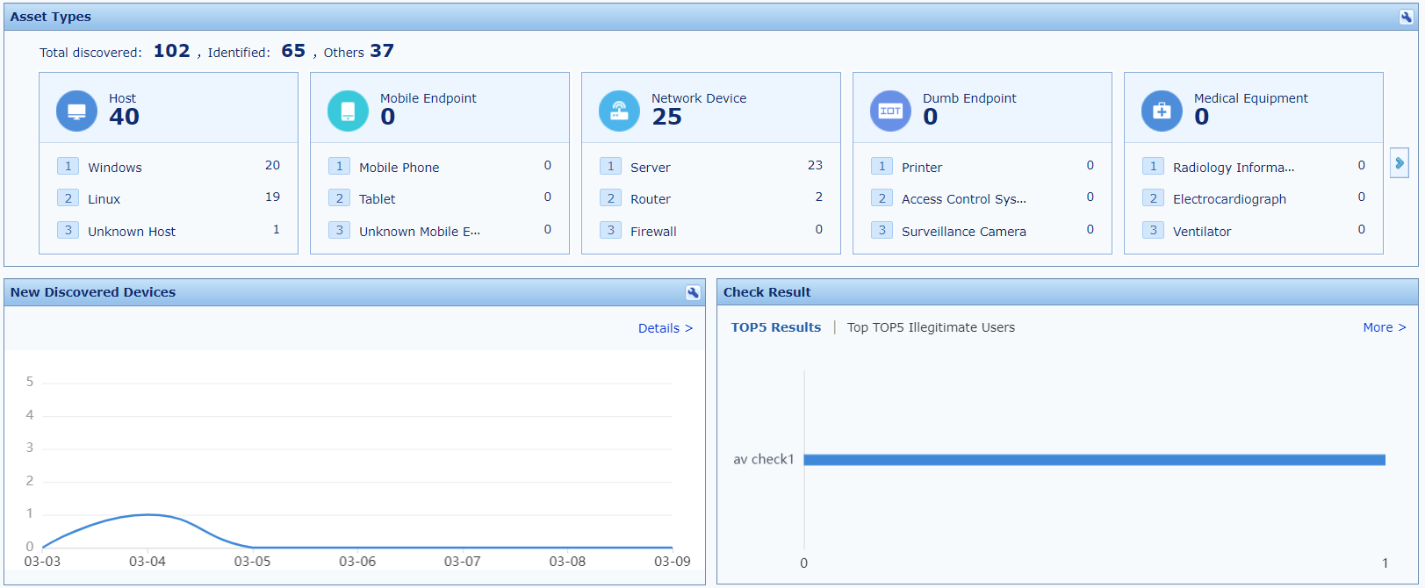
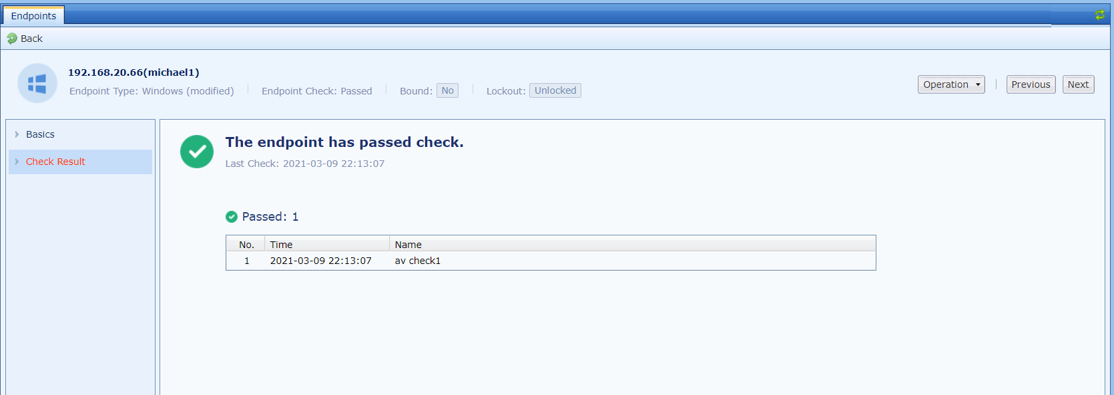
Excel VS Asset Discovery

Slide 16


Best of Both Worlds
+
Endpoint Check
(Ingress Client)
Antivirus Check
(Traffic Based)

Slide 17

Endpoint Check
Features
Rule design based on 13 category
Patch, process, access control, external device control, anti-defacement, anti-virus software and etc
Notification and action taken
Benefits
Reduce attack surface
Identify rogue device
Endpoint Telemetry
Single vendor with unified management
Endpoint Check
(Ingress Client)

Slide 18
Endpoint Check
Features
Application recognition based on traffic
Separated by personal software and enterprise software
Notification and action taken
Benefits
Identify and implement access control
Less intrusive with fast remediation
Enforce compliance
Antivirus Check
(Traffic Based)

Slide 19

Use Case – Enterprise & Government
Common Scenario Challenges
2000 servers and 1000 endpoints
Contractors and guest who work in and out on-premise
Unknown onboarding new devices
IT Asset Management vendor dependency
Benefits
Automatic discovery based on identified IP segments
Improve visibility on asset discovery
“Instant” Asset inventory
Perfect blend with granular control on internal users and flexible monitoring on guest/contractor

Slide 20


Use Case – Healthcare & Retail
Common Scenario Challenges
Inability to determine type of IoT devices
Hassle deployment on agent-based solution
Mix blend of multiple antivirus solution
Administration and checkpoint status of endpoint
Benefits
Improve visibility to network connected devices in dynamic environment
Real time classification based on detected online devices
Unknown devices such as VoIP and POS become detectable
Agentless deployment

Slide 21
Key Takeaway
01
02
03
Increase visibility, identify, control and analytics
Simplify unified management for user and device
Continuous assess, monitor and remediate to reduce risks

Slide 22


Contact Sangfor Today
Risk-Free 30-day trial for Sangfor IAG
*Ensure appliance is ready and local region presales assistance*
marketing@sangfor.com

Slide 23
Thank you！
Eugene Yew | IAG Product Marketing Manager
Sangfor Technologies
eugene.yew@sangfor.com
marketing@sangfor.com
www.sangfor.com
Sangfor Technologies Inc.

