Slide 1


Sangfor IAG (SWG)
Challenges
and Top Use Cases
Eugene Yew
IAG/SASE Product Marketing Manager
Sangfor Technologies
www.sangfor.com
Sangfor Technologies Inc.

Slide 2
Contents
PART
1
PART
2
PART
3
PART
4
Challenges
Sangfor Approach
Top Use Cases
Conclusion

Slide 3
PART 1
Challenges

Slide 4

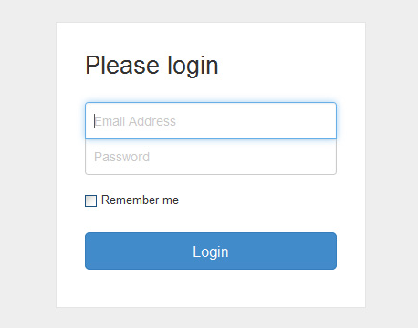
Challenges – Common Facts
NGFW
Either replace or new
Perimeter protection
Firewall sandwich
Identity/Authentication
Integrate with ADS
For staff/guest login
Centralized management
Wi-Fi integration

Slide 5


Challenges – Common Facts
Application Control
Allow/Block array of applications
Proxy Avoidance
Anonymizers
Quality of Service QoS
Website
Bandwidth
Prioritize applications
Individual/group categorization
Upstream/downstream allocation
Application
Email
Backup
VoiP
Data Transfer
Media Streaming

Slide 6
Challenges – Common Objection
Budget Constraints
Leasing •​
OPEX mode •​
​
​
Firewall can do everything
•​ Performance Degradation​
•​ Superior in certain features​​
​
01
02
IP address is good enough
User Identification•​
​Investigation•​
​
​
​
Bandwidth is cheap
•​ Never enough​
•​ Granular control​
05
03
Objection
04
Allow All
•​ Disgruntled employee​
•​Accidental​

Slide 7
Challenges – Common Objection
You only walk away if
Customer does not know what they want
Customer handling/visibility
Only for comparison purpose
Tender bidding lock to specific vendor characteristics

Slide 8



IAM Main Features
Authentication
Application Control with audit
Reporting
Bandwidth Management

Slide 9
PART 2
Sangfor
Approach

Slide 10



Sangfor Approach – Scenario Value Proposition 1
Positioning and bundle solution
Network perimeter protection and user behavior control
Application Control
Proxy Avoidance/Anonymizers
+

Slide 11

Sangfor Approach – Scenario Value Proposition 2
Integrate with Aruba/Cisco/Ruckus
Unified Authentication Center
Along with IAM main features for strategic positioning
Enforce Acceptable Use Policy (AUP) & augmented audit capabilities with user identity
+

Slide 12

Sangfor Approach – Scenario Value Proposition 3
Integration and correlation with Endpoint Secure
Enable reminder page for deploying and promote Endpoint Secure
Provide Endpoint Secure details within IAG
Enhance detection and blocking capabilities i.e proxy avoidance protection
+

Slide 13
Sangfor Approach – Scenario Value Proposition 4
Secure Internet Access with Bridge mode
Provide unified authentication, application control, bandwidth management and etc
Pioneer in this authentication, application control and bandwidth management

Slide 14
PART 3
Top Use Cases

Slide 15

Use Case – Sony Malaysia
Key Requirements
Internet line failover & bandwidth
Application control on Wi-Fi
Protection against cyber attacks
Solutions
NGAF act as gateway for internet failover, IPS, APT, GAV and routing
IAM act as centralized control for authentication, bandwidth management and application control
+

Slide 16

Use Case – PT Lippo Karawachi TBK
Key Requirements
Online payment experience
Abuse of bandwidth
Bandwidth usage and application reporting
Centralized management
Solutions
Improve Internet access experience
Bandwidth prioritization for uninterrupted online payment
Comprehensive reporting
Simplified operation

Slide 17




Conclusion – Key Takeaways
Visibility
Identity
Control
Analytics

Slide 18
THANK YOU
Eugene Yew
IAG/SASE Product Marketing Manager
Sangfor Technologies
eugene.yew@sangfor.com
www.sangfor.com
Sangfor Technologies Inc.

