Slide 1


Sangfor Managed Cloud Service
for Enterprise
Trusted and Worry-free Cloud Infrastructure and Service
www.sangfor.com
Sangfor Technologies Inc.

Slide 2

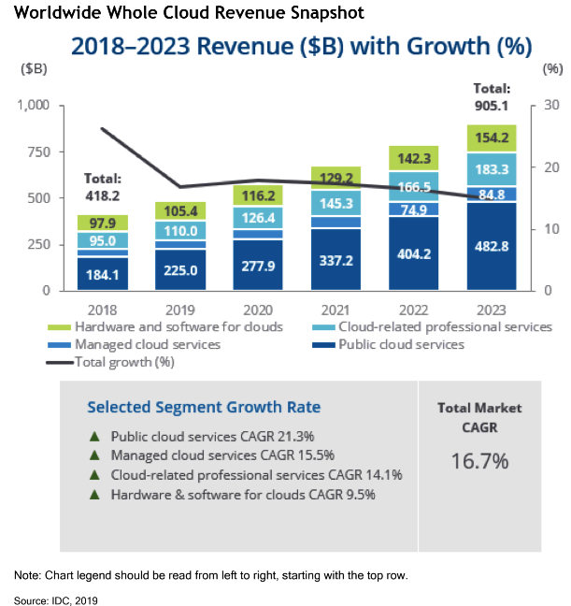
Worldwide Cloud Spending is Rising
The proportion of IT spending that is shifting to cloud will accelerate in the aftermath of the COVID-19 crisis, the cloud total market CAGR (Compound Annual Growth Rate) will reach nearly 16.7%

Slide 3
The Key Benefits of Cloud
Productivity Anywhere
01
Easily Upgrade
Off Site Data Storage
07
02
Cloud
Benefits
Lower Cost of Ownership
06
03
No IT Maintenance Cost
05
04
Always Up
Disaster Assistance
The Cloud strategy will accelerate the digital transformation of enterprise and greatly reduce the risk of digital transformation

Slide 4
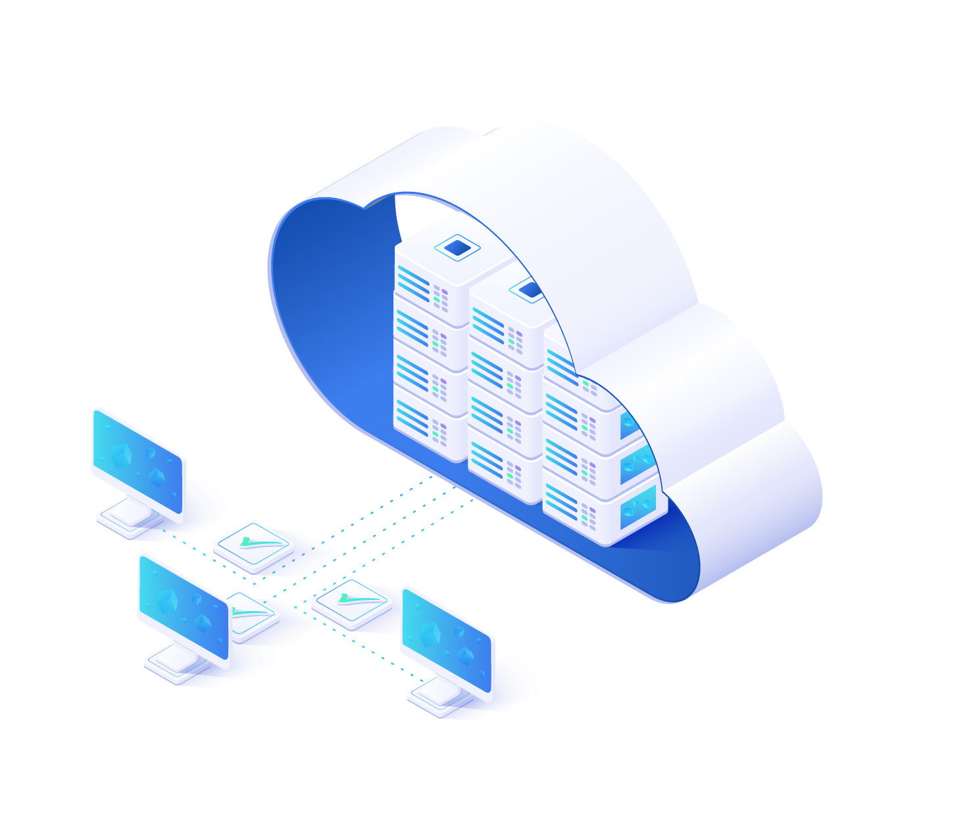
More and More Customer will Adopt the Cloud
“By 2021, over 75% of midsize and large organizations will have adopted a multicloud and/or hybrid IT strategy."
—— Gartner

Slide 5

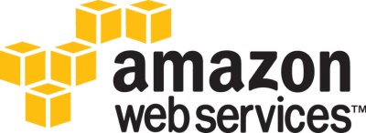










Public Cloud Use Case
Public Cloud
Web hosting on the cloud
Web developing and QA testing
Global interactive application
Spikes and drops in traffic (games/shopping/media)
Cloud-native application
Data archiving
Security Access and authentication service
Communication and social networking

Slide 6
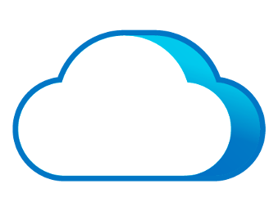
However Public Cloud Not Suited for Every Scenario
Security and Compliance
Sensitive applications and data have strong security and compliance requirements.
High Performance
Apps require high performance with low latency ( DB, HIS, MES, PACS).
Public Cloud
Legacy Applications
Lack of high reliability and difficulty migrating to public cloud.
Unsuited
Fast and Customized SLA
Fast and high-quality service response including DR, application and data migration and security services.
Cost
Goes well beyond expectations as business grows.

Slide 7







Managed Cloud Services Emerge
Low Cost
Flexibility
Managed cloud service gives customers the convenience and flexibility of a public cloud, with the security, control and professional service of a private cloud, making it the best cloud service approach for most SME customers.
Productivity
Collaboration
Cloud
Managed Services
Security
Software
Update
Data Lost Prevention
Mobility

Slide 8
Sangfor Managed Cloud Service
Our Vision
Cloud Service Value Proposition
Our Mission
Building a global-distributed cloud data center, allow every customer to afford and secure enjoy the cloud service, Building digital infrastructure exclusive store
  Offering trusted Cloud infrastructure and service
  Extremely Professional End-to-End Service
  Focus on Partner Enablement with Localisation
Enablement Partner & Customer adopt Cloud Journey effectively with the most optimized approach

Slide 9
Sangfor Backed Local IT Services
Sangfor Backed
Local Services
Security Center
Global Threat Intelligence
Big-Data
Onsite Service
CRM
DevSecOps
24x7 Network Center
Remote Digital Workspace
Data Management
IOT
GIS
HIS
Network Security
Edge Computing
Data Protection
Trading
MES
IaaS
Private Cloud
Edge Computing
ERP
E-Comm
Managed Cloud
Next Gen-Converged Digital Infra
SaaS

Slide 10



Sangfor Managed Cloud Service Idea
Managed
Cloud
Private Cloud
Public Cloud
One unified Architecture
HCI-Based Software
defined datacenter
Consistent Experience
VM & Container &Secure
Backup & DR
Superior Service
Automation M&O
Proactive & add-value service

Slide 11

Sangfor Global Distributed Datacenter
Over 1000 AZs & POPs worldwide by 2025 to cater localized Business/ Organizations needs
Serves end-users with local partners, just like a near-by convenience store
Regional Network & Security Operation Center meets Regulation & Compliance within the border
Distributed Design with Redundancy and Inter-connectivity
Regional
NOC SOC
AZ 1
AZ 2
AZ 3
AZ n
…
.
.
.
.
.
.
.
.
.
.
.
.
.
.
.
.
.
.
.
.
.
.
.
.
.
.
.
.
.
.
.
.
.
.
.
.
.
.
.
.
.
.
.
.
.
.
.
.
.
.
.
.
.
.
.
.
.
.
.
.
.
.
.
.
.
.
.
.
.
.
.
.
.
.
.
.
.
.
.
.
.
.
.
.
.
.
.
.
.
.
.
.
.
.
.
.
.
.
.
.
.
.
.
.
.
.
.
.
.
.
.
.
.
.
.
.
.
.
.
.
.
.
.
.
.
.
.
.
.
.
.
.
.
.
.
.
.
.
.
.
.
.
.
.

Slide 12













Sangfor Managed Cloud Architecture Overview
Business Operation
Migration
Multiple Tenant
Service Portal
P2V Tools
Ticket, Metering & API
Monitoring &Report
DB Migration
Cloud Service Catalog
Disaster
Recovery
Cloud Servers
Dedicated Hosted
Load Balance
NAT Gateway
Data Base
Storage Service
Container Service
Elastic IP
Virtual Desktop
Backup
Virtual Network
Cloud Backup&DR
Host Security Service
SaaS Service
Hyper Converged Infrastructure
aSV
aSAN
aNET
aSEC
vGPU
VMware
vSphere
Service
Consulting
External storage
Technical
support

Slide 13

SMCS Data Center Logic Architecture
Shared Zone
Dedicated Zone
Co-Location
Service Portal
Service Portal
Tenant A
Tenant B
Tenant C
Tenant D
Gov A
Ent B
DR site
Service Portal
Service Portal
Management Zone
Local Backup
Monitoring Center
Container
DR
Shared Storage resource
Dedicated Storage
Public Service Zone
Shared Zone: Offering computing or storage service based on the shared physical resource
Dedicated Zone: Offering dedicated compute and storage resource to build hosted private cloud to specific enterprise or industry
Co-location Zone: Offering dedicated physical space and hardware resource to meet customer’s specific business use case
Management Zone: Offering hierarchical management and access permissions whatever they are operators and end user
Public Service Zone: Dedicated Service and technical expert team to provide the superior service experience

Slide 14










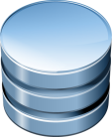

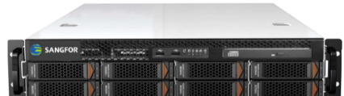
Maximized Security, Inside Out
Office user
Private
Or VPN
End user
Internet
Platform security
Cyber Command
(AI & ML backed
Global Threat Intelligence)
Cyber Command correlated service
Virtual border switch
24x7 NOC
&
SOC
NFV
Border security
vSwitch1
Security resource pool
vSwitch2
Network security
vAF
Distributed FW
Tenant
VPC
App&
DB
DB1
DB2
Distributed
Firewalls
web1
APP1
Distributed
Firewalls
web2
APP2
VM1
EDR
Pod1
EDR
Pod2
Endpoint security
EDR
Endpoint Secure integration
vSAN
vDisk1
vDisk2
vDisk3
Encrypted
Encrypted
Encrypted
Data security
Cloud Infra
Kernel Module
Platform Administration
Admin Logging
Encryption
Data protection & hardened kernel module
Kernel security
Subscribed Resource
Failover Standby
Scale Out Resource
Built-in WAF

Slide 15



Ultimate & Professional Service
Advanced Service | Assessment & Consulting Service | Technical enablement & certificated Service | GTM strategies Service
Online & Onsite Service | Application & Data migration | Remotely Managed on-premise HCI data center | Monitoring and report
 | 7*24 Online technical support | Delivery and deployment service | Mid-level, fast response
Application Service | DBA Manage and optimize Service | Critical-Apps management | AI&ML
 | Application image Service | Integrate Service | SaaS
Infrastructure as a Service | Performance optimization | Backup and DR | DaaS
 | Managed Hybrid cloud | Container as Service | SASE
 | Managed Private cloud | PaaS / Microservices | Database as a service
 | Managed VMware cluster | Manage & Operate | Network as a Service
Security as Service | Threat detection & response | Risk & Compliance | Application protection
 | Incident Response | Privacy & Data protection
Built-in all-round Cloud Security with AI & ML empowered Global Threat Intelligence

Slide 16



How to Ensure the Isolation Between Tenants
Sangfor SCP provide VPC (virtual private cloud) to each tenant, ensuring their internal traffics is completely isolated from others.
Internet
Bind EIP
Bind EIP
VPC 1
VPC 2
VPC n
VPC
Tenant 1
Tenant 2
…
Tenant n
Tenant
Service Provide also can offer dedicated cabinet or physical cluster to sensitive business and data
aCloud cluster 1
VMware cluster
aCloud cluster 2
Shared resource pool
Dedicated
resource pool

Slide 17
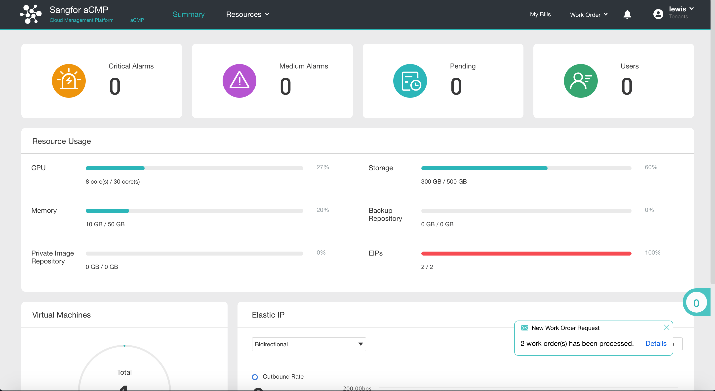
Tenant Self-Service Portal
A portal for tenants to manage their own virtualization environments.
VM Management
Tenant Network Management
Request resource
Usage Monitoring

Slide 18
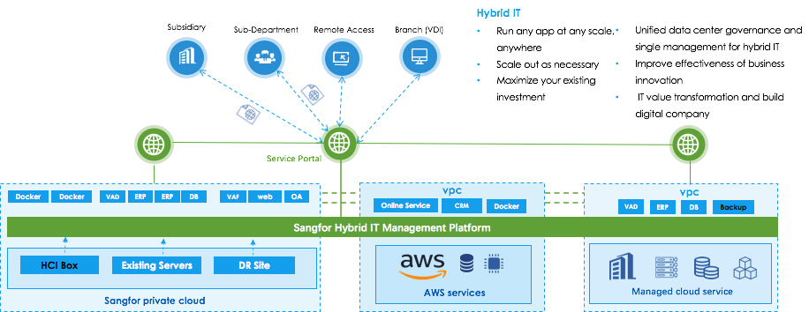
Build, Run and Protect Any Applications and Workloads Using a Hybrid Cloud

Slide 19
Cost Sample with 5-year TCO Projection
Cloud TCO Comparison with Same Configuration:
Server Farm with 40 VMs total Cloud resource 200vCPU, 400GB RAM & 10TB Storage
Public Cloud | vCPU | RAM (GB) | Storage (GB) | USD/VM/Year | VM Qty | 1st year TCO | 2nd year TCO | 3rd year TCO | 4th year TCO | 5th Year TCO
xSmall (2 old U;2GBRAM;30GB Disk) | 6 | 6 | 90 | 138 | 3 | 416 | 832 | 1,248 | 1,665 | 2,081
Small (2U;4GBRAM;30GB Disk) | 34 | 68 | 510 | 630 | 17 | 10,718 | 21,436 | 32,154 | 42,873 | 53,591
Medium (8U;16GBRAM;470GB Disk) | 160 | 320 | 9,400 | 3,012 | 20 | 60,252 | 120,504 | 180,756 | 241,008 | 301,260
 |  |  | Tenant Spending |  |  | 71,386 | 142,773 | 214,159 | 285,545 | 356,932
Sangfor Manged Cloud | vCPU | RAM (GB) | Storage (GB) | USD/VM/Year | VM Qty | 1st year TCO | 2nd year TCO | 3rd year TCO | 4th year TCO | 5th Year TCO
xSmall (2U;2GBRAM;30GB Disk) | 6 | 6 | 90 | 164 | 3 | 492 | 984 | 1,476 | 1,968 | 2,460
Small (2U;4GBRAM;30GB Disk) | 34 | 68 | 510 | 328 | 17 | 5,576 | 11,152 | 16,728 | 22,304 | 27,880
Medium (8U;16GBRAM;470GB Disk) | 160 | 320 | 9400 | 1500 | 20 | 30,000 | 60,000 | 90,000 | 120,000 | 150,000
 |  |  | Tenant Spending |  |  | 36,068 | 72,136 | 108,204 | 144,272 | 180,340
Save ~50%

Slide 20
Top Use Cases For Managed Cloud Services
Hosting a data center enables IT to focus on business innovation
Offering the infrastructure and container as a server
Protect and restore HCI-based on-premise critical data with managed cloud
Hosting service for customer on-premise data center
Managed
Private Cloud
Critical Application
Run and Modernization
DR or Backup-as-a-Service
Managed Service for On-Premise DC
Case 1
Case 2
Case 3
Case 4

Slide 21

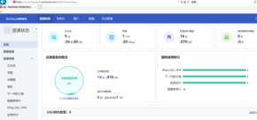








Case 1 - Managed Private Cloud
Cloud
Management
Portal
Sangfor powered Secured IaaS Platform
Unified Management and Operation
Unified Data Management and Protection
Unified Architecture between HQ & Branches
Enriching Functions and Features
Managed Private Cloud
Data Backup
Application Failover
Disaster
Recovery
DR
IPSec VPN
HQ
HQ VPC
Branches VPC
Branch
IPSec VPN
Branch
Application
RemoteDesktop
IPSec VPN
IaaS
Security

Slide 22






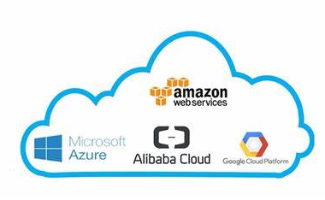
Case 2 - Critical Application Modernization
Sangfor PaaS Platform
VPN
Cloud Native App with Enhanced Kubernetes Core
Multiple Cluster Management for Physical, Virtual Machines & Containers
Support Hybrid & Multi-Cloud Application Provisioning
High SLA with Active-Active and DR design
IaaS, PaaS & CaaS with High Availability
AZ1
AZ2
Public Clouds
ADC
Development
Production
DR / Secondary
Sangfor

Slide 23



Case 3 - Backup and Disaster Recovery
On-Promise or Co-Location DC
Sangfor Managed Cloud Service
Failover Rehearsal
CDP /
Cloud Migration Tool
Sangfor DR Features
App Data
[8:59:59]
DB Data
[8:59:59]
Auto Rehearsal Procedure
Isolated DR/Failover Environment
Batch Rehearsal Process
Batch Application Validation
Allow External Assess
Auto Generate Report
RTO=Minutes level
RPO=0
Control
DR
Sandbox
DR Sandbox
VM
VM
VM
App
DB
Ad-hoc HCI Take Over
Normal Service
User
Admin
Rehearsal Report

Slide 24


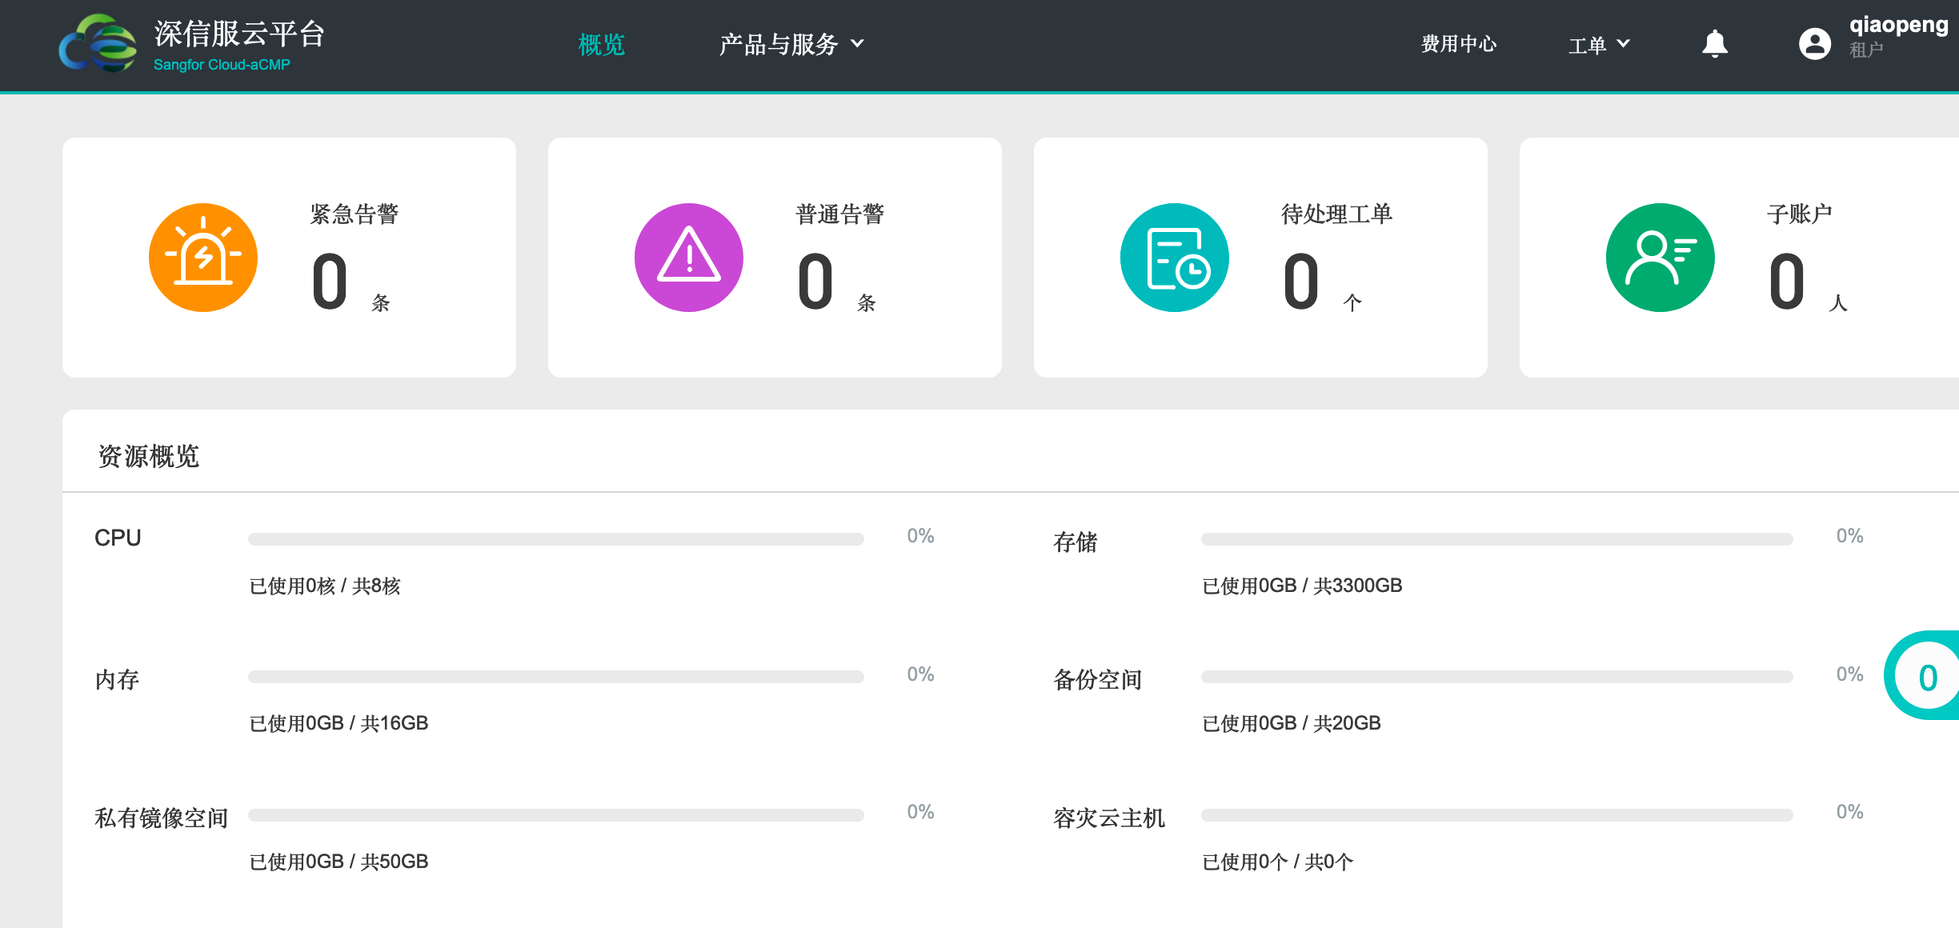


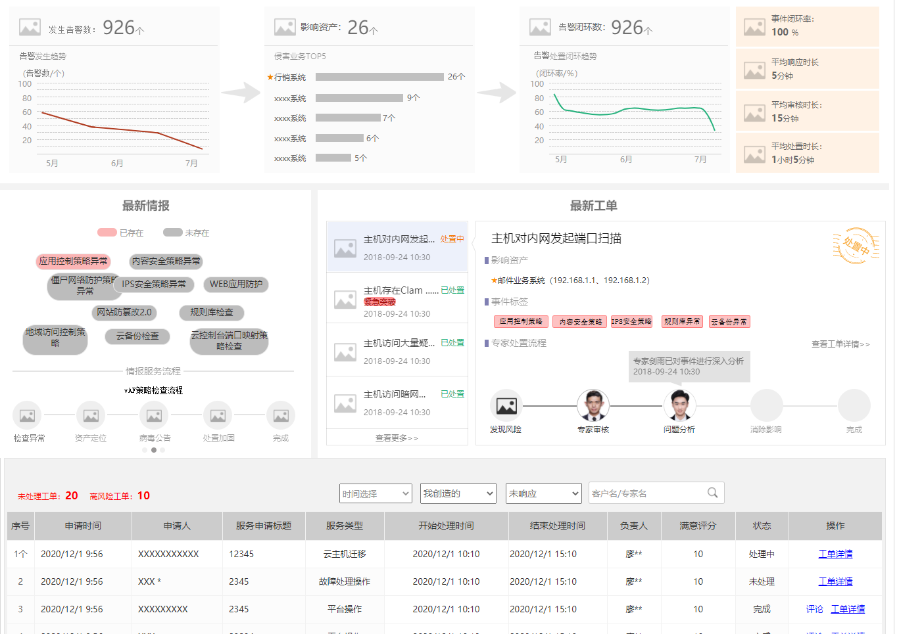
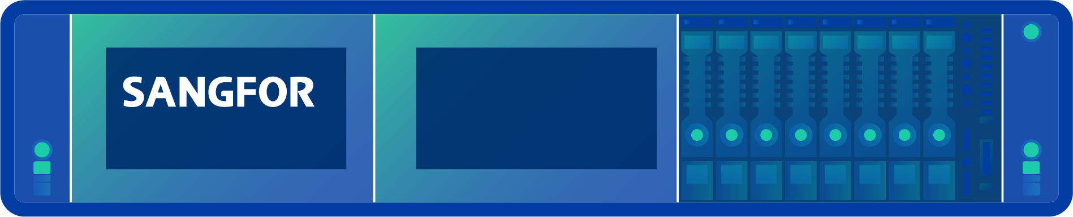
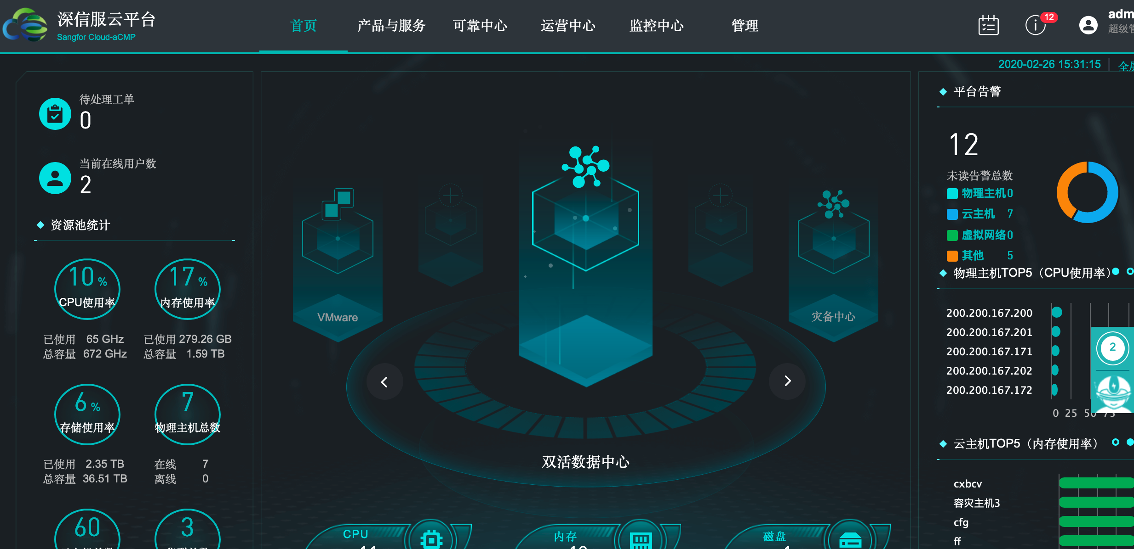
Case 4 - Managed Service for On-Premise Datacenter
Sangfor On-Premises Private Cloud
Sangfor Managed Cloud Service
Basic Infra Management or ITOps Total Outsourcing
Storage
Security
Alert
Auto Complete
Routine Check
Compute
Network
Portal
Risk Analysis
Workflow/
Event Logging
Manual Request
System Event
Manual Handle
with Services
MSS IR
Customer Total Visibility & Reporting
Local Infra
(HQ or Branches)

Slide 25
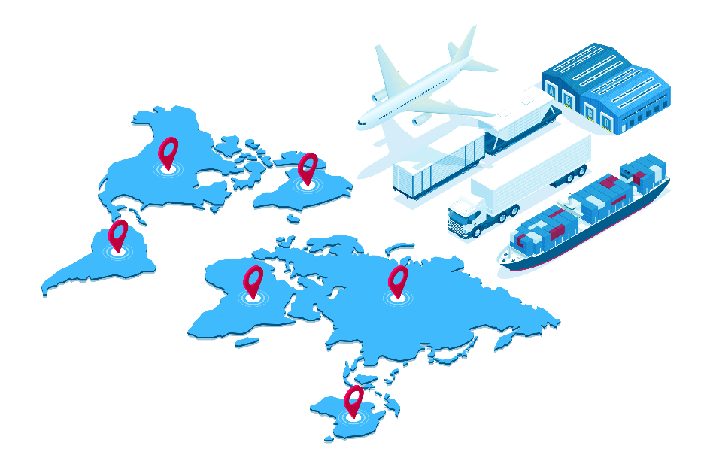
Customer Case Sharing
Business intention:
Developing E-commerce
Offering uninterrupted Global internet business and service
Achieve Light-assets target for IT team
Challenges facing
High subscription cost for web business on public cloud
CRM and Raw materials are sensentive datas and don't allowed to run in public cloud
Limted IT resource and skills and are not able to provide the best techncial service and busiess guarantee
Solution
Selected Sangfor manged dedicated cloud service to touch their requirments
Have the best TCO and service support (60% less compare to public cloud)
Better to meet the internal secuirty compliance( data secure and controlable)
An International Manufacturing
Business selling more than
23 countries
Over 5 raw material manufacturing centers

Slide 26





Sangfor Group
Network Security
Enabling Enterprise-Class
Security
Cloud Computing
One Architecture Sharing
Everything
Infrastructure
Achieving Interconnected
Network
Sundray
Enterprise Wi-Fi & Enterprise IoT
Virtiant
Cloud Service (USA)

Slide 27
Global Expansion
Hong Kong/
Taiwan China
China
Myanmar
Malaysia
UAE
Vietnam
Pakistan
Thailand
South Africa
Philippines
60+
Global Branches
Indonesia
USA
Spain
Singapore
Italy
South
Korea

Slide 28

Leading Technology
First
Innovation
The World First 3rd Gen HCI
The World First Converged NGFW +WAF
Sangfor IPSec VPN, SSL VPN, IAM, WANO #1 in Network Security market in China
Total Applied Patents: 1,500+
New Products Released Every 1-2 Year
New Versions Released Every Quarter

Slide 29
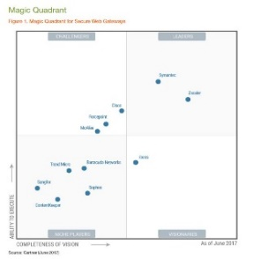
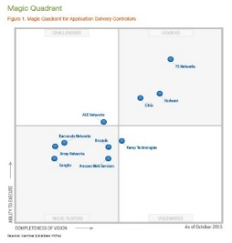
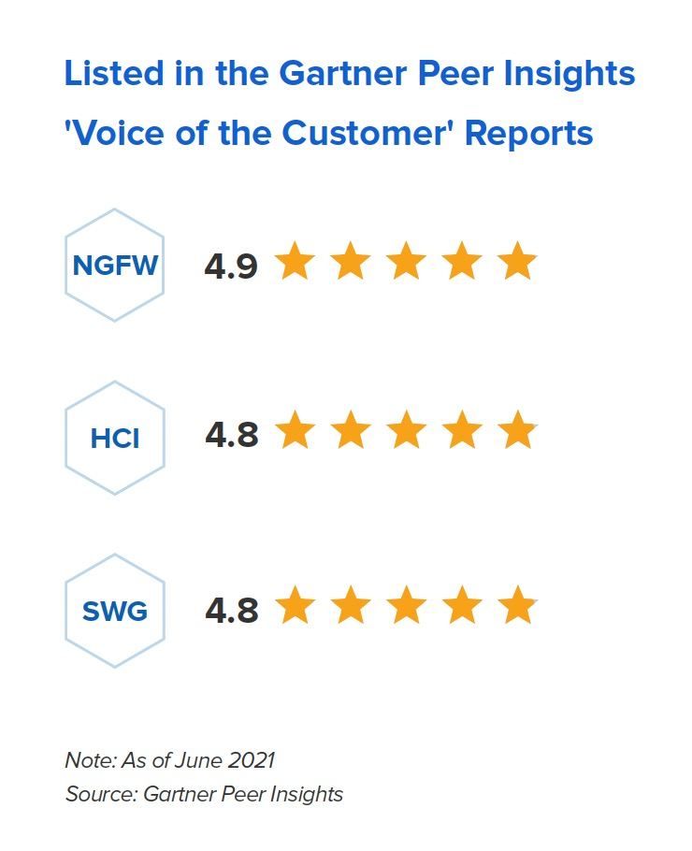

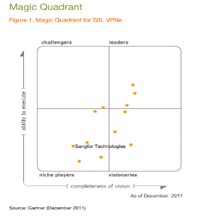
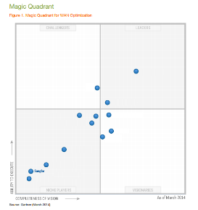
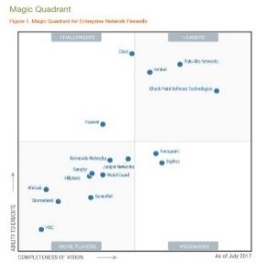
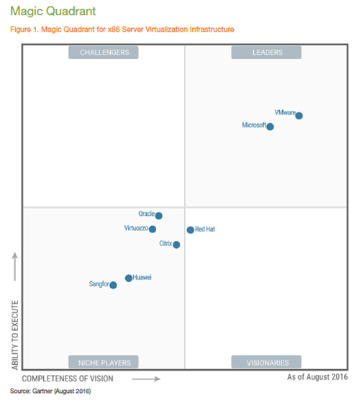
Global Expansion
Gartner (Magic Quadrant)
SSL VPN
01
HCI
VPN
07
02
06
03
NGAF
WANO
05
04
AD
IAG

Slide 30























































Over 100,000 Customers Worldwide

Slide 31
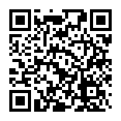

Thank You
With your local IT Partner, we provide promising
Managed Cloud Services for Enterprise
A One-Stop-Shop Cloud Solution just like a nearby Convenience Store
To Grab Opportunities
To React Market Needs
To Manage Risks
To the Mutual Success
with Sangfor’s Strong Background,
27x7 around the globe Fast Growing Services & Professional Support

Slide 32
THANK YOU
Your Name | Your Job Position
email@sangfor.com
www.sangfor.com
Sangfor Technologies Inc.

