Slide 1

Sangfor Managed cloud service program
Build the digital infrastructure exclusive store
www.sangfor.com
Sangfor Technologies Inc.

Slide 2
01
Unique values of Managed cloud service
02
How Sangfor enable partner move to MCP
03
How to engage your customers
04
Sangfor brand and differences

Slide 3

Cloud Adoption Rate is Rising
Help customers start their journey
Lower TCO & operation effort
Flexible to scale up or down
Greater speed and agility
Increased uptime and better disaster recovery
Improved security and control

Slide 4
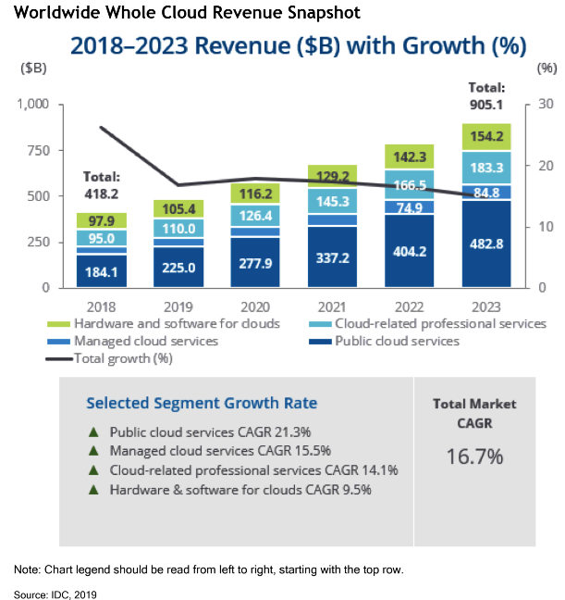
Worldwide Cloud Market Forecast
The proportion of IT spending that is shifting to cloud will accelerate in the aftermath of the COVID-19 crisis, the cloud total market CAGR (Compound Annual Growth Rate) will reach nearly 16.7%
Notes:
Cloud Adoption Rate is still Rising at the speed of double digit growth rate
Help customers start their Cloud journey to make sure it is safe and right
Lower TCO & operation effort
Flexible to scale up or down
Greater speed and agility
Increased uptime and better disaster recovery
Improved security and control

Slide 5
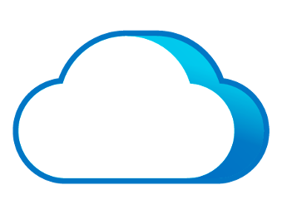
However, Public Cloud Not Suited for Every Scenario
Security and Compliance
Sensitive applications and data have strong security and compliance requirements.
High Performance
Apps require high performance with low latency ( DB, HIS, MES, PACS).
Legacy Applications
Public Cloud
Lack of high reliability and difficulty migrating to public cloud.
Better and Customized SLA
Unsuited
Fast and high-quality service response including DR, application and data migration and security services (Data Protection).
Cost
Goes well beyond expectations as business grows.
Notes:
When it comes to the PUBLIC cloud, security is a shared responsibility between CSP and Tenant.
Which means YOU (or the tenant admin) are in complete control of – and responsible for – securing your apps and data in the public cloud.
Therefore, you must implement the appropriate security tools BY YOURSELVES to protect them and keep your business safe from threats.
And any systems requires high performance with low latency at edge might not suitable
Migrate Legacy Application to Public Cloud get stuck into as no option other than Lift and Shift or have the application redesign/rewrite.
However, Some applications might have stick with traditional on-premise LAN design and outdated OS which the Public Cloud didn’t support.
https://modlogix.com/blog/what-is-legacy-system-replatforming-and-when-to-consider-it/
The Public Cloud provides infra or their PaaS/SaaS services SLA, which might not be valid to application services, which still requires better or customized SLA
TCO might as low as expected to use large and static deployment which is not being paid per usage by global end-user (e.g. Online Games, Netflix or Uber…)

Slide 6








Managed Cloud Services Emerge
Low Cost
Flexibility
Managed cloud service gives customers the convenience and flexibility of a public cloud, with the security, control and professional service of a private cloud, making it the best cloud service approach for most SME customers.
Productivity
Collaboration
Cloud
Managed Services
Security
Software
Update
Data Lost Prevention
Mobility
Notes:
That’s Why we believe that Managed Cloud Services should play a role here.
It is cheaper, localized and compensating the transition gap of end-customer’s digital transformation journey
Best of all, it comes with state of art Security measurement empowered by AI and ML and also giving Partners greater control of infra and service to end-customers.

Slide 7
Seeing through the Cloud – Investment
Cost:
Public Cloud Partners are required to invest on intensive training for sales & tech team and need to obtain a great number of CSP certifications as entry requirement. Which is also one of CSP’s business and non-refundable.
Managed Cloud Partners have more Flexible options, they can either self-own, co-own or resell. First time investment can be consumed as customer’ subscription fee and it is REFUNDEDABLE like a franchise exit option.
Margin:
Public Cloud publishes end-user price publicly with few % discount to Partners (depends on their a/c levels), Further Discount make to end-user directly for long-term static usage, which could lead to margin shrinking to Partners.
Managed Cloud Partners have better Margin control and own Pricing Strategy & Terms, as well as discount or commitment to end-customer.
Proprietorship:
Public Cloud Partners are classified by certifications & contribution. No Sole Proprietorship or regional distribution model. Multiple partners engagement is allowed for a single tenant.
Managed Cloud Partners may choose become Sole to Region/Area, ISP/MSP/SI/ISV utilizes existing skill-set or Business Consultant just make referral to technical partners.

Slide 8
Seeing through the Cloud - Operation
Customization:
Public Cloud Partners have no option for any customization. There’re force Global feature update without localization, but every Region might have different timeline.
Managed Cloud Partners have customizable features. Most of them can be enabled by license key with Global update and tailored localized functions.
Tenant Management:
Public Cloud Partners usually need 3rd party tools or Managed Services or Multi-Cloud Operation. Tenant portal focus on End-Customer only and have less consideration for the role of Service Provider
Managed Cloud Partners can make use all-in-one server portal to manage tenant and it also comes with Multi-Cloud Management, Tenant Billing.
Compliance & Data Protection:
Public Cloud Partners are required to make use information from CSP to design compliance solution by themselves. But regional data security or privacy protection clauses might not be easy to match with Public Environment.
Managed Cloud Partners have easier compliance tasks as Managed or Private Cloud can be dedicated or isolated in local data center for guaranteeing data security & privacy protection.

Slide 9
01
Unique values of Managed cloud service
02
How Sangfor enable partner move to MCP
03
How to engage your customers
04
Sangfor brand and differences

Slide 10
Sangfor Managed Cloud Service
Our Vision
  Building a global-distributed cloud data center, allow every customer to afford and secure enjoy the cloud service, Building convenience store chain in digital word
Our Mission
  Enablement Partner & Customer adopt Cloud Journey effectively with the most optimized approach
Cloud service Value Proposition
  Offering trusted Cloud infrastructure and service
  Extremely Professional End-to-End Service
  Focus on Partner Enablement with Localisation

Slide 11







Global distributed cloud infrastructure
APAC (MY) CTI team
EMEA CTI team
Sangfor
Sangfor Unified Service Platform
Sangfor Unified Service Platform
Version management
Professional service delivery
Monitoring & Fix
Version management
Professional service delivery
Monitoring & Fix
ID region
MY Region
Italy region
Spanish Region
Brand Operators
Brand Operators
Brand Operators
Brand Operators
Provider A
Provider B
Provider C
Provider D
Provider A
Provider B
Provider C
Provider D
Management and resource cluster
Management and resource cluster
Management and resource cluster
Management and resource cluster
T2 Service
T2 Service
Alliance partner
Alliance Partner
Reseller A
Reseller B
Reseller C
Reseller D
Reseller E
Reseller A
Reseller B
Reseller C
Reseller D
Reseller E
T1 Service
End user

Slide 12
Sangfor Managed Cloud Program
Alliance
Cloud
(New)
Customer Shared
Dedicated data center and network
Shared infrastructure
Asset ownership
Sangfor (Public platform) and Reseller(Node Resource)
Delivery & Operation
Sangfor (platform) + Reseller (tenant)
Subscription Cloud
Customer Shared
Dedicated data center, network
Shared infrastructure
Asset ownership
Service provider
Delivery & Operation
Sangfor (product) + service provider (platform and tenant)
Alliance Cloud: Partner and Sangfor jointly investment the cloud infrastructure without further investment in their owner cloud datacentre, and then partners are able to deliver the cloud service to end user based on it,suitable to traditional si,msp,product reseller and isv
Subscription Cloud: Partners subscribe the Sangfor cloud license to deploy their own cloud infrastructure and deliver managed services to their own customers,suitable to local IDC/ISP

Slide 13
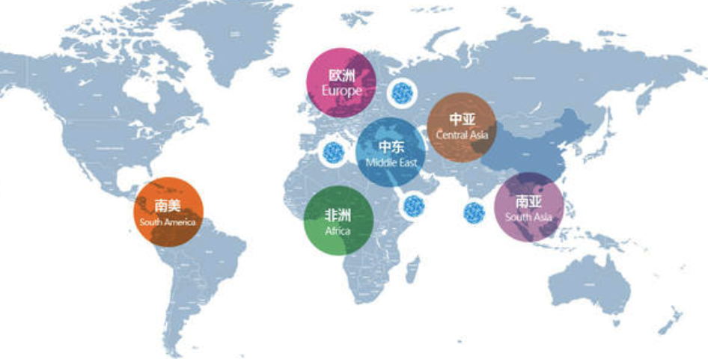
Alliance cloud service program
Business Position (Partner)
Sangfor enables partners to become a cloud service provider with low TCO
Unique Business Model (Partner)
Joint investment, shared risk and shared values
Joint operation, self-pricing, and reduced partner costs
VS Public cloud
Partner owns IaaS assets and decides the end-user pricing
Partner leads commerce and customer relations
More revenue and profit
Expand your business boundary from solution to managed cloud service and security

Slide 14
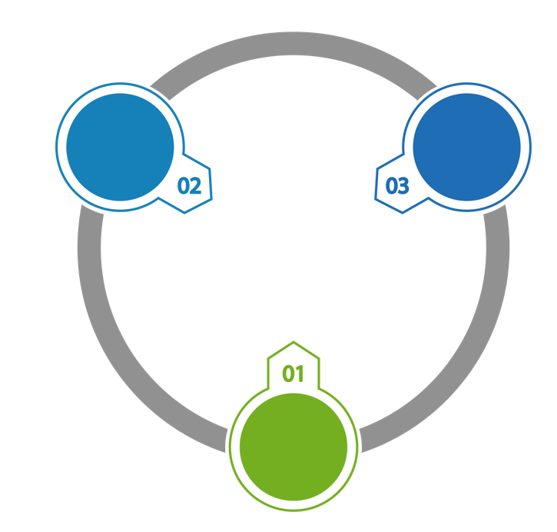


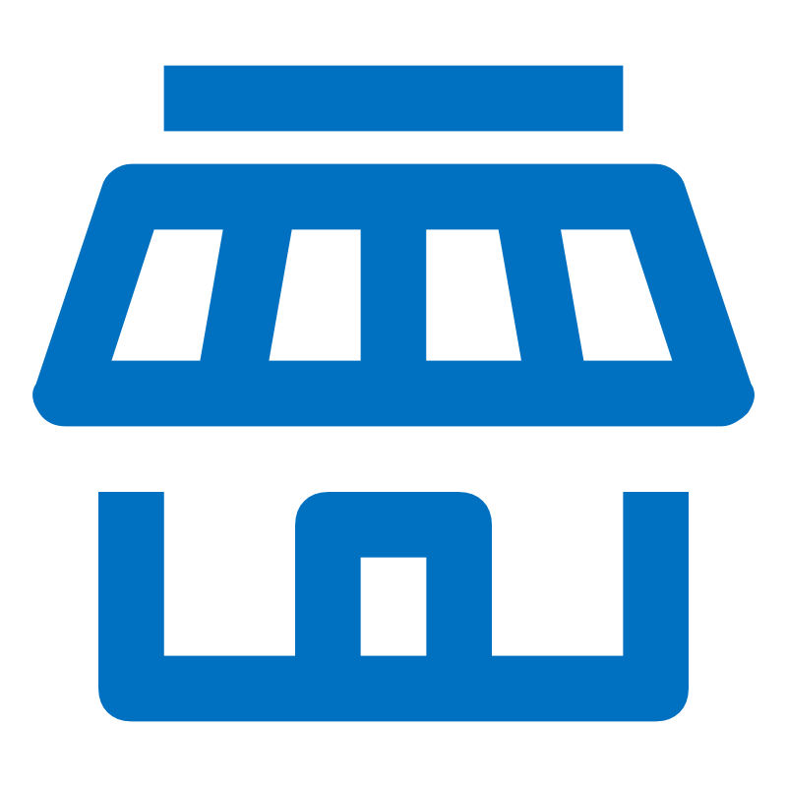
Sangfor Offers a Better Option for Partners...
A Trusted Cloud Service Provider
Build your own cloud service business and provide it to your customers directly
You have 100% control of your customer resources, as you own
the cloud service assets
You provide an on-premise solution and managed cloud service, to meet all your customer’s cloud service requirements
You provide value-added services continually, based on your customer needs
Business Expands or Transforms

Slide 15




Roles and Responsibilities
Authorization
Subscription
Subscription
CLOUD DC
Sangfor APAC Operation center
ID Region DC (Sangfor Dist)
Reseller
End user
Resource cluster and software are invested by Reseller
Platform management cluster and software are invested by Sangfor
DC space, Rack, bandwidth, and Cloud service operation certification are invested by Sangfor’s Operator)
Role | Asset's ownership | Management and Maintenance | Technical Support and service delivery | Revenue
Vendor (Sangfor) | Management platform (invested by Sangfor) | the Managed Cloud platform | the Managed cloud platform and Reseller | Resource Node and software license Subscription, Professional Service, Managed Service
Operator | Data center physical space and Rack, bandwidth | ----- | ----- | Managed DC service, Bandwidth subscription, Operation certificate
Reseller | Node resource | Tenant resource | Tenant | Tenant resource subscription & Service
Revenue for Reseller
Service catalog subscription (self-pricing)
Tenant resource managed and managed service subscription
Professional Service revenue: offering by reseller (Data Backup, application migration, Tailored service & MSS)

Slide 16
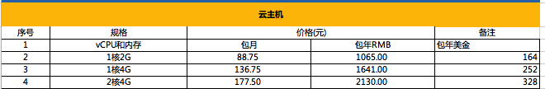
Sample of Revenue and Profit Gain
Saleable resources for one node resource: 200C vCPU, 400GB RAM and 10TB Hybrid Storage
Yearly subscription revenue is about 19. 4K (Assume offer 50% discount to UE)
Resource List Price recommended to End User
Compare to Public Cloud
Category | Investment Resource | First Year Cost (USD) | Subsequent Yearly Cost (USD) | First-Year Revenue (USD) | Subsequent Yearly Revenue (USD)
Sangfor | 1*Management Cluster(5* server and 7*switches),security device | 67K | 0 | At a loss : 3.8k BEP: over 10 +partners to join | 6.5K USD/Year/node
Reseller | Start with 1 node Server And Yearly Managed service subscription cost (includes software) | 17.9k (Node:11.4K + MS 6.5K) | 6.5k | 19.4k-17.9k=1.6K it will be more if factor in other components and service | 19.4k-6.5k=12.9k Subsequent yearly gross margin will up to 66%
Notice: This model is suitable for the comparison TCO with Public cloud offer, or on-premise solutions

Slide 17

Be an Sangfor Managed Cloud Partner
Enjoy Sangfor Global distributed Cloud + Security Best Practice and SOP Support
Simplify Operations with Sangfor GTM Support Services
Flexible Partner Investment Model
(Whitelabel, Service Partner or Co-investors)
Sangfor Commit & Protect Local Partnership
Partners Manage Own customers and cloud assets directly
Leverage Partner’s Eco-System to provide
one-stop-shop managed services by yourself

Slide 18

Partner Exit Option
Partner will get REFUNDED if no subscription for the initial resource invested within 10 month

Slide 19
01
Unique values of Managed cloud service
02
How Sangfor enable partner move to MCP
03
How to engage your customers
04
Sangfor brand and differences

Slide 20
Who should consider Managed Cloud Service?
Objective | Target
Concerns of Data Protection or Compliant with Local Privacy Ordinance/ Regulation | Sensitive data process Functions, Government, NGO, Education
Line of Business Application Requires High performance, Static or Low Latency | Hospital (HIS, PACS), Hospitality (PMS), Manufacturing (MES, ERP, MRPII),
Multiple Location with Edge Resource requirement | Logistic (3PL data exchange gateway), Design & Architect Firm (File Sharing with xref) Multinational Company & Branches (ROBO), Retail (Mall System, POS, Signage, Reporting)
Mission Critical Applications requires direct physical connectivity | Stockbroker (Decision Support & Algo Trade System) BSS ISV (Broker Support System Vendor)
System refreshment without the requirement of redesign and Revenue doesn’t relay on distributed scaling per volume of visitors | SME (File Service), Traditional Trading (Account, HRS, EDM), Legacy Production System fail to replatform, refactor or rearchitect with expected TCO,

Slide 21
Top Use Cases For Managed Cloud service
Hosting a data center enables IT to focus on business innovation
Offering the best service and performance improvement
Protect and restore HCI-based on-premise critical data with managed cloud
Hosting service for customer on-premise data center
Managed
Private Cloud
Managed Critical
Application
DR or Backup-as-a-Service
On-Premise Data Center Service Hosting
PART 1
PART 2
PART 3
PART 4

Slide 22

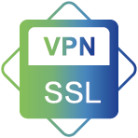






Comprehensive and Cost-Effective Infrastructure
Business
Operation
Multi-Tenant
Service Portal
Billing, Metering
Monitoring & Report
Technical Service
DBaaS
Middleware
App Center
Container
Operation
Monitoring
RDS(MySQL)
Kafka
APP Mange
DevSecOps
Multi-tenant
Monitoring
App
Service
SQL Server
RabbitMQ
Schedule
Microservice
Billing
Threshold
24/7 Online Support
Oracle
Redis
PIC Identify
K8S
Metering
Inspection
DB migration
Mango DB
Big Data
Img Registry
Traffic
Automation
On-site
Operation
Security
Service
Tailored
Service
LB
VPN
IAG
NGAF
EDR
CC
Audit
Mgmt
VAPT
Advanced
Service
Computing
Network
Storage
Data Protection
Unified manage
IaaS
Virtual Desktop
VPC
Block
DR
VMware
Virtual Servers
Elastic IP
File
CDP
AliCloud
Managed
Security
Service
Dedicated Host
Virtual private network
Object
Local Backup
AWS
Bare metal server
Load balance
Cloud Backup
Offsite backup
Physical server

Slide 23








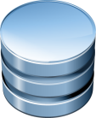
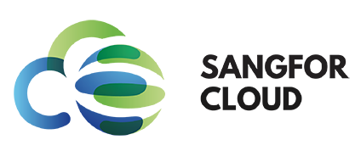
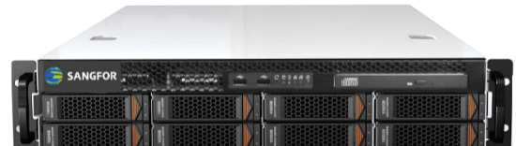
Maximized Security, Inside out
Office user
End user
Private
Or
VPN
Internet
Platform security
Cyber Command
(AI & ML backed
Global Threat Intelligence)
Cyber Command correlated service
Virtual border switch
24x7 NOC
&
SOC
NFV
Border security
vSwitch1
Security resource pool
vSwitch2
Network security
vAF
Distributed FW
Tenant
VPC
App&
DB
DB1
DB2
Distributed
Firewalls
web1
APP1
Distributed
Firewalls
web2
APP2
VM1
Pod1
EDR
Pod2
Endpoint security
EDR
EDR
Endpoint Secure integration
vSAN
vDisk1
vDisk2
vDisk3
Encrypted
Encrypted
Encrypted
Data security
Cloud Infra
Kernel Module
Platform Administration
Admin Logging
Encryption
Data protection & hardened kernel module
Kernel security
Subscribed
Resource
Failover Standby
Scale Out
Resource
Built-in WAF

Slide 24



Ultimate & Professional Service
Advanced Service | Assessment & Consulting Service | Technical enablement & certificated Service | GTM strategies Service
Online & Onsite Service | Application & Data migration | Remotely Managed on-premise HCI data center | Monitoring and report
 | 7*24 Online technical support | Delivery and deployment service | Mid-level, fast response
Application Service | DBA Manage and optimize Service | Critical-Apps management | AI&ML
 | Application image Service | Integrate Service | SaaS
Infrastructure as a Service | Performance optimization | Backup and DR | DaaS
 | Managed Hybrid cloud | Container as Service | SASE
 | Managed Private cloud | PaaS / Microservices | Database as a service
 | Managed VMware cluster | Manage & Operate | Network as a Service
Security as Service | Threat detection & response | Risk & Compliance | Application protection
 | Incident Response | Privacy & Data protection
Built-in all-round Cloud Security with AI & ML empowered Global Threat Intelligence
Notes:
Highlighted with Sangfor Managed Cloud Service’s Edges

Slide 25
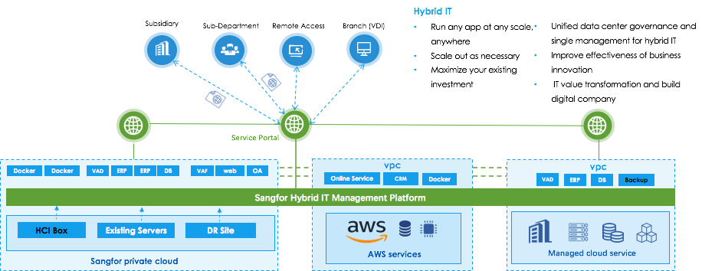
Smooth move to delivery Hybrid cloud service

Slide 26
TCO Comparison
Data Center | Cloud Infra Model | Self-built | Co-Location | Sangfor Managed Cloud | Public Cloud
 | DC Setup (Space, Engg, PM, Power, Cooling, Electricity, Fire , Rack, Security & Labor) | 240,000 | Subscription | Included | Included
 | Entry Fee (Cert, Talent) | NIL | NIL | NIL | 10,000
 | Management System (3 Nodes) | 36,000 | 36,000 | Dedicated/ Shared | Shared
Cloud Infra | Tenant Compute & Storage | 60,000 | 60,000 | Subscription | Subscription
 | Network Equipment (Router & Switch) | 30,000 | 30,000 | Included | Subscription
 | Cloud Security (AF, IPS, AD, IAG) | 35,000 | 35,000 | 5,000 | Subscription
 | Cloud Platform Software | 50,000 | 50,000 | Included | N/A
Operation | Annual Product Maintenance & Support | 41,100 | 21,100 | 500 | 1,000
 | Annual Power Consumption | 2,400 | Included | Included | Included
 | Annual Compute Subscription (2R/5N) | included | 36,000 | 115,000 | 232,256
 | Annual Storage & Backup | included | included | Included | 38,400
 | Tier 1 24x7 Customer Service | 44,100 | 23,210 | 23,000 | 30,000
 | Tier 2 Technical Consultancy | Additional Cost | Additional Cost | Included | Additional Cost
TCO | Initial + 1st year (M/USD) | USD 0.53 M | USD 0.29 M | USD 0.14 M | USD 0.31 M
 | 5 Year TCO (M/USD) | USD 0.89 M | USD 0.61 M | USD 0.72 M | USD 1.52 M
Loan Interest | 5 Year Loan w/ 10% Interest Rate | USD 1.07 M | USD 0.70 M | N/A | N/A
Notes:
Scenario
Self-Built 10㎡/2 Racks, Co-Lo or Managed Cloud: 5xHigh Density HCI Nodes as Tenant Resource Pool, Usable Resource (48 Physical Cores, 400GB RAM), additional 3xAdmin Nodes, 80TB Hybrid Storage, 2xCore Network Switches, 2xData Network Switches, Access Switch & Management Switch

Slide 27
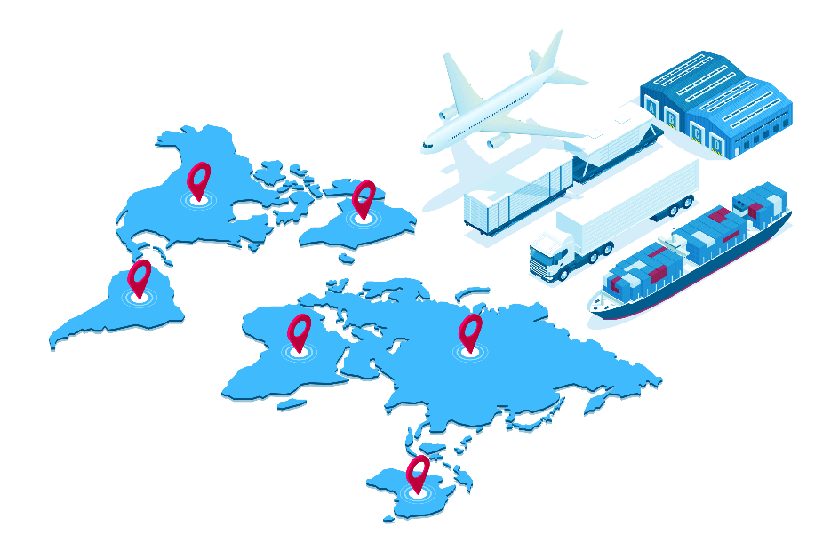
Customer case sharing
Business intention:
Developing E-commerce
Offering uninterrupted Global internet business and service
Achieve Light-assets target for IT team
Challenges facing
High subscription cost for web business on public cloud
CRM and Raw materials are sensentive datas and don't allowed to run in public cloud
Limted IT resource and skills and are not able to provide the best techncial service and busiess guarantee
Solution
Selected Sangfor manged dedicated cloud service to touch their requirments
Have the best TCO and service support (60% less compare to public cloud)
Better to meet the internal secuirty compliance( data secure and controlable)
An international manufacturing
Business selling more than 23 countries
Over 5 raw material manufacturing centers

Slide 28
01
Unique values of Managed cloud service
02
How Sangfor enable partner move to MCP
03
How to engage your customers
04
Sangfor brand and differences

Slide 29


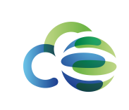


Sangfor Group
Network Security
Enabling Enterprise-Class Security
Sundray
Enterprise Wi-Fi & Enterprise IoT
Cloud Computing
One Architecture Sharing Everything
Virtiant
Cloud Service (USA)
Infrastructure
Achieving Interconnected Network

Slide 30
Global Expansion
Mainland China
HK/TW/MC
Malaysia
UAE
Vietnam
Pakistan
Myanmar
South Africa
Philippines
USA
Indonesia
60+
South Korea
Singapore
Global Branches
Italy
Thailand
Sangfor Technologies
CONFIDENTIAL
Page 29

Slide 31

Leading Technology
First
Innovation
The World First 3rd Gen HCI
The World First Converged NGFW +WAF
Sangfor IPSec VPN, SSL VPN, IAM, WANO #1 in Network Security market in China
Total Applied Patents: 1,500+
New Products Released Every 1-2 Year
New Versions Released Every Quarter

Slide 32



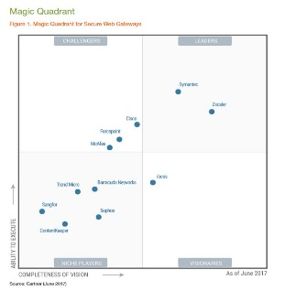
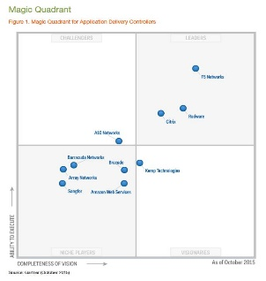
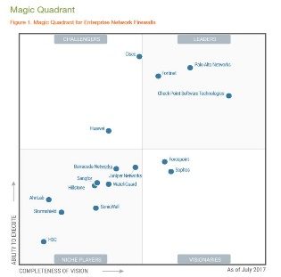
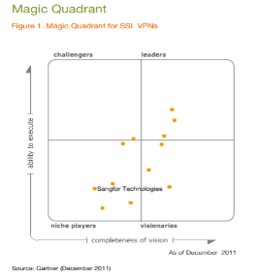
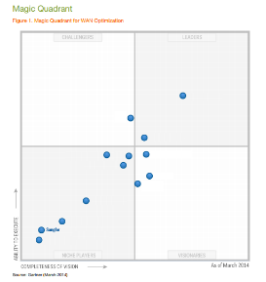
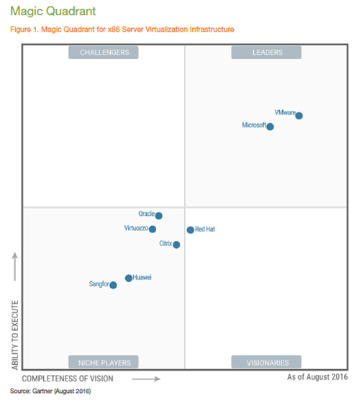
HCI
IAM
VPN
Gartner
WANO
Magic Quadrant
AD
NGAF
SSL VPN

Slide 33
























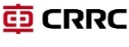


















































Over 100,000 Customers Worldwide

Slide 34
THANK YOU
www.sangfor.com
Sangfor Technologies Inc.
Notes:
Good afternoon! Everyone. Thanks Wilson for sharing the great changes of the Sangfor Group and the company's willingness to invest more in the international business.
Today, I will mainly introduce our thought on how to beat the competition, take our business to the next level, and the key strategies to accelerate our business transformation.

