Slide 1


Sangfor Digitally Transforms the Healthcare Industry
Aaron Wang | Senior Product Manager
Sangfor Technologies Inc.
www.sangfor.com
Sangfor Technologies Inc.
Notes:
Ladies and gentleman, good morning. It’s my great honor to be here to share Sangfor’s experience in healthcare. I’m hoping this sharing will inspire you on how IT infrastructure will improve healthcare’s efficiency.

Slide 2

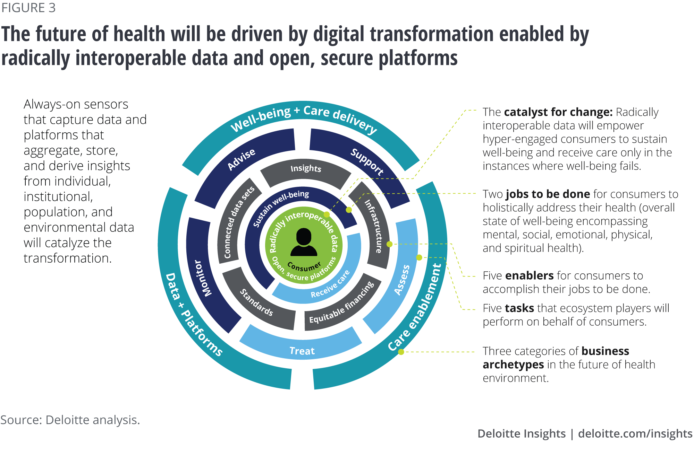
Digital Transformation is Driving The Future
of Healthcare
Notes:
Despite numerous challenges, there has been considerable progress in digital transformation of health care, which we expect will continue in 2020 and beyond. With digital finding traction, the health care systems will witness a shift in data management from storing data sets to extracting insights that can be monetized and support opportunity areas including population health management and value-based care. Amidst this growth, there are challenges to digitization in health care—posed by outdated legacy platforms, cost and complexity of new technologies, and constantly evolving business needs and scenarios—and cybersecurity will continue to remain a prime concern.

Slide 3
Money is Pouring into Healthcare IT Market
CAGR
15.8%
USD 390.7
Billion
USD 187.6
Billion
2019
2024
Notes:
The healthcare IT market is projected to reach USD 390.7 billion by 2024 from USD 187.6 billion in 2019, at a CAGR of 15.8% during the forecast period. The demand for healthcare IT solutions and services is driven by government mandates & support for healthcare IT solutions, rising use of big data in healthcare, high returns on investment for healthcare IT solutions, and the need to curtail escalating healthcare costs.
Favorable government initiatives for encouraging adoption of information technology in healthcare services will boost industry growth in the future. For instance, the U.S. government passed Health Information Technology for Economic and Clinical Health (HITECH) Act, providing funds worth USD 20 billion for setting up electronic health records. Such government initiatives should propel the Healthcare IT market growth.
Increasing demand for lowering cost of healthcare services by implementation of healthcare IT network will foster industry growth in the future. Inefficient processes in healthcare settings leads to loss of about 50% of the revenue earned by healthcare providers, ultimately leading to high healthcare cost. Implementation of healthcare IT services reduces errors in processes and manages the data efficiently, thereby lowering overall healthcare service cost. Aforementioned factors will propel healthcare IT market growth in the future.

Slide 4
Patient Treatment Process
Admission
Diagnose
Therapy
Post-treatment
Discharge
EHR/EMR
PACS
Billing/payment
IT systems play a vital role in healthcare services.
Notes:
IT systems play a vital role in healthcare services. Multiple medical systems are involved in the patient treatment process, such as electronic health/medical record in the whole process, PACS (picture archiving and communication system) in the diagnose and therapy, etc,.

Slide 5
Goal of Healthcare Providers
Admission
Diagnose
Therapy
Post-treatment
Discharge
EHR/EMR
PACS
Billing/payment
Reduce patient wait time
Improve patient throughput

Slide 6

However…
long waiting time

Slide 7
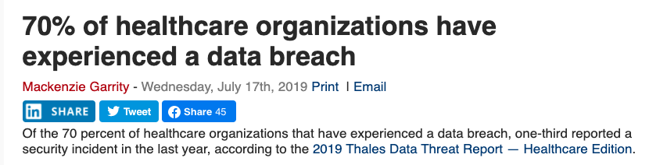
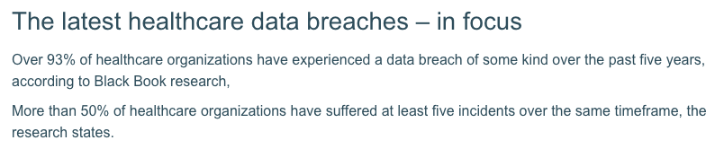
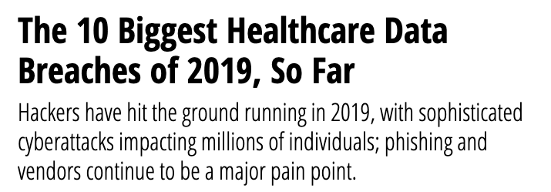
However…
Data breach of healthcare organizations is on the rise

Slide 8



IT Could Be the BIG PAIN Point
Slow to access patient’s medical records
7*24 service is not guaranteed
！
Slow to retrieve CT/MRI scan images
Data
Loss happens

Slide 9






Architecture of Hospital Information System
Service
HIS
ERP/DW
Administration
Medical treatment
Treatment support
Database is the key application to support the data exchange.
Typical infra. requirements of DB:
High performance
High availability
Registration
Outpatient nursing
Examination
DW
Reservations
Treatment
Medication
Profit statistics
Payments
Ward nursing
Injection
Diagnostic statistics
Insurance
Surgery recovery
Nutrition
mgmt. info.
Bills
Functional test
Unpaid
Image examination
ERP
EMR
Employment management
Clinical record
FI
Nursing record
Surgery/ anesthetic record
PACS
SCM
Mobile service
ABC
GW
Email
Announcement
Approval
EMR/EHR and PACS are the most common medical IT systems.

Slide 10

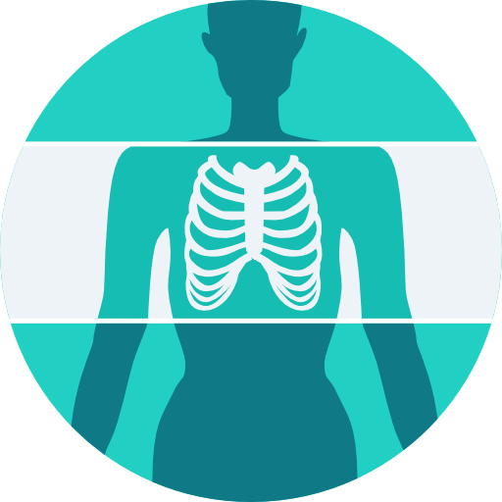
Hospital Information System Matters
Core services
Supporting services
Web servers
Analytics
Application servers
Disaster recovery
Production database
Other services
Components of a typical EMR/PACS deployment
Name:
Electronic Health/Medical Record (EHR/EMR)
Purpose
Contains a patient’s medical history, diagnoses, medications, treatment plans and test results.
Challenges
Slow response, occasional downtime
Name:
Picture Archiving & Communication System (PACS)
Purpose
Provides economical storage and convenient access to images from multiple modalities
Challenges
Slow response, scaling, flexible storage capacity
Notes:
An electronic health record (EHR) is a digital version of a patient’s paper chart. EHRs are real-time, patient-centered records that make information available instantly and securely to authorized users. While an EHR does contain the medical and treatment histories of patients, an EHR system is built to go beyond standard clinical data collected in a provider’s office and can be inclusive of a broader view of a patient’s care. EHRs are a vital part of health IT and can:
Contain a patient’s medical history, diagnoses, medications, treatment plans, immunization dates, allergies, radiology images, and laboratory and test results
Allow access to evidence-based tools that providers can use to make decisions about a patient’s care
Automate and streamline provider workflow
One of the key features of an EHR is that health information can be created and managed by authorized providers in a digital format capable of being shared with other providers across more than one health care organization. EHRs are built to share information with other health care providers and organizations – such as laboratories, specialists, medical imaging facilities, pharmacies, emergency facilities, and school and workplace clinics – so they contain information from all clinicians involved in a patient’s care.

Slide 11
How EMR/PACS Are Deployed in A Traditional DC
Just because traditional architecture works doesn’t mean it’s the optimal way.
Notes:
An electronic health record (EHR) is a digital version of a patient’s paper chart. EHRs are real-time, patient-centered records that make information available instantly and securely to authorized users. While an EHR does contain the medical and treatment histories of patients, an EHR system is built to go beyond standard clinical data collected in a provider’s office and can be inclusive of a broader view of a patient’s care. EHRs are a vital part of health IT and can:
Contain a patient’s medical history, diagnoses, medications, treatment plans, immunization dates, allergies, radiology images, and laboratory and test results
Allow access to evidence-based tools that providers can use to make decisions about a patient’s care
Automate and streamline provider workflow
One of the key features of an EHR is that health information can be created and managed by authorized providers in a digital format capable of being shared with other providers across more than one health care organization. EHRs are built to share information with other health care providers and organizations – such as laboratories, specialists, medical imaging facilities, pharmacies, emergency facilities, and school and workplace clinics – so they contain information from all clinicians involved in a patient’s care.

Slide 12
Traditional Healthcare IT Challenges
EHR/EMR/PACS/BILLING/OA
Performance
Poor performance wastes valuable staff time, increases costs, increases the time spent on each patient, and decreases patient satisfaction.
Availability
Service disruptions affect patient care, making maintenance windows and outages unacceptable.
Bottleneck
What if storage fails?
What if the entire DC is down?
Notes:
Performance: Users notice and complain when performance is slow or inconsistent. Poor performance wastes valuable staff time, increases costs, increases the time spent on each patient, and decreases patient satisfaction.
Scaling: It is not always straightforward to expand infrastructure
to support more users. With legacy infrastructure it can be difficult to scale out all the elements—servers, storage, storage networking —in lockstep. This can mean over-provisioning up front or making potentially painful and disruptive changes later.
Availability: Service disruptions affect patient care, making maintenance windows and outages unacceptable.

Slide 13

Traditional Healthcare IT Challenges
EHR/EMR/PACS/BILLING/OA
B
If there is backup, usually it’s from 3rd party.
Data Security
Loss of patients’ data leads to reputation damage and lawsuits.
Where is backup?
Data is protected by local RAID
Notes:
RAID is adopted by external storage array to protect data at a disk level. You can have RAID 6 and RAID 5, What if a bunch of disks fail in the RAID group? RAID can’t ensure data integrity in the case of multiple disk failure. Moreover, backup is not bundled with traditional storage solution, if customer needs backup, 3rd party backup software usually needs to be purchased, this will introduce additional cost and management overhead.

Slide 14
The Ideal Hospital Data Center Solution

Slide 15
End-to-End Healthcare Cloud Platform
Front-End
VDI
Back-End
HCI

Slide 16
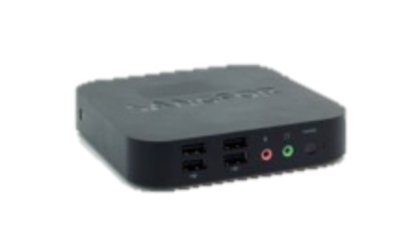
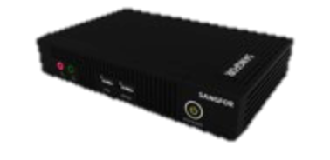




End-to-End Virtual Desktop Architecture
Thin Client
Virtual Desktop Controller (VDC)
Authentication
HW VDC
SW VDC
STD-200H
Desktop Template
Server/Storage Virtualization
STD-500
Department Management
PC Client
aSV for aDesk
aSAN for aDesk
Centralized Upgrades
HCI Servers + GPU
Smartphone
HW
Monitoring
Sangfor End-to-End VDI Solution

Slide 17





What Can VDI Bring to Hospital?
Provide solution with remote access functionality. Doctors can access HIS or EMR system with any terminal inside or outside of hospital.
Assign different levels of authorization for nurses to access data. They can access the same data from any desktop of the hospital.
aDesk solution provides
application access control for doctor’s PC.
End-to-end security functionality to prevent patient’s information leakage.
Dramatically
reduce electricity cost of the hospital.
Support BYOD

Slide 18
BizBox HIS Experience Improvement with Sangfor
Medical records inquiry
Node failover
6’53“
1d
2’13“
1st
42“
32.6“
2nd
Legacy infra.
Sangfor
Legacy infra.
Sangfor

Slide 19
Reliability Design Recommendation
Applications | Criticality | Reliability design
HIS/EHR/EMR | RPO=0/seconds RTO=seconds/minutes | Full redundancy for management, service, network, storage planes. Hardware failure detection data copies & data reconstruction HA DRS Resource reservation CDP local backup, remote replication in seconds Recover service within 30 minutes A-S deployment for aCMP
PACS | RPO=minutes/hours RTO=hours | Hardware failure detection 2 copies & data reconstruction HA Local CDP backup, remote replication per 12 hours recover service in 2 hours
OA/others | RPO=hours/days RTO=hours/days | Hardware failure detection 2 copies & data reconstruction HA Local CDP backup, remote replication per 12 hours recover service in 2 hours

Slide 20











Local Data Center Consolidation for Hospitals
ISP1
ISP2
Access
Switch
Gateway
10 GE
NGFW
IAM
NGAF
Clinic
Inpatient
GE
NGAF
ADC
IAM
IAM
NGAF
Core switch
EHR/EMR high performance
PACS scalable capacity
Primary site reliability
Network security
Single cluster environment with tailored performance and capacity
Radiology
Internal switch
PACS/OA
HIS/EMR/LIS
NGAF
NGAF
Big capacity (hybrid)
High performance (flash)
Notes:
To consolidate a datacenter, the primary target is consolidate vary hardware in to X86, and assign reliability & performance to different applications.
Existing server is able to be reused

Slide 21
Integrated Data Protection to Ensure Data Integrity
PACS/OA
HIS/EMR/LIS
CDP
Backup repository
NGAF
NGAF
Backup
Big capacity (hybrid)
High performance (flash)
App types | Recommended protection | RPO/RTO
HIS/EMR/PACS/LIS | CDP | RPO=0, RTO=5mins
OA/others | Backup | RPO=1hr, RTO=5mins
Notes:
To consolidate a datacenter, the primary target is consolidate vary hardware in to X86, and assign reliability & performance to different applications.
Existing server is able to be reused

Slide 22





Sangfor HCI Hospital Data Center with DR/SC
Access
ISP1
ISP2
Primary Site
DR Site
Switch
EHR/EMR high performance
PACS scalable capacity
Cross-site business reliability with DR
Active/active business continuity with SC
Network security
10 GE
NGFW
Gateway
GE
NGAF
IAM
NGAF
Clinic
Inpatient
ISP1
ADC
IAM
IAM
NGAF
Gateway
WEB/APP
Core switch
NGAF
Radiology
Internet zone
HIS/EMR | RTO=0 | RPO=0
PACS | RTO=5mins | RPO=0
OA & others | RTO=1hr | RPO=1hr
Internal switch
Alliance
NGAF
Data center
NGAF
PACS/OA
HIS/EMR/LIS
NGAF
NGAF
NGAF
Big capacity (hybrid)
High performance (flash)
DR Zone
Notes:
Based on Sangfor best practice, I would like to introduce a typical data center topology.

Slide 23







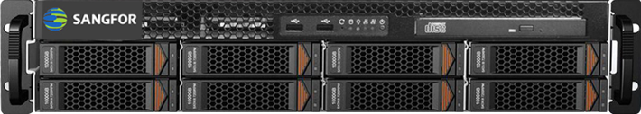







A Single Platform to Unify All
HIS HIP EMR LIS
PACS
Compute
Storage
Security
Network
Mgmt.
aSV
aCMP
aSAN
aNet
aSEC
HCI
OR
OR
HCI software
HCI
Stable
Secure
Performance
Hypervisor
Compute
Storage
Network
Security
Notes:
Legacy hardware defined infrastructure need different hardware to manage different applications, just like in a feature phone era. You need additional iPod to listen music, dictionary to translate.
In Hyper converged era, all functions are defined by software. Different performance requirement is adopted by different mix of SSD & hard disks.
1 server is one mini datacenter, 2 begins with data redundancy
No limitation to scale

Slide 24


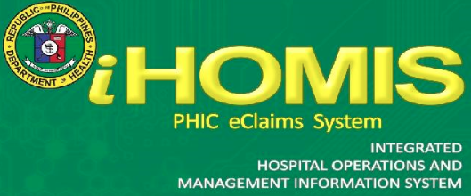


Validated by Mainstream Medical Systems
Notes:
Sangfor aCloud has been validated by mainstream medical systems in the industry, we have tested these applications on our aCloud with partners. It was been comprehensively proved to be performant, stable and scalable.
We are also actively working with other HIS providers to expand our healthcare ecosystem. Stay tuned for more update in the near future.

Slide 25

A Case Study: Mariano Marcos Memorial Hospital and Medical Center
Customer background
Mariano Marcos Memorial Hospital and Medical Center (MMMH & MC) is the biggest public hospital in Llocos Norte province, city Laoag, which was founded in 1972. MMMH & MC is the only level-3 hospital (the highest level) in the region that offers CT. In the year of 2012, MMMH & MC started digital transformation, with iHomis (Hospital Information System) & MedSys that were supported by DOH (Department of Health). With more and more systems being digitalized and patient quantity increasing in recent years, the IT infrastructure has become a critical challenge.
Challenges
Slow performance of HIS and PACS
High risk of failure without high availability design
Sangfor Solution
3 nodes of aServer with aSV, aNET, aSAN and CDP
Benefits and Values of Sangfor Solution
Increased performance of key applications with SSD caching, data striping, DRS and DRX.
Improved reliability and availability with data redundancy, backup, CDP, live migration and HA.
Reduced management overhead with one-stop web-based user interface.
Notes:
A case sharing here. Let’s have a look at how Mariano Marcos Memorial Hospital and Medical Center in PH leveraged Sangfor aCloud to build a efficient and stable healthcare platform.

Slide 26


Laboratory Experience Improvement
5 mins
90%
30s
Before
After
Notes:
This table listed the user experience improvement of key businesses in MMMH & MC. With aCloud supporting their healthcare systems, lab, pharmacy, billing and nurse station all experienced dramatic efficiency and reliability improvement.

Slide 27

Pharmacy Experience Improvement
4 mins
75%
1min
Before
After
Notes:
This table listed the user experience improvement of key businesses in MMMH & MC. With aCloud supporting their healthcare systems, lab, pharmacy, billing and nurse station all experienced dramatic efficiency and reliability improvement.

Slide 28

Billing Experience Improvement
6 mins
67%
2mins
Before
After
Notes:
This table listed the user experience improvement of key businesses in MMMH & MC. With aCloud supporting their healthcare systems, lab, pharmacy, billing and nurse station all experienced dramatic efficiency and reliability improvement.

Slide 29
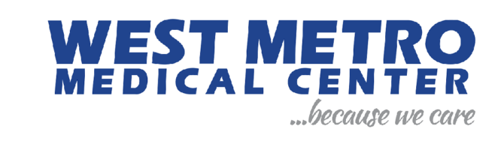







Trusted by Widespread Healthcare Providers
Notes:
Sangfor aCloud has been adopted by healthcare providers across regions, customers like MMMH & MC, St. Luke’s Medical Center in PH, Jakarta Eye Center from ID and Medical Gamma from Italy all enjoyed high performing, highly available and stable and scalable software-defined infrastructure brought by aCloud to take them to the next level of healthcare IT experience.

Slide 30
THANK YOU
Aaron Wang | Senior Product Manager
Sangfor Technologies Inc.
marketing@sangfor.com
www.sangfor.com
Sangfor Technologies Inc.

