Slide 1

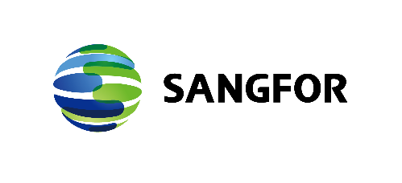
Cloud Infrastructure Trends
www.sangfor.com
Sangfor Technologies Inc.

Slide 2



We are Moving to a Digital World
Government
Education
E-Government
Smart City
Service Government
MOOC
Intelligent Campus
E-Backpack
FSI
E-Money
P2P Loan
E-Payment
Medical
Remote Diagnosis
Mobile Health Care
Retail
O2O
Precision Marketing
Transportation
Manufacturing
Car Networking
Pilotless Automobile
Car Sharing
Industry 4.0
IoT
Notes:
Digital transformation is a must have across industries and across the world.
Let me give you some recent examples from America. COVID-19 forces many food services are fast-tracking DX of quick service.
Starbucks is changing 400 of of their stores to pickup only locations. ordering coffee using mobile app is a key part of that strategy.
BurgerKing offers 100% touchless restaurant.
Chiptole has invested heavilty in DX for the past three years. In 2020, ½ of Chiptole’s sales came from digital sales. $780M revenue.
While most drive through time is 327 seconds. (over 5 minutes), including ordering, paying, and receiving. Chiptole’s average service time is 12 seconds.

Slide 3
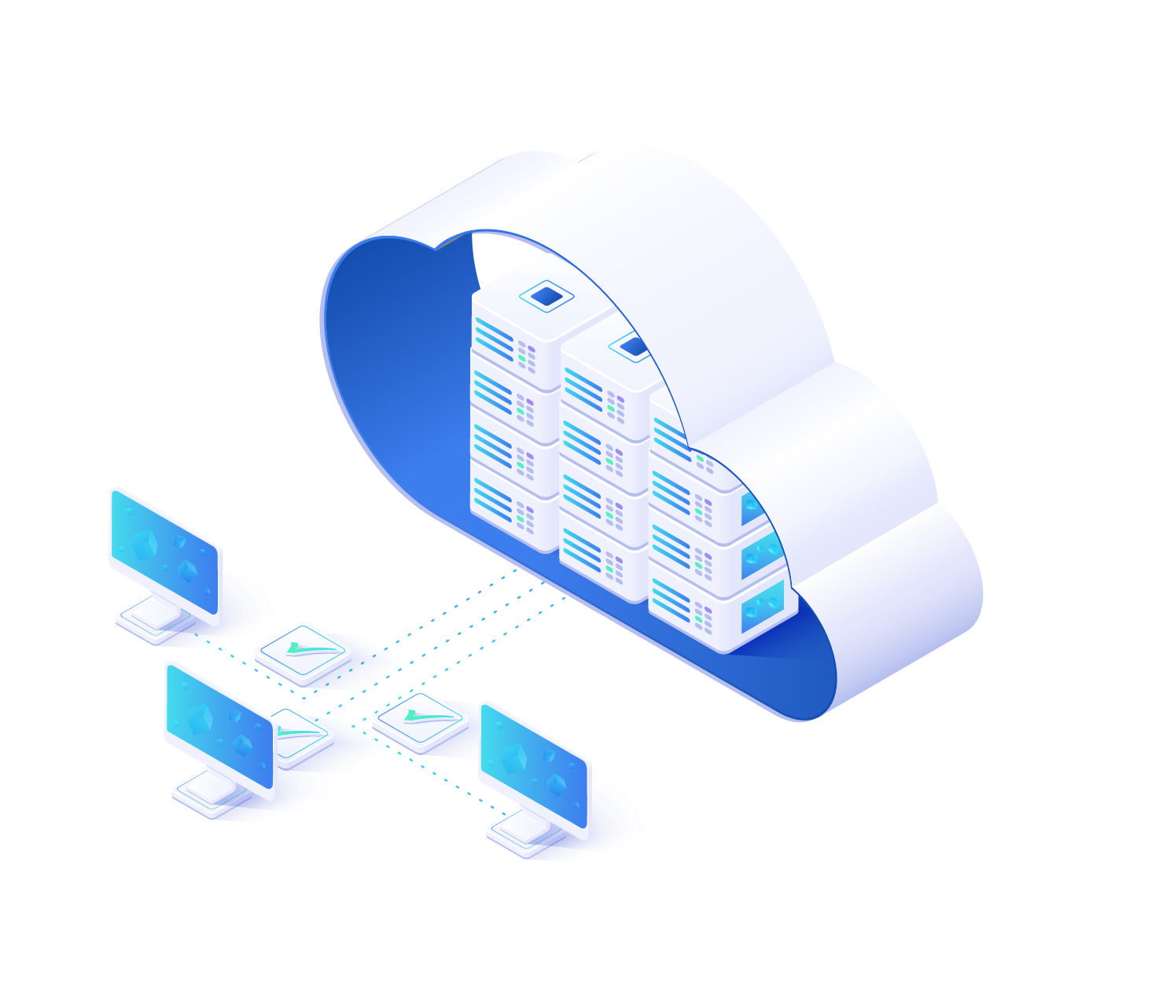
Cloud is a Vehicle for Next Generation Digital Business
“By 2021, over 75% of midsize and large organizations will have adopted a multicloud and/or hybrid IT strategy."
—— Gartner
Notes:
Secure and reliable running of Digital business need a trusted infrastructure, Gartner predicts ,by 2021, over 75% of mid and larger customer will have adpoted a multicloud or Hybrid IT strategy to drive digitalization.
Cloud has been rapidly evolving from a market disruptor and innovator to an expected approach for traditional and next-generation IT.
However, most organizations do not have the skills to make an extensive move to cloud on their own, nor do they have in-house resources to effectively manage an increasingly complex IT environment. As a result, many organizations are turning to service providers, both for their initial move to the cloud, but also as they seek to outsource management of their infrastructure.
60% of organizations will use an external service provider’s cloud managed service offering, up from 30% in 2018

Slide 4
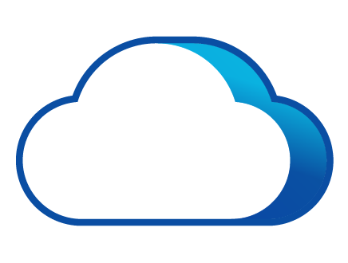
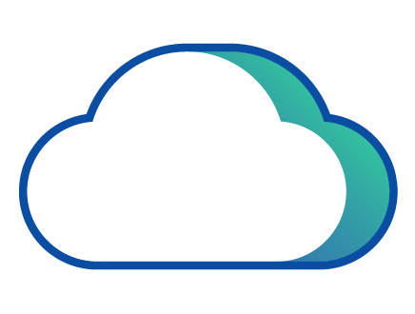
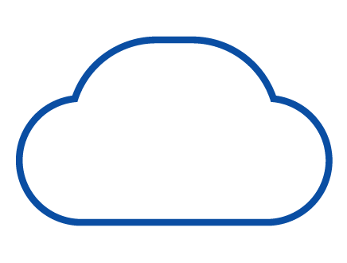
Common Types of Cloud IaaS Service
Customer Datacenter
Cloud Provider Datacenter
Managed Cloud Service
Hybrid Infra
(HCI/VMware)
Private Cloud
Dedicated Managed Private Cloud
On-demand Managed Private Cloud
Public Cloud
Aws, Azure
Dedicated/Single-Tenant Delivery Platform
Shared / Multi-Tenant Deliver Platform
Hybrid Cloud
Notes:
Today, There are three mainstream cloud services: on-premise private cloud, Public cloud , Managed cloud , and each of them have some sub-categories

Slide 5
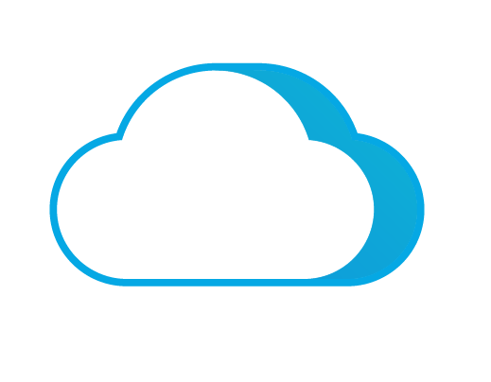
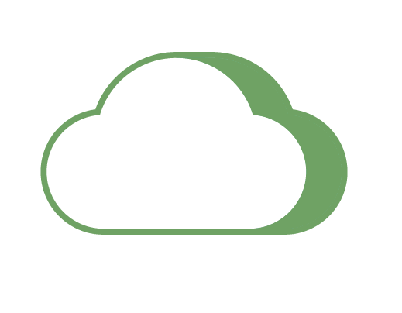


Comparison of Three Mainstream Cloud Service
Private
Cloud
Managed
Cloud
Public
Cloud
Sensitive Applications
Hosted Sensitive
Applications
Internet Business
Customer DC
Provide DC
Self Operated
Service Provider Operated
Service Provider Operated
Self Operated
Shared Resource
Product Delivery
Service Delivery
High Cost
Complicated
Dedicated
Secure
SLA
Service
Flexible
Pay-as-Needed
Reliable
Logic Isolation
Flexible
Long Cycle
Limited Space
Data Risk
Pay-as-Needed
Private
Inflexible
Managed
Limited Service
Public
Have Both
Notes:
Let’s briefly introduce the advs and disadvs of three common cloud service for the customers.
Private cloud : Security ,controllable and reliable ,however it's pretty complicated and come at a high cost of investment in technologies and people.
Public cloud: Elastic, Pay-as your need ,access in anywhere ,however ,they have limited service, lacking control and high cost in long-term
Managed cloud service : Have the best of both worlds. For the customers, they get their dedicated cloud. It’s in region. MY or Indonesia data does not go to Singapore. Meanwhile, customer can subscribe to the cloud; don’t need heavy investment in both hardware, software and expertise.

Slide 6
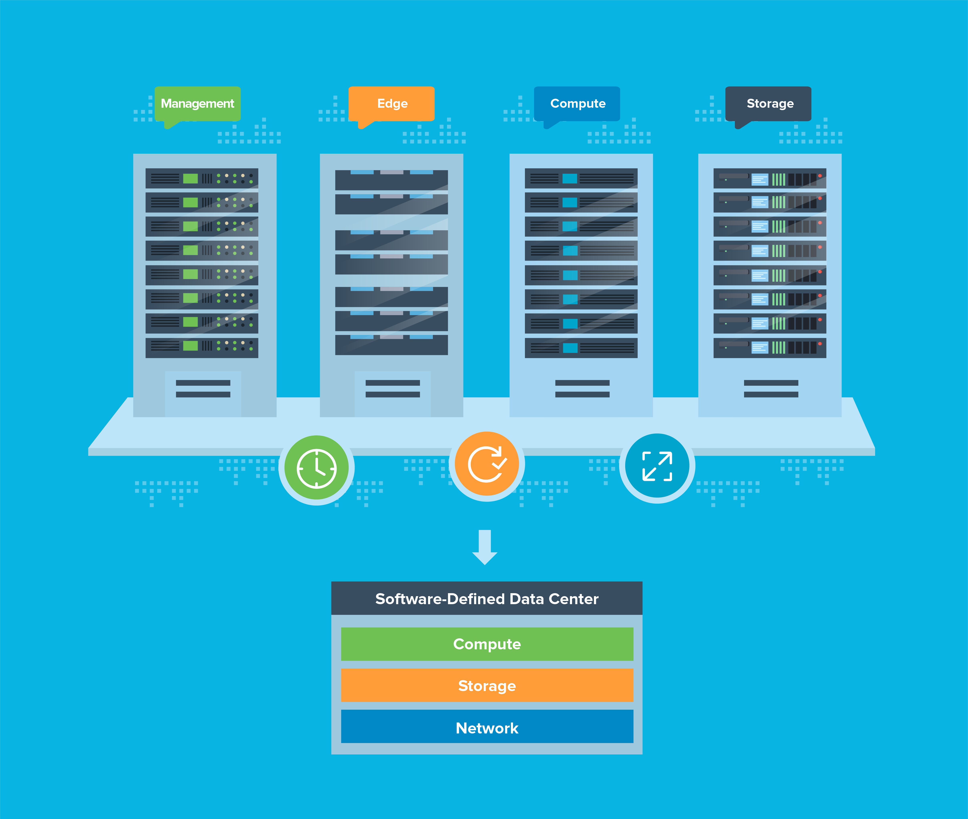
HCI-Based SDDC most Popular Solution
for On-Premise Private Cloud Data Center
Reliability & Agility
Reduced CAPEX
by 46%
Reduced OPEX and
productivity improved by 58%
Notes:
While expensive, private cloud gives organizations the best control.
Most organizations have their own data center today and would like to optimize or upgrade it to private cloud. From the best practice view, HCI based SDDC is the most popular and preferred technical solution by its Agility and superior TCO
one of the biggest changes of HCI is using far less number of servers to achieve the same jobs. Customers who have moved into HCI based data center managed to reduce their CAPEX by 46%;
in addition, HCI based SDDC puts all the daily infrastructure operation into an easy to use dashboard, and reduce OPEX by 58%

Slide 7
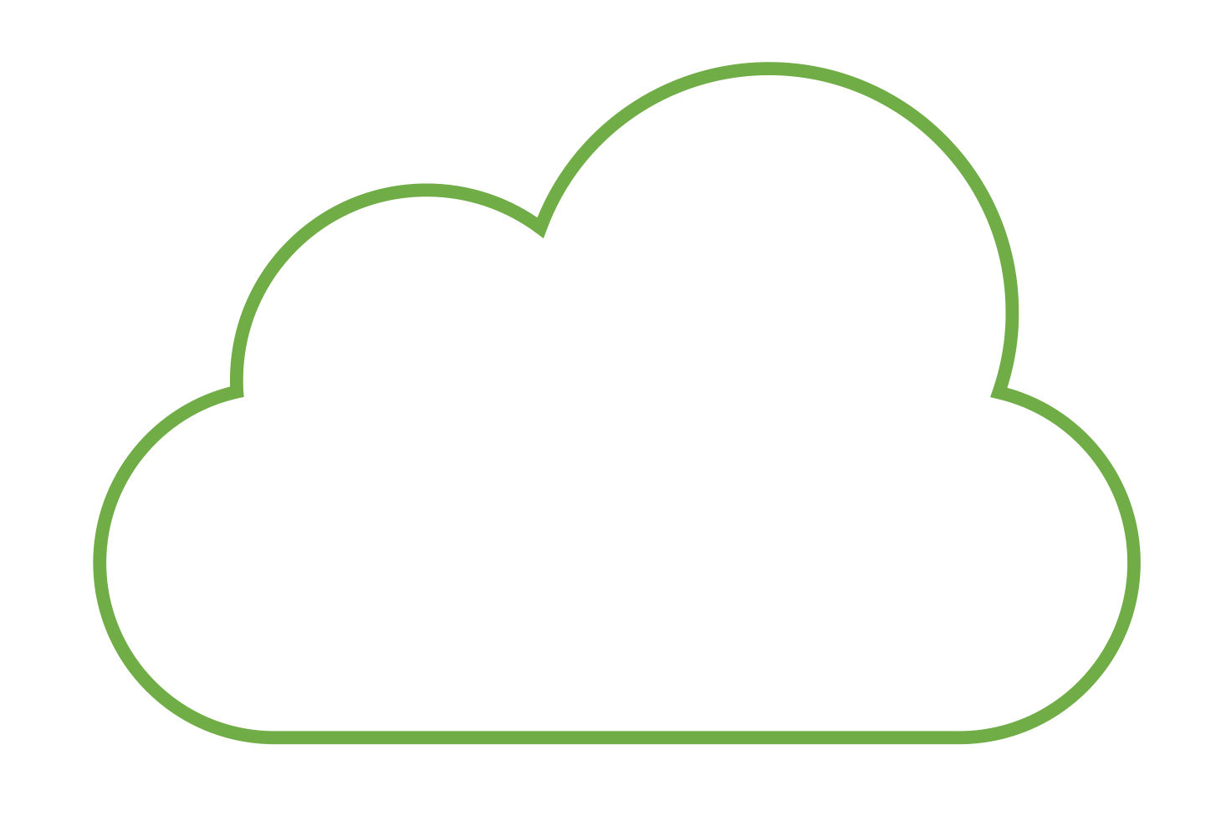
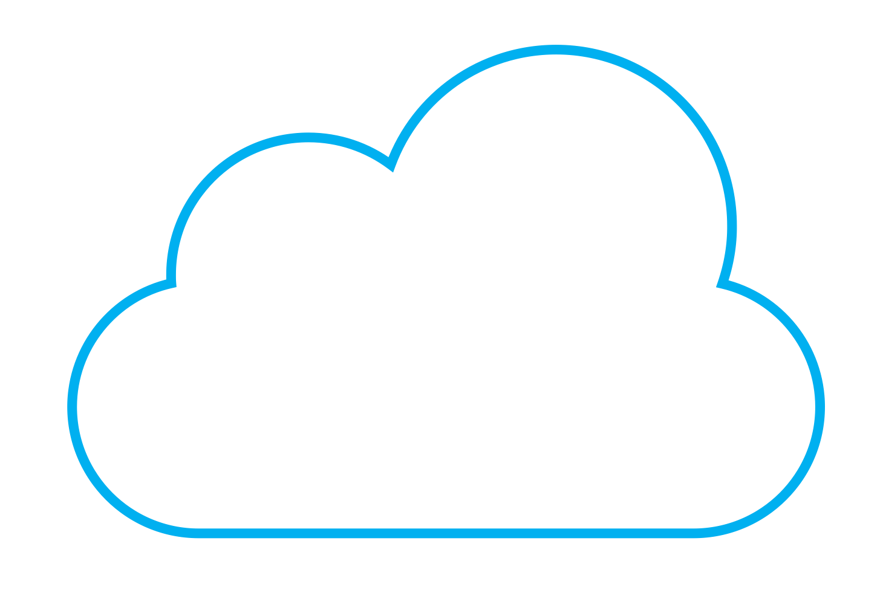



SDDC Solution Advantages
Private Cloud
Hybrid Cloud
Public Cloud
Seamlessly extend your data
center to the public cloud
Software-Defined Data Center
Virtualize the entire data center
Storage and Availability
Compute
Network and Security
SDDC focuses on transformation of traditional data center and provides easy connection to the Cloud.
Notes:
In addition, not only SDDC helps customer to upgrade their existing DC to private cloud, but also offers smooth connection to hybrid cloud

Slide 8
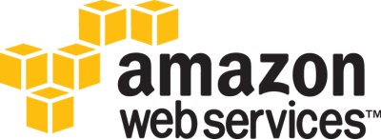
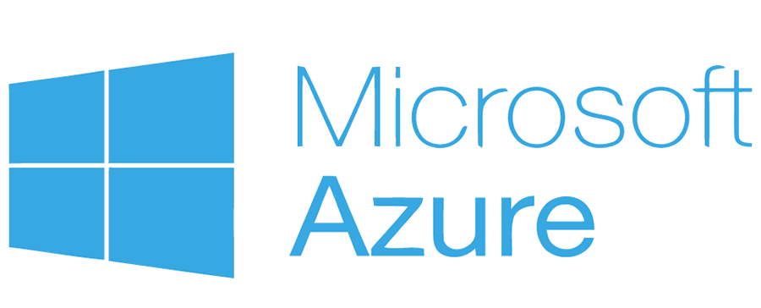









Public Cloud Use Cases
Public Cloud
Web hosting on the cloud
Web developing and QA testing
Global interactive application
Spikes and drops in traffic（games/shopping/media)
Cloud-native application
Data archiving
Security Access and authentication service
Communication and social networking
Notes:
Pubic loud addresses the shortage of private cloud in agility and performance.
Top use cases for public cloud are:
Web, Mobility, collaboration, video conferencing, scale out applications. DR

Slide 9
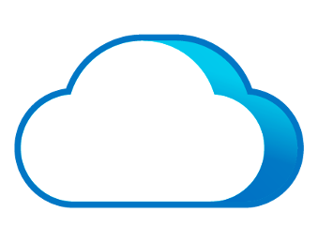
Public Cloud Not Suited for Every Scenario
Security and Compliance
Sensitive applications and data have strong security and compliance requirements.
High Performance
Apps require high performance with low latency ( DB, HIS, MES, PACS).
Legacy Applications
Public Cloud
Lack of high reliability and difficulty migrating to public cloud.
Fast and Customized SLA
Unsuited
Fast and high-quality service response including DR, application and data migration and security services (DR).
Cost
Goes well beyond expectations as business grows.
Notes:
However, in the true word there are still have some business scenarios and requirements can't be well satisfied by public cloud ,such as
in some countries, the sensitive data is not allowed to leave their country due to compliance,
other example is some apps need to exchange data and get access with a low latency,
some legacy applications that difficult to migrate to public cloud,
they need to have a good onsite service support and guarantee
cost of public cloud can be significant if the data is predictable. Funding-model or accounting constraints, such as an inability to shift from capital expenditures (CAPEX) to operational expenditures (OPEX), can be a factor encouraging private cloud use.

Slide 10







Managed Cloud Services Emerge
Low Cost
Flexibility
Managed cloud service gives customers the convenience and flexibility of a public cloud, with the security, control and professional service of a private cloud, making it the best cloud service approach for most SME customers.
Productivity
Collaboration
Cloud
Managed Services
Security
Software
Update
Data Lost Prevention
Mobility
Notes:
Hence ,the Managed cloud service are emerging , Managed cloud service allow customer to experience the connivence and flexibility of a public cloud, as well as the security , control and professional service of private cloud at the same time
It’s the best cloud service approach for most SME level customer

Slide 11
Managed Cloud Services: Primary and Secondary Market
Secondary Markets
Primary Markets
Application Management (ADM)
Managed Public Cloud
Managed laaS
Managed SaaS
Application management (ADM)
Managed Cloud
Services
Managed Private Cloud
(on-premise or hosted)
Managed laaS
Managed SaaS
Managed
Hybrid
Hybrid IT
Hybrid Cloud
Source: IDC, 2019
Notes:
By definition, managed cloud service consist of 3 market segments. Managed public cloud ,Managed private cloud and Managed Hybrid,
Managed Public Cloud: Azuer/AWS/Google
Managed Private: local DC, service providers. NTT.
Managed private cloud including on-premise data center in customer side and hosted in service provider
And based on it ,Service provider can offer different level service such as Application management ,PaaS service as well as IaaaS
Hybrid: Rackspace. Cloud Infrastructure.

Slide 12
Managed Cloud Service Market Size
Total Market size：
83B+
Growth Rate:
50%+
Notes:
From the IDC data analysis
By 2023 the total market size of managed cloud service over 83B+,The growth rate more than 50%+
Managed private cloud and Hybrid service dominate the major market
Public cloud is controlled by a few.
The biggest potential is private cloud and hybrid services.
Private cloud providers are very fragmented.
Hybrid service: has the highest technical requirement.
Hybrid IT, defined as the “blending of traditional services, public cloud services and private cloud services into a singular IT environment,” will dominate the IT landscape

Slide 13
Managed Cloud Service Market Size
Growth rate
41%
Americas
100%
27%
APAC
EMEA
Notes:
From the regions distribution: Americas market are really mature ,APAC and EMEA are raising quickly ,in APAC market ,the total market size is over 26B+

Slide 14
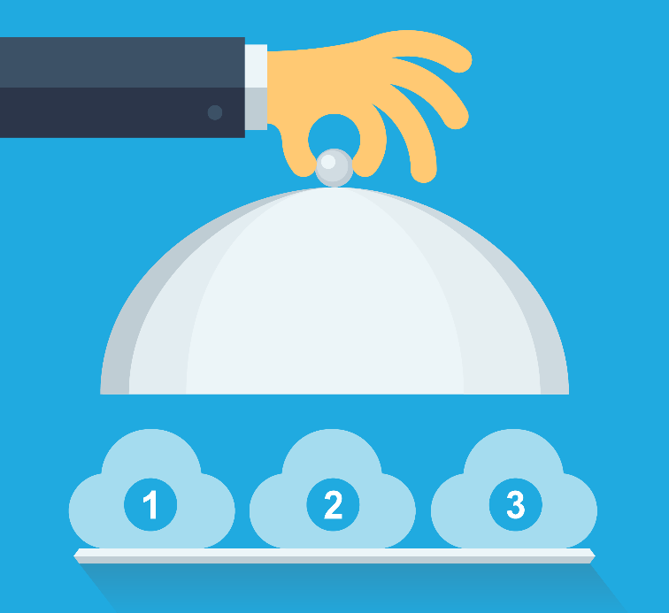


It's Time for Change: Move to Managed Cloud Service Now!
Offer Cloud Services
Retain Customers
Improve Competitiveness
Notes:
Business transformation is happening to our customers. As a service provider or technology partner, we should transform ourselves by offering cloud series. This would enable, retention more customers, improve your business competiveness, create add-values service, and increase revenue.

Slide 15

Challenges for MCP Transformation
Steep Learning Curve for Cloud
High Cost
Using cloud technologies・
Provide cloud service・
Manage different cloud–based solution・
・ Have an owner cloud infrastructure
・ Building a cloud technical and service team
・ Marketing promotion
Deliver Professional Services
Lack of Cloud Branding
・ Application migration
・ Management workloads
・ Operation lifecycle
・ Professional service
Building Business difference・
Execute GTM strategy ・
Design services ・
Notes:
Become a service provider actually is not a easy, for most partners, they just want to have a cloud service to delivery their customer rather than have their own data center.
Here are the top challenges to become a managed cloud provider.
1. Steep learning Curve for Cloud.
Many of partners might focused on SI. Was not an expert providing cloud services.
One of our partners built a 20 people team, developed based on openstack. After 2 years. Give up.
2. Lack cloud branding. How do you compete against AWS or your local SP?
3. Significant investment: data center infrastructure. A team of technical and service experts. Marketing cost.
4. Deliver Professional Services.
Partners used to focus on reactive service. Used to focus on product related services. Such as providing a report, or upgrade firmware.
Now the services is turning into professional and proactive. Such as application migration. Data backup. These are closer to customer’s business; not products. The good news is that customers are willing to pay for a much higher premium for these services; the challenges is that partners don’t have these expertise.

Slide 16







Sangfor's Flexible Managed cloud Service Busines Model
Sangfor Managed Cloud Service (SMCS)
Option 1: Build your Own Cloud
  Partners to build, operate and collect revenue; Sangfor to provide underlining technology
Option 2: Joint Investment
  shared operation, revenue sharing
Provider A
Provider B
Provider C
Local cloud data center in ID
Local cloud data center in MY
Local cloud data center in EMEA
Global Distributed Cloud Site
Sangfor Unified Service Platform
Migration & Backup
Automation
Fix & Recovery
Technical expert team (HQ + Local)
Notes:
As a leading security and cloud technical and solution provider, Sangfor have introduced a brand new managed cloud service program to allow partner leverage Sangfor cloud solution …......
First: if a partner/provider has their own data center, they can buy the software from Sangfor. Sangfor is a technology and service provider to the partners. You are responsible for the selling and operation of your own services. Sangfor provides the underlining technology, upgrades and support for you.
Second: service is based on a joint investment from Sangfor and partners, where we jointly share both the cost of investment, share operation, and sharing of the revenue. the benefit is lower initial investment, you don’t need to invest in higher technology (people), and Sangfor can help with sales and marketing.
This model has been operating in China for some years now, getting a lot of success. We are now taking it to the international audience.

Slide 17
Top Use Cases For Managed Private Cloud
Hosting a data center enables IT to focus on business innovation
Offering the best service and performance improvement
Protect and restore on-premise critical data with managed cloud
Hosting service for customer on-premise data center
Managed
Private Cloud
Managed Critical
Application
Backup-as-a-Service
On-Premise Data Center
Service Hosting
PART 1
PART 2
PART 3
PART 4
Notes:
There are plenty of use cases we can pitch to our customers together. Here are the top use case recommendation for sangfor Manged cloud service
1) Customer is to build a new data center for a new application or a new location.
2) Customers would like to move a critical application to public cloud. However, concerned about security and serviceability.
3) Back up as a service is a very common service.
4) Help customers to manage their own data center.

Slide 18
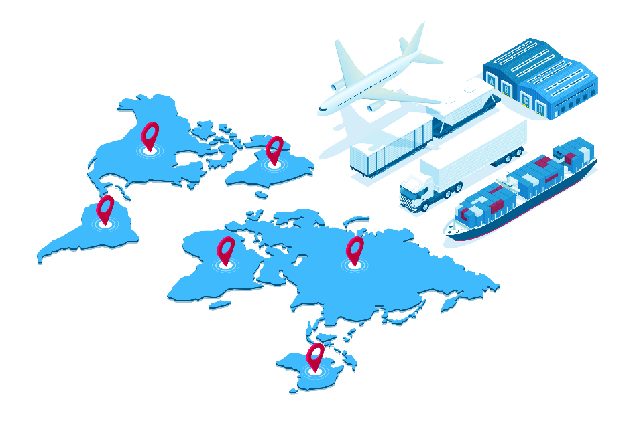
Business intention:
Developing E-commerce
Offering uninterrupted Global internet business and service
Achieve Light-assets target for IT team
Challenges facing
High subscription cost for web business on public cloud
CRM and Raw materials are sensentive datas and don't allowed to run in public cloud
Limted IT resource and skills and are not able to provide the best techncial service and busiess guarantee
Solution
Selected Sangfor manged dedicated cloud service to touch their requirments
Have the best TCO and service support (60% less compare to public cloud)
Better to meet the internal secuirty compliance( data secure and controlable)
An international manufacturing
Business selling more than 23 countries
Over 5 raw material manufacturing centers
Notes:
Let’s take a look at one customer who has made this transformation.
The customer is a leader in health supplements. Their products are sold globally, and they source their ingredients from 23 countries. They are also one of the first ones to invite a concept of “transparent factories”, where customers and partners are invited to see every step of their food processing.
A key strategic goal in recent years is to promote ecommerce, develop a manufacturing process that is highly available. For IT, not only it needs to support these initiatives, IT are given little capitals and human resources.
They have evaluated public cloud as the first option. Since they have many business operations across 23 different countries, and most countries requires data residency, having their business scattered across public cloud does not make it compliant. It is also expensive.

Slide 19
THANK YOU
www.sangfor.com
Sangfor Technologies Inc.

