Slide 1


Sangfor IAG
Unparallel Visibility and Control
May 2021
Eugene Yew
Product Marketing Manager for IAG & Sangfor Access
www.sangfor.com
Sangfor Technologies Inc.

Slide 2
Contents
PART
1
PART
2
PART
3
PART
4
Challenges
Sangfor Approach
New Pricing Bundle
Conclusion

Slide 3
PART 1
Challenges

Slide 4



Challenges - Facts
90% of web traffic is encrypted
Encryption = Danger
Data Exfiltration
Malware infections and malicious content infiltration
Undetected
Threats
Confidential data and intellectual property exposed
Notes:
90% encrypted based on latest google transparency report
Enjoy privacy but this introduce another problem where organization cannot see what is running i.e productivity, unnecessary applications and etc. However, this inevitably creates a blind spot in the corporate defences when security applications fail to detect malware disguised as secured packets.
3. Web-based emails and file sharing services have default encryption settings, which means that insiders can discreetly send sensitive data and files outside of the organisation without being detected.
Being Ironic, while employees are the greatest asset in any organisation, they can also be the biggest threat

Slide 5

Challenges – Visibility for SSL
More enterprise traffic is being encrypted
Productivity issues
C&C Attacks
80% performance degradation of security appliances due to SSL
33% of malware uses encryption
Notes:
Productivity such as O365, Google apps, Salesforce and moving to SAAS.
Productivity - Improves workforce performance but introduce lack of visibility
- 80% performance degradation due to SSL from nsslabs
33% malware uses encryption based on Gigamon.
Malware such as Robbinhood causing 13 bitcoins about USD 100K. The creator of ransomware even offer to decrypt 3 files for free to show their sincerity.

Slide 6


Challenges – With/Without SSL Decryption
Comparison
Useful, but not good enough
IP Address
Traffic Identification
Bandwidth
Hidden Threats
Audit
Internet Activities
Almost 65% important encrypted traffic passes through
Data Type
Applications
File Type
Notes:
From the previous use case for both with and without SSL Decryption, we can see what sort of information and protection presence in practical environment.

Slide 7

Challenges – Common Pain Points
Application Identification
WHAT?
User Identity and Endpoint
Traffic Usage
WHO?
HOW?
Notes:
Who is the authorized/illegal user/endpoint
What application being used, website, local installed applications. More importantly, is that productivity work or accidental incident for malicious contents
How this traffic being used via encrypted traffic i.e streaming, download, tor, conference and etc

Slide 8
PART 2
Sangfor Approach

Slide 9



Sangfor Approach - Concepts
Visibility - Uncover any passing traffic
Identity - User Identity
Control - Application, bandwidth, audit and other security content aspects
Analytics - Holistic view of logs and reporting
Visibility
IAG
Control
Identity
Analytics

Slide 10

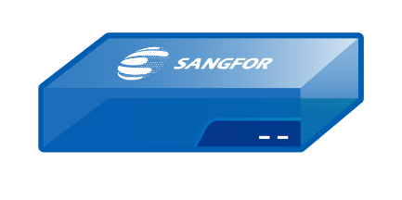


Sangfor Approach – Visibility
(SSL Decryption Performance)
80%
IAG performance degradation reduction
20%
IAG performance degradation reduction
80%
20%

Slide 11
Sangfor Approach – Visibility
(Client Decryption working principle)
1-2: SSL Proxy to Perform PKI and symmetric key encryption / decryption. 80% performance impact
IAG
2
1
Internet
Client
Man-in-the-middle
Server
Ingress Client to perform PKI and encryption.
Private key is shared with IAG
IAG only need to decrypt. 20% perf impact
Symm Key Shared with IAM
1
IAG
2
Internet
Sangfor
Ingress
Client
Client
Server

Slide 12
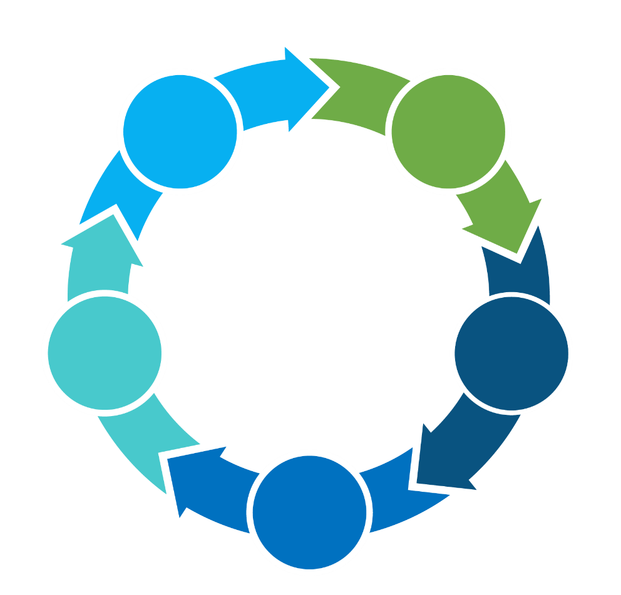
Sangfor Approach – Visibility
(SSL Decryption Benefits)
Certification distribution
Supports all deployment modes
01
02
Ingress Client
Support TLS 1.3
05
03
Uncloak hidden applications
04
Small footprint: Average CPU 5%
Notes:
TLS
Symantec, McAfee and Fortinet support TLS 1.3
Based on shodan.io, 1.5 million websites uses TLS 1.3. Big CDN take up from Akamai, Cloudflare and Incapsula
Like Barracuda WAF support TLS 1.3, it does not support within their WSG product line

Slide 13


Sangfor Approach – Visibility (Asset Management)
Endpoint Discovery
Asset Management
Endpoint Classification
Endpoint Check

Slide 14

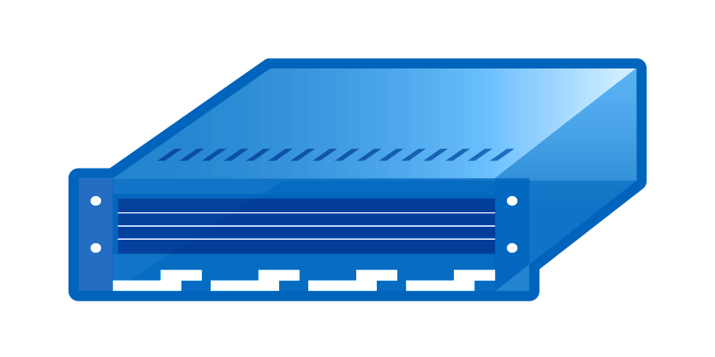
Asset Discovery Methodology Selection
(Asset Management)
Agent-based asset discovery
Agentless-based asset discovery
API-based asset discovery
Pros
Granular control
Run locally without credential
Pros
No software
Low maintenance
No vendor lock-in
Pros
No impact on environment
Seamless data aggregation
Cons
Users resistance to install
Unsupported due to variety of OS involved
Cons
False positive detection
Intensive scanning
Cons
Script customization
Some are proprietary and open

Slide 15
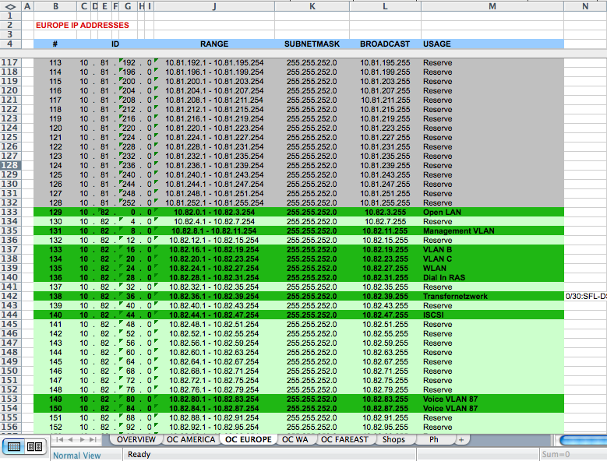
Excel VS Asset Discovery (Asset Management)
Excel inventory update is not part of asset discovery solution
Manual processes
Labour intensive
Unable to keep up with constant changes
Error prone

Slide 16


Sangfor Approach – Visibility (Endpoint Check)
+
Endpoint Check
(Ingress Client)
Antivirus Check
(Traffic Based)
Benefits
Reduce attack surface
Identify rogue device
Endpoint Telemetry
Single vendor with unified management
Benefits
Identify and implement access control
Less intrusive with fast remediation
Enforce compliance

Slide 17
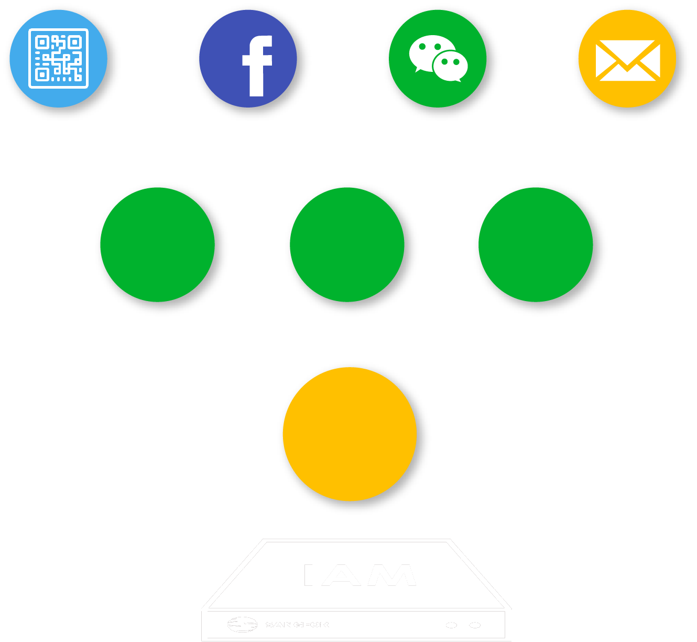


Sangfor Approach – Identity
User Identity
Authentication method
Policies based on identity
Rogue users and innocent victims
3^{rd.} Party Server
SSO
Self-
Register
AD SSO
Portal
Auth.

Slide 18
Sangfor Approach – Control (Application Control)
01
02
03
Applications
Local Installed Applications
Proxy Avoidance
Google, Facebook, Youtube, O365
Freegate, Ultrasurf, Xunlei
Dropbox, Teamviewer, QQ, SecureCRT

Slide 19











Sangfor Approach – Control (Shadow IT)
SaaS Analysis
Policy Enforcement
Not allowed in company
Status: Unsanctioned
Block Apps
Sanctioned and Unsanctioned Apps
Determine security risks
Policy Control and Blocking
Setup control policy and block this app if require
Account Control
Analysis
Evaluation
Discovery
Status: New
Application Control
Allowed in company
Status: Sanctioned
Content identification

Slide 20

Sangfor Approach – Control
(Bandwidth Management)
Intelligent P2P Traffic Control
Control P2P traffic by restraining upload traffic
Dynamic Traffic Control
Allow idle bandwidth occupy by limited channel to improve experience
Granular Quota Control
Daily and monthly traffic quota

Slide 21

Sangfor Approach – Control (Content Audit)
Monitor user internet activities
Prevent abuse of data
Exclude banking transaction and payment
Achieve organizational compliance

Slide 22
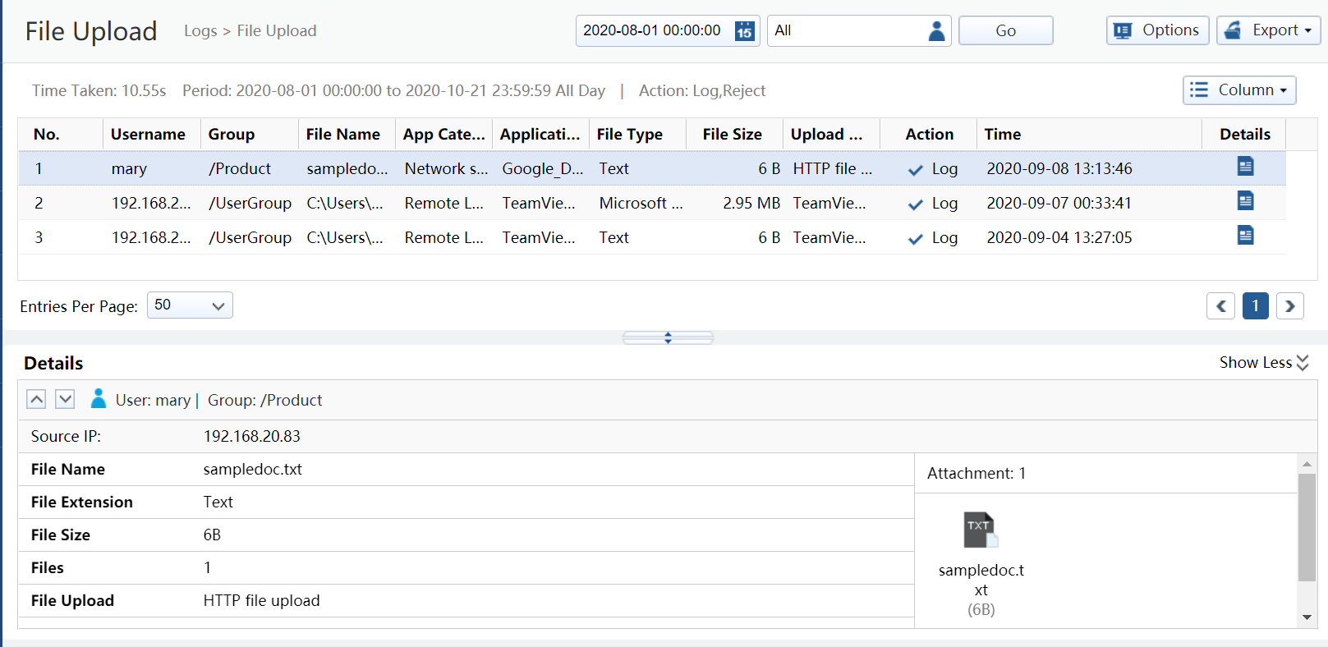
Sangfor Approach – Analytics
Report Center
Compliance
AUP Violation
User Investigation

Slide 23
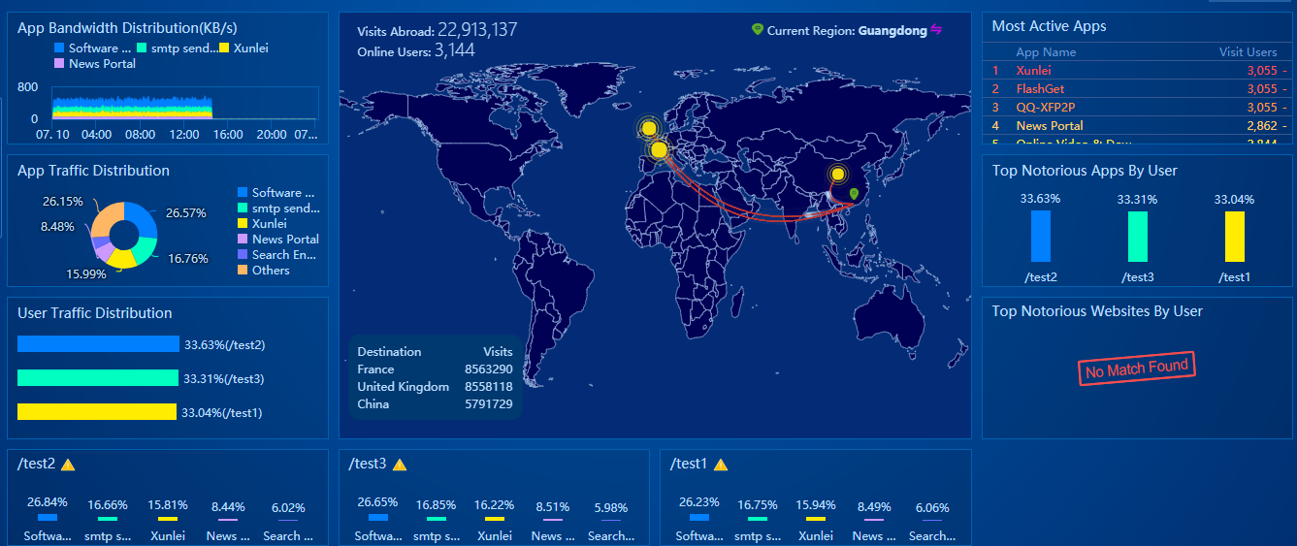
Sangfor Approach – Analytics
Business Intelligence
Single Pane of Glass
Overall Assessment

Slide 24




















Sangfor IAG – Synergy with Endpoint Secure
User: Authentication
Access: Authorization
VDI
OS：Win10
Process: Running
File: Does Not Exist
SCANNING…
Service Pack: Installed

Slide 25















Sangfor IAG – XDDR Synergy
Sangfor Access
Security Infrastructure
NGAF
IAG
NGAF
IAG
Public/Private HCI
Authentication
/Authorization
Access
Control/DLP
IAG
SWG/CASB
ES
Cloud/SaaS
IAG
Coordinated
Response
Access
Control/DLP
Remote
SSL VPN
ES
SSL VPN
ES
SSL VPN
ES

Slide 26

Sangfor Approach – Case Study
Pain Points
Sangfor IAG Solution
Bandwidth Exhaustion
Lack of visibility
Application identification & Control
Dynamic Bandwidth Management
Application Control
Granular Reporting
Secure Internet access
UMW

Slide 27

Sangfor Approach – Case Study
Pain Points
Sangfor IAG Solution
Inability to trace user identity
Bandwidth Exhaustion
Single point of failure
SSO
Dynamic Bandwidth Management
Granular Reporting
High Availability
Secure Internet access
Crown Property Bureau

Slide 28
PART 3
New Pricing Bundle

Slide 29

New Pricing Bundle
Reduced complexity of license
selection
More appealing and better pricing
Better pricing competitiveness

Slide 30
New Pricing Bundle
Essential Bundle
Premium Bundle
50%
70%
Hardware
Hardware
Anti-Malware Protection (Known & Unknown)
Basic SWG with URL filtering

Slide 31

New Pricing Bundle - Breakdown
 | Essential | Premium
Bandwidth Management
User Authentication
Traffic Control
Content Audit
Proxy Avoidance
Endpoints Management
Report Center
Link Load Balance
Support Services
Sangfor URL Database
Anti Malware (Engine Zero)
Threat Intelligence (Neural-X)

Slide 32
PART 4
Conclusion

Slide 33
Conclusion – Key Takeaways
01
02
03
Gain Visibility and Control over your network
Proactive rather than reactive security approach
Empower your network with continuous monitoring and protection

Slide 34
THANK YOU
Eugene Yew
Product Marketing Manager IAG & Sangfor Access
Sangfor Technologies
eugene.yew@sangfor.com
www.sangfor.com
Sangfor Technologies Inc.

