Slide 1


Breakthrough larger-named customer in Hospital
Ratsakan Srisawat
Product Manager
Cloud BG, Sangfor Technologies Inc.
2020.10.27

Slide 2

Agenda
Challenge faced with Healthcare customer
Industry Development Process
Gain the larger customer and bigger Healthcare Portfolio

Slide 3
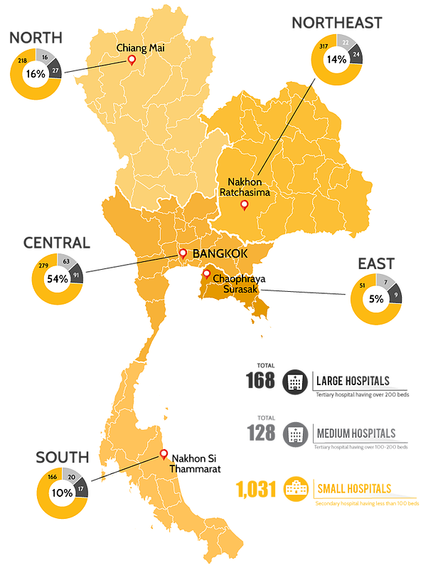
Healthcare Market Structure in Thailand
Super Tertiary Care - 23 Hospitals
  These hospitals are equipped with the best resources in Thailand considering they are medical schools for teaching and research
Tertiary Care - 34 Hospital
  More than 500 bed
  Serve as Regional hospital (Category A)
Secondary Care - 86 Hospital
  More than 120-500 bed
  Serve as General / Provincial hospital (Category S & M2)
Primary Care – 723 Hospital
  More than 120-500 bed
  Serve as community hospital (Category M2, F1, F2 & F3)
Nongkhai Hospital - 200 Bed
Thanksin Hospital - 200 Bed

Slide 4
Opportunities and Development Timeline
Healthcare Opportunities (Low success)
Work with ISV
Investigate Customer
Gain more Healthcare customer and larger size
June 20
July 2020
Q4 2019 – Q1 2020
Covid Pandemic
Q1 2020
Dec 2020

Slide 5
Research the market – HIS Vendor
Vendor | Website | Main Customer
HOSxP | https://hosxp.net | Most of Public Hospital, Nongkhai Hospital
Hospital OS | http://www.hospital-os.com | A few hospital
iMed | http://www.intermedisoft.com | Bangpakok 9, Piyavatm, BDMS Chain in South Area
Centrix | http://www.humancentric.co.th | A Few hospital
Mor Corporation | https://www.mor.company | Ramathibordi
SSB | http://www.ssb.co.th | Kasemrad Group, Pranangklao
MSE | http://mse-th.com | Thonburi Group, Thaksin Hospital
Abstract | https://www.abstract.co.th | Hospital in Medical Service Department
Info-d HoMC | http://www.info-dsoftware.com | Public and Private Hospital
Reference https://rath.asia/2019/11/his-vendors-thailand

Slide 6

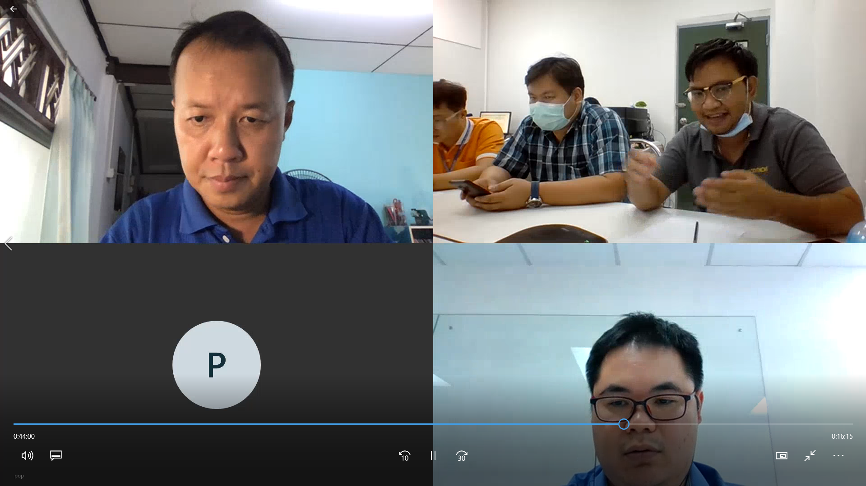
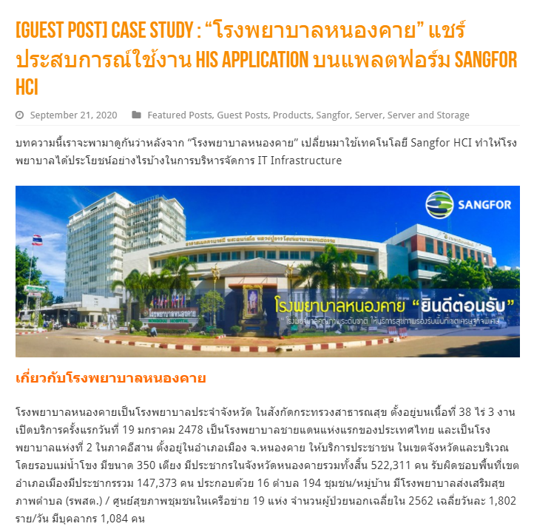
Nongkhai Hospital - Learning from Customer Experience & Sharing
HIS / Key Application | HOSxP v.3
Customer Challenge | HIS Application encounter slowness during OPD peak hour System ever take long time to recovery 10-12 hrs Monthly report (43 files) export taking long time 10 multiple hardware device in DC room while 3 IT support all
Sangfor Solution & Benefit | HCI 3 nodes run on SuperMicro deploy 2 yrs ago Improve HIS application performance (No complaint) and monthly report take 3 times faster Simplify IT operation, No downtime and flexible of hardware scaling
Reference https://www.techtalkthai.com/nongkhai-hospital-chooses-sangfor-hci-as-infrastructure

Slide 7

Phrachomklao Hospital – Expanding larger customer by story telling
Customer Size | Reginal Hospital – 550 Bed Tertiary Care Level
Key challenge | Build DC to support HOSxP (New HIS), the old one is slow and some function don’t support Ever encounter Ransomware issue System recovery taking long time
Business requirement | Simply IT operation as IT staff don’t have high skill Nutanix ever propose but cost is too high
Sponsorship | Partner relation
Solution | HCI 4 Nodes + CDP + NGAF + WAF ( 67K USD / 33K USD)
Visit Customer
Live Demo
Solution Design
Finish Project
Identify Requirement
Customer Reference
Simplify IT Operation
Match with HIS requirement
Security Improvement

Slide 8


Larger customer size with partners
Chulabhorn Hospital
Chulalongkorn Hospital
Customer Size | Super Tertiary Care – Cancer
Partner | Sysnect – (ISV – Education)
Solution | Extension to HIS application
Solution | HCI 4 Nodes (License only)
Expansion | Q3, 2021 – SCP + PaaS (8 License)
Customer Size | Super Tertiary Care – 1,500 Bed
Partner | Abstract (ISV – HIS)
Solution | Business Intelligence
Solution | HCI Dell 2 Nodes
Expansion | N/A

Slide 9
Healthcare Industry Result
2021 Pipeline
Kluaynamthai Hospital (General Private) 70K USD
Phrananklao Hospital (Tertiary Care) 18K USD
Nongkhai Hospital (Secondary Care) 15K USD
Phramongkutklao Hosital 10K USD

Slide 10



Key Takeaway & Lesson Learn
Talk the same language with customer
Expand your channel
Don’t stop your idea & thinking

Slide 11
Thank you
Ratsakan Srisawat
Product Manager
Cloud BG, Sangfor Technologies Inc.
2020.10.27

