Slide 1


MOSTI Project Sharing
HCI Solution
Keith Lee
Jeffrey Zhang
www.sangfor.com
Sangfor Technologies Inc.
PPT_Intro_20190227

Slide 2

Contents
1
PART
2
PART
3
PART
4
PART
5
PART
Opportunities
Key Job & Pain Points
How to influence?
Solution Proposal
Sangfor Value
Sangfor Technologies
CONFIDENTIAL
Page

Slide 3

01
Opportunities
MOSTI know as Ministry of Science, Technology and Innovation (MOSTI)

Slide 4
Opportunities
Existing Customer
NGAF User, so customer are familiar with us.
Technical Clarification
Bring customer to site references, show the case study, demo on the solution, POC
Partner Introduction
Partner bring us to meet with customer to talk on the ICT planning and HCI solution
Proposal Stages
Design the proposal together with customer to meet the expectation

Slide 5
02
Key Job & Pain Point

Slide 6
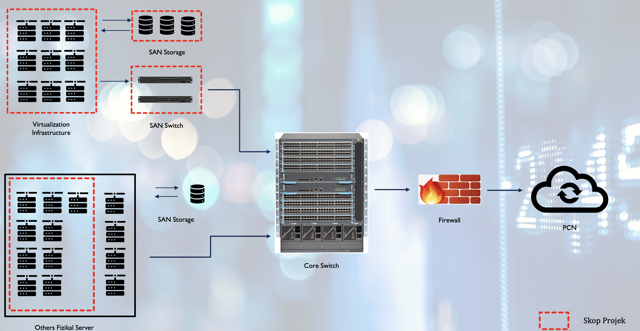
Key Job & Pain Points
Key Job
- IT manager F52 - Shamsul
KPI for IT manager was to upgrade legacy server and storage(Plan this project for 2 years already)
TCO: Leasing direction, due to pandemic most of project need to pay by subscription.
- IT officer F48 - Akmal
Project Quantity, Project timeline, Project Management, completion rate.(Audit will be involved evaluate)
Downtime SLA for the data center and application (Due to ‘eDana’ server has down 2 days before recovery)
Green Technology(Save electricity, space, utilization)
Pain points:
Out of dated technology
  All more than 5 years server
Enhance the infra and security ICT
  Vmware couldn’t upgrade(5.5/6.0) and no patch.
Lack of resources (human and IT)
  Only few IT member and storage is full
Green Technology
  Direction of company to reduce the hardware.
Enhance the MOSTI application performances
  9 server facing slowness issue.

Slide 7
03
How to Influence

Slide 8
How to influence Decision Maker
POC
Prove of concept to the client on the migration part and how to manage the infra.
References site
Tech
Share the existing gov case study and also attend our webinar or event.
Proposal
Work together with customer to design the proposal base on customer template.

Slide 9
How to influence Decision Maker
Providing ES free license to customer
Due to security team currently Anti-virus ESET expired on May 2020. That time is MCO in Malaysia. Customer asking Sangfor help if we can open license for them temporary using 3 Months
Political achievement
Before retirement the IT director – Shamsul wish to complete this project and have the political achievement for build up a platform for centralize.
Site Visit
Business
Bring customer to pay visit to MOHR(existing HCI customer using DC+DRC)
Centralize resources
Build the private cloud with MOSTI and share the resources to the Jabatan(Agency) under MOSTI
Commercial VS VMware
Apple to Apple compare the price with full set of vCenter+vSan, Sangfor cheaper more than 30%; at same time work with partner providing 5 years subscription cost.

Slide 10
04
Solution Proposal

Slide 11
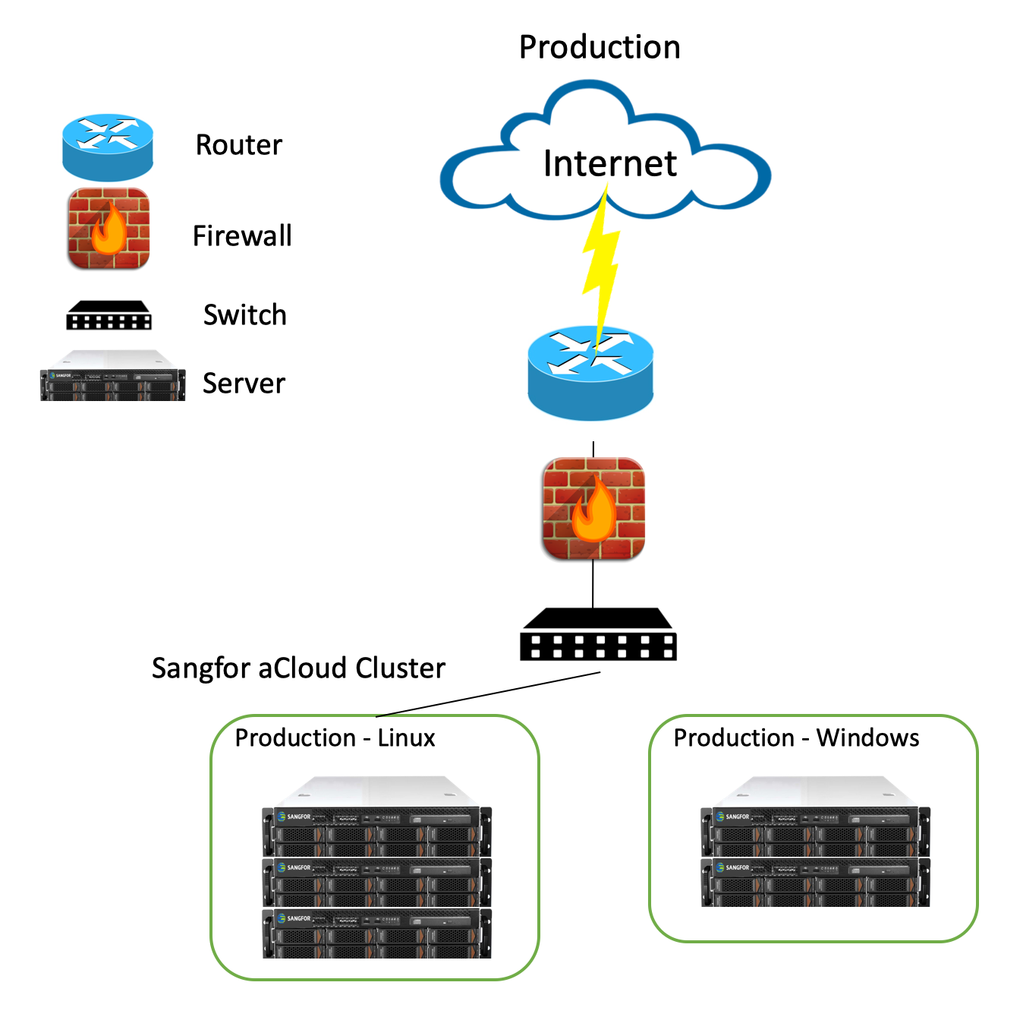
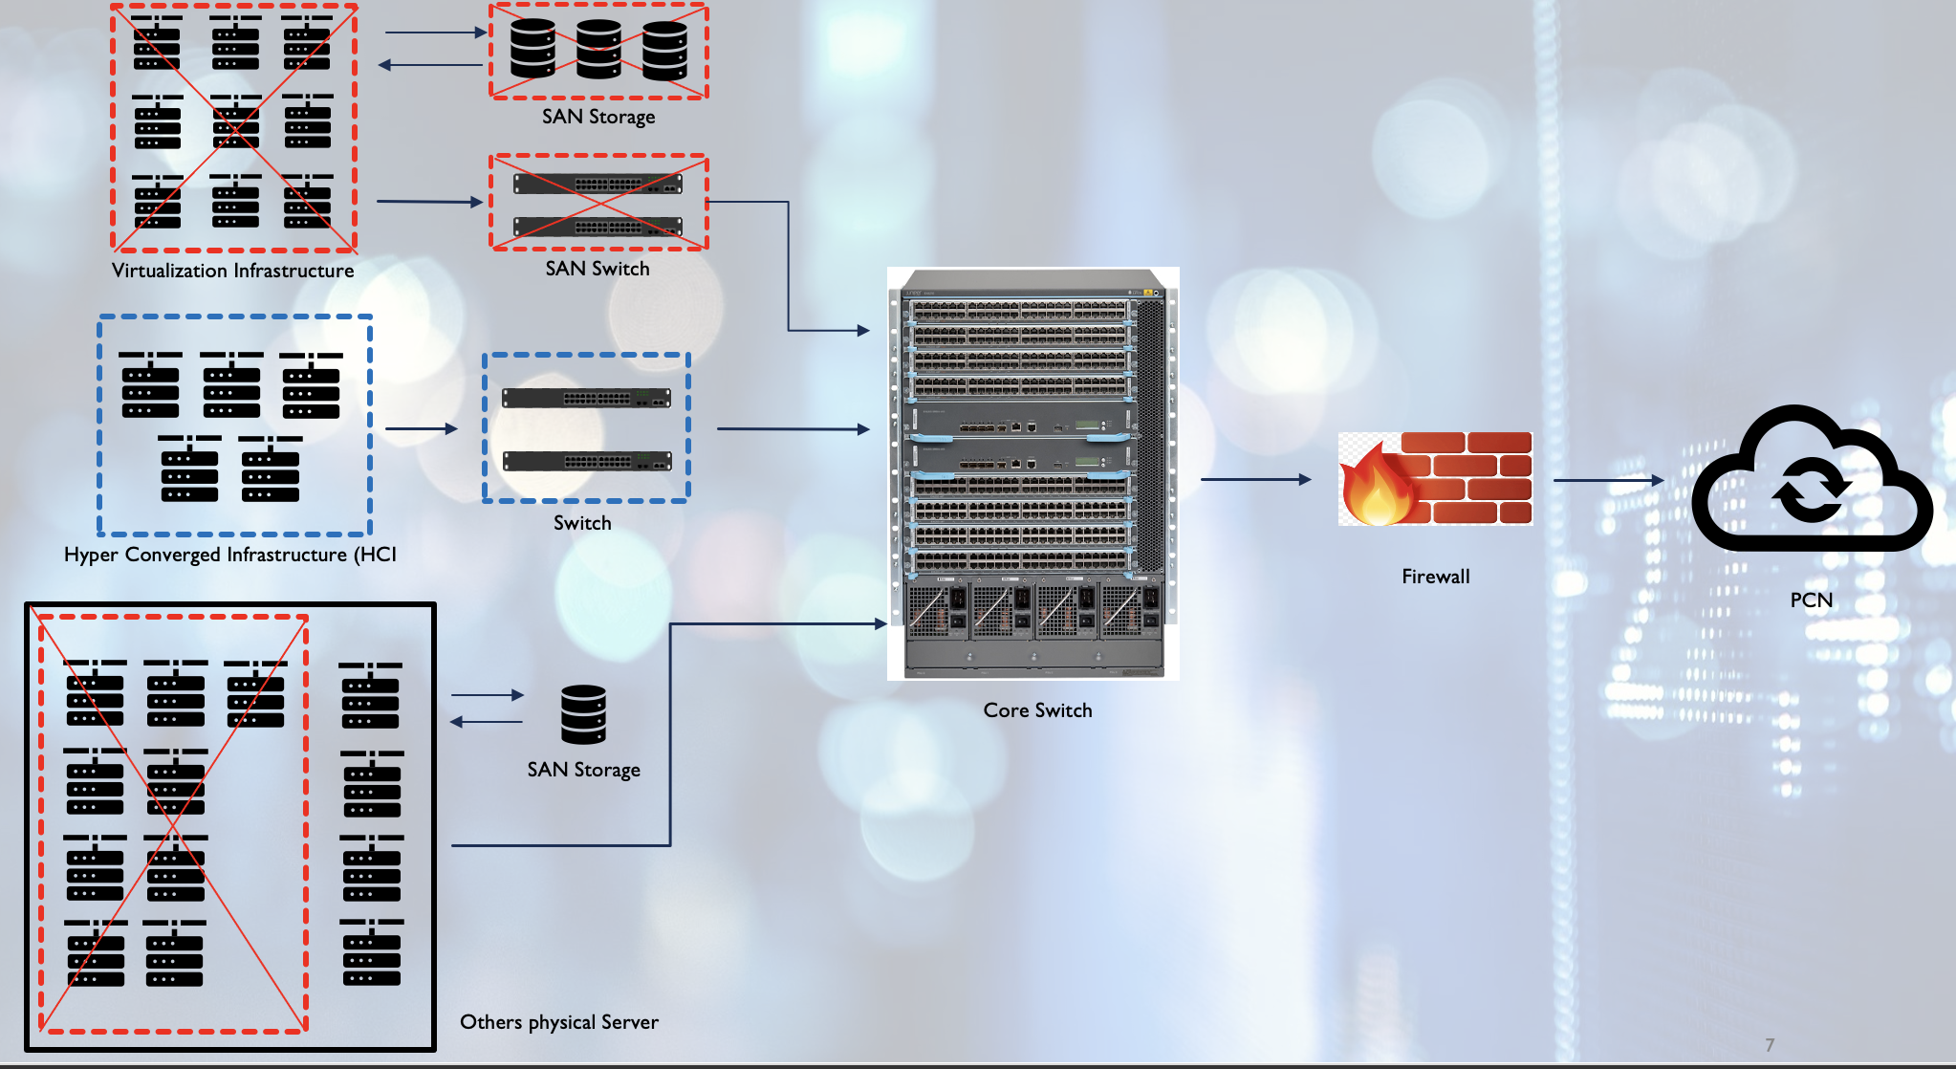
Solution Proposal

Slide 12
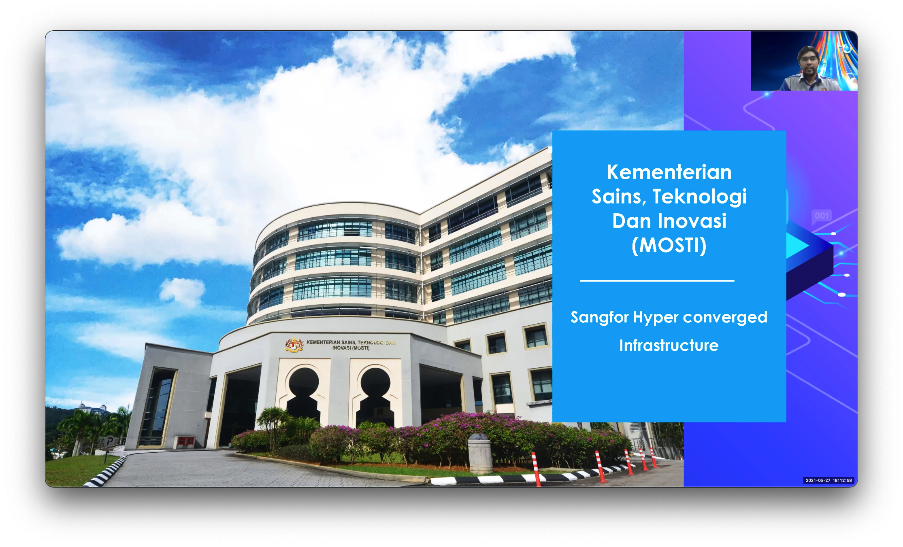
The Result
Becoming Sangfor HCI customer + References Site

Slide 13
05
Continuously Value after HCI project

Slide 14
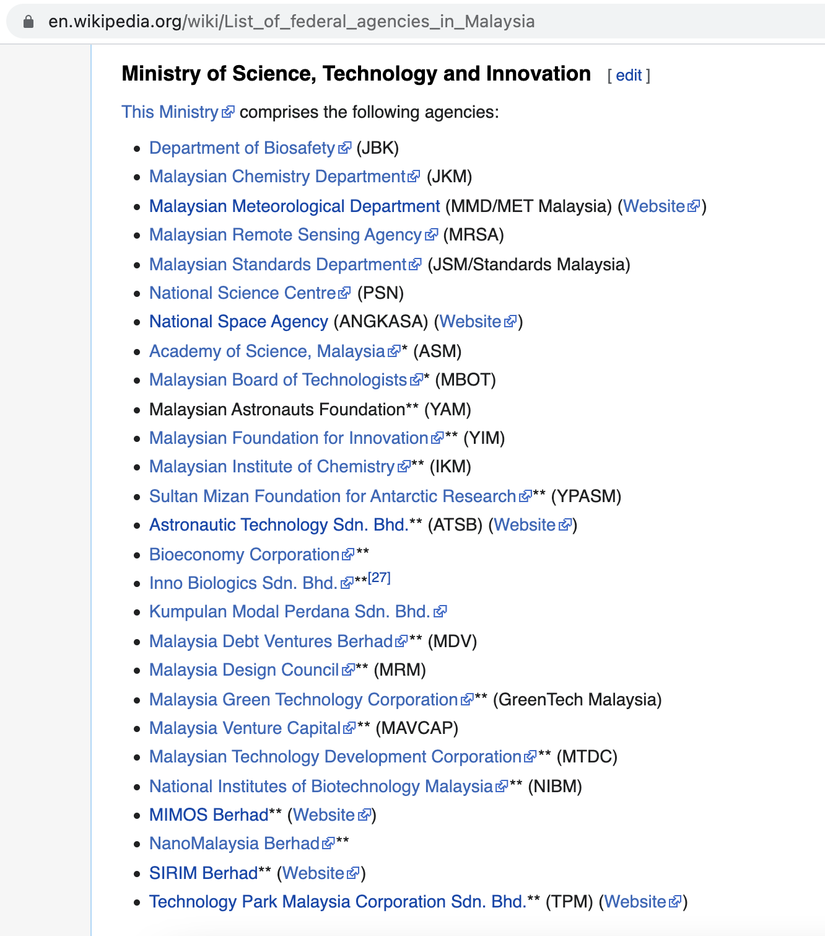
MOSTI agencies list

Slide 15
Continuously Value after HCI project
Value
2020- Become Sangfor reference side and allow others department people call and visit.
2020- In order to consolidate all the infra to MOSTI from others agency under MOSTI, customer give us contact and allow us to visit and introduce our HCI to them. (Nuclear Agency, Atom energy licensing board, Chemistry Malaysia, Malaysian Meteorological etc.)
2020- Gov has different batch of recruitment for IT officer. If passed all the training and assessment then only become Gov servant. Normally they have a WhatsApp group for each Batch people and all communicate about latest technology and raise up some question or advise. MOSTI able introduce us to his batch classmate: (Fire and rescue Malaysia, Ministry of Higher Education)
2021- Introduce Sangfor to a Malaysia Non profit Gov ICT association - Association of Public Sector Systems Analysts (PERJASA). We are on the discussion with this association to became their Strategy partner to promote Sangfor product. (From this association event we know more than 10 new Gov customer).
2021- Presenting and share Sangfor using experience on Malaysia roadshow 2021.

