Slide 1


JEC Project Sharing
HCI PaaS Solution
Steven Tanuwijaya
Kent Alexander
www.sangfor.com
Sangfor Technologies Inc.
PPT_Intro_20190227

Slide 2

Contents
1
PART
2
PART
3
PART
4
PART
5
PART
Opportunities
Key Job & Pain Points
How to influence?
Solution Proposal
Cloud Project Highlight
Sangfor Technologies
CONFIDENTIAL
Page

Slide 3

01
Opportunities
JEC is our loyal existing customers since 2018 and always add our solution each year. We keep on giving our best support and service with the customers.

Slide 4
How we get the opportunities?
The promise
We mentioned our roadmap but no clear timeline from HQ. Partner ask us not to mention to customer. The 3rd party K8s want to be run on our HCI so we help the sizing
Solution Proposal & Pricing
With limited information we convinced customer and push them for POC. Also ask pricing information and licensing scheme from HQ to proposed to customer
8/2020
9/2020
11/2020
9/2020
9/2020
The beginning
Clarification
POC Process
We heard of K8s project in JEC with our existing partner (Altros) using 3rd party K8s developer
Customer saw PaaS function on our website that we share for the technical materials. Invite us directly to explain the microservices function on our HCI. At that time PaaS function delayed for 3 months and no materials, pricing, licensing scheme ready yet from HQ.
They have done POC before with 3rd party K8s vendor and have the pricing as well. So, with the help from HQ team we do our 1st Beta POC for PaaS and complete all customer test case.
Sangfor Technologies
CONFIDENTIAL
Page

Slide 5
02
Key Job & Pain Point

Slide 6
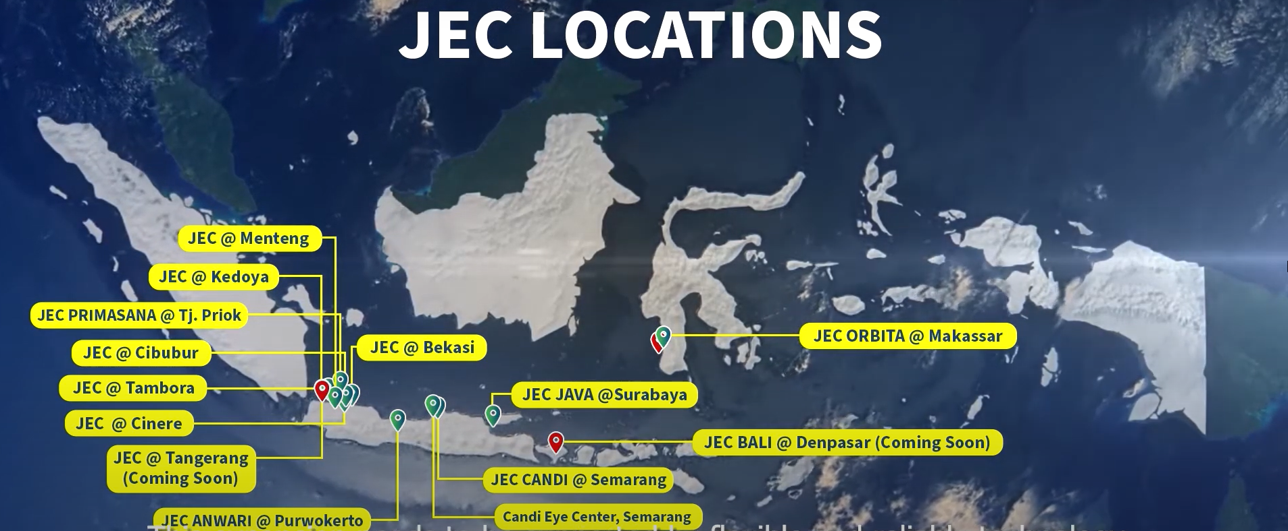
Key Job & Pain Points
Key Job
They need to plan for the infrastructure of the expansion in another region of Indonesia
2019 they plan to de centralize the server, we already proposed our smaller model HCI for the clinics.
2020 because of the pandemic they need to think different approach for the infrastructure expansion. There is where the microservices development become an option.
Pain points:
New branches have unpredictable growth rate and workload.
De-Centralized server need more manpower, investment, and maintenance cost.
Centralized server using virtual machine is not effective as it will make database and application become huge.
Need trusted support from vendor because healthcare business runs 24/7 without downtime.
Need to find cost effective solution even more because of the pandemic.

Slide 7
03
How to Influence

Slide 8
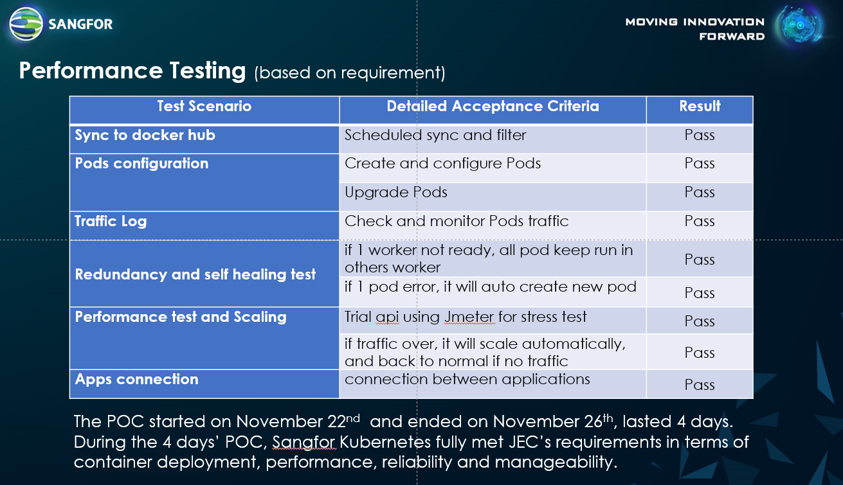
How to influence Decision Maker
Technical:
We don’t have any other option because of no materials ready from HQ regarding the new PaaS solution, so the only way to influence is to do POC. We do POC with full support from FAE and HQ team to fulfill customer testing requirement. In the POC process we do the POC not only with Infrastructure team but also with Software Development team from JEC. This is new for us and both PM and FAE don’t have any experience in K8s and Software Development, so we can only rely on HQ. With the IT Head as the main PIC and decision maker for this Project.

Slide 9
How to influence Decision Maker
Business Perspective:
We make sure that our proposed PaaS solution is competitive price comparing with the 3rd party K8s developer
We give 100% priority support for this new Sangfor PaaS Solution and help them developing their new microservices application.
We promise them to using the PaaS Solution using our demo first until their purchased had been arrived
Maintain the relationship with the customer IT Head

Slide 10
04
Solution Proposal

Slide 11
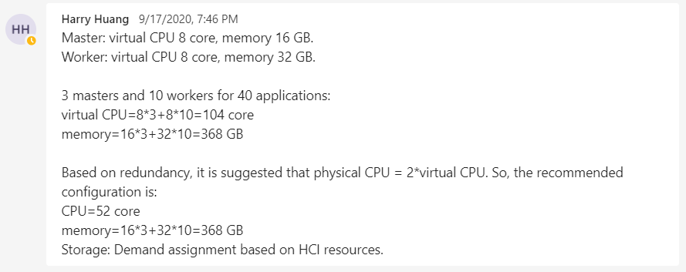
Solution Proposal
This is new solution with no material ready yet at that time, we need to send the pricing in September 2020. So, to do the sizing we rely 100% on HQ team.
We proposed 2 nodes separate clusters for the new PaaS environment.

Slide 12
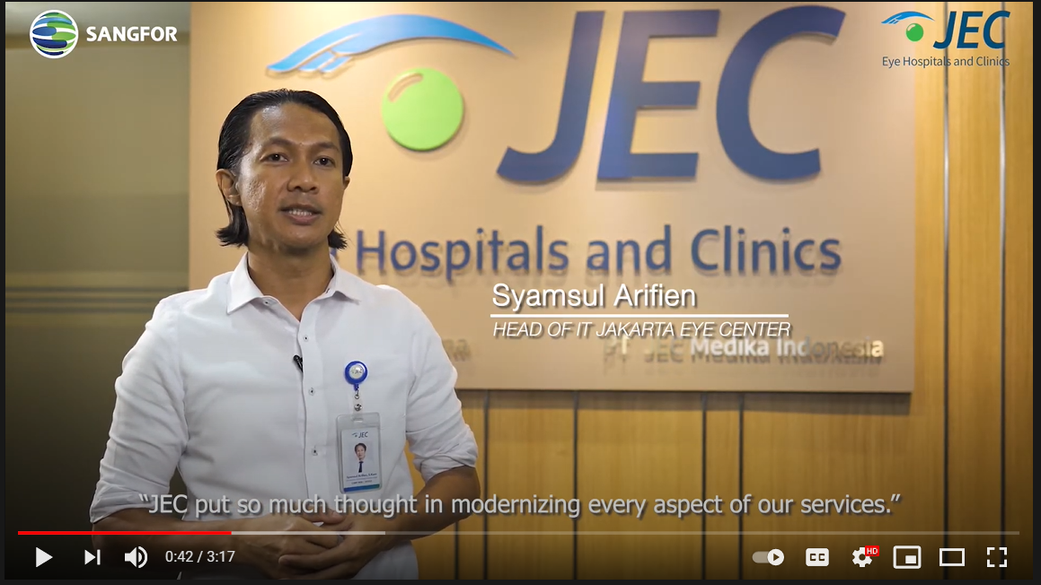
The Result
in the first 3 months they do testing and development of their new application in Sangfor KubeManager
They do the production phase in the May 2021
With the PaaS functionality they can do development and production easily
Until now they still do some development that need us to support them optimize their new microservices applications
Website: https://www.sangfor.com/en/info-center/video-center/sangfor-hci-customer-success-jakarta-eye-center-indonesia-2
YouTube: https://youtu.be/RM0KEtKPKeY
Facebook: https://www.facebook.com/Sangfor/posts/4899305053415152
LinkedIn: https://www.linkedin.com/feed/update/urn:li:activity:6803526406434361344/
Twitter: https://twitter.com/SANGFOR/status/1397761039232421888

