Slide 1


Accelerate Your Digital Transformation with
Sangfor Acceleration SD-WAN
Sangfor SD-WAN Team
www.sangfor.com
Sangfor Technologies Inc.

Slide 2
Contents
PART
1
PART
2
PART
3
PART
4
Digital Transformation Trends and Challenges
Sangfor Acceleration SD-WAN Solution Introduction
Highlights of Sangfor
Acceleration SD-WAN
Use Scenarios and Best Practices

Slide 3
PART 1
Digital Transformation
Trends and Challenges

Slide 4

Boost your Business with Digital Transformation
Importance of digital transformation
Benefits of digital transformation
More than 90% CIOs consider
digital transformation is important
63%
Improved customer satisfaction
(ie. NPS)
10
9
8
7
6
5
4
11.7%
49%
11.1%
Increased lead gen/sales
41.7%
75%
27.2%
Lift in
engagement
6.7%
53%
0.6%
46%
Higher traffic
1.1%
Greater
conversions
Note: 1 refers to not important, 5 refers to important, and 10 refers to very important
N=180
Source: IDC, 2019
Source: Altimeter Group Digital Transformation Survey, 2014. N-59.

Slide 5

A Case for Digital Transformation
Beggars began to use the QR code for begging

Slide 6
Network a Key Carrier of Data
Management Apps
HR Apps
Customer Relationship Apps
Business Process Apps
Data Monetization Apps
ERP Apps

Slide 7
MPLS Network Does Not Support True Business Change
Apps =Increase & Traffic Surges
Business Expands Globally
Service Moves to Cloud
Bandwidth shortages & limited budget
Long deployment cycle & expensive
MPLS to cloud is not optimal

Slide 8


Data is Critical to Business but a Poor Network
Decreases Productivity
Intermittent Network Connection
Poor User App Experience

Slide 9
PART 2
Sangfor Acceleration SD-WAN
Solution Introduction

Slide 10
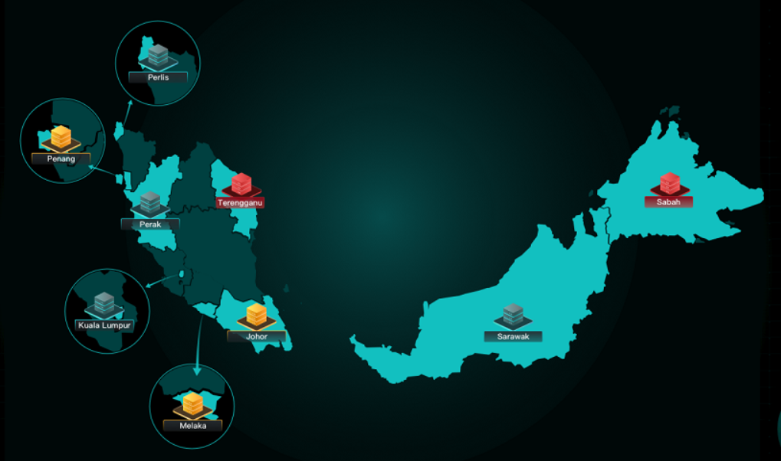
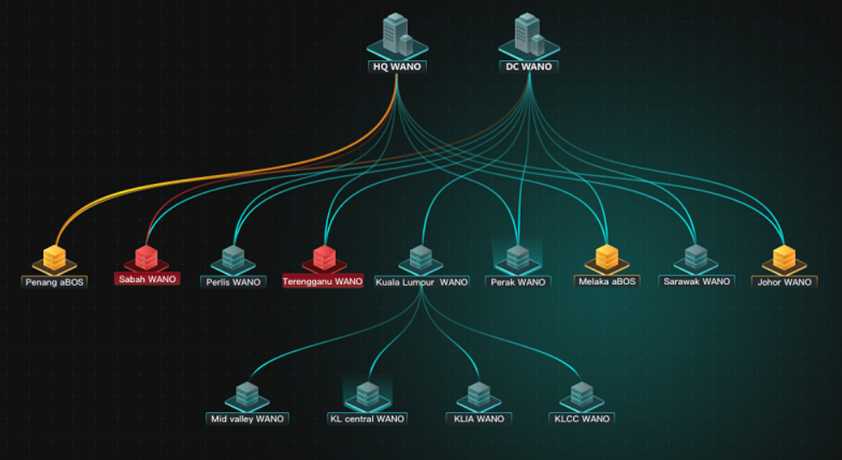
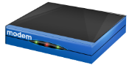
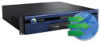















Sangfor Acceleration SD-WAN Solution Overview
Branch Map
VPN Topology
Visualization
Management
Orchestration
Alerts
Sangfor
Central Manager
Branch
Cloud POP
SD-WAN
MPLS/Metro-E
SD-WAN
Data Center
Branch
SD-WAN
Internet
vCPE
Branch
SD-WAN
Public Cloud
Your WAN Network Connections and Optimization Wizard!

Slide 11

Network Connection is Like Transportation
4 Hours
Critical Package
KL
HK
7 Days
2T Cargo

Slide 12


#1: Add Internet Link
Increase Bandwidth & Reduce WAN Investment
20M
10M
1k
4M
Internet
20M
10M
MPLS
4M
10M
MPLS
20M
4M
X2.4
50% off
Bandwidth
Costs

Slide 13









#2: Bonding All WAN Links as a Pool
Maximizes WAN Utilization
MPLS
INTERNET

Slide 14


#3: Critical App Traffic Always Runs on Optimal Link
Guarantee Critical Apps
20ms 0.2%Loss
Link1
10ms 0%Loss
10ms 0%Loss
50ms 0.3%Loss
50ms 0.3%Loss
Link2
10ms 0.1%Loss
30ms 0.1%Loss
60ms 0.3%Loss
SD-WAN
SD-WAN
10ms 0.1%Loss
90ms 0.1%Loss
Link3
20ms 0.2%Loss

Slide 15



#4 : Automatic Fail-Over without User Perception
Link1
Link2
SD-WAN
SD-WAN
Link3
Fail-Over
Link1
Link2
SD-WAN
SD-WAN
Link3

Slide 16





Network Optimization = Transportation Upgrade
X 10

Slide 17
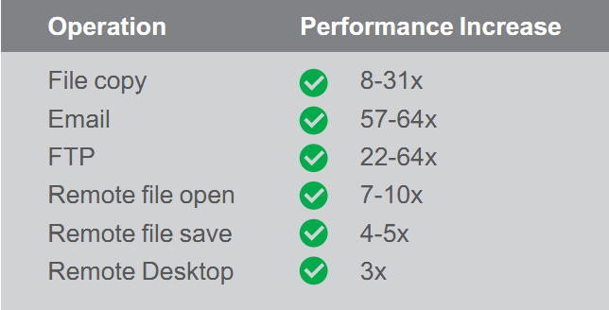
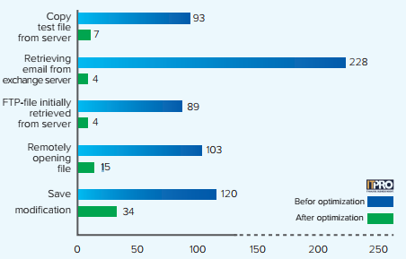



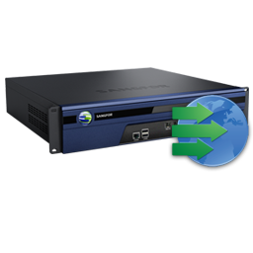
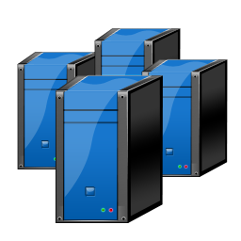



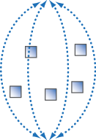

Full Acceleration Builds Information Highway
Operation Time Comparison
Data
Data
Tag
WAN
Date center
Branch Office
Data Reduction
Link Optimization
Application Acceleration

Slide 18

Strong Data Reduction Performance
TCO for leased line & MPLS reduced
50%
Amount of data transmitted through WAN reduced
70%
>>>
Data
Data
Data
Data
Data
Data
doc, jpg, pdf
WANO
Data
Data
Data
Data
Data
Data
Data
application
Data
Data
Data
Data
Data
>>>
Data
Data
Data
Data

Slide 19



















Excellent Application Acceleration Performance
User application speed improves
3-10X
Video conference packet loss rate decreased to
0%
Data synchronization time reduced by
50%-70%

Slide 20
Sangfor SD-WAN/WANO Key Value Summary
01
Reduce WAN Investment
02
Improve Business Reliability
03
Boost User Work Efficiency
04
Maximize Bandwidth Value

Slide 21
PART 3
Sangfor Acceleration SD-WAN
Highlights

Slide 22
Highlight 1:
Network Connectivity & Optimization 2 in 1
Helps the customer’s network evolve seamlessly from MPLS to SD-WAN
Sangfor Acceleration SD-WAN
(WANO)
Software-Defined
Network
Network
Optimization

Slide 23
Highlight 2:
Perfectly Compatible with Current Network
Gateway Mode
Reduce gateway device cost
Bridge Mode
Without any network changes
Arm Mode
Zero down-time

Slide 24





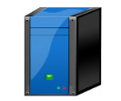




Highlight 3:
URL Path Selection Combines DNS Proxy
Different DNS for different URL provides the best user application experience
Good for
Internet Apps
Good for
Intranet Apps
oa.sangfor.com
www.o365.com
Intranet DNS
Internet
Intranet DNS
Public DNS
ISP1 DNS
Data Center
ISP1
Internet
ISP2
MPLS
MPLS
Internet

Slide 25
PART 4
Scenarios and
Best Practices

Slide 26

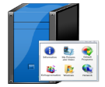
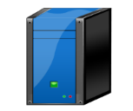


Scenarios and Best Practices
Disaster Recovery Center
Disaster Recovery Center
DC-DRC Data Backup and Recovery
Reduce RTO/RPO
Reduce MPLS costs
DB Server
Application Server
MPLS
DB Server
Application Server
File Server
Backup & Recovery
Backup & Recovery
File Server
Application Acceleration over MPLS/VSAT Link
Improve user experience and work efficiency
Reduce bandwidth costs
Enhance link throughput and increase productivity
Internet
VSAT
MPLS
MPLS
Hybrid WAN for Branch Access Network
Secure access to server
Improve business availability
Increase bandwidth and reduce bandwidth costs
Guarantee core business traffic
Branch Office
Branch Office
Branch Office

Slide 27






Scenarios and Best Practices
Controller
Global Network Connections
High quality cloud POP network solves multi-national network high latency and high packet loss issues
Application acceleration improves user application experience and work efficiency
Reduced file transmission time
INTERNET
Singapore POP
Cloud POP
Japan
Chinese POP
SaaS and Public Cloud Optimization for Chinese Users
Improve SaaS & public cloud application experience
Chinese traffic and global traffic separation
Satisfy Chinese regulations
USA POP
Los Angeles
Beijing
Office
Business
Office
Business

Slide 28


















Sangfor SD-WAN Notable Customers

Slide 29


















Sangfor SD-WAN Notable Customer

Slide 30
Know More Detail and Try
www.sangfor.com

Slide 31
THANK YOU
SD-WAN Team | Product Manager
sales@sangfor.com
www.sangfor.com
Sangfor Technologies Inc.

