Slide 1
Sangfor Secure SD-WAN Solution

Slide 2



New challenges of WAN edge
New best practice of WAN edge solution
Sangfor secure SD-WAN solution
CONTENTS
Sangfor SD-WAN user cases

Slide 3
Three Challenges we face when build a better WAN edge
Bad access
experience
Complicated to maintenance
Low level security of ROBO
MPLS: small bandwidth and expensive
Internet: cheap but slow and unstable
Remote office and branch office(ROBO): Complicated to deploy and maintenance
Blackbox of network: No visibility hard to manage
ROBO: lack of security appliance and technology

Slide 4










Challenge 1: Digital time with massively increasing WAN traffice, hard to balance the cost and experience
Jam
SaaS/IaaS & Internal access traffic massively increase
Limited bandwidth resources, expensive to expand
Bad experience accessing apps
OA
JAM
ERP
CRM
MPLS is stable but limited bandwidth and high cost to expand
Internet is cheap but slow and unstable, especially for online meeting and internal data center access
Online meeting is hard to hold with voice latency and low picture quality
OA systems is very slow to browse
File is slow to tranfer over FTP
Massively increasing outbound Internet traffic due to the SaaS/IaaS access

Slide 5


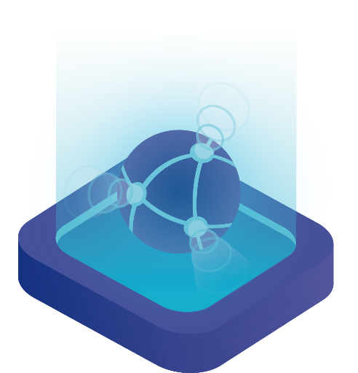

Challenge 2: Legacy router or VPN appliances are difficult to deploy and maintenance
Hard to deploy
Difficult to maintenance
Legacy router or VPN appliances are complicated to configure and could only deploy one by one, couldn’t adapt the fast new world
Mostly based on command line to configure, require too many skills for admin
Without visibility
Not easy to troubleshooting remotely
Without centralized analysis center, hard to find key issues hiding in the back
Without centralized management platform, hard to position the issues remotely

Slide 6





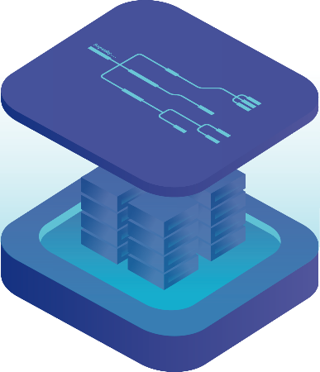

Challenge 3: ROBO could be the breach point of whole system, causing ransomware
Don’t let your ROBO be the shortest wood plate: network security follow the “cask principle ”
Internet access security and manage: 内部员工上网安全管理，行为审计，做到合法合规
1
  Hacker
  Office365
  ROBO
Link Security: 没有加密的数据传输存在被监听、拦截、窃取的风险
2
  OA
Endpoint Security：存在被攻击的风险，特别是未知威胁等新型攻击很容易绕过传统边界防御
3
  ERP
  Internet
  AWS
  Azure
Security visibility：无法快速实现威胁定位，难以感知全网安全状态
4
  Cloud
  Private Data Center

Slide 7
New challenges of WAN edge
New best practice of WAN edge solution
Sangfor secure SD-WAN solution
CONTENTS
Sangfor SD-WAN user cases

Slide 8




Key capabilities of new WAN edge
Deployment flexibility and easy to operate
Zero-touch to deploy, centralized management platform to operate
Secure the perimeter and endpoint from ransomware
Saving money and improve experience
Secure is not the optional for WAN edge anymore, should build cloud/gateway/endpoint synchronized security
Saving money from expensive MPLS, using MPLS+Internet to gain a balance of cost and effect
Fully support work-from-home in the COVID-19 new normal
Not only support for branch office, also should support home office

Slide 9


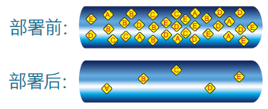



SD-WAN is the new trend of WAN edge
Manage Layer
Smart Apps control, network/security policy centralized management, centralized device manage, centralized monitor, Auto VPN
SD-WAN
Controller
Control Layer
Before:
Smart path selection, smart QoS, overlay tunnel, TCP/UDP WAN transmission optimizing, NFV security
Overlay tunnel selection
After:
WAN path selection
WAN optimize
Data Layer
多WAN接入、多WAN池化、多WAN捆绑等
MPLS
Internet
4G/5G
Physical Layer
CPE、uCPE、vCPE .etc branch SD-WAN device
IaaS
SaaS
Shop
ROBO
Headquarter

Slide 10
New challenges of WAN edge
New best practice of WAN edge solution
Sangfor secure SD-WAN solution
CONTENTS
Sangfor SD-WAN user cases

Slide 11



Key feature 1: Improving accessing experience with no more investment on bandwidth
Smart DPI + Smart Path select + Smart accelerate
4G
Encrypt
Encrypt
Optimize
NGAF
NGAF
Optimize
LTE
MPLS
Smart DPI
Smart Path select
智能优化
Smart and powerful Internet DPI library, transform from legacy IP/Port to App
10000+ Apps library
故障秒级切换实现高可靠
带宽利用率最高提升至100%
UDP伪装加速
QoS

Slide 12
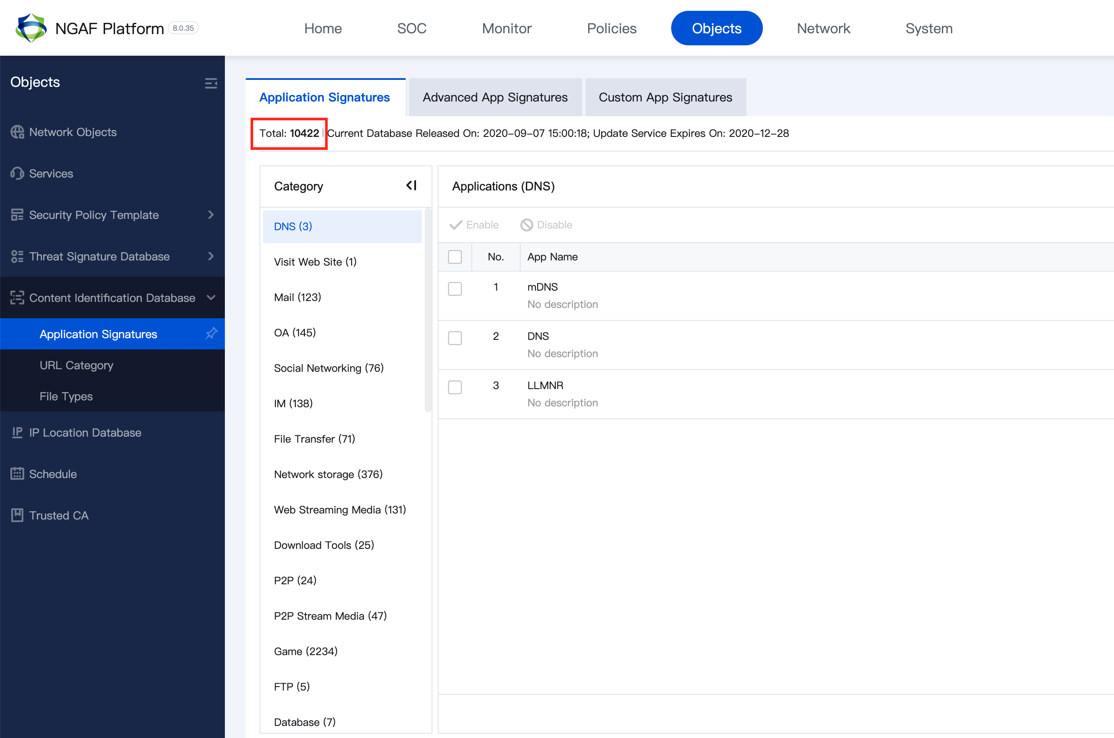
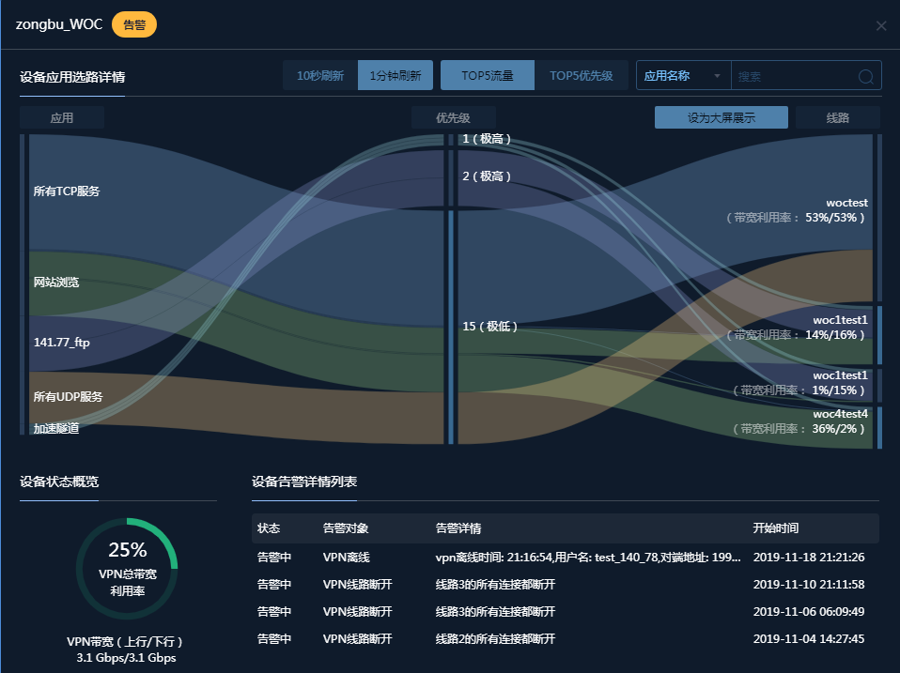
Smart DPI: Powerful Applications Control
Smart and powerful Internet DPI library, transform from legacy IP/Port to App
APP Control
APP Visualize
1)10000+ apps control；
2)DPI library keep upgrading for free;
3)SEA local apps control like Shopee and Lazada;
1) Detailed app usage visualized
2)Link QoS visualized

Slide 13
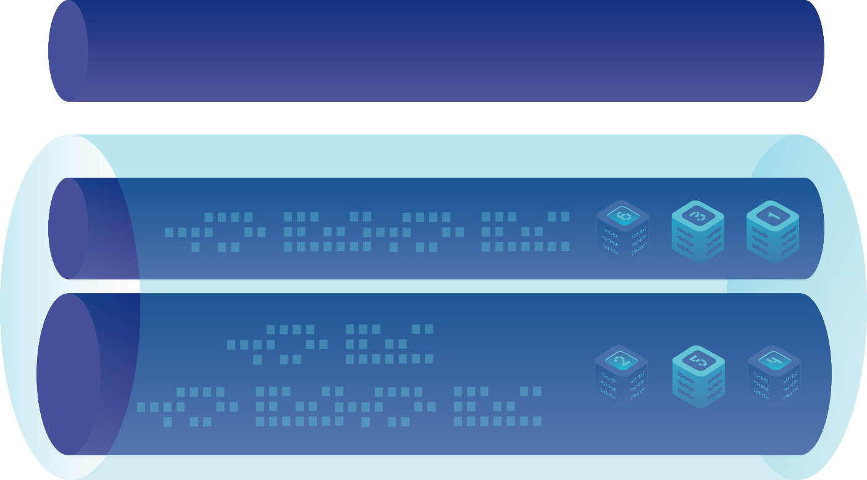








Smart Self-Adapt path selection
4G/5G
MPLS
INTERNET
包负载
选路
指定线路
指定应用
选路
按剩余带宽
比例选路
把单个应用数据包负载达到多条链路
指定某些应用在固定线路上传输
计算线路实时剩余带宽，将业务数据等比例的负载至各线路进行传输

Slide 14


Smart acceleration: Decoupling of underlying routing, transmit the package by overlay tunnel
Improve transmission efficiency by packaging UDP
Optimizing ISP transmission by TCP伪装
Transports
IPSec VPN
Based one IPSec VPN, we have SANGFOR VPN transmission protocol
SD-WAN transmit packages by UDP tunnel to accelerate, because some of the ISPs will limit the UDP transmitin, Sangfor SD-WAN could also camouflage the UDP packages to TCP.

Slide 15





Key feature 2: Enhance whole system security
  App Control
  IPS
  WAF
  APT
  Engine Zero
  Anti Virus
  Neural-X Threat
  Intelligence
  SD-WAN
  IPSec/SSL
  VPN
  WAN接入
Security your connection

Slide 16


The most powerful ransomware protection: Intergrated firewall and Endpoint secure
Synchronize
Gateway Protection
NGAF
Endpoint Protection
EDR
Notes:
功能特性1：

Slide 17
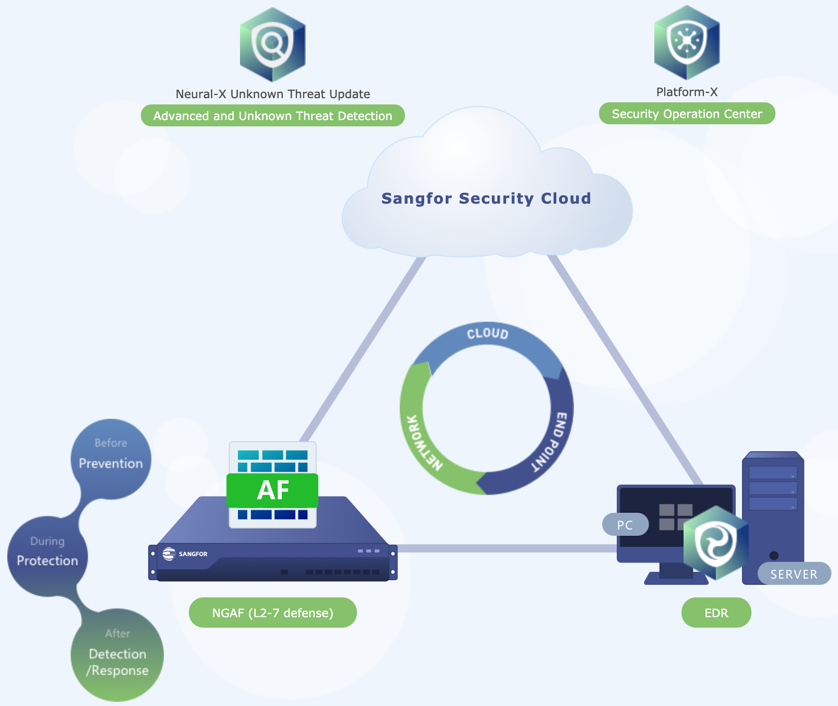
P-X+SCM, security analysis visualization
Cloud Centralized Analysis & Manage

Slide 18
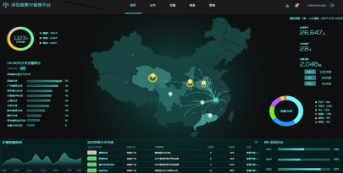
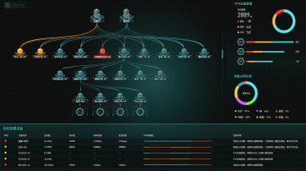
Key feature 3: easy to deploy, visualized operating
Controller
Visualized Screen
Monitor Screen
Branch
Link
Manage
Hardware NGAF
SD-WAN Global accelerate network
SaaS
Public/Private Cloud vNGAF
MPLS/Internet/4G
Public/Private Cloud

Slide 19
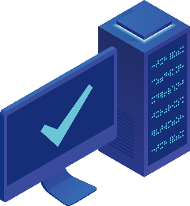












Easy-to-deploy: Email deploy
Three steps to finish deploying by email
Step 1: Admin auto send the email
Step 2: Connect to the device
Step 3: Click URL in the email
Login
Power
SD-WAN
SCM
Auto connect
Admin
NGAF
connect WAN cable
Click URL in the email
SCM
Branch office employee
LAN interface connect
SD-WAN
Deploy Successfully
Send the deploy email to branch office employee
WIFI Connect
Branch office employee
NGAF
Auto send the configuratoin to the device
Desktop/Pad/Phone
Desktop/Pad/Phone
Branch office employee
Easier than your home router to deploy!

Slide 20
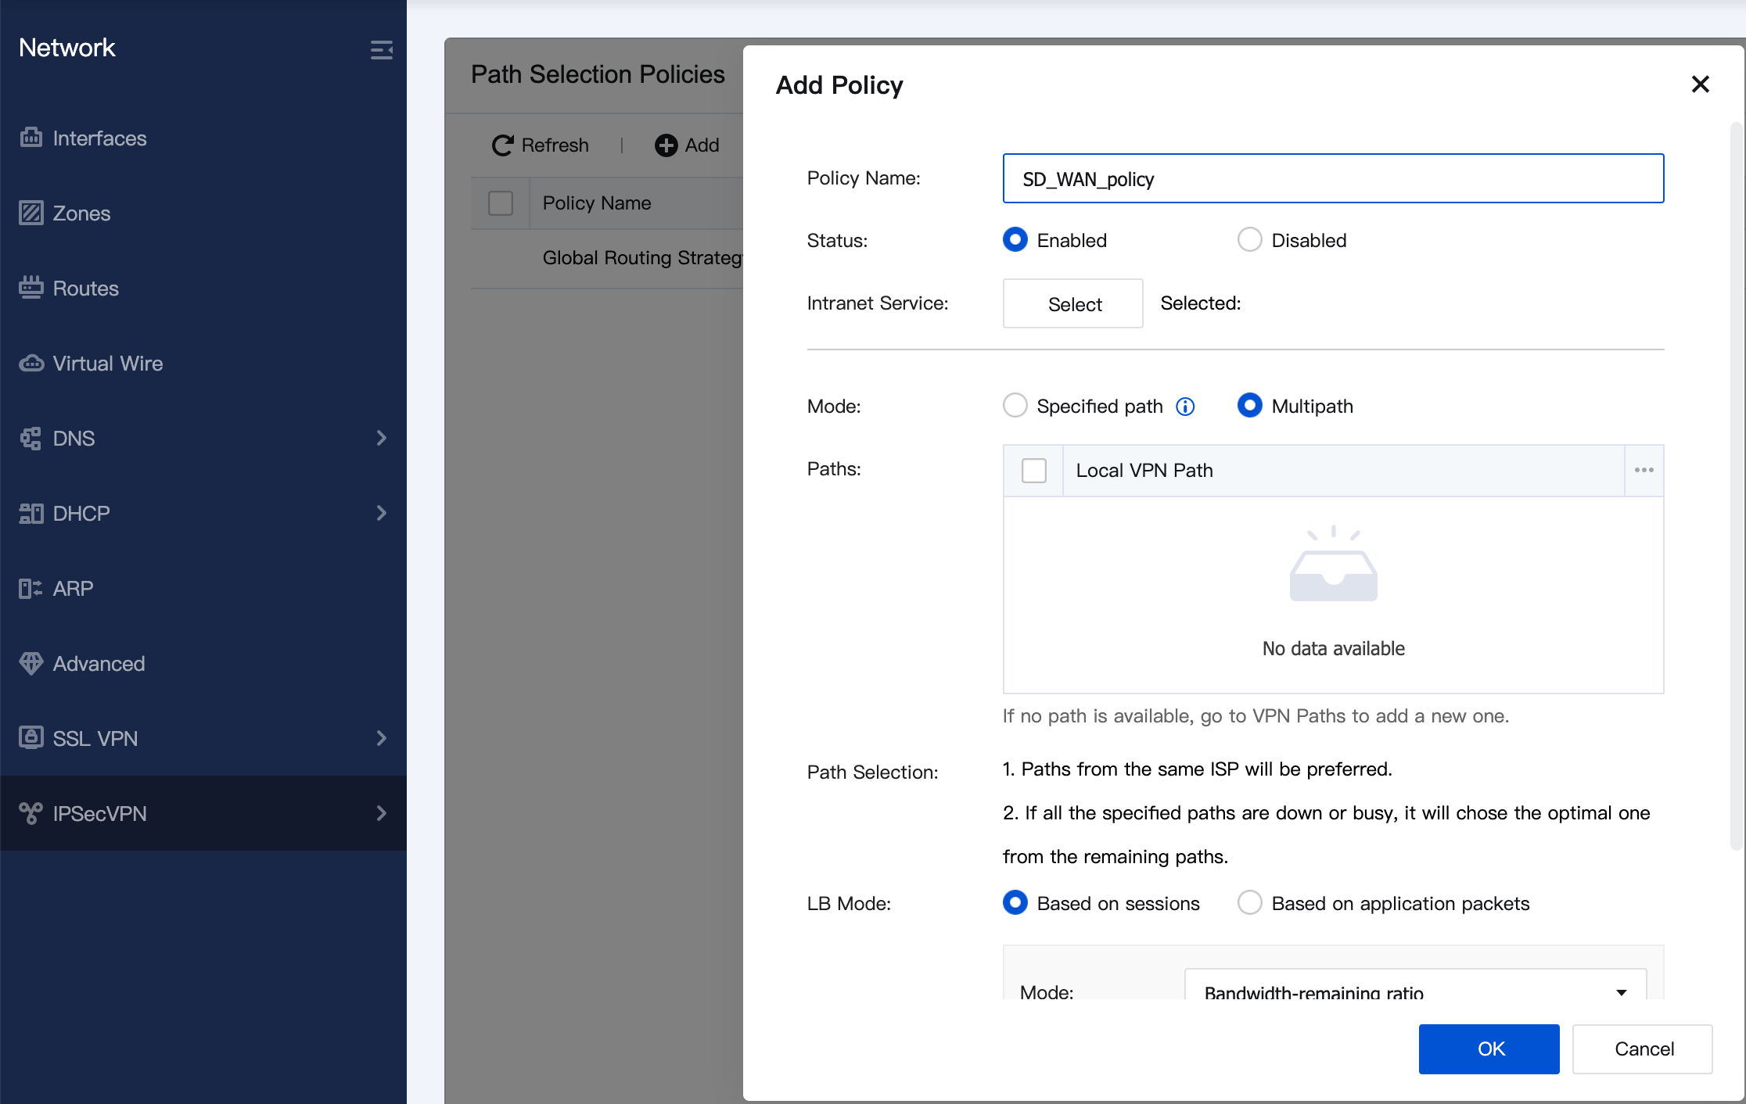
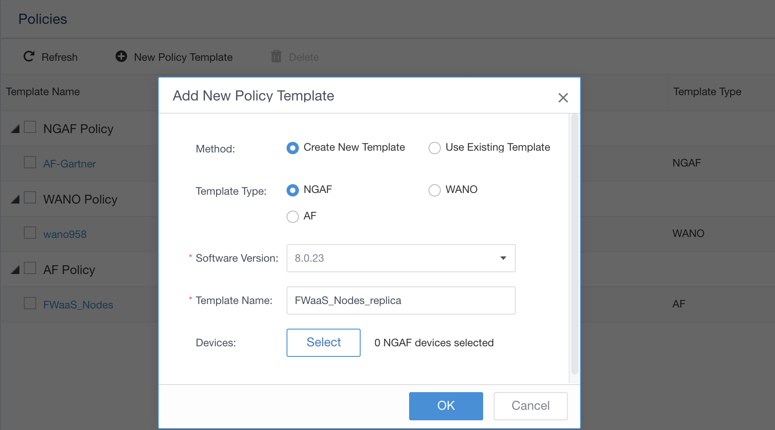

Easy to operate: directly add new policy to all of your devices
Auto VPN policy config
Smart path selection config
Security policy config
Fast network building, auto generate topology
Directly send the path-select policy to ROBO
Direct network/security policy config and system update
Fast network building: Headquarters and ROBO devices auto finish VPN network building with SCM
Auto generate topology: SCM will auto generate your network topology with the all your ROBO devices
Smart path selection config: based on the ROBO apps category, links quality, links capacity to send the right policy
network/security policy config: synchronize your security configuration to all of your devices
System update: keep all your devices being lastes version

Slide 21
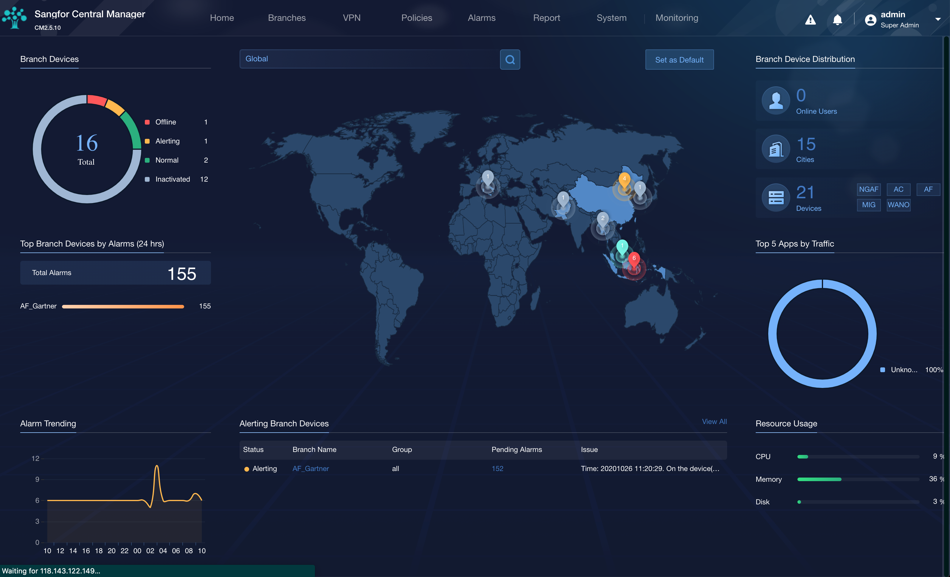
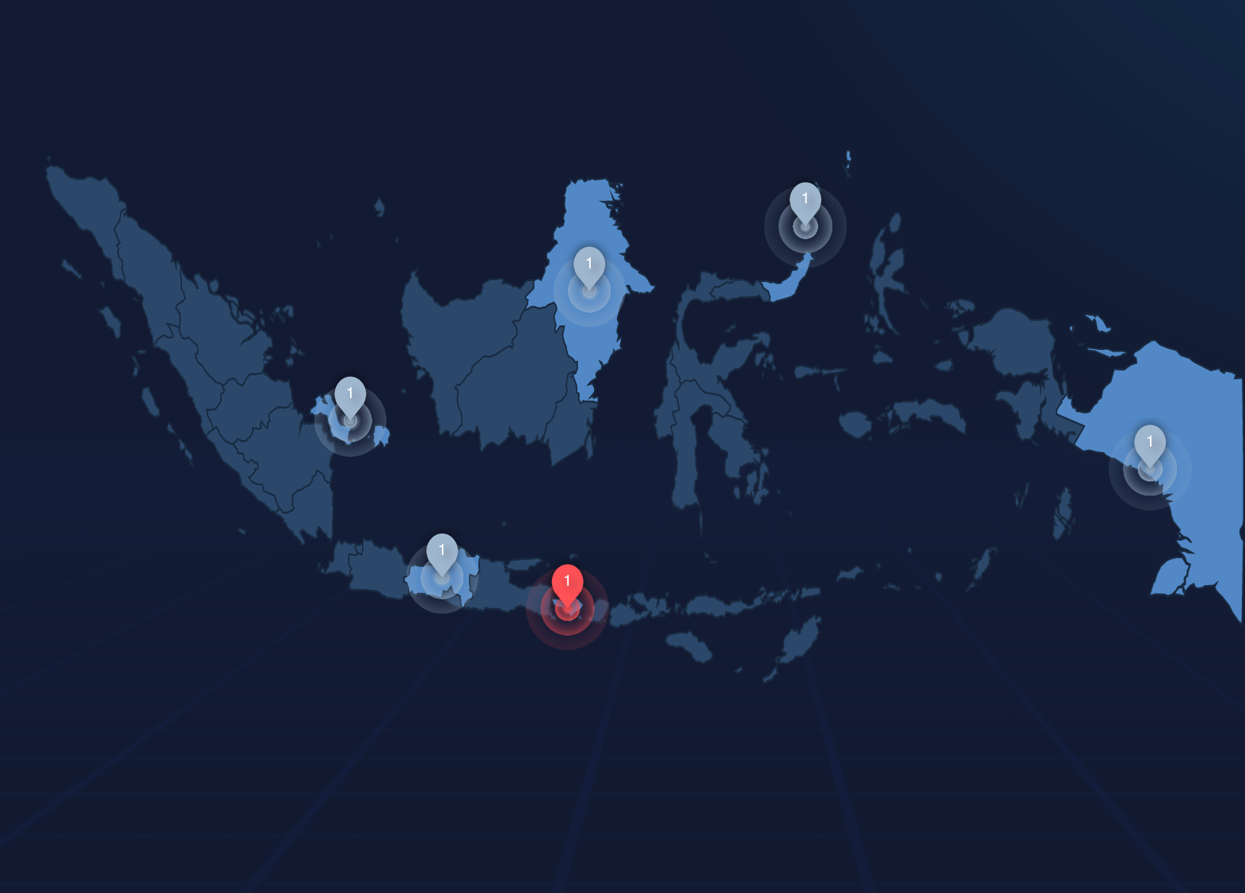
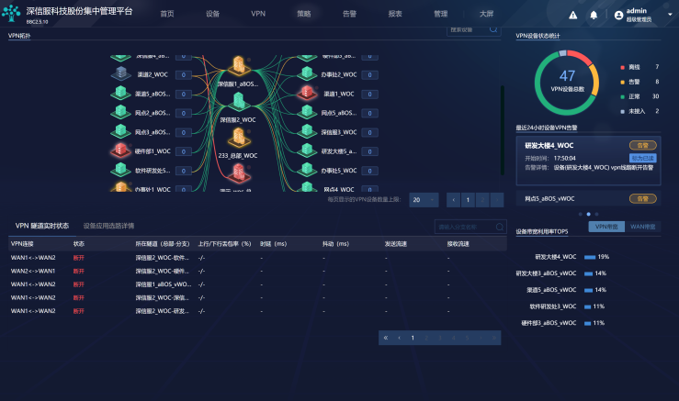
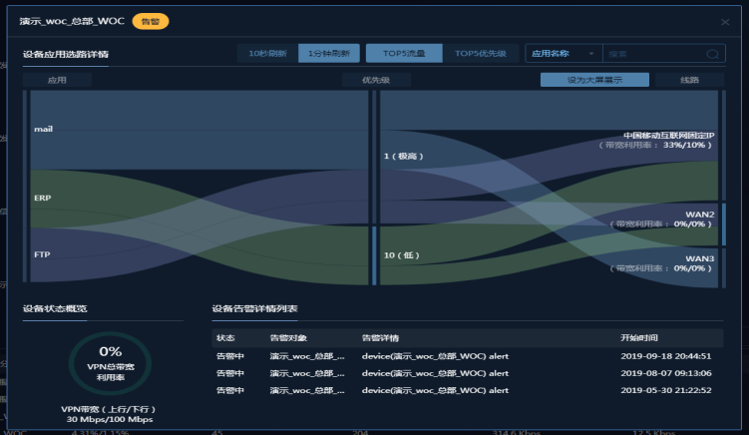
Easy to operate: Devices, links, app traffice visualization
Devices operating visualized
VPN Link status visualized
Apps traffic visualized
Map view of global NGAF SD-WAN devices
Global geographic position
Operating health condition
Big screen of global VPN link condition
Delay, drop, speed moniter
Bandwidth usage
Real-time detailed Apps usage
Real-time path selection details
Real-time apps speed moniter

Slide 22
New challenges of WAN edge
New best practice of WAN edge solution
Sangfor secure SD-WAN solution
CONTENTS
Sangfor SD-WAN user cases

Slide 23
SD-WAN User Cases
小标题
正文

Slide 24
THANK YOU

