Slide 1

Unlocking New Business
Opportunities with Sangfor Incident Response
Fan Yue
Product Manager
fan.yue@sangfor.com
www.sangfor.com
Sangfor Technologies Inc.

Slide 2
Agenda
PART
1
PART
2
PART
3
PART
4
PART
5
Ransomware & Sangfor IR Impact
Sangfor Partners IR Assistance
Sangfor IR Services
Sangfor Assistance for Compromised Customers
Taking Action
Notes:
Comment from Jeff: Standardize the letter, such as capital letter for first character of each word

Slide 3
PART 1
Ransomware & Sangfor Incident Response (IR) Impact
Notes:
Comment from Jeff: dun put why Sangfor IR first. Probably make it “Ransomware and its Impact” or whatsoever

Slide 4
The Threat
363%
Cyber attacks starting with RDP brute force
- TrendMicro
01
64%
$2.4M
02
Increase of Ransomware attacks annually
- Malwarebytes
350K
03
New malicious malware samples seen daily
- AV Test
04
Average cost to enterprise victims of malware attack
The longer discovery of a breach takes, the more it costs.
- Accenture

Slide 5


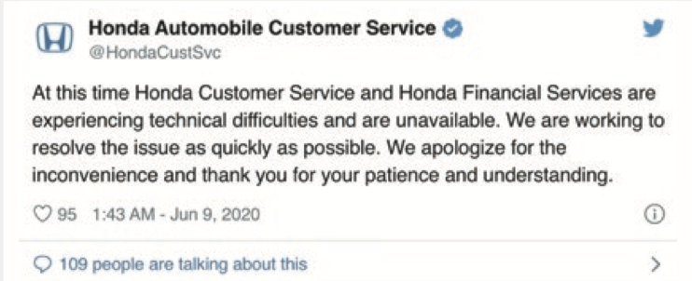
Honda Exposed to Ransomware
Date & Time: June, 2020
Loss: Unknown
Industry: Manufacturing
Event Profile:
The fifth largest automobile manufacturer company in the world
SNAKE ransomware is strongly suspected to be the culprit of the Honda attack
Honda's stock dropped 10% in 2 days
Analysis of the malware shows that the internal domain mds.honda.com was found embedded in the SNAKE ransomware
and used as a kill switch.
http://community.sangfor.com/forum.php?mod=viewthread&tid=3455

Slide 6

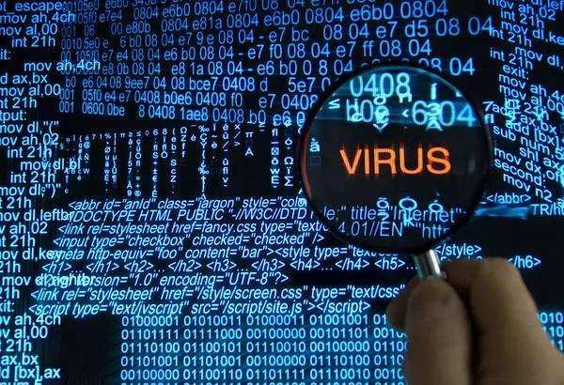
TSMC Exposed to Ransomware
Date & Time: August, 3rd - 6th 2018
Loss: 370M USD
Industry: Manufacturing
Event Profile:
The largest semiconductor company in Taiwan
Company statement shows the ransomware came from a newly connected computer
TSMC's stock dropped 15.2% in 3 days
TSMC announced that luckily, their core codes weren’t lost
Considered the most serious WannaCry attack globally, as of 2018
Notes:
典型的一个案例发生咋2018年8月，台积电在装设新机台时，没有按照操作流程，遭到了Wngcay勒索病毒的感染，首先是位于台湾竹科学院的12英寸晶原厂和运营总部突然传出电脑遭到病毒入侵全线停产的消息，几小时后，位于台中科员的FAb15厂房和台南的FAb14厂也出现了同样的消息，此次病毒勒索病毒事件造成了25.96亿的损失，约占基因收的1%。
Comment from Jeff: instead of using this, why not use Honda case? Then we can promote our blog article as well.

Slide 7
Sangfor Partner IR Assistance
Why should you take advantage of Sangfor’s Incident Response Service?
A good method to develop a closer relationship with existing customers.
A useful tool to help expansion into high level customers.
Sangfor provides immediate and free assistance to customers under ransomware attack.
Opportunity to upsell and cross-sell（bundle with Sangfor NGAF, SES, HCI, etc).
Sangfor IR website:
https://www.sangfor.com/product/services-incident-response.html

Slide 8
Customer Success Stories
Customer A: Government
Country
Ransomware
Response Timeline
Sangfor Solution
Recover Backup (1 hour)
Virus Type Confirmation and Infected File Isolation (30 mins)
ES Virus Removal (2 hours)
China
WannaCry
NGAF +
Endpoint Secure + CC
Customer B: Education
Country
Ransomware
Response Timeline
Sangfor Solution
Recover Backup (5 mins with Sangfor HCI)
Virus Type Confirmation and Infected File Isolation (30 mins)
ES Virus Removal (2 hours)
Malaysia
GandGrab V2.1
NGAF +
Endpoint Secure
Customer C: Enterprise
Country
Ransomware
Response Timeline
Sangfor Solution
Virus Type Confirmation and Infected File Isolation (30 mins)
ES Virus Removal (2 hours)
Vulnerability Scanning (2 hours)
UAE
Phobos
NGAF +
Endpoint Secure
Notes:
Comments from Jeff: time to update the case studies

Slide 9
PART 2
Sangfor Partners
IR Assistance

Slide 10
Sangfor IR Services for Customers
1
2
3
4
5
Security Assessment Services
Identify Ransomware Family
Reinforce Defenses to Minimize Risk of Subsequent Attacks
Locate Virus & Contain
Trace & Block Attack Source

Slide 11
How to Start?
Active
Customer Engagement
Ransomware Protection Assessment
Proposal
Passive
Security Incident
IR provided
Proposal
International Service Centre | Local Sangfor branch office
+60 12711 7129 (7511) ; marketing@sangfor.com

Slide 12

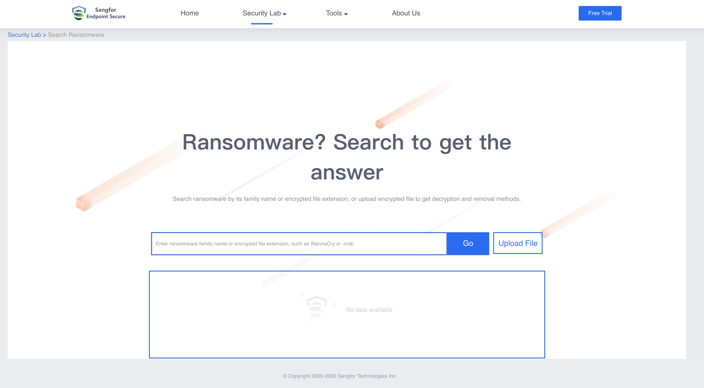
Sangfor Ransomware Decryption Website:
Sangfor does not provide decryption services.
Sangfor only provides the link to some useful third-party decryption tool sites.
While Sangfor carefully vets their vendors, Sangfor is not responsible for the services provided by third-party vendors.
http://endpoint.sangfor.com/#/introduction/ransom_search
Notes:
Comment from Jeff: cannot say “but Sangfor uploads some decryption tools regularly on this website for free to use”. Must mention Sangfor only provide the link to third party sites, but it’s partner/customer responsibility in using it.
Remove “Ransomware family GrandCrab, CryptON, Crazycrypt, Planetary etc can be decrypted through Sangfor security lab.” too.

Slide 13
The Sangfor IR Service Difference
Vendors name | Services | Pricing Model | Feedback
Sangfor | Essential Package Standard Package Premium Package Cover pre-mid-post attack phase One-stop ransomware protection solution | By IR event | Very quick response Cost-effective Multilingual support
McAfee | Tier 0 (Best-Effort Response); Tier 1 (Two-Hour Remote Response) Tier 2 (One-Hour Remote Response) | Hourly | Expensive
Symantec | Retainer Services Custom Retainer Options Additional Service Days and Responders | Hourly | Time-delay
Cisco | Readiness: Proactive Services Retainer: Reactive Services | Hourly | 5 day/8 hour per day response
Fireeye | Incident Response Preparedness Service Initial response Service-level agreement | Hourly | Expensive Only English support
Notes:
Comment from Jeff: Instead of types of packages, maybe can put “cover pre-mid-post attack phase”, “one-stop ransomware protection solution”, or etc..

Slide 14
PART 3
Sangfor IR Services

Slide 15
Sangfor IR Offering Package
Assistance Mode:
Remote Only (Working Hours 9am – 6pm)
Mid-incident Scope
Ransomware family and type identification
Root cause & kill chain determination
Entry point identification
IOC and triage determination
Remediation assistance
Credible and professional professionals
Recommendation and improvement plan
Pre-Incident Scope
N/A
Essential Package
Report Delivery
Security Incident Report
Incident Response Count
1 time per year
Notes:
uncover potential threat
uncover compromised machines
bypassed attack traffics identification
Root cause & kill chain determination
Event validation
remediation assistance / IR
comprehensive report
credible and professional opinion
recommendation and improvement plan

Slide 16
Sangfor IR Offering Package
Assistance Mode
Remote Only
(Working Hours 9am – 6pm)
Pre-Incident Scope
Provides external vulnerability assessment to determine public facing live hosts and respective listening ports
Provides vulnerability, threat and risks assessment, based on possible attack surfaces
Provides recommendations for fixes
Mid-incident Scope
Ransomware family and type identification
Root cause & kill chain determination
Entry point identification
IOC and triage determination
Remediation assistance
Credible and professional professionals
Recommendation and improvement plan
Standard Package
Report Delivery
Security Incident Report,
Vulnerability Assessment Report
Incident Response Count
2 times per year
(carry forward 50% of unused services to following year)

Slide 17
Sangfor IR Offering Package
Assistance Mode
Remote + Onsite (24 x 7)
Pre-Incident + Post-Incident Scope
Provides external vulnerability assessment to determine public facing live hosts and respective listening ports
Provides vulnerability, threat and risks assessment, based on possible attack surfaces
Provides recommendations for fixes
Perform firewall ruleset and policy review
During-incident Scope
Ransomware family and type identification
Root cause & kill chain determination
Entry point identification
IOC and triage determination
Remediation assistance
Credible and professional professionals
Recommendation and improvement plan
Premium Package（Especially for listed company）
Report Delivery
Security Incident Report,
Vulnerability Assessment Report,
Firewall Ruleset Policies Review Report Yearly
Incident Response Count
4 times per year
(carry forward 50% of unused services to
following year)
Notes:
Comment from Jeff: services (During) is not standardized. The content make it standardized. Get the latest slides from Teams.
Add 1 more slides, can talk about TIARA and why TIARA is needed after post-incident

Slide 18
PART 4
Sangfor Assistance for Compromised Customers
Notes:
How partner can move to next stage (what are the thing they can bring to csutomer on table, Show customer IR brouchre...bla bla bla)

Slide 19

Prevention is the Key!
External Attack Surface Assessment
Understanding of Internet-facing systems and respective listening services
Review of threat and risk from each exposed service
Review of security control and protection mechanisms of each exposed service
Remediation plan and suggestions on discovered threats and risks

Slide 20

Uncover Unnoticed Malware & Compromised Machines
Uncover Threats & Risks Before Attack!
Identify Potential Data Leakage
Uncover Potential Threat
Discover Compromised Machines
Reveal Bypassed Attacks
Discover Network Abnormalities
Threat Identification, Analysis & Risk Assessment
(TIARA)

Slide 21

Qualified Security Consultants
Certified Information Systems Security Professional (CISSP)
CREST Registered Tester (CRT)
Offensive Security Certified Professional (OSCP)
Cisco Certified Internetwork Expert (CCIE)
ISO/IEC 27001 Lead Auditor
CompTIA Pentest+ (Pentest+)
Certified Ethical Hacker (CEH)

Slide 22
PART 5
Taking Action

Slide 23
Target Customers
Previous Ransomware Attack
All Firewall Customers
Concerns About Unnoticed Malware & Compromised Machines
Currently Being Attacked by Ransomware

Slide 24
Partners Moving to the Next Stage
What can you provide to customers?
Sangfor IR brochure, IR report sample, Sangfor IR case studies, ransomware protection assessment tools and health check tools.
What should you do when a customer is hacked?
Contact Sangfor, collect encryption screenshots and establish remote control for the Sangfor IR team.
What should you do after Sangfor incident response service?
Try to push Sangfor products based on Sangfor IR report.

Slide 25
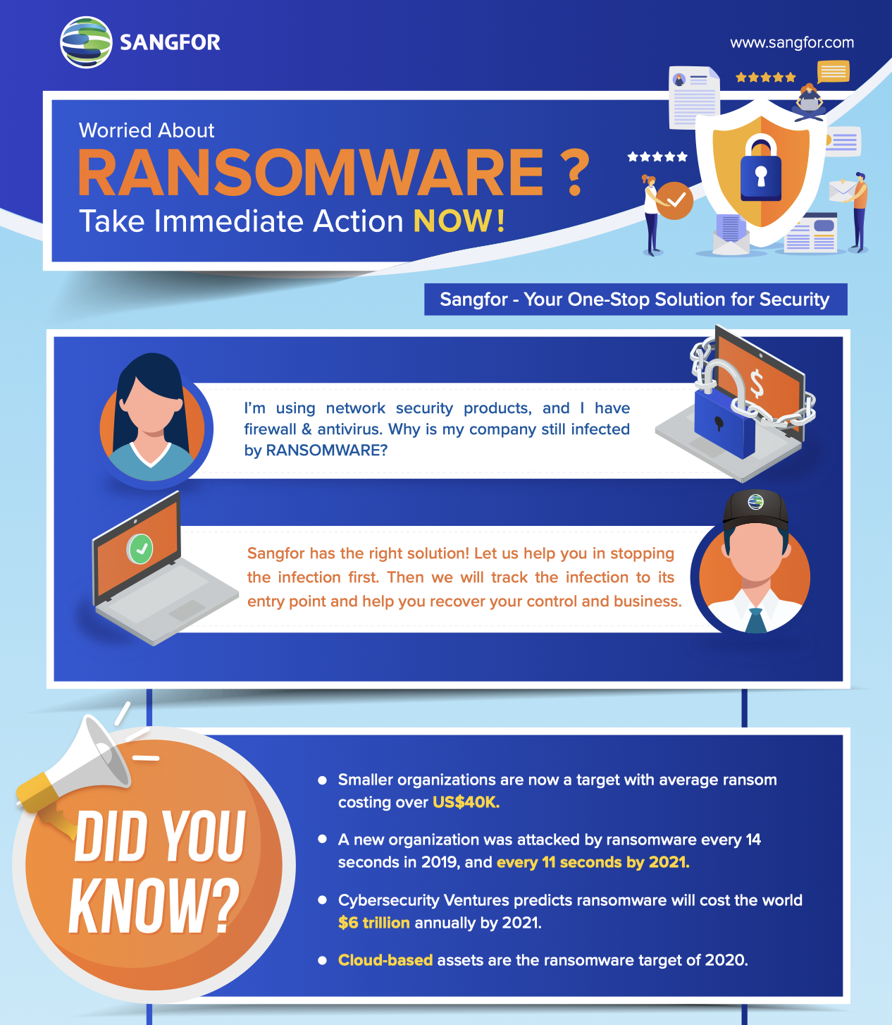
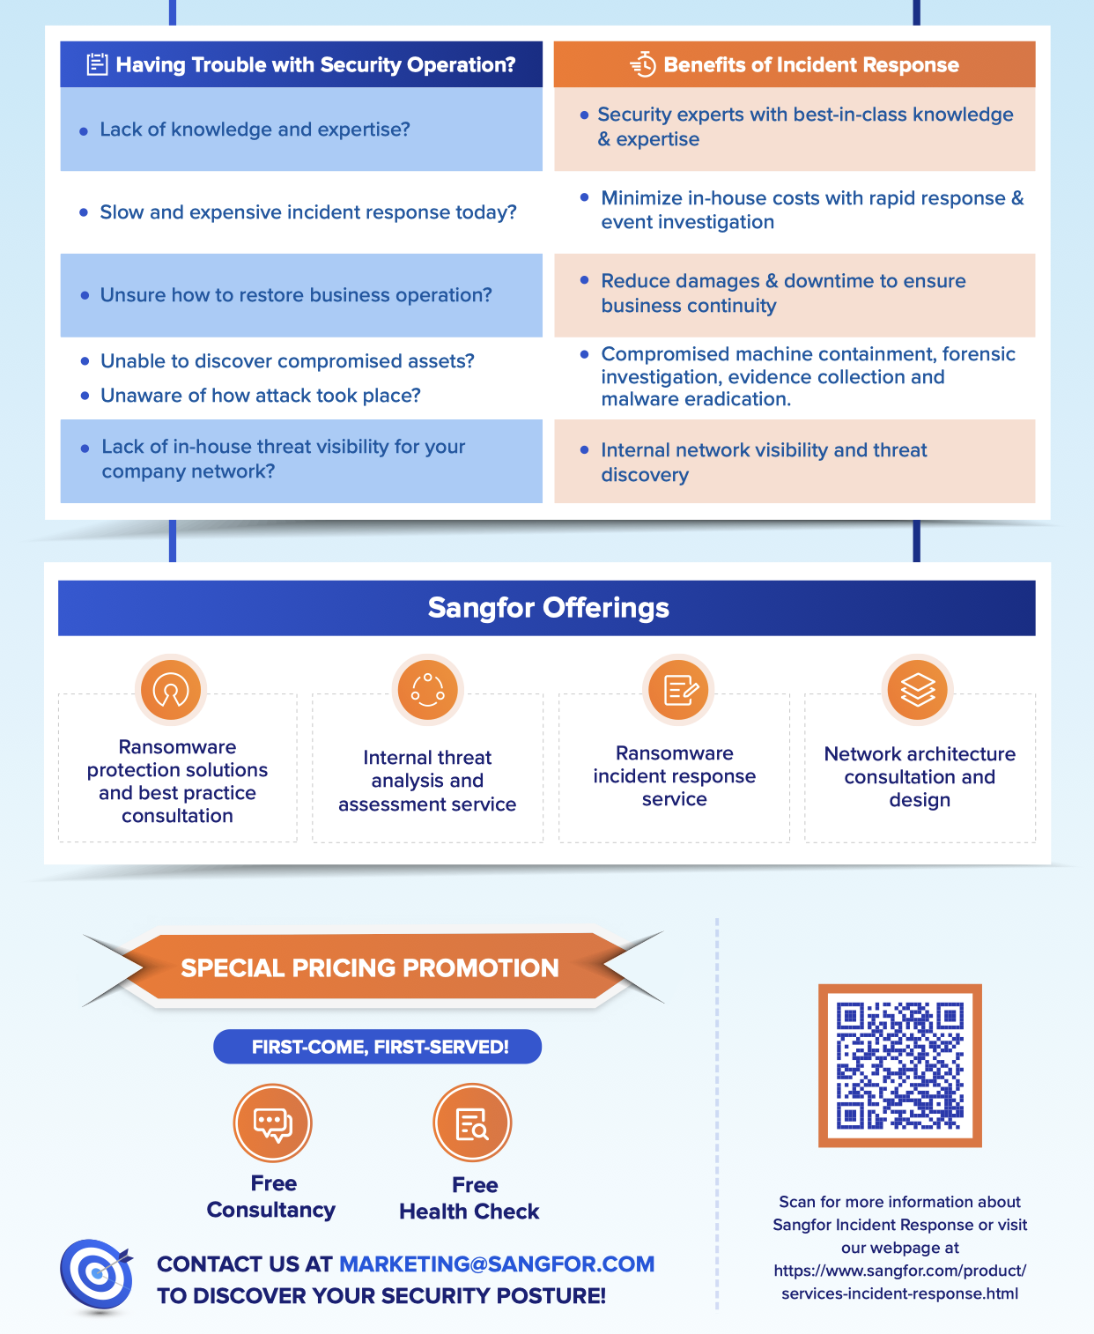
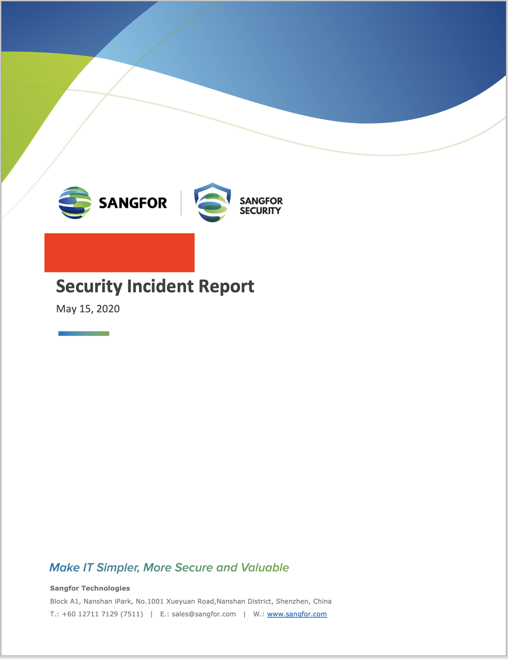
Partners Moving to the Next Stage

Slide 26
THANK YOU !
Fan Yue
Product Manager
fan.yue@sangfor.com
www.sangfor.com
Sangfor Technologies Inc.

