Slide 1


Competing & Beating Symantec SEP
TRAINING
Fan Yue | Sangfor ES Product Manager
fan.yue@sangfor.com
www.sangfor.com
Sangfor Technologies Inc.

Slide 2
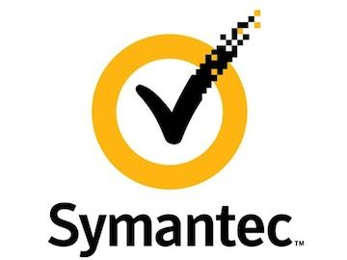
History
Founded in
Cupertino California,
USA
Security business
acquired by
Broadcom
Norton
M&A
Keep M&A
1982
1990
2009
2019
Already far away from the Chinese market
1989
2014
2016
2020.5
Successfully listed
Split into two companies
(One focused on security,
the other focused on
information management)
Acquired BlueCoat
Resale to Accenture

Slide 3

Symantec's Development
Acquired Norton in 1990
Traditional Interface
Slow Updates
Symantec Endpoint Protection SEP
Norton
Cutting-Edge Interface
Quick Updates
Enterprise Edition
Personal Edition
Sometimes use SEP
as the online version of Norton
EDR benchmark is SEP

Slide 4
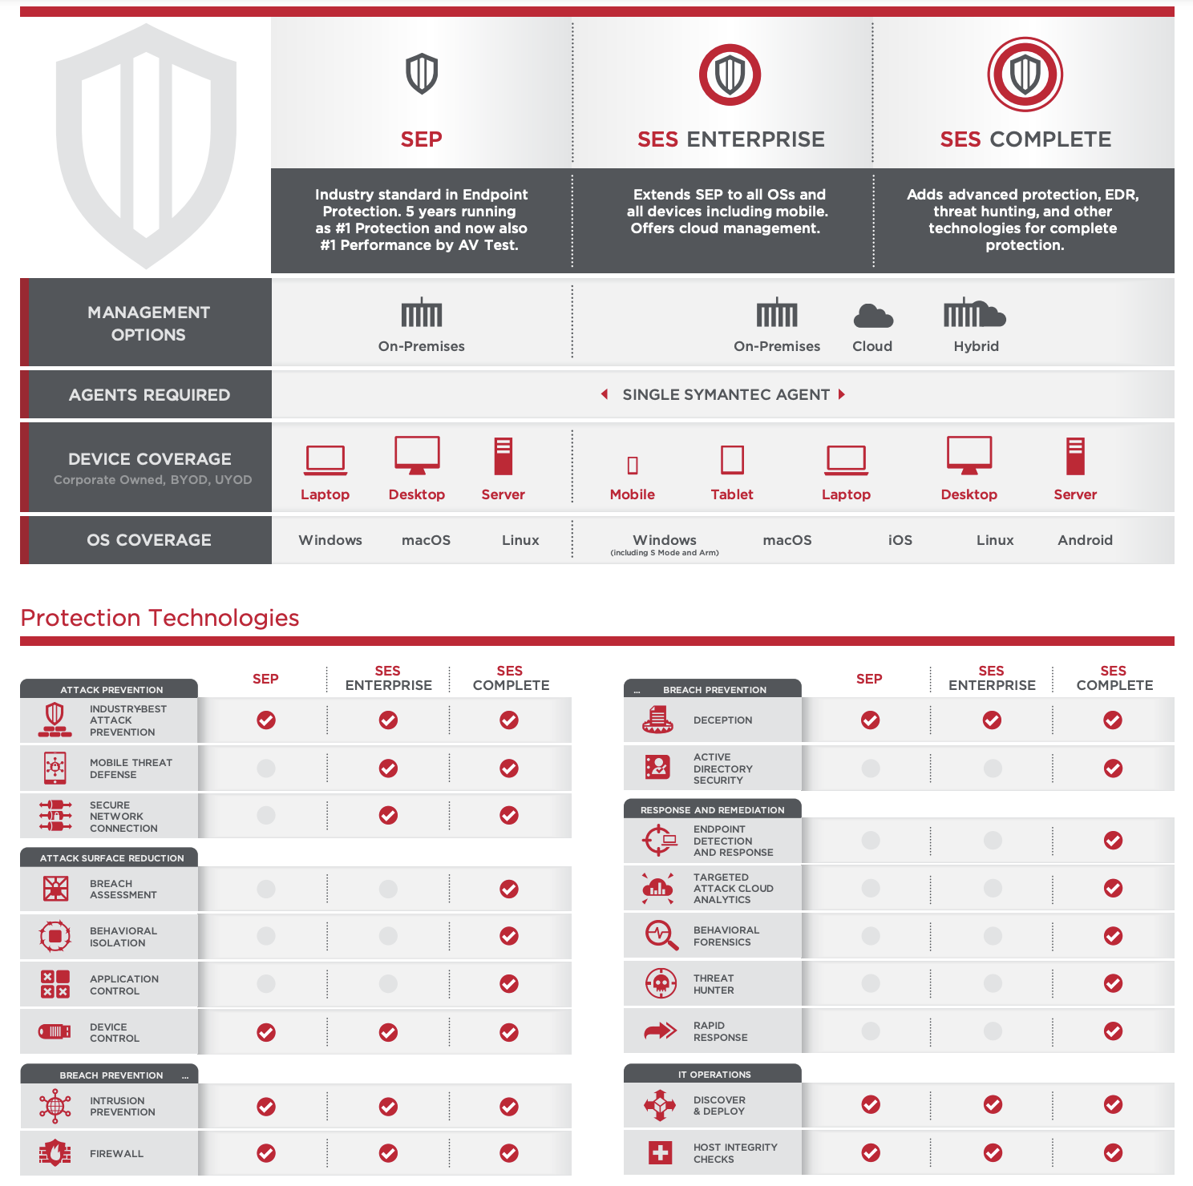
Symantec Endpoint Solution

Slide 5
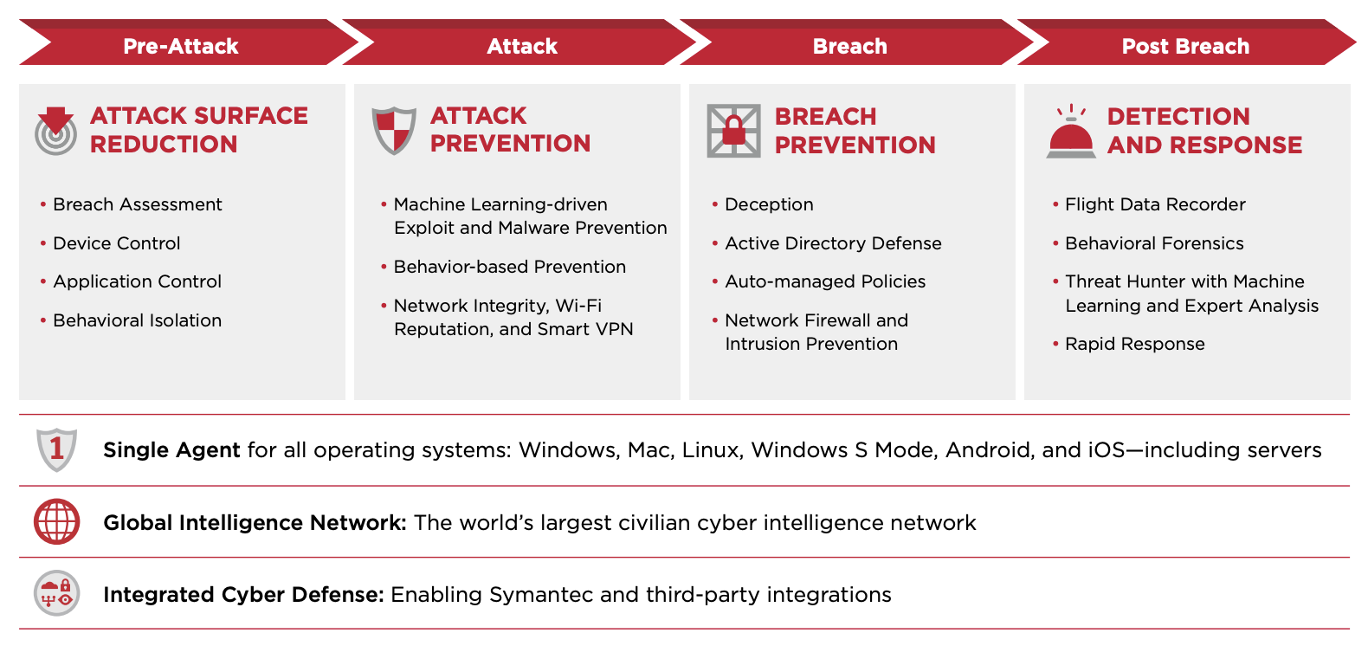
Symantec Endpoint Solution

Slide 6
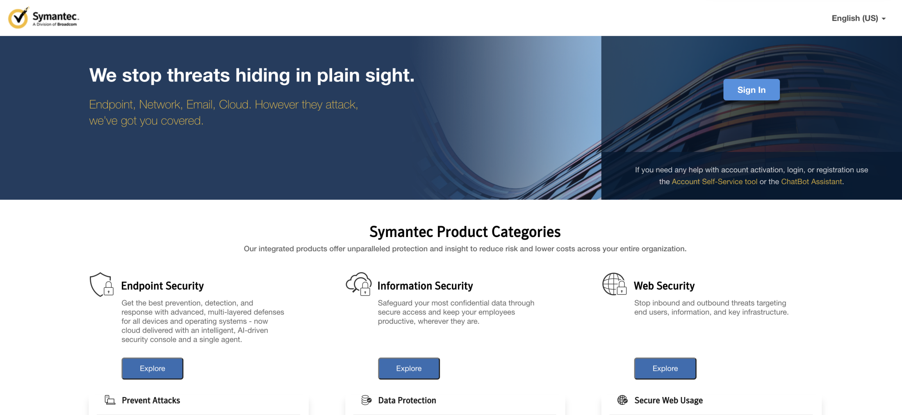
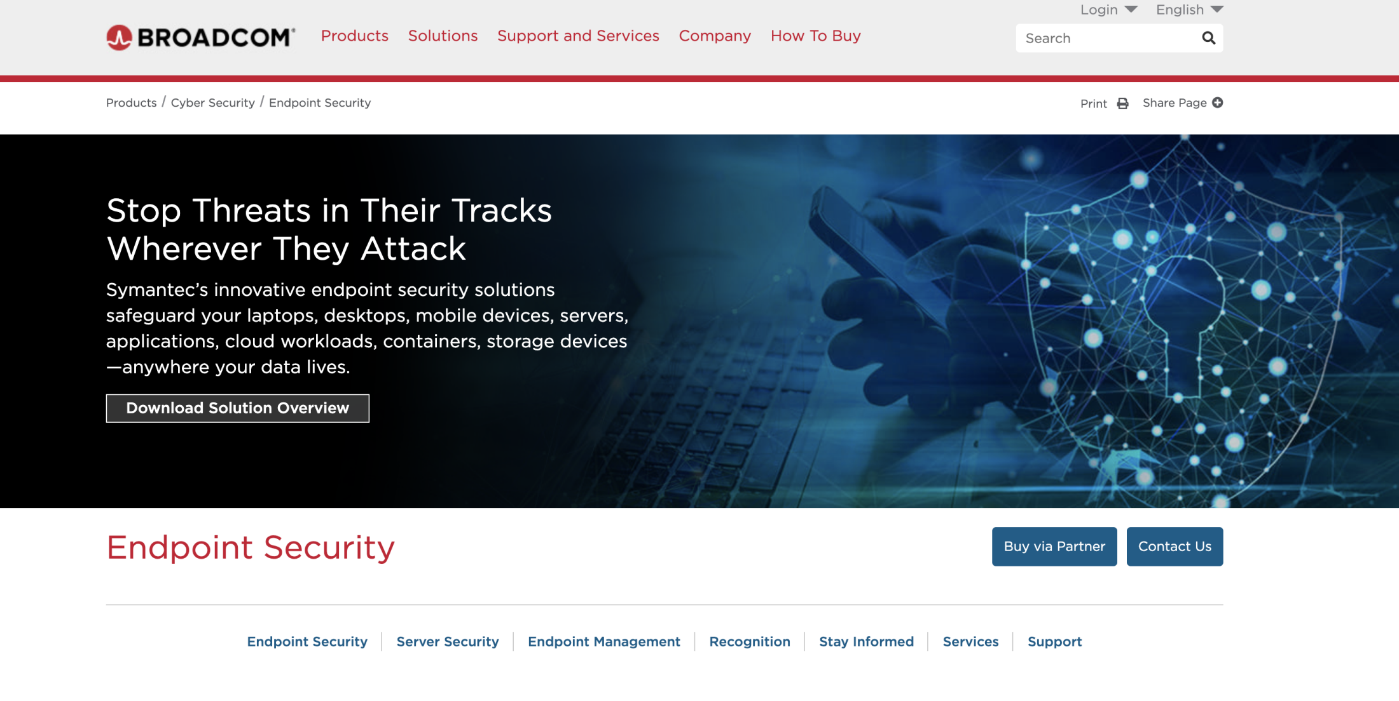
Symantec Analysis
Endpoint Protection goes beyond the capabililties of Anti-Virus by providing protection from many different attack types including:
Advanced persistent threat
Targeted attack
Phishing e-mail attachments
Social engineering
Malware variants
Traditional AV can't prevent at all

Slide 7
Symantec Analysis
Symantec
Conventional Endpoint Protection Solution
Sangfor
Conventional Endpoint Protection Solution
Secure
Insight: Cloud reputation evaluation
Sonar: Real-time behavior detection engine
APT: Advanced sustainable threat
Fast
Scanning technology
High-performance management console
Compatibility
Supports Windows, Mac, Linux
Supports three virtualization platforms
Security Cloud—Neural-X
Engine Zero
Three-dimensional protection
Multi-dimensional vulnerability detection framework
Single platform W point performance
Supports all virtualization platforms

Slide 8
Symantec Endpoint Protection
Access Control
APT
Application Control
Symantec
Endpoint
Protection
Personal Firewall
Equipment Control
Intrusion Prevention
Malicious Code Protection

Slide 9
Symantec Conventional Endpoint Security Defense: In-depth Mechanism
Intrusion Prevention
Reputation Rating
File Scanning
Behavior Analysis
Blocks and prevents network attacks from bringing malicious programs into the
system. (Protocol-based intrusion detection and
browser protection)
Uses reputation ratings from more than 100 million people to block malicious file and website access. (File reputation and
website reputation)
Search for virus signatures to block malicious files (Antivirus engine, heuristic scanning and automatic protection)
Monitors suspicious behavior to block malicious code in real-time (Sonar behavior detection engine, behavior feature library, ATP)
No browser protection Or website reputation support
Other support

Slide 10
Sangfor Endpoint Secure Solution
Sangfor support
Sangfor can also support integration with IAG
Connect to the internet
Activate service
Log into account
Remote sending method
Automatic E-mail notification delivery
Save Money
Simple, Fast and Effective
Flexible Deployment
Local deployment and remote migration
No additional hardware required
No special IT staff or training required
Sangfor support

Slide 11
Sangfor VS Symantec
Competitive Comparison
Features | Symantec | Sangfor
Asset management | Support | Support
Endpoint discovery | Unsupported | Support (Sangfor can view the installation rate, discover endpoints, unconfirmed endpoints, inactive devices and can clearly count managed and unmanaged endpoints.)
Storage control | Support | Support
Intelligent detection engine | Support | Support
Vulnerability patch management | Unsupported (Symantec does not have the vulnerability scanning, vulnerability repair and patch distribution functions of anti-virus software. Instead, it uses the host integrity strategy to check whether the corresponding patch has been applied.) | Support
Email protection | Support | Unsupported
Micro segmentation (firewall) | Support | Support

Slide 12
Symantec Functions
Competitive Comparison
Features | Symantec | Sangfor
Vulnerability attack protection | Support | Support
Global threat intelligence | Support | Support
Macro virus disposal | Support | Support
Ransomware disposal | Unsupported (Without feature detection, layered technology of key endpoint protection, lateral movement control and decoy technology to fully resist malicious ransomware and unknown attacks. Symantec mainly relies on the main defense capability and does not support ransomware protection, ransomware document catalog protection, ransomware encryption compensation) | Support
Network file search | Unsupported | Support (The entire network can be searched for the specified MD5 file, and the host name, file description, version, HASH value, security level and other information of the searched file can be displayed, and further processing of the file is supported)
Domain name search | Unsupported | Support (The entire network can be searched for the specified domain name, and the host name, process name, process file description, process file version, HASH value and other information that access the domain name can be displayed, and further processing of files is supported)

Slide 13
Symantec Functions
Competitive Comparison
Features | Symantec | Sangfor
Firewall-endpoint integration protection | Unsupported | Support
Endpoints remote management | Unsupported (Only supports restarting the endpoints’ system) | Support
Policy management | Support (Able to provide strategic adaptation capabilities based on geographic location) | Unsupported
Log report management | Support | Support
Account permissions | Support | Support
Malicious communication interception | Support | Support
USB control | Support | Unsupported (Cooperated with IP-guard)

Slide 14
Symantec Competitive Strategy
1. For operation and maintenance personnel
Highlight Endpoint Secure’s
convenient and closed-loop operation
and maintenance
Threat identification, tracking
and disposal
01
02
Visual display of threats
04
03
Report analysis
2. Older systems (XP, WIN7, Win Server2003) use Endpoint Secure's patch-free vulnerability repair functions
Overall solution integration
Service and customization capabilities

Slide 15
Analysis of Symantec
Can't keep up with
service capacity
Prism doors occur in
endpoint security vendors
01
02
Their configuration method is
focused on the Western market,
where operation and Maintenance
habits are very different
from the Asia-Pacific region
03
04
No special protection
against ransomware

Slide 16
Symantec Competition Summary
01
Ransomware protection at all stages of attack
02
The ability to visualize micro-isolated traffic and self-generate policies
Encourage
customers
to test products
03
Network endpoint integration
Threat location on the whole network with one-click quick isolation
04
05
Special tests for old systems
Competition Summary
The four main capabilities of Symantec SEP are anti-virus, firewall, IPS, and application control. Endpoint Secure's main capabilities are anti-virus, firewall (micro-segmentation), network endpoint integration, and patch-free repair technology. Symantec is relatively strong in anti-virus. Emphasize Endpoint Secure's AI anti-virus and integration capabilities, closed-loop operation and maintenance capabilities and service advantages.

Slide 17
Starting Conversations with Customers and Partners
Which endpoint security product is your company currently using? Are you concerned about the current ransomware and
mining incidents?
Note: To understand customer cybersecurity status, find their security product pain points, and what problems need to be solved.
2. When a security incident occurs , do you have professional security personnel to analyze and handle this incident?
Note: If the customer has a demand for security construction and their abilities are limited, customers will be impressed by the
IR + network endpoint integration program, and the cloud big data and online remote assistance from security experts.
3. Are you able to accurately locate any security problems and carry out effective closed-loop treatment?
Note: When a security incident occurs, it is often too late with a lack of effective closed-loop remediation methods. Endpoint
Secure provides a one-click kill function to quickly solve this problem.
4. If they use XP, WIN7, or Win Server2003, discuss Endpoint Secure's patch-free vulnerability repair functions.
5. Can your firewall provide integrated protection capabilities?
Network-endpoint integration and rapid response highlight the advantages of Sangfor Endpoint Secure in threat detection and
one-click response with network-endpoint integration, making it an overall ransomware solution.v c

Slide 18
Sangfor Endpoint Secure Advantages
1. Endpoint security operation and maintenance functions are relatively complete and easy to use
Frankly speaking, Symantec SEP may still focus on anti-virus analysis, but it lacks a closed-loop operation and maintenance perspective, such as how to allow administrators to easily see the entire network, how to effectively remotely control endpoints, and how to directly scan and detect risks and vulnerabilities. How to summarize experience and lessons through comprehensive report analysis and improve the overall defense strategy.
2. Advantages of ES at the operation and maintenance level
Security administrators can use ES to overview the entire network threats, what are the current problems of each endpoint in real time. Symantec SEP does not provide this kind of whole perspective of risk perception and presentation ability, and this kind of ability is very needed by operation and maintenance engineer.
Sangfor ES micro-segmentation function can be tailored to the isolation strategy of each endpoint/endpoint group/business domain and the flow between endpoints in the network is visible.
3. Closed loop protection and quick response
At the endpoint security protection level, Sangfor ES has a small closed loop and a large closed loop, forming a complete capability coverage.
Small closed loop: Sangfor ES forms a small closed loop of endpoint security from prevention-protection-detection-response-operation.
Large closed loop: the multi-product integration loop, supports integration with NGAF/IAM/CC/security service SOC platform, cloud etc. The large closed loop can make the detection and killing more accurate, and greatly improve the efficiency of threat disposal. It is a great value for security operation and maintenance.
4. Sangfor anti-ransomware module
In the field of ransomware protection, ES provides special defense capabilities (layer 4-5-6 protection architecture), and it is displayed on the main page of ES and provide convenient operation guidelines. Sangfor is the most professional vendor in the world in ransomware protection.

Slide 19
Sangfor Endpoint Secure Advantages
Cautions
The acquisition by Broadcom was not factored into this analysis as the acquisition has not closed. The acquisition by Broadcom adds some uncertainty to Symantec’s execution. Broadcom’s goals may not align with Symantec’s customers’ aspirations for the Sangfor Endpoint Secure.
Symantec’s has undergone numerous management changes over the past several years, including the recent departure of its CEO and replacement of several key managers. Symantec has been gradually losing market share as the market becomes more competitive, and it has lost its first place in market share by seat licenses to Microsoft.
Although Symantec has made significant investments in integrating its various products into a more cohesive middleware platform called Symantec Integrated Cyber Defense Exchange(ICDx), it is still lacking a universal incident response environment. However, Symantec does offer a rich set of APIs to integrate with other security tools.
Symantec EDR is missing advanced functions for large enterprise customers, such as case management workflow, remote shell response function (due 1Q20) and rapid pivot capabilities from one query to another. EDR does not provide blocking rules although automated actions can be scripted for specific detections. The user interface lacks guided investigation tips or contextual information, which makes it difficult to use for mainstream buyers. EDR and SEP are different management consoles.
SEP 15 Cloud console is relatively new and, although Symantec reports 55% of customers are using cloud, the vast majority are not using SEP 15 Cloud console. SEP Cloud is not FedRAMP certified.

Slide 20
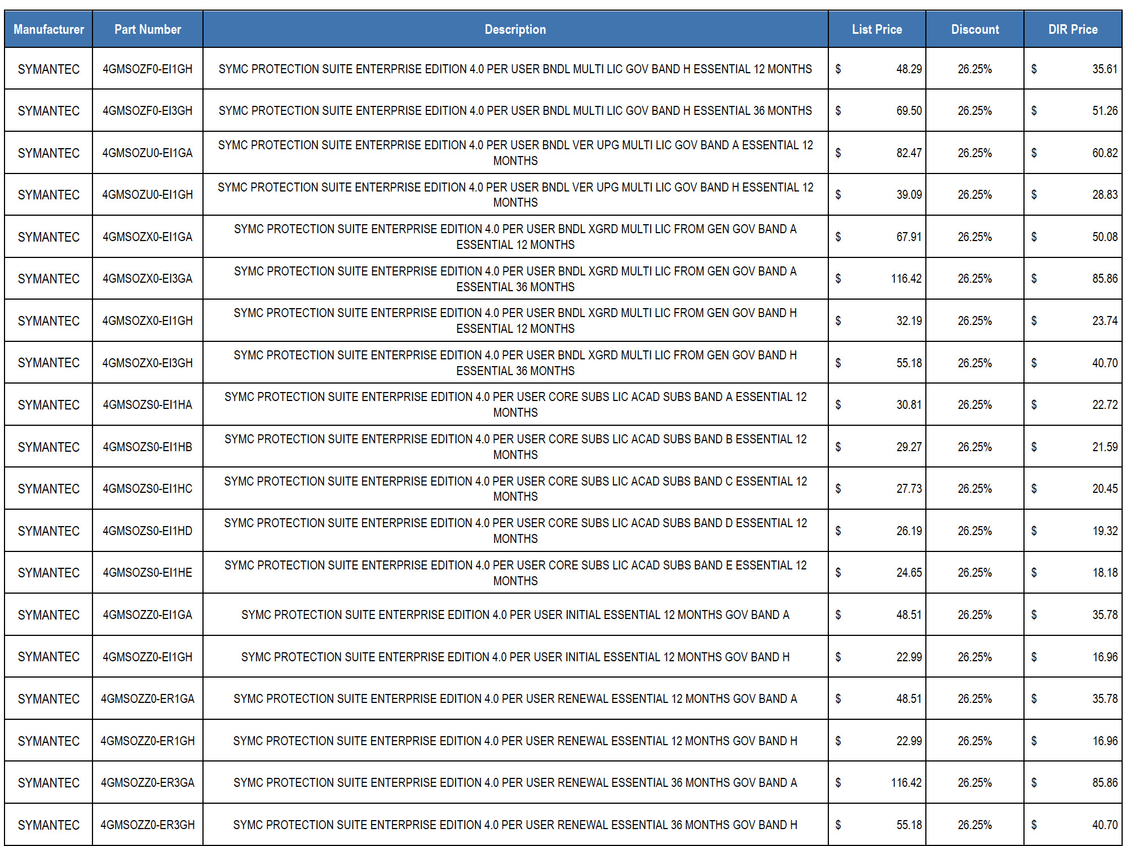
Price Analysis

Slide 21
Promotional Campaign
Buy 1 year of
Endpoint Secure service,
get 2 years of free service.
Endpoint Secure
promotion for 2021
(Only for projects sold with firewall)

Slide 22
THANK YOU !
Fan Yue | Sangfor ES Product Manager
fan.yue@sangfor.com
www.sangfor.com
Sangfor Technologies Inc.

