Slide 1


Veeam Backup and DR Solution Introduction
Cheney Hu
HCI Senior Solution Manager
cheney@sangfor.com
www.sangfor.com
Sangfor Technologies Inc.

Slide 2
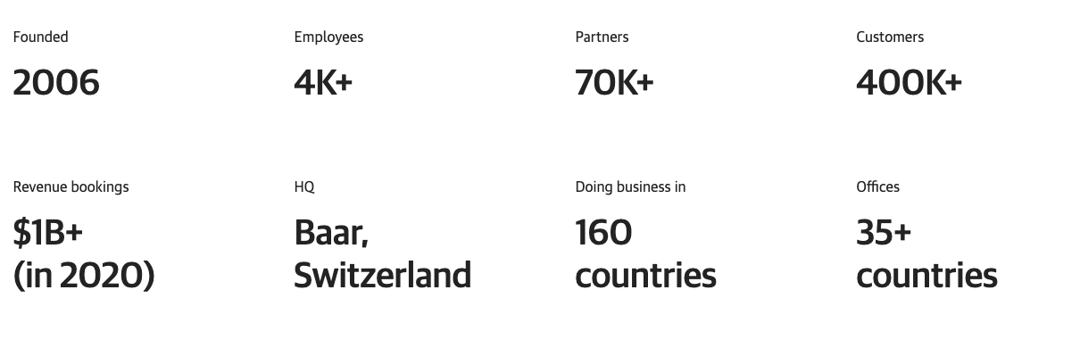
Veeam Company Overview

Slide 3
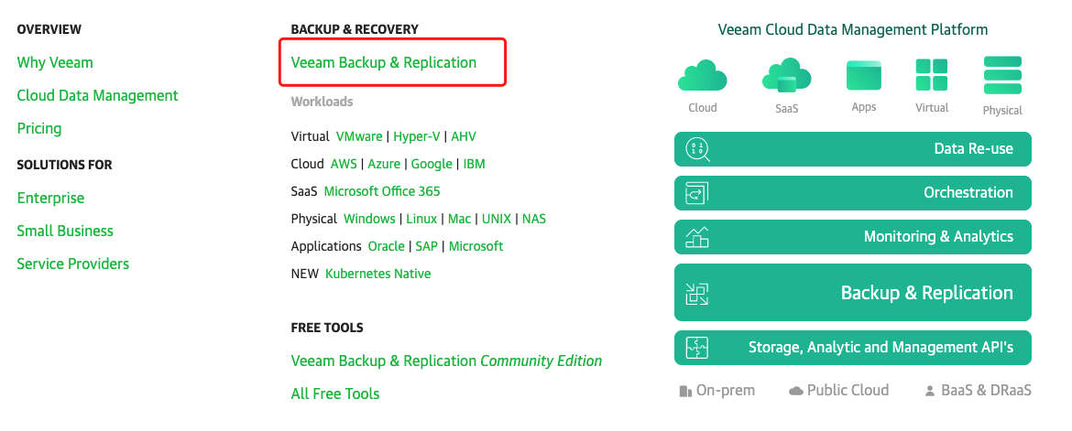
Veeam Product Offering

Slide 4
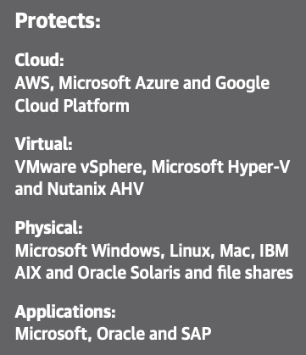
Veeam Backup & Replication
Key Capabilities:
Backup and recovery: Ensure your data is backed up and recoverable on your terms with various backup and granular recovery options.
Automation: Prepare, test and orchestrate your disaster recovery (DR) strategy to protect critical applications.
Cloud: If the cloud is part of your data center strategy, be prepared to backup and recover to, from and within the cloud for portability and cost savings.
Security: Effectively manage your backups from virtual testing to ensure that copies of your data are recoverable, secure and compliant.

Slide 5
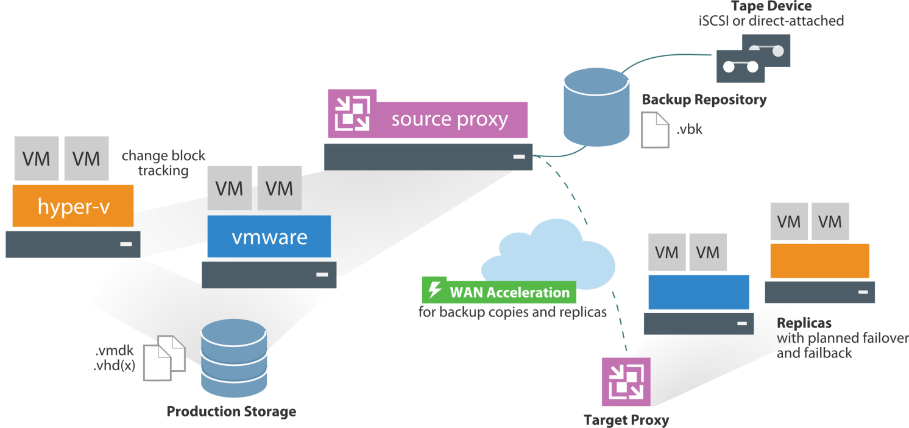
Veeam Backup & Replication Architecture

Slide 6
Core Components of Veeam Backup & Replication
Veeam backup server
Serves as the role of “configuration and control center”, it coordinates backup tasks, validates backup and recovery and handles resource distribution.
Veeam backup proxy
It handles backup tasks and transmit backup data to backup repository or backup proxy on the other side, features include looking up data from production storage, deduplication, compression and encryption.
Veeam backup repository
It is the storage location in which Veeam keeps the backup files, VM copies and metadata. It supports DAS (Microsoft Windows Server, Linux Server, SMB, NFS, external storage appliances and object storage).

Slide 7
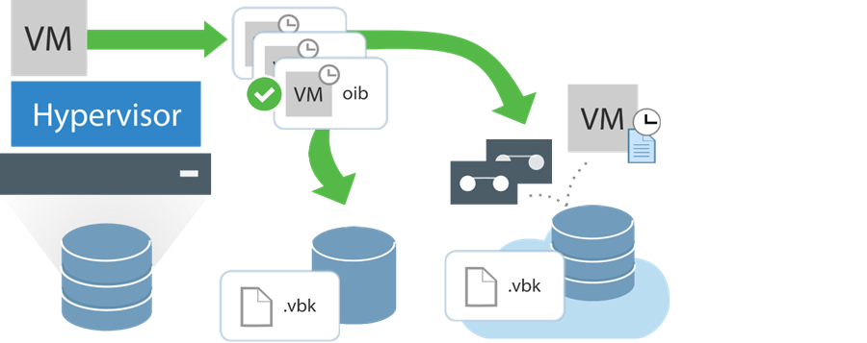
3-2-1-1-0 Backup Rule of Veeam
Have at least 3 copies of data.
Store the copies on 2 different media.
Keep 1 backup copy offsite.
Have 1immutable backup copy
0 data loss

Slide 8
Veeam Solutions and Highlights

Slide 9
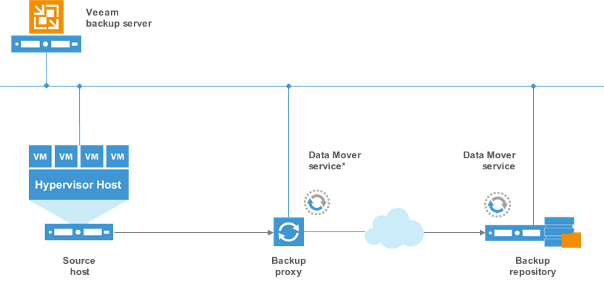
Agent-less VM Backup (for VMware & Hyper-v)
No need to install agent or plugin on the VMs, Veeam leverages vStorage API and VSS
to achieve efficient backup and recovery for VMs in VMware and Hyper-v without any
performance impact.
Notes:
Veeam leverage snapshot form Hypervisor and Storage and mount these snapshot to proxy server and backup data directly to Veeam repository if you setting the backup process with application awareness Veeam will recognize what application is during backup, and talk to these application to make sure the data consistency

Slide 10
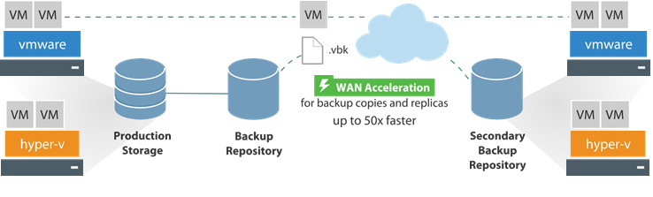
Agent-less VM Replication & DR (for VMware & Hyper-v)
Veeam can create Replication copy from VM’s backup file and transmit it to the off-site.
If the production site goes down, VM can be quickly recovered at the secondary site.

Slide 11
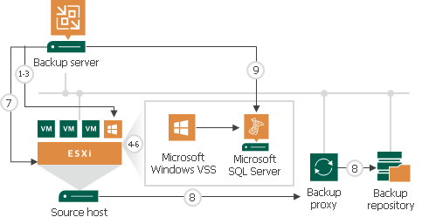
Application-aware Backup and Replication
Veeam supports backup and replication for applications in the VMs, supported applications include Oracle, SQL Server, Exchange, SharePoint and Active Directory.
Veeam Backup & Replication can create image-level backup based on the Application-Aware Image Processing (AAIP) technology of Microsoft VSS without shutting off the applications. That means, the data and files are consistent between source and target after the backup is done.

Slide 12


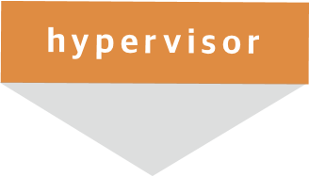



VM Instant Recovery
Recover in minutes
vPower®
Backup files
Deduped and compressed
Live migration
Production storage
Backup repository

Slide 13

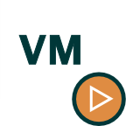



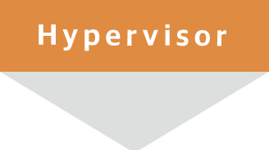





Heterogeneous Instant Recovery to vSphere & Hyper-v
3
1
Run the VM directly from backup file
Mount backup file
2
Register VM on the VM management console
VMware vSphere
Microsoft Hyper-V
Nutanix AHV
Windows Agent
vPower NFS
Linux Agent
Veeam Backup & Replication
Backup repository
Notes:
Remember that failed machine there could be from any source that we have backed into the Veeam VBK format and this functionality allows for us to instantly recover that machine into vSphere and have machine that was once an Agent or a Cloud based machine now running in your vSphere environment.

Slide 14
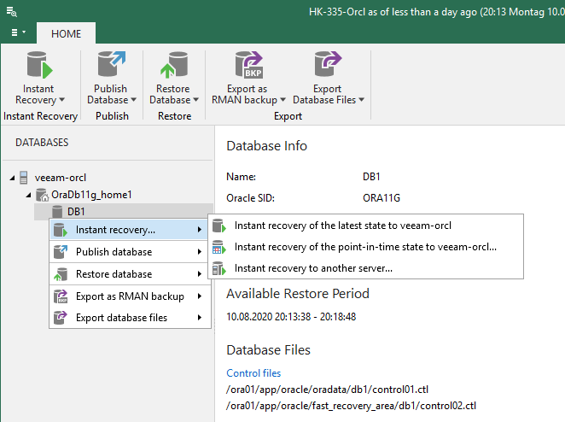
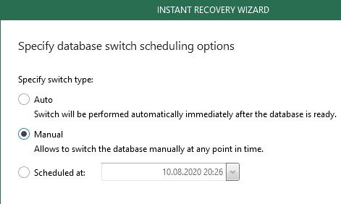
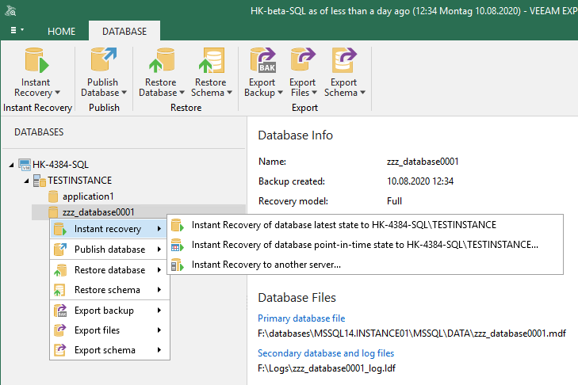
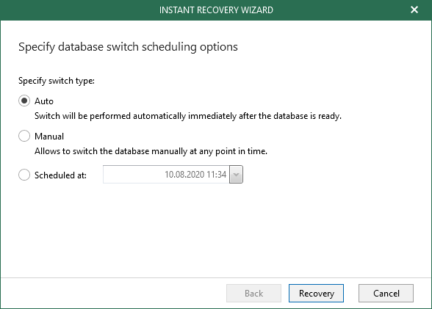
1-click Oracle & SQL Instant Recovery

Slide 15












File-level Backup
Data source: file sharing
Data management
Highlights
Innovative Cache Repository to facilitate fast incremental backup
Intelligent tier-ed data retention with short-term and long-term, 2nd backup copy can be backed up or archived to cloud
Fine-grained data recovery, specified recovered file version.
Scalable file backup proxy
VBR
ONE
SMB
EM
NFS
Short-term retention
Long-term retention (Archiving)
Linux Machine
Windows Machine
Cache Repository
2nd backup copy

Slide 16
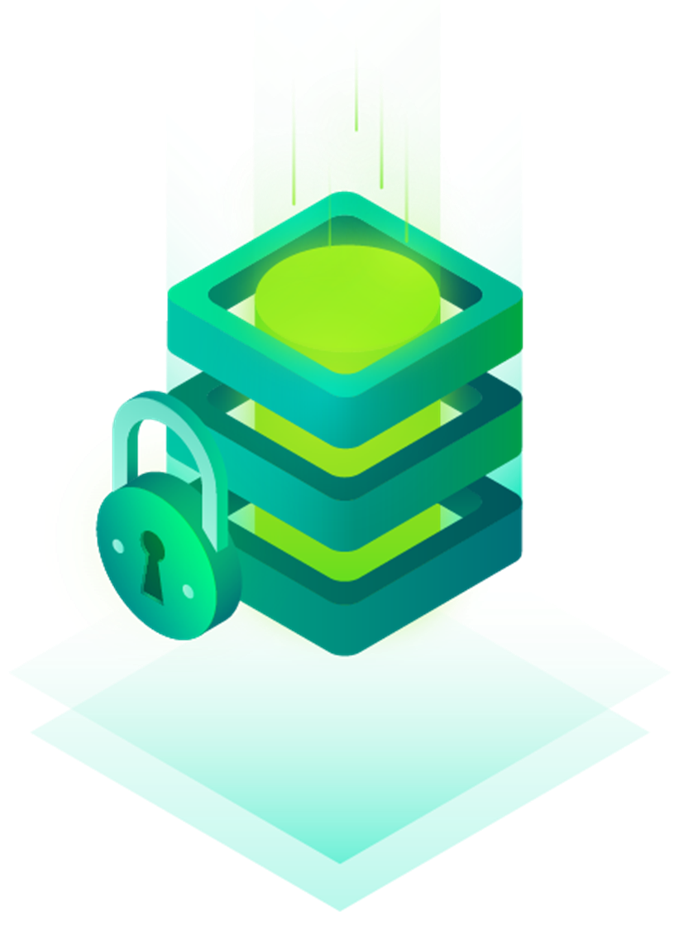
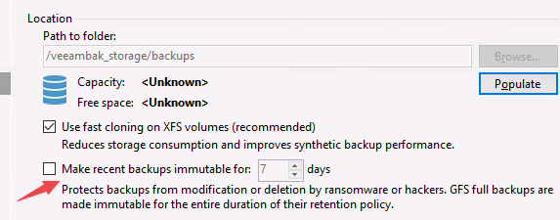
Hardened Linux Repository (new on V11)
Key features
Ensure data security by leveraging natively immutable anti-malware repository to prevent malicious encryption and deletion.
Natively support standard Linux OS, no need to acquire dedupe device or tape library.
Prevent the backups from tampering for a designated retention period.
Support fast data block cloning of XFS file system to reduce IO consumption
Notes:
Hardened Linux repository
With ransomware and bad actors lurking at every turn, data security is core to any strong data protection strategy and is paramount for ensuring customer privacy and business success. Primary storage is often an attack vector for cyberthreats, including ransomware attacks, making it important that your backups are made natively immutable to keep them safe. Veeam v11 offers a path of confidence by helping you store, secure and recover your backup data with confidence for its entire life cycle. Stop ransomware in its tracks, ensure backup compliance and safeguard your recoverability with native immutability for your backups.
Why/customer pain point
As malware often focuses on primary storage as an attack vector, it is more important than ever that they safeguard their backups kept on this storage — natively and for a set amount time as needed by the data’s retention policy.
What/Veeam rescue
Keep your data safe with native immutable, malware-safe storage repositories for your backups, preventing malicious encryption and deletion.
How/functionality
• Deliver native immutable backups in v11, preventing deletion or modification
• Keep backups and copies safe for the designated retention period
• Storage agnostic with reduced consumption using XFS fast block cloning

Slide 17
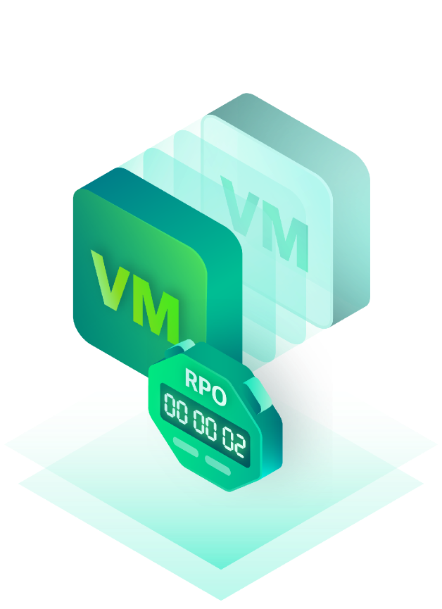
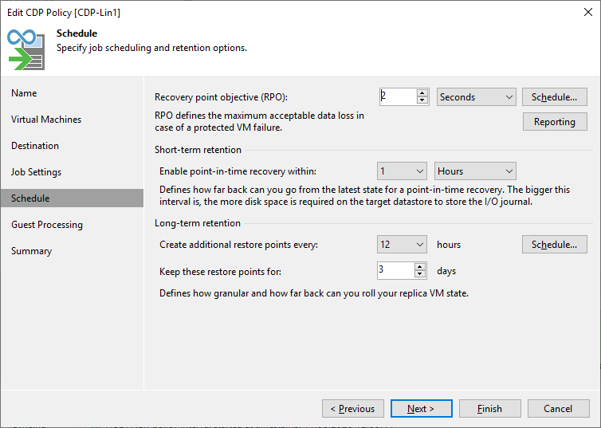
Veeam CDP
Highlights
Agentless
OS agnostic
Leverage vSphere VAIO API
Minimum RPO 2s
On-demand RPO
Application-consistent backups
can be specified for long-term
retention
Notes:
CDP
Business continuity and meeting both internal and external SLAs are things that all IT leaders keep front of mind. Requiring specialized hardware and training, solutions are often expensive in cost and complexity. Continuous Data Protection in v11 eliminates downtime and minimizes data loss for your Tier 1 VMware workloads. Now, you can instantly fail over to the latest state or point in time with ultra-low RPO granularity, measured in seconds, and customize RPOs and deployment options to meet your recovery objectives without added complexity and cost.
Why/customer pain point
Business continuity and meeting both internal and external SLAs are things that all IT leaders keep front of mind. Solving the problem is often expensive in actual cost of the technology and in the complexity that requires personnel training and time to build proficiency.
What/Veeam rescue
Eliminate downtime and minimize data loss for your Tier 1 VMware workloads with built-in Continuous Data Protection (CDP) and achieve immediate recoveries to a latest state or desired point in time.
How/functionality
• Instantly fail over to the latest state or point in time with ultra-low RPO granularity
• Eliminate cumbersome, disconnected point products that add complexity and cost
• Customize RPOs and deployment options that actually help meet your recovery objectives

Slide 18


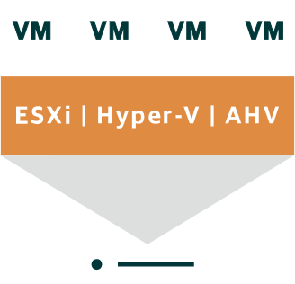

Built-in WAN Accelerator for Cross-site Data Replication
Help customer build 1-to-1 DR, VMs can be reovered at the DR site
Support CBT (changed block tracking) to realize minutes-level RPO
Minutes-level RTO
Save bandwidth cost with WAN accelerator
Support database-consistent protection without agents
Source WAN accelerator
WAN
Target WAN accelerator
Data Mover
Service
Backup Copy
and/or Replica job
Data Mover
Service
Source Backup Repository
Target Backup Repository
Source virtualization platform
Target hosts
Notes:
if you have Mission Critical Application need to Protect
Veeam help you replicate your mission critical application within near CDP RPO, customer can demonstrate your DRP as soon as they want.
Build-in WAN accelerator help customer reduce the cost for bandwidth and shrike the RPO.

Slide 19
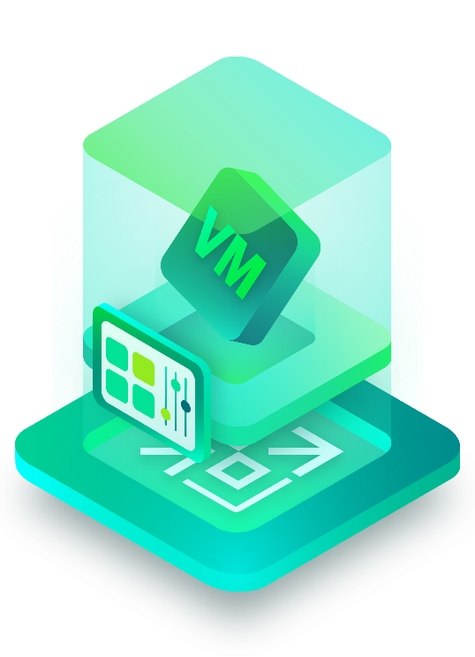
Veeam Datalabs
Data copy is exactly the same as that in production
From physical, cloud, HCI, oracle
To VMware/Hyper-v
Can be run simultaneously with production environment under isolated network, no impact on production business, delivering:
Value-added business capability
Data service
Data asset utilization
Natively supports
SureBackup & SureReplica: validation of backup and replication
On-demand Sandbox
Staged Restore: cleanse and decrypt data by automatically leveraging user script when creating datalabs
Secure Restore: launch virus scanning before recovery to ensure the security of data.

Slide 20


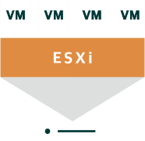









Secure Restore
1. Choose the recovery point
3. Triggers anti-virus scanning
4a. Keep restoring if no infection is detected
Veeam
Backup & Replication
Backup repository
Mount server
4b. Keep restoring but disable network adaptor when virus infection is detected
2. Mount the backup file to server
Includes the defined anti-virus software
4c. Pause restore when infection is detected
Notes:
The talk track here is to speak about the use case of Secure Restore – triggering an anti virus scan on the backup file before / recovery before restore

Slide 21
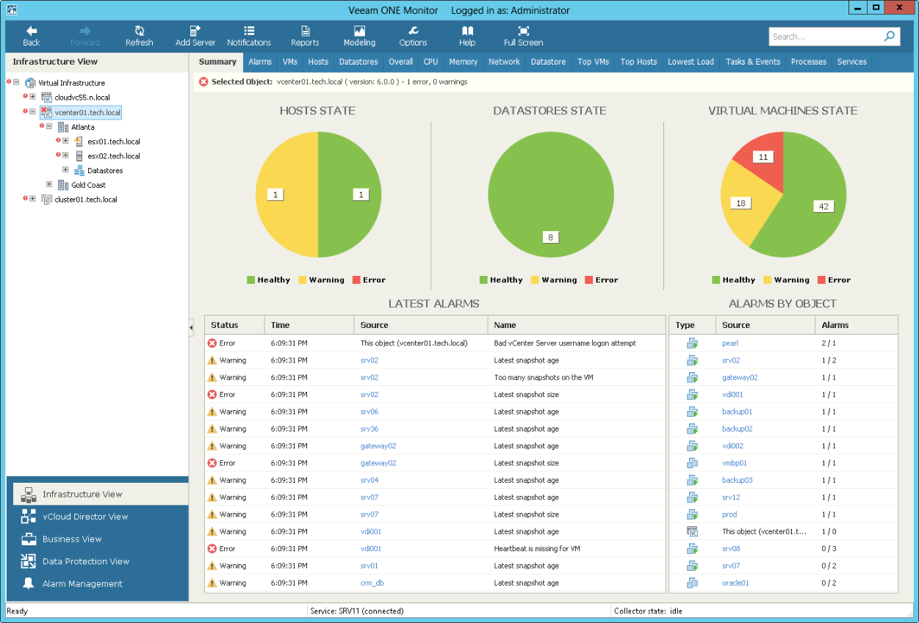
Veeam ONE Monitor
Veeam ONE:
Monitors health status of the virtualization platform
Provides Real-time alarms and alerting
Provides performance analytics dashboard and log tracking
Discovers OS-level potential risks of VMs

Slide 22
Veeam & Sangfor Joint Solutions

Slide 23

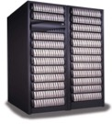
Agent-based VM Backup and Replication
Veeam Backup on HCI
1. Deploy Veeam B&R on HCI, mount repository from
aSAN storage.
2. Install agents on VMs, backup data to backup
repository through B&R.
3. Support both VM and file-level recovery.
4. If recovering to a new VM, the VM needs to be
pre-deployed.
Veeam Agent
Veeam B&R
Veeam Agent
VM
VM
VM
Sangfor HCI
aSV（Hypervisor）
NAS
SAN
Veeam Replication/DR on HCI
1. Deploy Veeam B&R on HCI at DR site, mount
repository from aSAN storage.
2. Install agents on VMs, configure DR policy on B&R.
3. Pre-deploy placeholder VMs at DR site
4. Recover the data in the placeholder VMs
Veeam Agent
Veeam Agent
Veeam Agent
Veeam B&R
Veeam Agent
VM
VM
VM
VM
VM
Sangfor HCI
WAN
Sangfor HCI

Slide 24
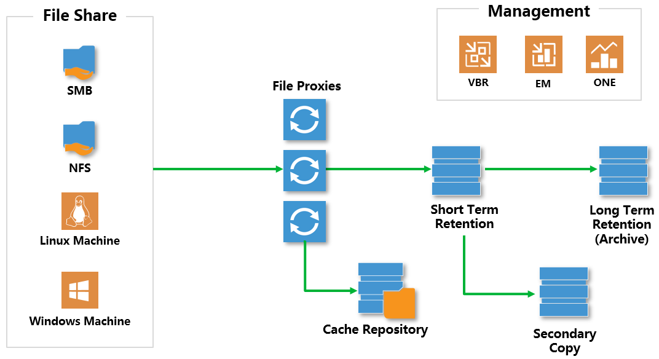
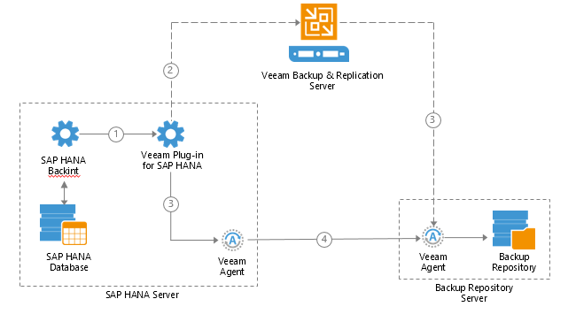
Veeam File-level Backup and Database Backup on HCI
Sangfor HCI
Oracle backup
File-level backup
For customers with requirements of backup or archiving
unstructured data for a long term, such as hopitals and schools.
SAP HANA backup

Slide 25
Heterogeneous Replication/DR to Sangfor HCI
VM
VM
Veeam Agent
Veeam B&R
Veeam Agent
VM
VM
VM
VMware/Hyper-v/Nutanix/Public cloud/Physical
WAN
Sangfor HCI
Veeam Replication/DR to HCI
1. Deploy Veeam B&R on HCI at DR site, mount
repository from aSAN storage.
2. Install agents on VMs on HCI, configure DR policy on B&R.
3. Pre-deploy placeholder VMs at DR site
4. Recover the data in the placeholder VMs
5. HCI VMs take over business after failover
DR from 3rd party infrastructure to Sangfor HCI

Slide 26
Feature Supportability Comparison
Veeam features | VMware | Hyper-v | Nutanix | Sangfor
Agent-less VM backup | ✔️ | ✔️ | ✔️ | ✖️(agent-based)
Agent-less VM replication/DR | ✔️ | ✔️ | ✖️ | ✖️(agent-based)
Instant VM recovery | ✔️ | ✔️ | ✖️ | ✖️
Physical host backup | ✔️ | ✔️ | ✔️ | ✔️
Instant Restore to VMware | ✔️ | ✔️ | ✖️ | ✖️
Database backup | ✔️ | ✔️ | ✔️ | ✔️
File-level backup | ✔️ | ✔️ | ✔️ | ✔️

Slide 27
THANK YOU
Cheney Hu | HCI Senior Solution Manager
cheney@sangfor.com
www.sangfor.com
Sangfor Technologies Inc.

Slide 28
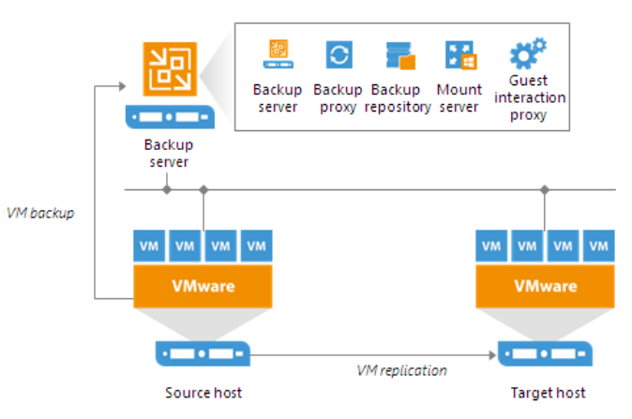
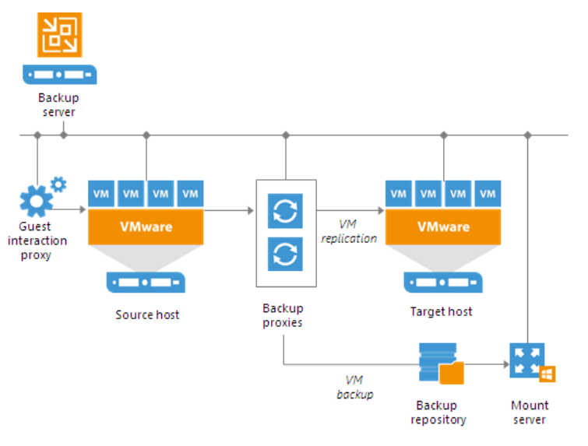
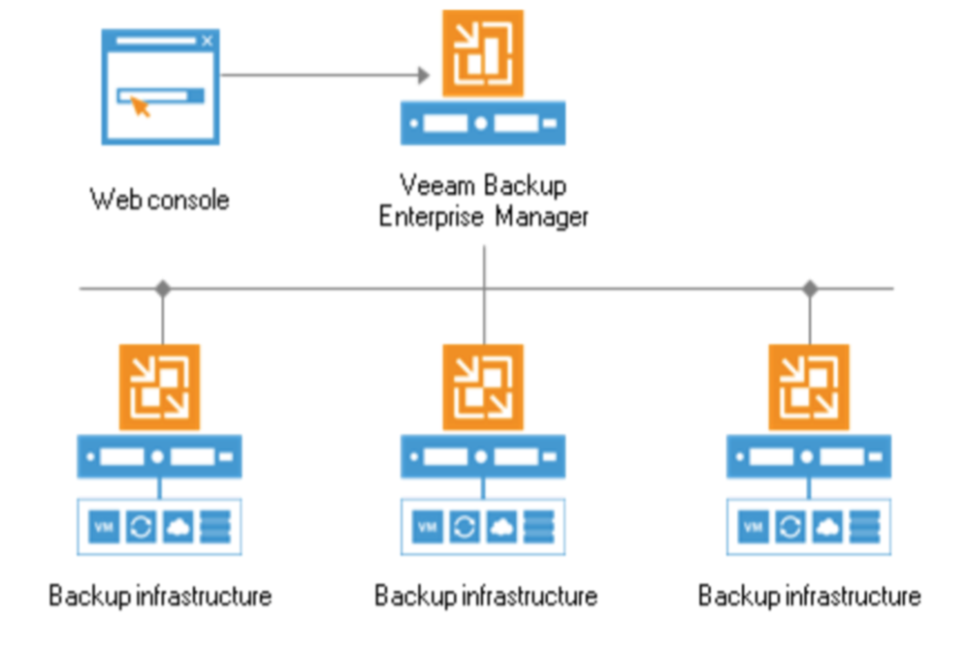
Veeam B&R Deployment Modes
Simple mode
Advanced mode
Distributed mode

Slide 29
Veeam Backup Solutions

Slide 30
VMware VM Backup

Slide 31
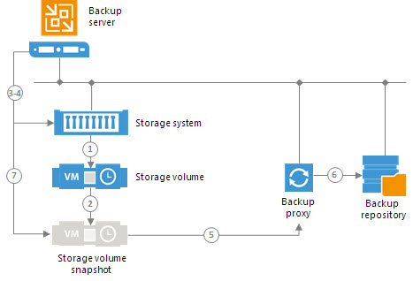
Backup Leveraging Storage Snapshot

Slide 32
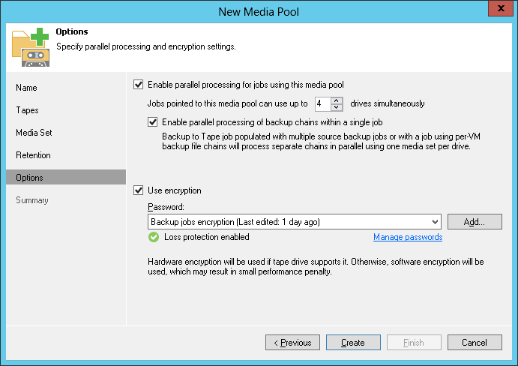
Backup to Tape

Slide 33
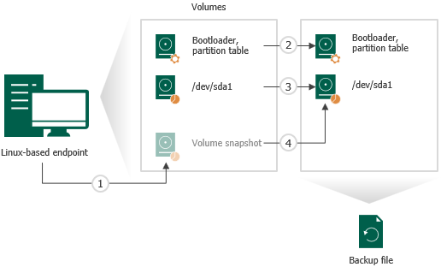
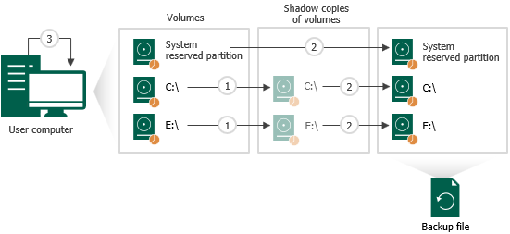
Data Protection for Physical Workloads
Veeam agent for Microsoft Windows
Veeam agent for Linux

Slide 34
Database Backup
Oracle backup
SAP HANA backup
Veeam supports backup for Oracle, SQL Server, MySQL, PostgrelSQL and SAP HANA

Slide 35
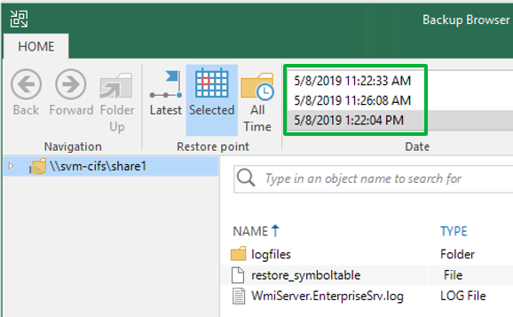
File-level Backup
Veeam for NAS
File-level recovery

Slide 36
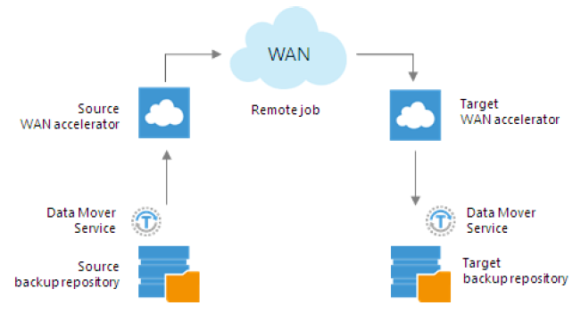
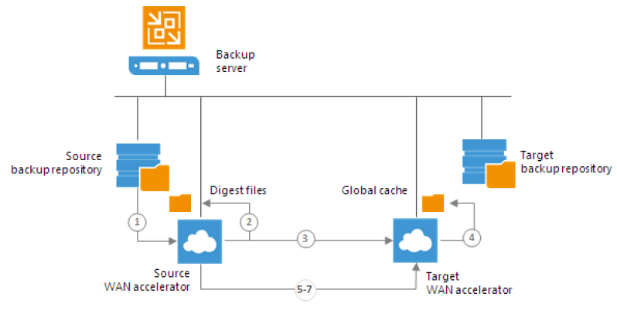
Replication & DR Solution

