Slide 1


Sangfor Business Continuity Solution
Technical Introduction
Cheney Hu
HCI Senior Product Manager
cheney@sangfor.com
www.sangfor.com
Sangfor Technologies Inc.

Slide 2
Sangfor Business Continuity Solution Panorama
Local HA
Disaster recovery
Planned migration
Disaster avoidance
Planned downtime
Inter-site load balancing
High availability
Active-passive disaster recovery solution
Active-active stretched cluster solution
SCP
aDR
aSC
aSV/aSAN/aNET/aSEC
x86
x86
x86
x86
x86
x86
DR
Site 1
Site 2
Site 3
SC
City A
City B

Slide 3
Choose The Business Continuity Solution
That Suits Your Need
Business Objective | Target RPO | Target RTO | Sangfor Solution & Capabilities | Bandwidth | Distance
Local high availability | 0 | Seconds | Local HA, RPO = 0, RTO = seconds | 1Gbps mgmt. | N/A
Disaster recovery, Disaster avoidance, planned migration | Minutes to hours | Minutes to hours | Active-passive disaster recovery, RPO = min. 1s, RTO = mins | Based on RPO and IO speed | No limitation
Planned downtime , disaster avoidance, site-level load balancing | 0 | Seconds | Active-active stretched cluster, RPO = 0, RPO = seconds | 10Gbps fiber, RTT<=5ms | <=50km

Slide 4









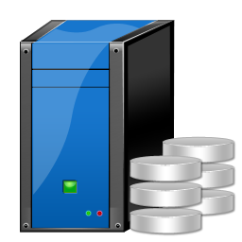
Recovery from Different Failure Scenarios
No distance limit,
RPO＞1hr, bandwidth≥30 Mbps, latency<50ms
RPO≤1hr, bandwidth≥100 Mbps, latency＜30ms
Data transfer
DC gateway
Incremental failback
DC gateway
Virtual storage
Virtual storage
Failure 1: VM crash/virus
Recovery: from backup/CDP
Failure 2: Node failure
Recovery: from HA
Failure 3: Site failure
Recovery: from DR failover
SCP
VM A
VM B
VM C
VM B
(placeholder VM)
Instant recovery
VM B
Backup/CDP
Instant recovery
Backup
storage pool
Production
storage pool
External storage
Primary site HCI
Secondary site HCI

Slide 5

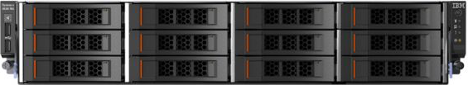
Sangfor Active-passive Disaster Recovery in A Nutshell
Main SCP
Standby SCP
VM
VM
VM
VM
VM
VM
VM
VM
VM
VM
Virtual network
Virtual network
Integrated and easy to use
Local backup + remote replication
Flexible RPOs, min. 1s
Backup storage pool
Backup storage pool
Production storage
pool
Backup
CDP
Production storage
pool
Instant recovery
HCI
HCI
Sync data to
DR site
Failback to production site
Site A
Site B

Slide 6
Drilling into Details
3. DR monitoring center
Provide DR monitoring, displaying DR status of all sites and protected VM groups with detailed alarms for fast troubleshooting
Main SCP
Standby SCP
1. Local backup/CDP
Support scheduled backup for VMs, backup interval can be set on hourly, daily and weekly basis
Support CDP for VMs to record every IO and roll back to any point of time in seconds granularity
4. Retrieve files
Able to directly retrieve files from local backup data (Windows) without recovering an entire VM
VM
VM
VM
VM
VM
VM
VM
VM
VM
VM
6. Failover to DR site
Failover VMs to DR site for fast business recovery in the event of disaster or planned maintenance
Virtual network
Virtual network
Backup storage pool
5. VM recovery
Able to recover an entire VM directly from local backup data
Backup storage pool
Production storage
pool
Backup
CDP
Production storage
pool
Instant recovery
HCI
HCI
Sync data to DR site
Failback to production site
2. Data replication
Sync the VM data to target HCI cluster according to configured RPO
7. Failback to production site
Failback VMs back to production site with only delta data transmitted
DC A
DC B

Slide 7
Highlights of Sangfor A-P DR
Solution highlights:
Integrated in the platform, no need for additional software, 1 click to enable VM-level DR solution
Adopted “local backup – offsite DR” DR solution, instant recovery from local CDP with seconds-level continuous protection. A variety of RPOs (1s, 10s, 10mins, 30mins, 1h, 2h, 4h, 8h, 12h, 1d, 2d, weekly) for offsite DR based on HCI
Save bandwidth consumption by features like continuous data transfer from breakpoint and compressed replication
Provide 1-click failover to DR site, network can be preconfigured to minimize RTO to mins
Provide incremental failback to production site from DR site
Provide main SCP and standby SCP to eliminate single point of failure
Provide visualized DR monitoring with detailed running status and alarms
DR testing is included to validate DR effectiveness without business disruption
Easy to use, no learning curve

Slide 8
HCI to HCI DR Bandwidth Calculation
RPO | Data change | Data change size | Needed bandwidth
1s | IO throughput | 5MB/s | 40 （Mbps )
 |  | 10MB/s | 80 （Mbps )
 |  | 30MB/s | 240 （Mbps )
2 hrs | Hourly data change | 1GB | 3 （Mbps )
 |  | 5GB | 15 （Mbps )
 |  | 10GB | 25 （Mbps )
 |  | 20GB | 50 （Mbps )
 |  | 50GB | 160 （Mbps )
12 hrs | Data change in every 6 hours | 50GB | 20 （Mbps )
 |  | 100GB | 45 （Mbps )
 |  | 150GB | 70 （Mbps )
 |  | 200GB | 100 （Mbps )
 |  | 300GB | 160 （Mbps )
24 hrs | Data change in every 12 hours | 50GB | 10 （Mbps )
 |  | 100GB | 20 （Mbps )
 |  | 150GB | 30 （Mbps )
 |  | 200GB | 45 （Mbps )
 |  | 300GB | 70 （Mbps )
RPO is highly relevant to data change rate and bandwidth, the amount of average data change must be fully replicated at a given bandwidth within the required RPO time.
Note: data must be backed up first before being replicated, that’s why the backup time needs to be deducted.
HCI to HCI DR bandwidth calculation formula
Item | RPO | Data sync interval | Data change size | Local backup speed | Needed bandwidth
Example | 1 day | 12 hrs | Data change size in 12 hrs:100GB | 50MB/s (default) | 100GB * 1024 * 8 /（12 * 3600 - 100 GB * 1024 / 50） ≈ 20Mbps
Formula | R s | R/2 s | Data change size in R/2 s: N GB | T MB/s | N * 1024 * 8 / （R/2 - N * 1024 /T）

Slide 9
HCI to HCI DR Storage Capacity Calculation
Production
Backup
Backup
Production
aSAN
aSAN
Primary site
Secondary site
Total usable capacity >= (production capacity + backup capacity) * 2
e.g. a VM is 100GB in size, RPO requirement is 1 hour, the data that’s changed in ½ hour is 0.1GB, the backup data needs to be stored for 7 days, then:
The total usable capacity for this VM at each site should be at least
100GB (production capacity) + (100GB+0.1*2*24*7)(backup capacity)=233.6GB

Slide 10
Sangfor Active-active Stretched Cluster in A Nutshell
Witness
Site C
10Gbps fiber
RTT<=5ms
App1
App2
App3
App4
App5
App6
HCI
HCI
HCI
HCI
HCI
HCI
Active-active storage
Site A
Site B
Automatic failover
Minimal downtime
0 data loss
Easy to deploy and manage

Slide 11
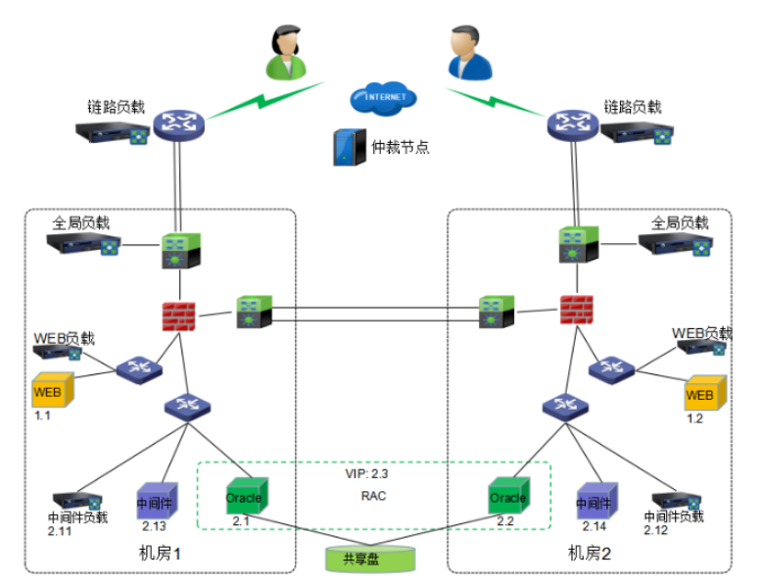

Drilling into Details
6. DRS
When a host in one fault domain is overloaded, VMs on this host will be live migrated to another host in the other fault domain to make sure host resources utilisation across fault domains are load balanced
7. Active-active
VMs for active-active applications are distributed across 2 fault domains, when either fault domain fails, VMs on the other fault domain will take over the business and ensure continuity
5. HA
When a host in one fault domain fails, the VMs on that host will be rebooted on another host in the other fault domain to restore compute. The access traffic will be redirected to other active VMs to ensure business continuity
SCP
HA/live migration
VM
VM
VM
VM
VM
VM
VM
VM
VM
VM
Virtual network
4. Stretched network
Network orchestration can be done on the unified WYDIWYG page
2. Fault domain
A HCI cluster in each site is considered as a fault domain, VMs are running in an active-active manner on 2 fault domains, obeying mutex rule, there’s no single point of failure
Storage pool
3. Stretched storage
Provide unified storage access route for upper applications based on stretched storage, one data has 2 copies at 2 sites. When application writes IO, it will be copied into 2 replicas and writes to both sites, only acknowledgements received by both sites will be counted as write succeeds to ensure data consistency
1. Stretched HCI
A logical HCI cluster
across 2 sites for unified
compute, storage and
network resources
HCI
DC A
DC B

Slide 12

Why Witness Matters in A-A Stretched Cluster
Witness
Site C
App1
App2
App2
10Gbps fiber
RTT<=5ms
App2
App1
App6
HCI
HCI
HCI
HCI
HCI
HCI
123
67
gh
67
123
45
abc
ef
abc
gh
45
Site A
Site B
The purpose of witness is to enable the cluster to achieve quorum when one of the two main data sites is offline. The witness also acts as “tie-breaker” in scenarios where a network partition occurs between the two data sites. This is sometimes referred to as a “split-brain” scenario. The witness does not store virtual machine data such as virtual disks. Only metadata such as witness components is stored on the witness.

Slide 13
Values of Sangfor Stretched Cluster Solution
Ultimate business continuity with 0 RPO and near-zero RTO
Start from 4 nodes, greatly lowering the entry threshold
Flexible workload allocation to maximize resource utilization with the co-existence of stretched virtual volume and traditional virtual volume
Unified and visualized management
Capable to work with DR to facilitate an A-A + A-P business continuity scheme

Slide 14
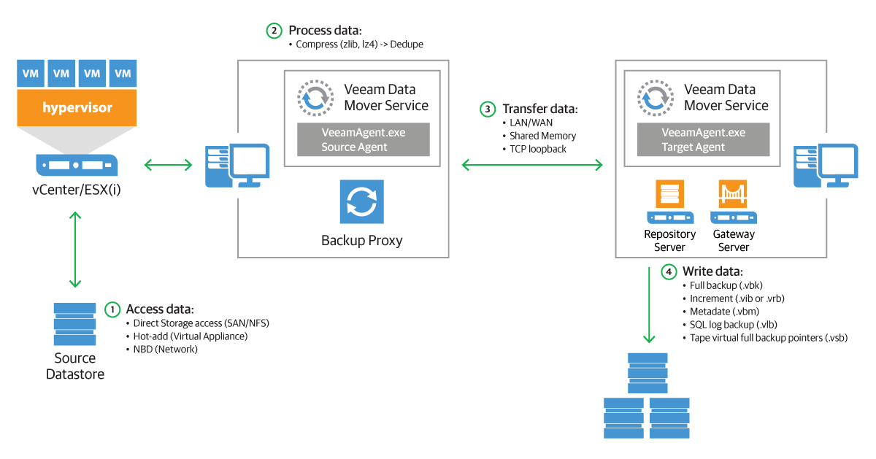
Veeam & Sangfor Joint DR Solution
Primary site
VMware/Hyper-v/…
DR site
Sangfor HCI

Slide 15
Veeam Adds The Last Piece to The Puzzle
Application-aware backup and DR for
Oracle
SQL Server
SAP HANA
PoastgreSQL
…
Note: Veeam agent is required

Slide 16


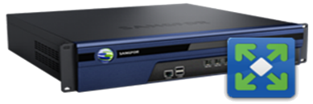

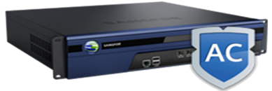



DR Responsibility Matrix
Sangfor HCI provides only platform-level data sync and failover, for the external network design, we offer suggestions and consultation, final design is up to customer’s existing environment and willingness.
ISP/LB provider
DC gateway
DC gateway
DNS, Internet service, load balancer
e.g. F5, A10,…
AD
AD
Security
NGAF
Security
NGAF
Sangfor
IAM
IAM
Core switch zone
Leased line
/fiber
Core switch zone
Network provider
Access/Core Network,
e.g. Cisco, Juniper,…
SSL VPN
SSL VPN
SSL VPN
SSL VPN
AD
Core switch
Core switch
AD
AD
Core switch
Core switch
AD
Business zone
Management switches
Business zone
Management switches
Business switches
Business switches
Infrastructure
Compute, storage and virtualization
Sangfor
VM
VM
VM
VM
VM
VM
VM
VM
VM
VM
VM
VM
VM
VM
VM
VM
VM
VM
VM
VM
VM
VM
VM
VM
VM
VM
VM
VM
VXLAN switches
Page 15
VXLAN switches
Storage switches
Storage switches
CONFIDENTIAL

Slide 17

DR: Network Architecture
OA
VPN
Finance
system VPN
Order
system VPN
... ...
Email
system VPN
DC A
DC B
DC gateway
DC gateway
AD
AD
NGAF
NGAF
IAM
IAM
Core switch zone
Leased line
/fiber
Core switch zone
SSL VPN
SSL VPN
SSL VPN
SSL VPN
Core switch
Core switch
Core switch
Core switch
AD
AD
AD
AD
External storage zone
Business
switches
Business zone
Management
switches
Business
switches
Business zone
Management
switches
VM
VM
VM
VM
VM
VM
VM
VM
VM
VM
VM
VM
VM
VM
VM
VM
VM
VM
VM
VM
VM
VM
VM
VM
VM
VM
VM
VM
Storage
Storage
VXLAN switches
Storage switches
VXLAN switches
Storage switches

Slide 18









Stretched Cluster Network Architecture
Router
Internet
Router
AD-1000
DWDM
Witness
Router
Internet
Router
AD-1000
AD-1000
AD-1000
DWDM
DWDM
Core
switches
DWDM
Dark fiber
DWDM
Core
switches
Stacking
Stacking
AD-1000
AD-1000
AD-1000
AD-1000
Management switches
Business
switches
Storage switches
Storage switches
Business switches
Management switches
GE
10GE
10GE
Stacking
Stretched volume
Stretched volume
SANGFOR HCI cluster
External storage
SANGFOR HCI cluster
Site A
Site B

Slide 19


Sangfor Business Continuity Solution’s Differentiations
Simple
Reliable
Affordable
All-in-one architecture
Unified management
No learning curve
Ultimate protection with zero RPO and near-zero RTO
Bottom-up reliability design
DR testing
No 3rd party backup or DR management involved
No external storage involved
Minimum footprint

Slide 20
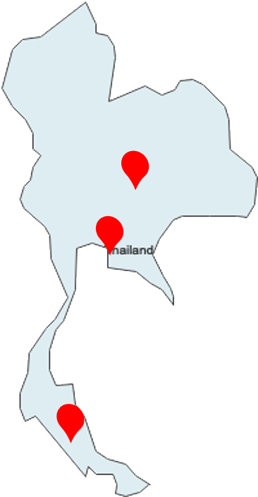
A Manufacturer’s Story
Original requirements
Build SAP ERP at the two factory sites
Provide HA and maximum data protection
Provide Business Continuity plan between 3 sites to meet regulations of public listed companies
Sangfor Solution
HCI + aDR (CDP) + vAF + SD-WAN + IAM
Benefits
One-stop solution to offer a complete infrastructure stack
Maximum protection with CDP, file-level recovery for file server
Simplified and flexible disaster recovery solution to meet
regulatory requirement
SD-WAN is leveraged to reduce DR traffic over the links

Slide 21
Supplemental Videos
Sangfor HCI backup and DR demo video
https://www.youtube.com/watch?v=NRzfI0x_kxk
Sangfor HCI DR Architecture Whiteboard
https://www.youtube.com/watch?v=eREWBhXz_us
Sangfor HCI Reliability & DR live demo
https://www.youtube.com/watch?v=qzoRO3BCYyA&t=3s

Slide 22

THANK YOU!
Cheney Hu
HCI Senior Product Manager
Sangfor Technologies
cheney@sangfor.com
Make IT Simpler, More Secure and Valuable

Slide 23
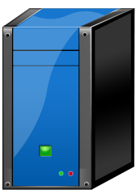
Drilling into Details
HA, DRS
Solution
A single HCI cluster is divided into two fault domains at each site, data copies are distributed on the 2 fault domains
RPO=0 Support data active-active, the data stored at DC A and DC B is exactly the same, RPO = 0
）Support cross-site HA, if a site fails, VM is pulled up at the other site, RTO = 3-5 mins (HA trigger time + reboot time)
Support business A-A and data A-A for distributed applications, RPO=0, RTO is up to the switchover mechanism of the application, e.g. Oracle RAC RTO ≈ 30s
VM works normally when link between witness site and production site is down
VM A
VM B
VM C
VM A
Virtual
disk
Virtual
disk
Virtual
disk
Virtual storage data copy
Virtual storage data copy
1. Distance <= 50KM
2. Bare fiber ≥ 10Gbps
3. RTT <= 5ms
Restrictions:
Minimum cluster size is 4 nodes (2+2)
Witness node is required to be deployed at a 3rd site with link bandwidth ≥100Mbps and RTT ≤5ms
Stretched cluster can’t solve problems caused by virus or bluescreen, backup should be deployed to protect business from these logic failures
Stacking
External storage
DC A
DC B
Stretched cluster can’t solve logical failures caused by virus and bluescreen, backup is required for those problems.
Bandwidth≥100Mbps
RTT≤5ms
Bandwidth≥100Mbps
RTT≤5ms
Witness appliance can be deployed on either physical server or VMware.
Witness node
DC C

Slide 24





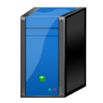

Network Switchover
Sangfor HCI provides only platform-level data sync and failover, for the peripheral network design, we offer suggestions and consultation, final design is up to customer’s existing environment and willingness.
Access route before failover
External users
切换前访问线路
Access route after failover
切换后访问线路
DNS
www.test.com<->Main DC gateway IP/ DR DC gateway IP
Internet
Public IP
Internet
Public IP
172.16.1.254
172.16.2.254
Office network gateway
172.16.1.1
172.16.1.1
Core/access
172.16.1.254
Business line
Core switch
192.168.1.254（vlan）
192.168.1.254
172.16.2.1
Local DNS
10.2.2.254
Core switch
Main site access
DR site
Access switch
vRouter
Access switch
192.168.1.0/24
192.168.1.0/24
192.168.1.254
10.2.2.0/24
Data link
192.168.1.0/24
192.168.1.0/24
Office area
Main site
DR site
Data sync link
Main site
DR site
Normally user accesses business running on main site through DNS resolution
When main site fails, user should try to restore main site first, DR failover is only initiated after systematic risk assessment.
During the failover, user manually restores the VMs at DR site, and change the DNS resolution to DR site to make business accessible.
AD or public DNS can be used, manual switchover is recommended
Normally user accesses business on main site through route resolution
When main site fails, user should try to restore main site first, DR failover is only initiated after systematic risk assessment.
During the failover, user manually restores the VMs at DR site, and change the routing to DR site to make business accessible.

Slide 25


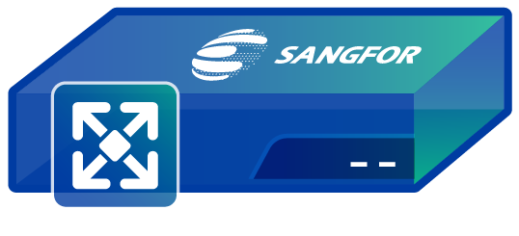

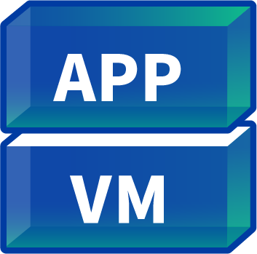
Automatic DNS Switchover Based on Sangfor AD
Domain name: www.sangfor.com
NS1: ns1.sangfor.com
A-record: 202.202.2.110
NS2: ns2.sangfor.com
A-record: 202.202.2.112
Access www.sangfor.com
Doman name provider
Client
AD1(global DNS) IP：202.202.2.110
AD2(global DNS) IP :
202.202.2.112
Domain name: www.sangfor.com
A-record: 202.202.1.111
DNS configuration sync
Domain name: www.sangfor.com
A-record: 202.202.1.112
vAD1
vAD2
VIP: 202.202.1.111
VIP: 202.202.1.112
Normal
VM recovery
Failover
10.10.2.11
10.10.2.12
10.10.2.13
10.10.2.11
10.10.2.12
10.10.2.13

Slide 26








Failure Scenarios in Stretched Cluster
Ineternet
Ineternet
Gateway
Access switch
Gateway
Gateway
VRRP
Office area
Core switch (active)
Core switch (standby)
Core switch
Access switch
Access switch
Access switch
Access switch
Access switch
Office area
Fault domain A
Fault domain B
Fault domain A
Fault domain B
Witness node
Witness node
Stretched cluster
Stretched cluster
Normally, VMs are working properly between fault domain A and fault domain B at the two sites
When fault domain A suffers failure, HA is triggered to reboot the VMs on B, no manual interruption is required.
Normally, VMs are working properly between fault domain A and fault domain B at the two sites
When fault domain A suffers failure, HA is triggered to reboot the VMs on B, no manual interruption is required.
Core switches are configured with VRRP to automatically switchover in the event of failure.

Slide 27
How to License for DR
①SCP
②aSV
⑦
CDP
⑧
aHM
⑨
aDR
⑩
aSC
③aNET
④aSAN
⑤aSEC
Must have
Backup: ②
CDP: ②⑦
HCI DR: ②⑨
Stretched cluster: ②④⑩

