Slide 1



Sangfor Managed Cloud
Service Program
Sangfor Cloud
Masoud Malik
Senior Product Marketing Director
www.sangfor.com
Sangfor Technologies Inc.

Slide 2

Contents
PART 1
PART
2
PART
3
PART
4
Background of MCS
Sangfor MCS Solution
Sangfor MCS advantages for the Partner
MCS Success Stories

Slide 3
PART 1
Background
of MCS

Slide 4
It’s Cloud Era
Are you still hosting traditional IDC ？
Are you still only selling bandwidth and Internet IP？
Come on, it’s Cloud Era !
Why Cloud？
Speed
Make it possible that vast amounts of computing resources can be provisioned in minutes
The worldwide Managed Cloud Service is forecast to be 84.7 billion USD by2023. IDC Report
Cost
Only pay when customers consume computing resources, and only pay for how much customers consume.
84.7 Billion USD
Productivity
Help your customers focus on projects that differentiate their business, not the infrastructure.
48 Billion USD
Scalability
Deliver the right amount of IT resources — more or less computing, storage—right when customers needed
2019
2023

Slide 5

Why Customers Need Local MCS
Better Service
Most enterprise face difficulties getting a fast response from the Public cloud, which is mainly focused on serving large-scale organizations, so customers really need a better-service cloud built for their needs
Simplicity
Most organization do not have enough experience to operate the public cloud and fix urgent problems, so they need local cloud help.
01
02
Reliability
To prevent disaster, customers need to backup or replicate their data to secondary site, but most of them cannot afford to build a DRC, so Local MCS can provide backup as a service or DRaaS to help them promote reliability
Policy & Compliance
Many Governments don’t allow to host Data and business server outside the country, so local cloud is really necessary for customers
03
04

Slide 6

Three approaches move to cloud
Private cloud
Managed cloud
Public cloud
Sensitive application
Hosted Sensitive application
Internet business
Customer DC
Provide DC
Self operation
Service provider
Service provider
Dedicated Resource
Shared Resource
Product delivery
Service Delivery
High Cost
Long Cycle
Inelastic
Complicated
Limited space
Logic isolation
Data risk
Limited Service
Elastic
Pay as you need
Dedicated
Secure
SLA service
Elastic
Pay as need
Reliable
Private
Managed
Public
Have Both

Slide 7
PART 2
Sangfor MCS
Solution

Slide 8





What is the Sangfor Managed cloud service Program
Sangfor Managed Cloud Service(SMCS)
The Sangfor managed cloud service Program enables partners to use Sangfor cloud solution on a subscription basis , economicaly, Efficiently, driving them successfuly move to Managed private or hybrid cloud providers, Whatever they are traditional MCP,MSP,MSSP or SI
Local Managed cloud
Local Managed cloud
Hybrid cloud
Local cloud & AWS
Global Distributed Service Platform
Sangfor Regional Service Data Center
Migration & Backup
Automation
Fix & Recovery
Technical expert team( HQ + Local )

Slide 9



Sangfor Managed cloud service idea
Managed
Cloud
Private Cloud
Public Cloud
One unified Architecture
HCI-Based
Software defined datacenter
Consistent Experience
VM & Container &Secure
Backup & DR
Superior Service
Automation M&O
Proactive & add-value service

Slide 10













SANGFOR Managed Cloud Architecture Overview
Business Operation
Migration
Multiple Tenant
Service Portal
P2V Tools
DB Migration
Ticket, Metering &API
Monitoring &Report
Cloud Service catelog
Data Base
Cloud Servers
Dedicated Hosted
Load Balance
NAT Gateway
Backup
Storage Service
Container Service
Elastic IP
Virtual Desktop
Disaster
Recovery
Virtual Network
Cloud Backup&DR
Host Security Service
SaaS Service
Hyper Converged Infrastructure
aSV
aSAN
aNET
aSEC
vGPU
VMware
vSphere
Service
Consulting
Technical
support
External storage

Slide 11

SMCS Data Center logic architecture
Shared zone
Dedicated zone
Co-location
Service portal
Service portal
Talent A
Talent B
Talent C
Talent D
Gov A
Enterprise B
DR site
Service
Portal
Service Portal
Management Zone
Local Backup
Monitoring Center
Shared the Storage resource
Dedicated S
Dedicated S
Container
DR
Public Service Zone
Shared Zone：Offering computing or storage service based on the shared physical resource
Dedicated Zone：Offering dedicated compute and storage resource to build hosted private cloud to specific enterprise or industry
Co-location Zone：Offering dedicated physical space and hardware resource to meet customer’s specific business use case
Management Zone：Offering hierarchical management and access permissions whatever they are operators and end user
Public Service Zone：Dedicated Service and technical expert team to provide the superior service experience

Slide 12





SMCS Tenant view
Admin can manage, operate and allocate resource through Sangfor SCP
Tenant can manage, monitor and approve resource through tenant console;
USER A
USER B
USER C
USER D
Sangfor Cloud Management Platform
VPC A
VPC B
VPC C
VPC D
Tenant A
Tenant B
Tenant C
Tenant D
aCloud Cluster A
aCloud Cluster B

Slide 13
Multi-Tenancy Hierarchy
Super Admin
Tenant A
User 1
User 2
Tenant B
User 3
PLATFORM Admin
TENANT Admin
TENANT User
Multi-level management to allow the administrators to allocate and monitor resources for each individual tenant and pre-define cascading security parameters and permissions.

Slide 14



How to ensure the Isolation between tenants
Sangfor SCP provide VPC (virtual private cloud) to each tenant, ensuring their internal traffics is completely isolated from others.
Internet
Bind EIP
Bind EIP
VPC 1
VPC 2
VPC n
VPC
Tenant 1
Tenant 2
…
Tenant n
Tenant
Service Provide also can offer dedicated cabinet or physical cluster to sensitive business and data
aCloud cluster 1
VMware cluster
aCloud cluster 2
Shared resource pool
Dedicated
resource pool

Slide 15

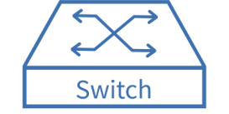
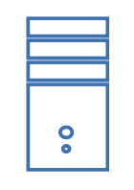
EIP Assignment in VPC
ISP
EIP is stand for Elastic IP.
A pool of IP address that can assign to every tenant. Tenant have more than 1 EIP.
Normally EIP pools is a public IP address pool.
EIP Use Case 1: Assign at edge virtual router at every VPC to allow internet access
EIP Use Case 2: Assign to specific VM in VPC and able to access directly from public network
VPC A
VPC B
VM 1
VM 2

Slide 16
Tenant Quota Allocation
Tenant Resource
CPU
Memory
Storage
IP Address
Bandwidth
Every Tenant will have their own dedicated resource quota…
Compute (Cores, RAM)
Network (Bandwidth, EIP,Security)
Storage (VM Storage, Backup Storage)
Container and backup
YOUR TITLE
HERE
applications and network functions. A cloud-based architecture for.

Slide 17
Billing & Metering
CPU
RAM
Storage
$$$
Monitor, measure and control each tenant’s resource consumption and define charging policy by the pre-defined/negotiated rates.
CPU
RAM
Storage
The charges rate is count by per hour usage
Able to achieve pay-per-use business model.

Slide 18
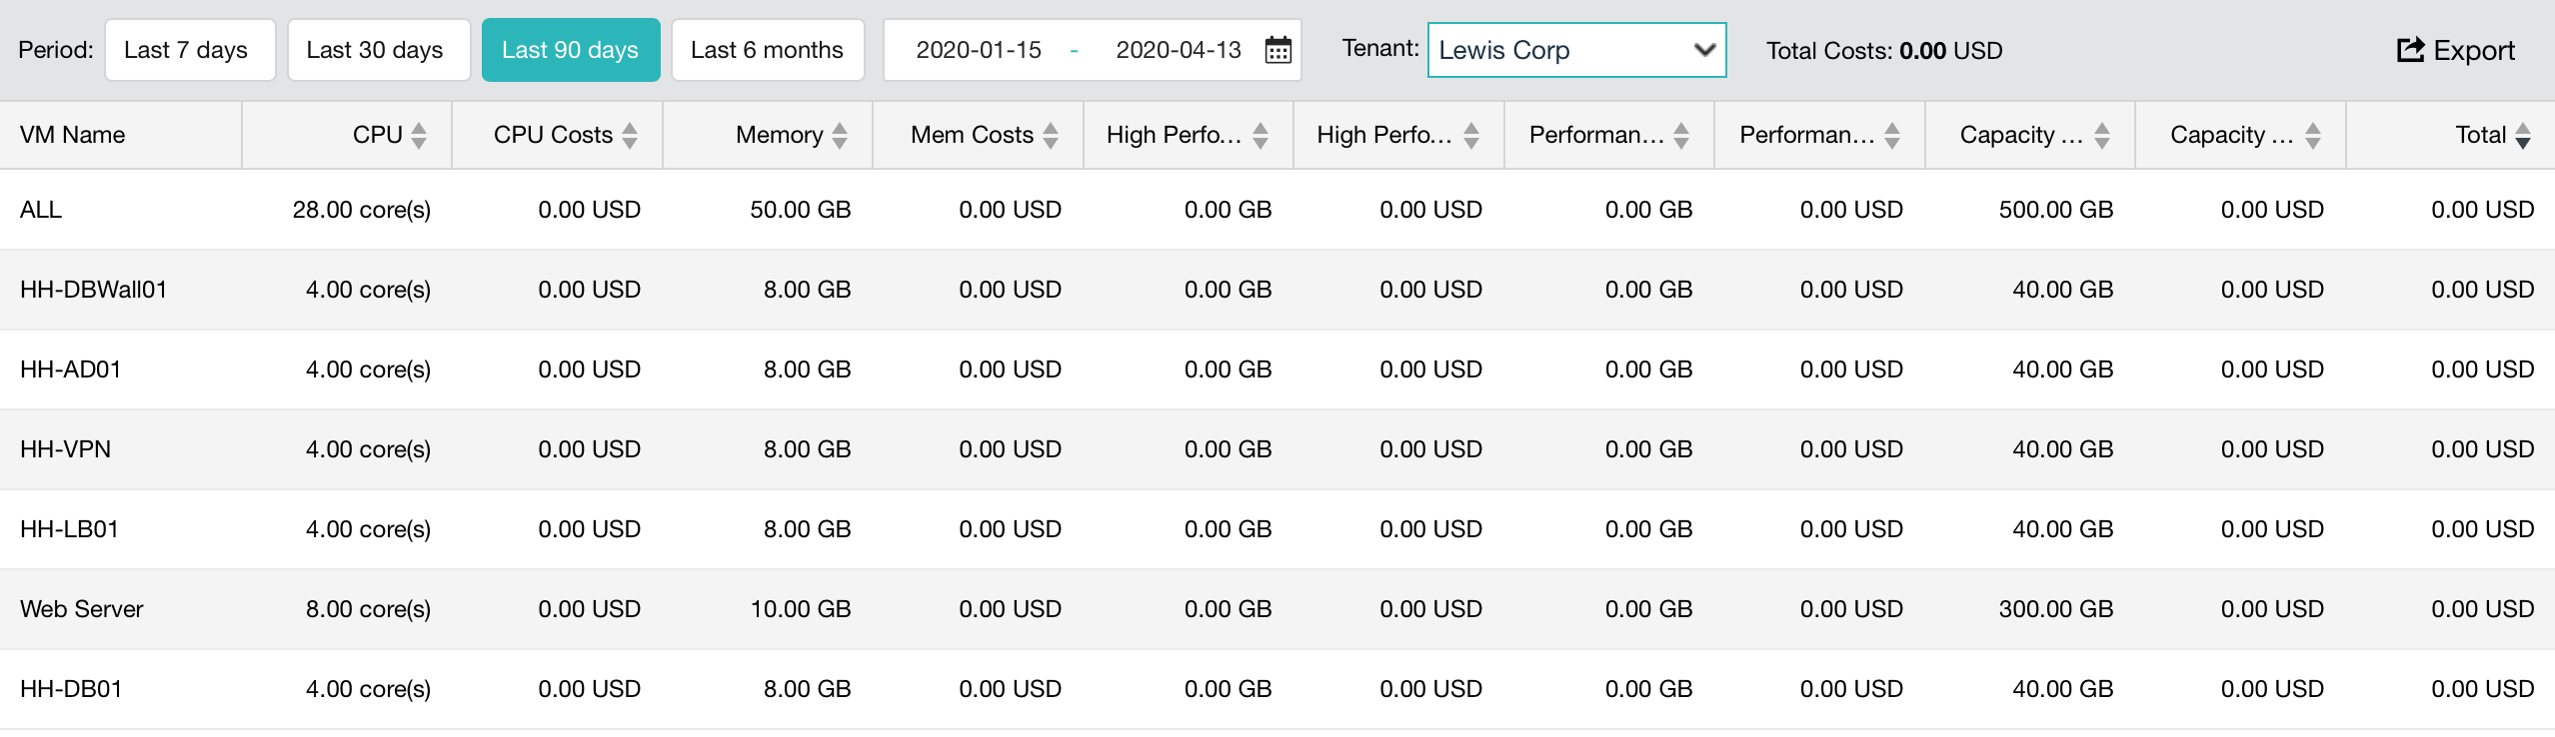
Billing Report
Billing report can be generated based on tenant usage
Report can be exported and import other billing software for further used

Slide 19
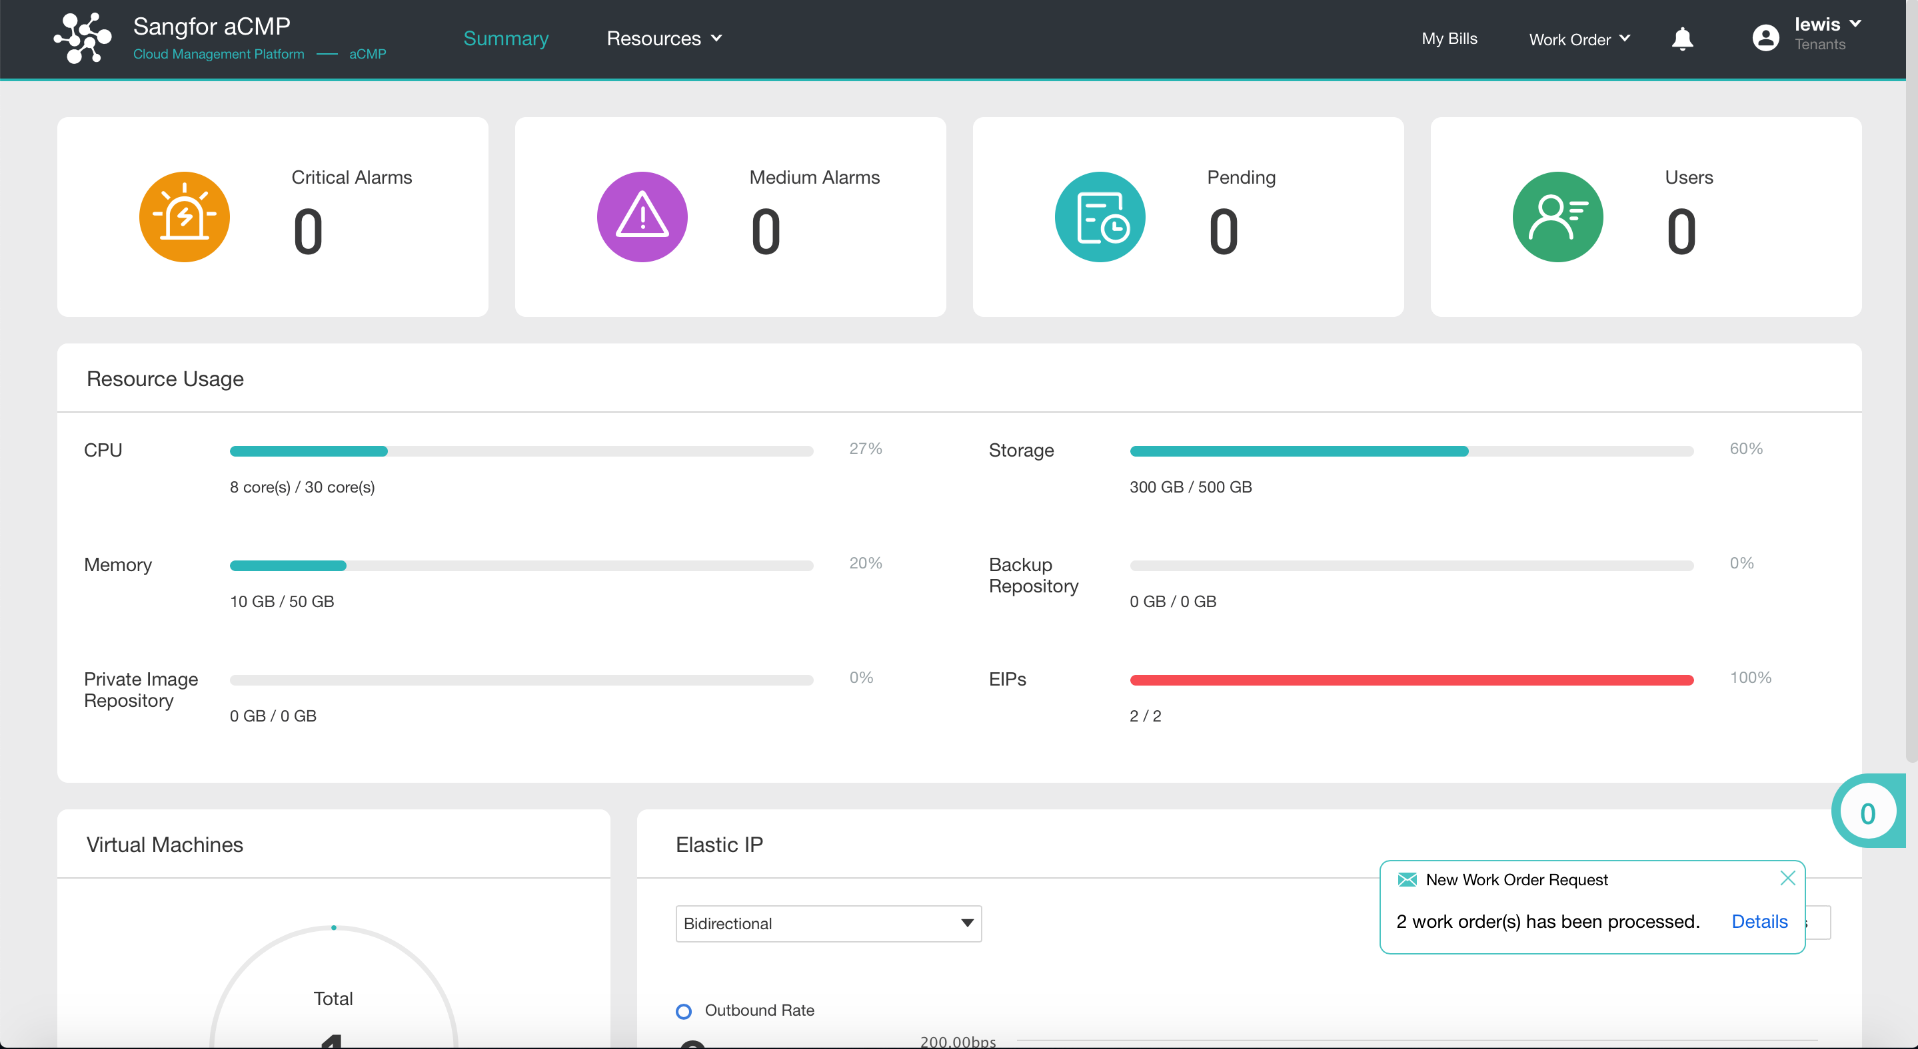
Tenant Self-Service Portal
A portal for tenants to manage their own virtualization environments.
VM Management
Tenant Network Management
Request resource
Usage Monitoring

Slide 20
Pre-defined Workflow & Request
Tenant Resource Quota Increase Request
Fill in request form
Submit
Super admin approval
Resource Auto Allocation & Email notify
Tenant User create VM Request
Fill in request form
Configure VM Specs
Submit
Tenant admin approval
VM auto creation & Email Notify

Slide 21
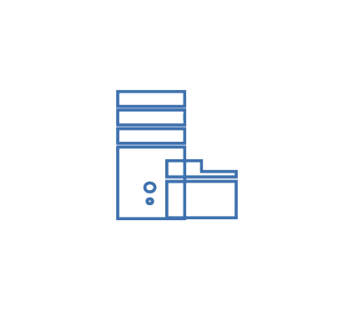
Backup/Archive as a Service Solution
Billing & Metering
Work Order
Self-service
Sangfor Cloud Management Platform
Tenant A
Tenant B
Storage Pool
VM-level Backup/Archive
VM-level Backup/Archive
Native VM-level backup and archive inside Sangfor SCP, no need to buy 3-party backup software

Slide 22
Disaster Recovery as a Service Solution
Sangfor Cloud Management Platform
Tenant A
Tenant B
Tenant A
Tenant B
Primary VM
Primary VM
VM for DR
VM for DR
Primary Data Center
Secondary Data Center (DR)
Replication
Replication
Built-in Disaster Recovery function, be able to provide 1-second RPO

Slide 23


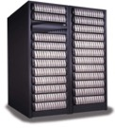
Security Service as a Solution
Infection
C&C
Exploitation
Propagation
Ransomware
IO Mirror
Hypervisor
aSV（Hypervisor）
IO Log
NAS
SAN
Built-in advanced backup & CDP Near-zero data loss protection

Slide 24
PART 3
Sangfor MCS advantages for the Partner

Slide 25
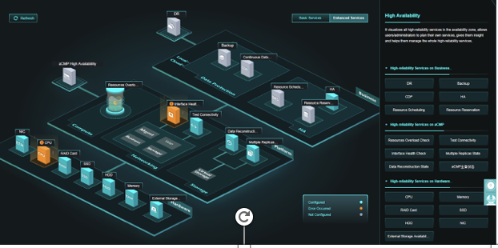
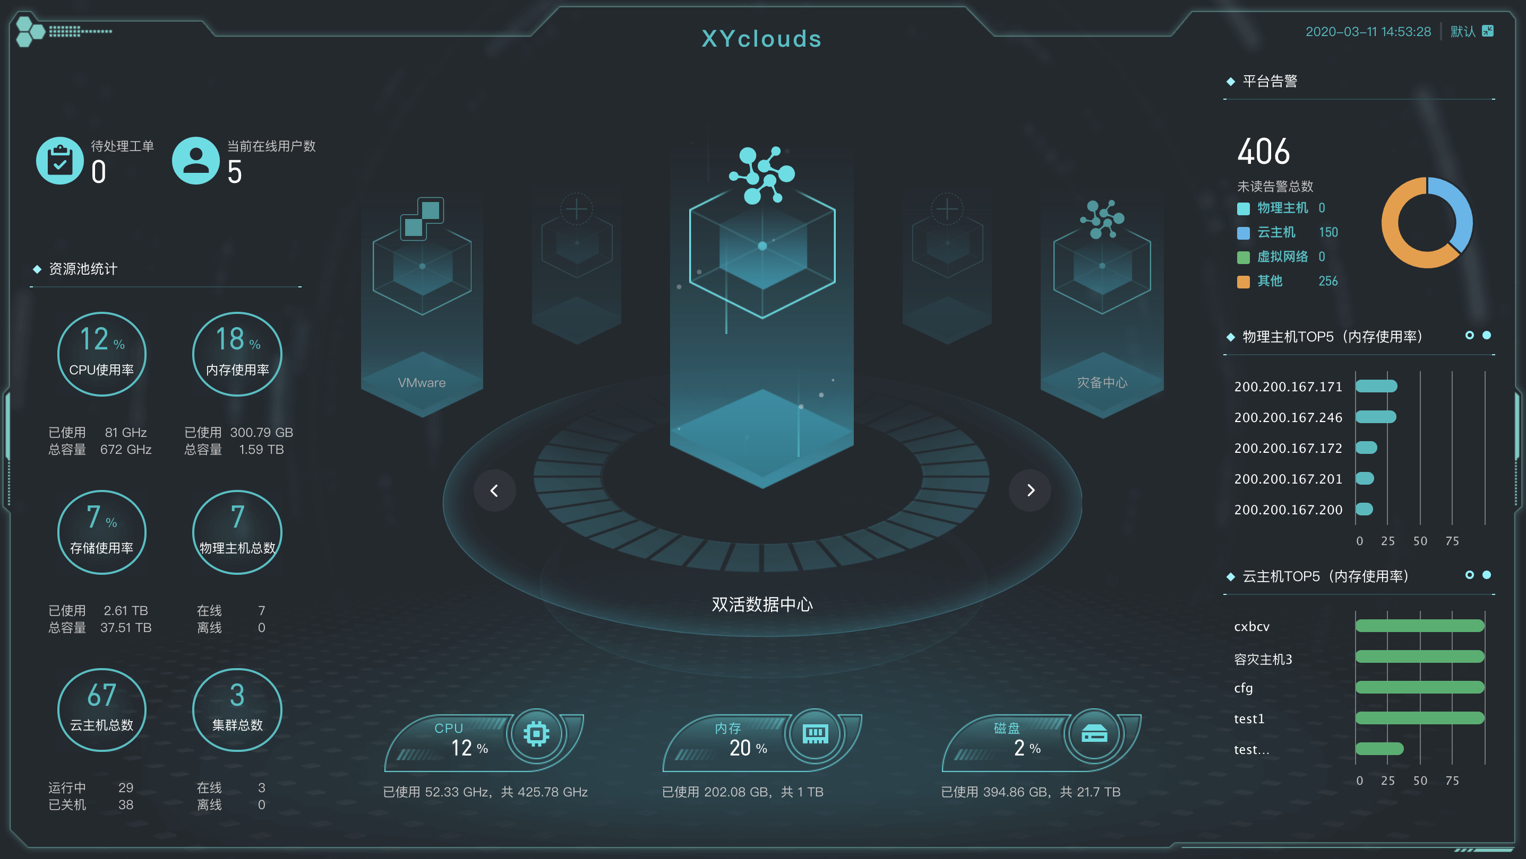
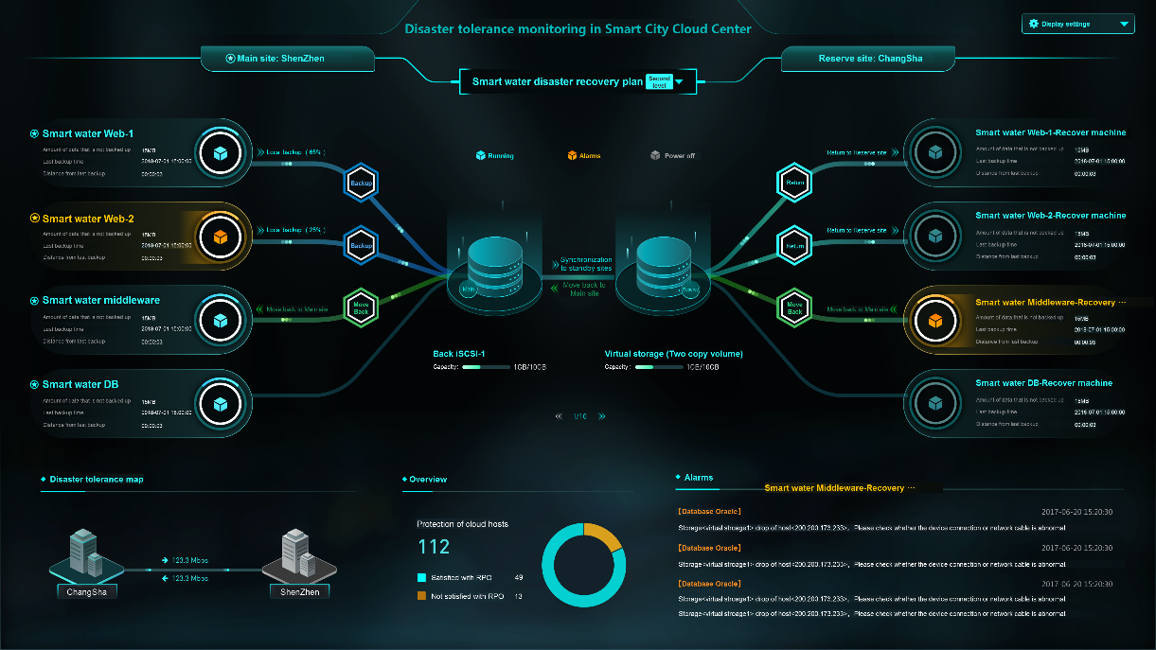
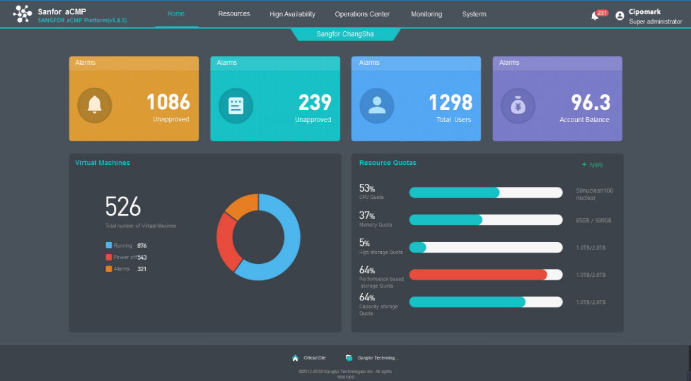
Sangfor Advantage - Simplicity
High-visibility console can help you manage and control the whole cloud;
Graphical interface can help you operate the cloud easily
Abundant monitoring tools can help you locate risks quickly

Slide 26
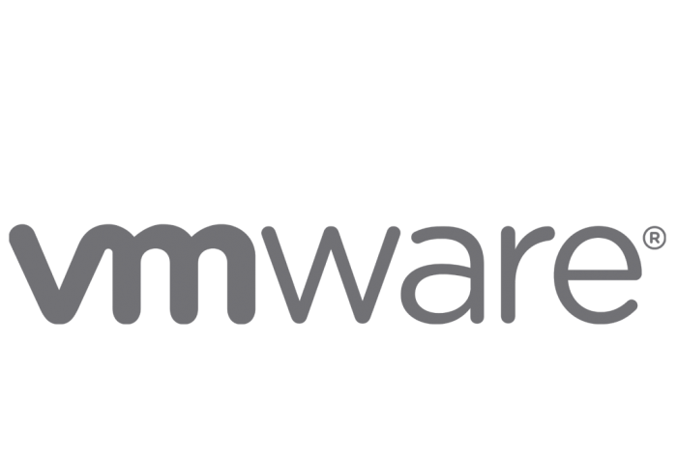



Sangfor Advantage - Multi-cloud Management
Sangfor Cloud Management Platform
Standard Openstack API
Sangfor aCloud
Sangfor aCMP can manage not only Sangfor aCloud, but also VMware vCenter, AWS and AliCloud, we can provide standard Openstack API to integrate with other appliances.

Slide 27


Sangfor Advantage - Reliability
1 data center broken: minute-level interruption, Sangfor aCMP can provide built-in DR solution and recover VM on the DR site
Replication
1 VM broken: minute-level interruption, Sangfor aCMP can restore it from snapshot/CDP, with only 1 second data loss
VM
VM
VM
VM
VM
X
1 server broken: second-level interruption, Sangfor aCMP can power on VMs on other servers inside the cluster
VM
X
1disk broken: no-interruption, Sangfor multi-copy architecture will work
X

Slide 28





Sangfor Advantage - Security
Anti
Virus
APP
APP
APP
APP
APP
Network
Agent
Agent
Agent
Agent
Agent
Center
OS
OS
vNGAF
OS
OS
OS
aFW Distributed FW
VM
aSwitch Distributed Switch
Vulnerability
Scan
Fraud Detection
Web Security
IPS
Build-in WAF in kernel
Data Encryption
Platform
Sangfor aCMP can provide global anti-ransomware solution: defense & response (vNGAF & End-point Security), isolation (micro-segmentation) , recovery (snapshot & backup & CDP)

Slide 29




Sangfor Advantage - Security
Additional virtual applications are readily available to plug into to the Sangfor platform for partners to be able to upsell and generate increased revenue streams.
Including SSL VPN, Next Generation Application Firewall etc.

Slide 30
Sangfor Advantage - Performance
Hosts
3
aCloud ver.
aCloud5.8.6
Performance v.s. vSAN:
CPU
2*Intel® Xeon® CPU E5-2680 v4® 2.4Hz
VSAN ver.
VSAN6.6
IOPS avg.:
50%
Throughput avg.: 90%
RAM
128GB
Tool
IOmeter
Disk
2*Intel S4600 SSD，6*1T HDD
IO depth
32
NIC
2* 10GE

Slide 31
The best benefits sangfor MCS offering
Superior TCO：Save over 30% total cost of ownership than other solutions
01
Secure and Reliable: Business availability is up to 99.99%, Effectively protect business and data from APT attacks
02
Superior SLA : Save time Save worry to you and and also make your customer payment for your service
03
More business revenue: Sangfor will help you promote your business and service to more resellers and ISV partners
04

Slide 32
PART 4
SMCS Business model and success Stories

Slide 33
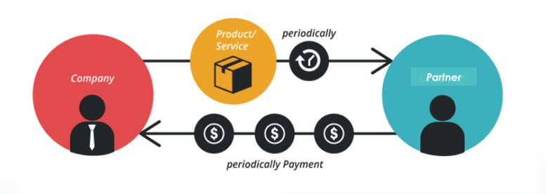
Sangfor MCS business model
Yearly Subscription for any components
Two months Free Trial

Slide 34
6 countries have adopted our Sangfor MCS solution to operate their cloud.
It’s time to join the revolution!

Slide 35
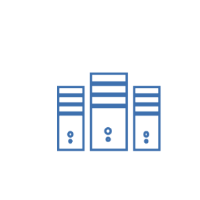




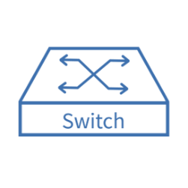
aCloud & aCMP – Multitenant & DR
Data Center Production
Customer A
Customer B (vpn)
Data Center DR

Slide 36

THANK YOU
Sangfor Managed Cloud Service
Masoud Malik (MAS)
Senior Product Marketing Director
mas@sangfor.com

