Slide 1


Sangfor PaaS
General Introduction to Competitors
www.sangfor.com
Sangfor Technologies Inc.

Slide 2
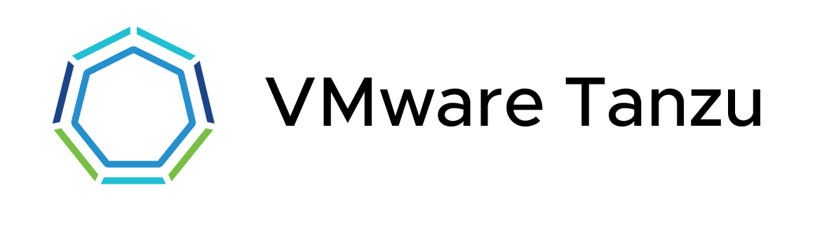
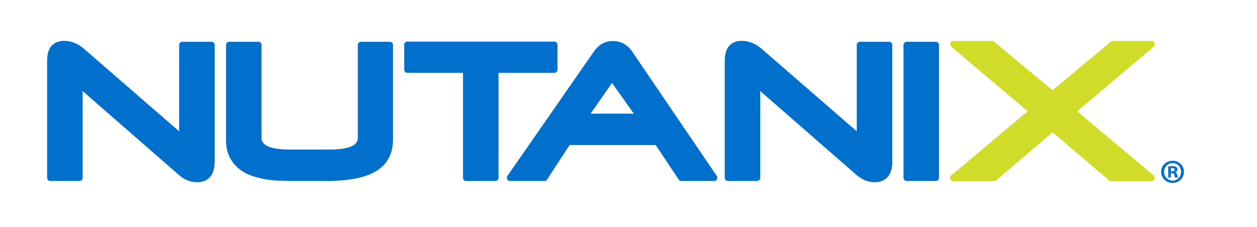



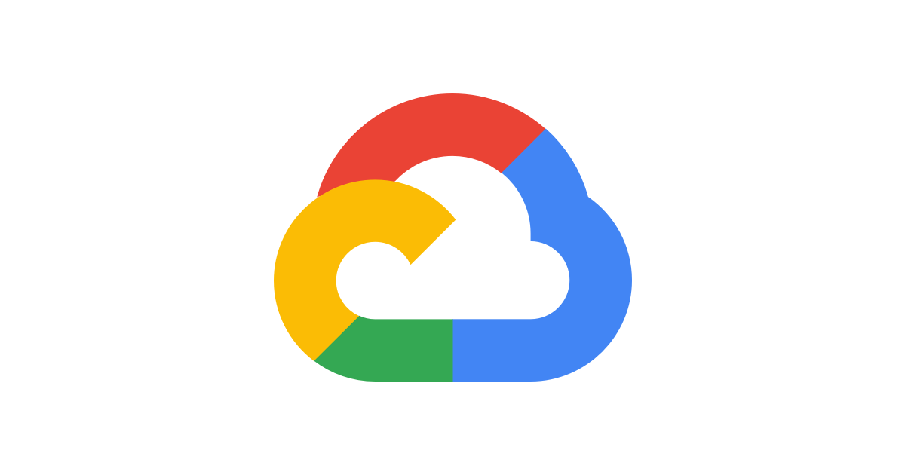

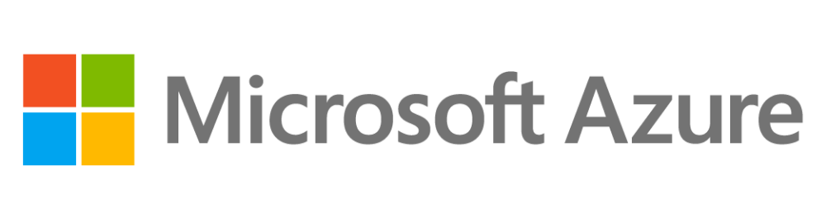
PaaS Competitor Landscape

Slide 3
Comparison Overview
 | Sangfor PaaS | VMware Tanzu | Nutanix Karbon | Redhat OpenShift | Rancher
Architecture | IaaS+PaaS | IaaS+PaaS | IaaS+PaaS | PaaS | PaaS
PaaS solution completeness | ★★★ | ★★★★★ | ★★★★ | ★★★★★ | ★★★★
Ease of use | ★★★★★ | ★★★ | ★★★★★ | ★★★ | ★★★★★
CNCF Conformant | ✔️ | ✔️ | ✔️ | ✔️ | ✔️
Cost-efficiency | ★★★★★ | ★★ | ★★ | ★★★ | ★★★★
Support | Vendor-led | Mostly partner-led | Mostly partner-led | Mostly partner-led | Mostly partner-led
Notes:
https://dzone.com/articles/kubernetes-distributions-how-do-i-choose-one
https://rancher.com/blog/2020/rancher-vs-openshift
https://ubuntu.com/kubernetes/compare
Kubernetes Solutions and Vendors
Although the landscape is large and growing, we selected these platforms because of their maturity in the market, as well as the similarities in terms of how their solutions are architectured and delivered to an enterprise.
Rancher
Rancher describes itself as a complete container management platform that provides an easy on-ramp to Kubernetes. It considers itself pure open source software and includes a mature user interface as well as policy and RBAC with a full selection of add-on components to choose from in order to build out your platform.
Rancher is focused on the mid-market and so ease of use is one of its most important features. Although its graphical user interface helps to get teams quickly up to speed, its underlying architecture does not scale across a large organization very well. It also lacks some of the enterprise features like built-in auditing for compliance and other regulatory requirements. Although Rancher indicates that they are an API first solution, it’s architecture is not based on declarative constructs and cannot be managed with GitOps for a consistent configuration management.
Red Hat OpenShift
OpenShift is an integrated container platform aimed at large enterprise users who want a single solution. As a solution from a major enterprise vendor, OpenShift aims to provide all the elements enterprises need: for example the security controls are extensive as regulated companies need these. The entire system works around an operator framework that makes deployments to the cluster a mostly hands off affair.
As an integrated platform OpenShift is an inherently complex solution, it can be complicated to install and the integrations limit choices to those available through the framework. This lack of flexibility means OpenShift users can’t easily take advantage of other CNCF technologies and upgrades are reportedly complicated. As an enterprise solution it can also be a costly solution.

Slide 4
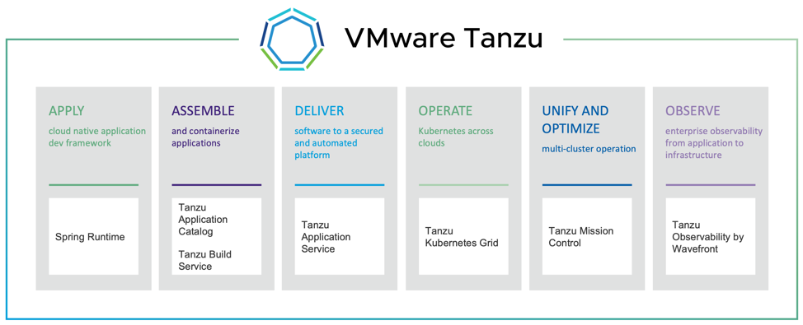
VMware Tanzu Overview
VMware Tanzu is the suite or portfolio of products and solutions that allow its customers to Build, Run, and Manage Kubernetes controlled container-based applications.
Notes:
https://www.virtualizationhowto.com/2019/08/what-is-vmware-tanzu-kubernetes/

Slide 5
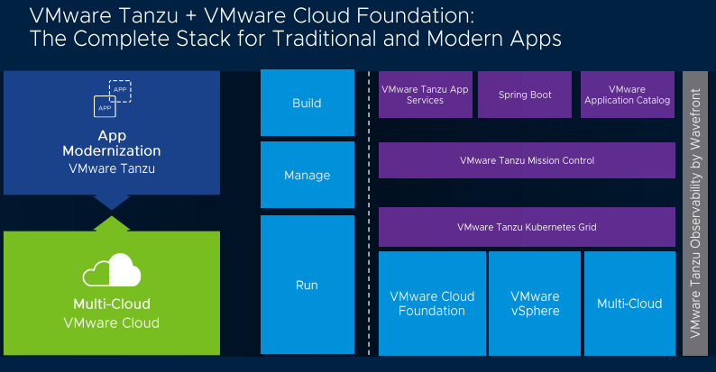

Slide 6
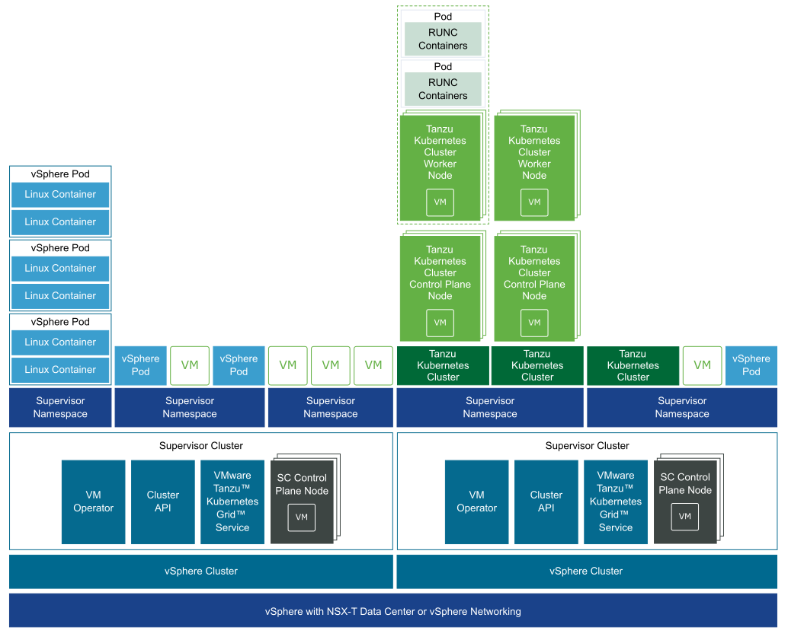
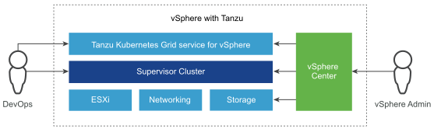
vSphere with Tanzu Architecture for Tanzu Kubernetes Clusters
Notes:
https://docs.vmware.com/en/VMware-vSphere/7.0/vmware-vsphere-with-tanzu/GUID-3E4E6039-BD24-4C40-8575-5AA0EECBBBEC.html

Slide 7
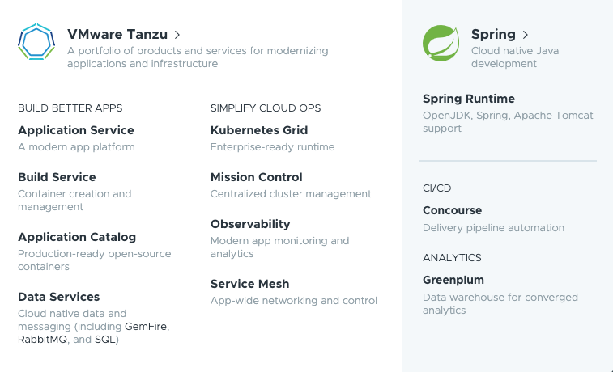
VMware Tanzu Product Family

Slide 8
VMware Tanzu Product Family
Tanzu Kubernetes Grid (TKG)
This is VMWare’s enterprise ready upstream Kubernetes distribution and will be available in different form factors based on end user / customer requirements.
Tanzu Application Services
Fully automated PAAS (Platform As a Service platform) to increase productivity by automating all cloud related configuration and deployment on cloud by just a single command and only source code of the application.
Tanzu Build Service
TBS is a tool to build OCI container images and manage the container life cycle irrespective of the deployment platform. Based on the CNCF project Buildpacks.io TBS takes care the pain of maintaining docker files and brings in standardization to you docker image build process.
Tanzu Application Catalog (TAC)
TAC is a curated collection of production-ready popular opensource software that can be used by IDP users. Software support is still based on what’s available with the open source version, but VMWare provide the ‘proof of provenance’ as well as enterprise grade testing on these images. Also it allows customers to bring your own Golden Image while Bitnami(VMWare) is making this image for your developers.
Notes:
https://cloudificationzone.com/2020/07/10/vmware-tanzu-offerings-cheat-sheet-references-technical-docs-and-demo-videos/

Slide 9
VMware Tanzu Product Family
Tanzu Service Mesh (TSM)
Tanzu Service Mesh not only simplifies lifecycle management of service mesh over fleets of K8s clusters, it provides unified management, global policies, and seamless connectivity across complex, multi-cluster mesh topologies managed by disparate teams. It provides app-level observability across services deployed to different clusters, complementing/integrating into modern observability tools you use or are considering.
Tanzu Mission Control (TMC)
VMware Tanzu Mission Control provides a single control point for teams to more easily manage Kubernetes and operate modern, containerized applications across multiple clouds and clusters. It codifies the know-how of operating Kubernetes including deploying and upgrading clusters, setting policies and configurations, understanding the health of clusters and the root cause of underlying issues.
Tanzu Observability/WaveFront (TO)
The VMware Tanzu Observability by Wavefront platform is purpose built to handle requirements of modern applications and multi-cloud at high scale. It’s a unified solution with analytics (including AI) that ingests visualizes, and analyzes metrics, traces, histograms and span logs. So you can resolve incidents faster across cloud applications, correlated with the cloud infrastructures views.
Notes:
https://cloudificationzone.com/2020/07/10/vmware-tanzu-offerings-cheat-sheet-references-technical-docs-and-demo-videos/

Slide 10
VMware Tanzu Product Family
Tanzu Data Services – GreenPlum, GemFire, RabbitMQ, SQL/PostGresSQL
VMware also has SQL, NoSQL, messaging broker, analytical and distributed caching solutions.
GreenPlum – Analytical database based on PostGresSQL
GemFire – Distributed caching
RabbitMQ – Messaging broker
SQL/PostGresSQL – SQL databases
Concourse CI/CD
It’s an opensource for platform automation.
VMware Spring Runtime
It’s a standalone product offering under Tanzu to cover Production and Development support for OpenJDK, 40+ Spring projects (including the ones used in IDP) and Tomcat.
Notes:
https://cloudificationzone.com/2020/07/10/vmware-tanzu-offerings-cheat-sheet-references-technical-docs-and-demo-videos/

Slide 11
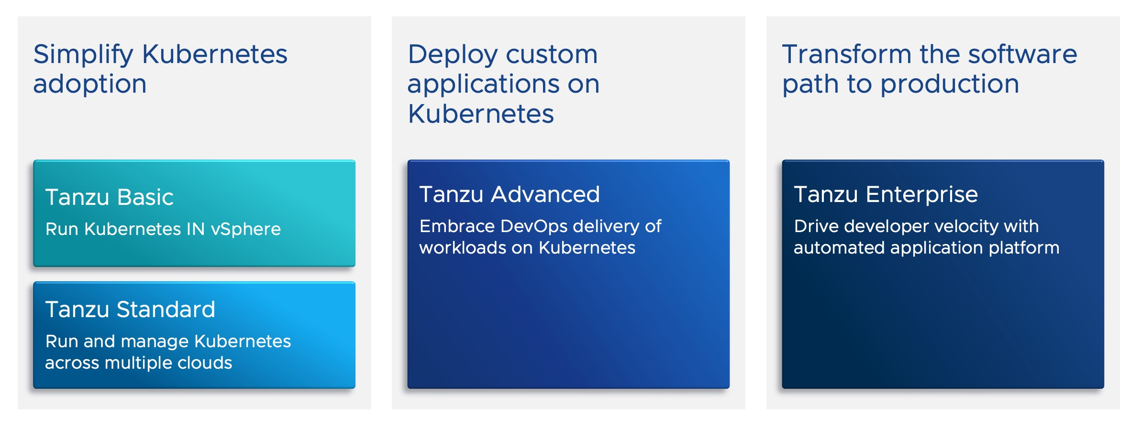
Tanzu Editions
Only advanced and upper versions come with the full set of services.
Notes:
https://tanzu.vmware.com/content/blog/simplify-your-approach-to-application-modernization-with-4-simple-editions-for-the-tanzu-portfolio

Slide 12
Pros and Cons of Tanzu
Pros:
PaaS+IaaS with a rich set of tooling and services
Built into vSphere with consistent operations for developers
Cons:
VMware has a very complex legacy between Pivotal, the new stuff they’re doing with Tanzu and other acquisitions they’ve made – it’s kind of a mash-up of different things that makes it complicated
High cost with per-core based subscription

Slide 13
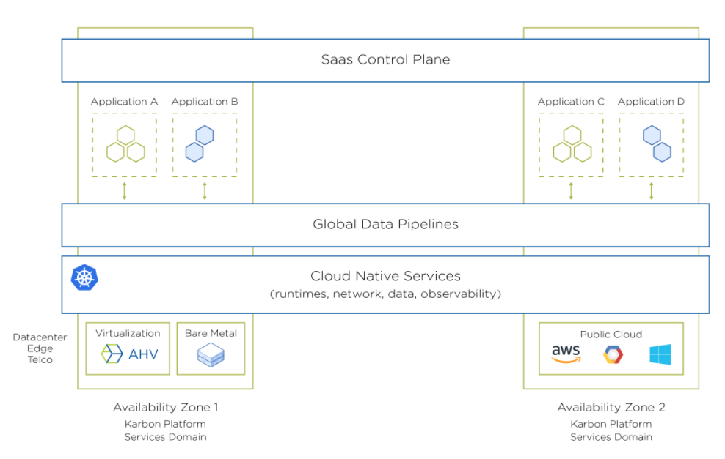
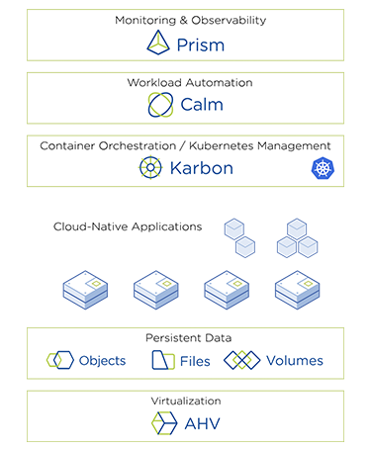
Nutanix Karbon Platform Services (KPS) Overview
Nutanix Karbon, introduced in April, 2020, is a wrapper around Kubernetes that makes it simpler to use and so set up and run cloud-native applications. Nutanix Karbon is an enterprise-grade Kubernetes distribution that simplifies the provisioning, operations and lifecycle management of Kubernetes with a native Kubernetes experience.

Slide 14
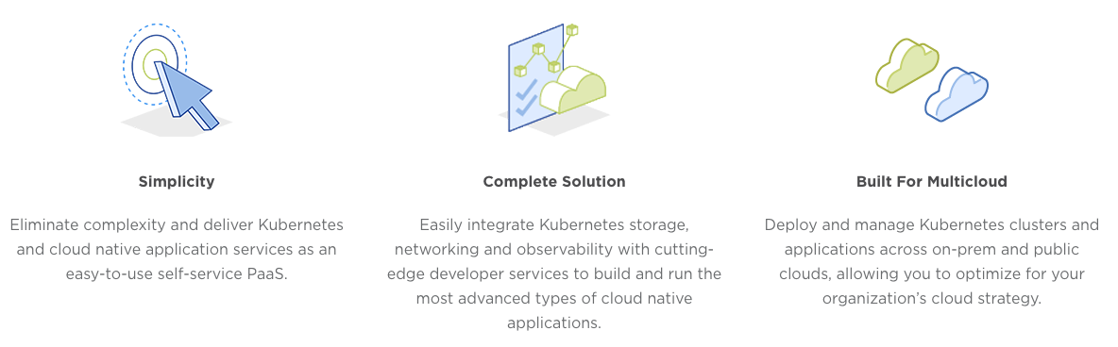
Features/Services of KPS
Kubernetes applications (Containers-as-a-Service)​
Serverless functions (Functions-as-a-Service)​
Global data pipelines ​
Streaming data and message bus​ (Kafka-aaS, NATS-aaS)
AI (Tensorflow-aaS, Openvino-aaS)
Ingress controller and service mesh​ (nginx/traefik-aaS, Istio-aaS)
App monitoring and alerting (Prometheus-aaS)
Log Forwarding

Slide 15
Pros and Cons of Karbon
Pros:
PaaS+IaaS
Simple, single pane of glass management with Prism
Cons:
Lack of native support for DevOps (such as Jenkins for CI/CD)

Slide 16
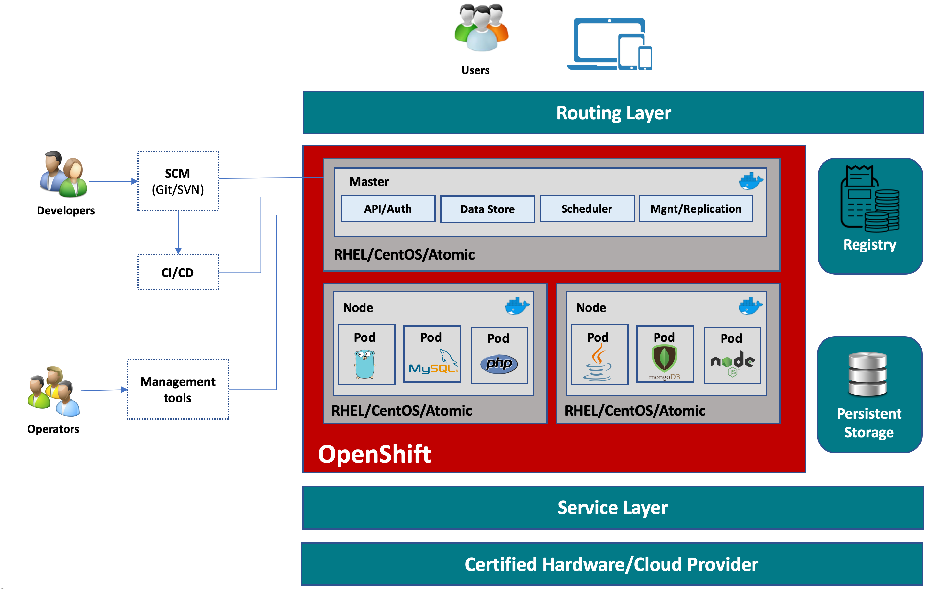
Redhat OpenShift Overview
OpenShift is a family of containerization software products developed by Red Hat. Its flagship product is the OpenShift Container Platform — an on-premises platform as a service built around Docker containers orchestrated and managed by Kubernetes on a foundation of Red Hat Enterprise Linux.

Slide 17
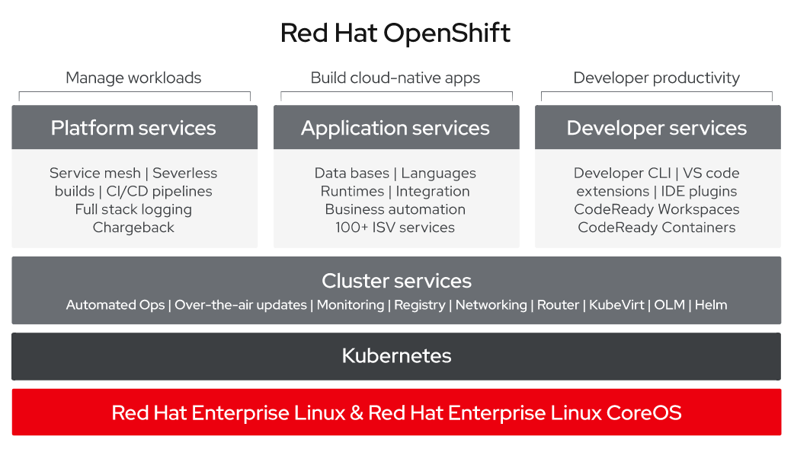
OpenShift Architecture

Slide 18
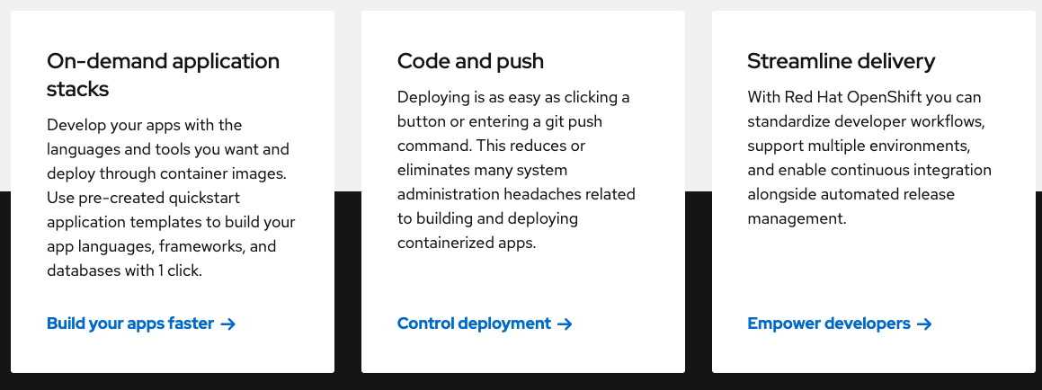
Comprehensive Tooling for DevOps
IDE integration - With OpenShift's integration with Eclipse, JBoss Developer Studio, and Visual Studio developers can stay entirely within the IDE that they prefer when working with OpenShift.
Continuous integration - OpenShift includes Jenkins for continuous integration and release management. Jenkins can perform tests at code check-in, orchestrate the build process, and automatically promote or cancel an application release based on the results.
Service Mesh - Connect, manage, and observe microservices-based applications with security-focused Istio. Istio is an open-source project for integrating and managing traffic flow across services.
And many more…
Notes:
The main differences from classic Kubernetes are:
Advanced and integrated user management
Integrated Docker registry
Integrated CI pipelines
Integrated resources templates
Usage of similar but slightly different concepts, like Routers instead of Ingresses, Projects instead of Namespaces, etc.

Slide 19
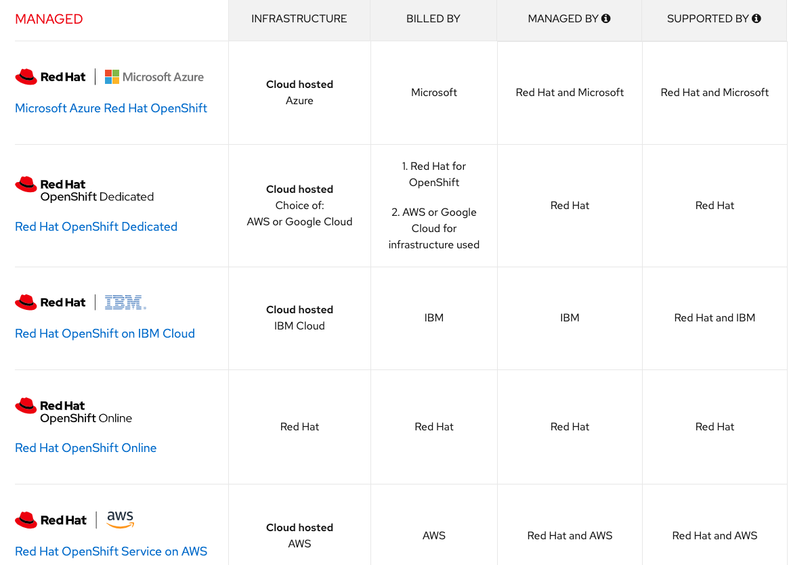
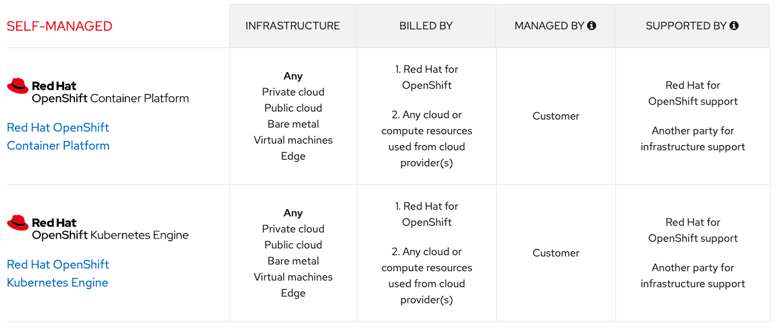
OpenShift Deployment Methods
Notes:
OpenShift has three pricing models:
OKD, a free distribution of Kubernetes by OpenShift.
OpenShift Enterprise, which can be either hosted and managed by RedHat, or be deployed on-premises by the client. The hosted version starts at $48,000/year for 3 masters, 3 etcds, and 4 application nodes.
OpenShift Online, which is the PaaS version available online. It costs approximately $50/month for each 2 Gb of RAM, which is a bit expensive in comparison to other Kubernetes-as-a-Service providers.

Slide 20
Pros and Cons of OpenShift
Pros:
Comprehensive PaaS tooling and integration
Widespread cooperations with major public cloud and private services, flexible deployment methods
Cons:
OpenShift is a pure PaaS, on-premise deployment requires additional infrastructure.
Master nodes only support Redhat Enterprise Linux CoreOS (a RHEL subscription is required and bundled into OpenShift)

Slide 21
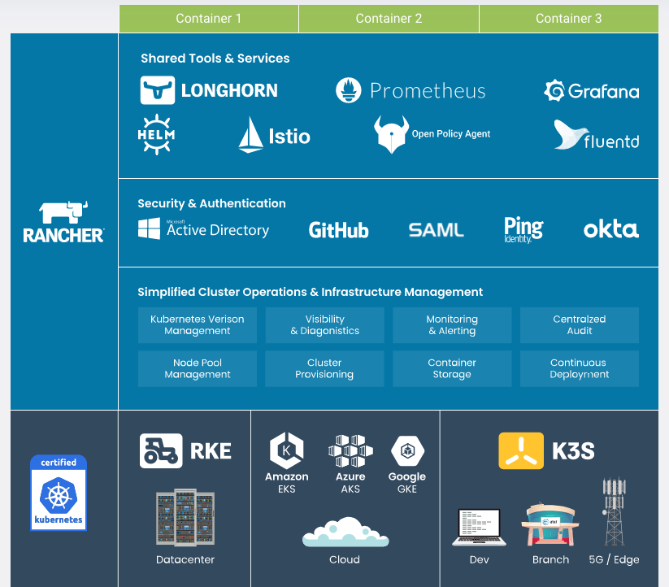
Rancher Overview
Rancher is a container management platform that includes Kubernetes, so we can consider it a Kubernetes distribution. Rancher Kubernetes is backed by Rancher Labs, a startup founded in 2014.
Rancher’s infrastructure-agnostic architecture supports any CNCF-certified Kubernetes distribution. As open source company, Rancher is committed to delivering 100% true open source software with no vendor lock-in. In July 2020, Rancher was acquired by an open source vendor SUSE, the company behind one of the oldest Linux distributions.
Notes:
Rancher is a mature, stable, enterprise-grade, and easy-to-use Kubernetes management platform with over 37,000 active users and greater than 100 million downloads. Rancher also comes with its own Kubernetes distribution, Rancher Kubernetes Engine (RKE) that runs entirely within Docker containers.
Rancher’s infrastructure-agnostic architecture supports any CNCF-certified Kubernetes distribution. As open source company, Rancher is committed to delivering 100% true open source software with no vendor lock-in. In July 2020, Rancher was acquired by an open source vendor SUSE, the company behind one of the oldest Linux distributions.
Rancher places a special emphasis on multi-cluster Kubernetes deployments, which could be useful if you want to deploy Kubernetes across multiple clouds. Rancher is similar to OpenShift in that it integrates Kubernetes with a variety of other tools, although it is a bit more flexible because it provides some choice for which components to use.

Slide 22




Rancher Products for the Datacenter
Rancher is a container management platform that includes Kubernetes, so we can consider it a Kubernetes distribution. Rancher unifies these clusters to ensure consistent operations, workload management and enterprise-grade security.
RKE is a lightning-fast, CNCF-certified Kubernetes distribution that runs entirely within containers and solves the common problem of installation complexity.
Longhorn is 100% open source, distributed block storage built for Kubernetes.
K3s is an ideal Kubernetes distribution for agile development in the cloud.
Notes:
The main features it adds to a vanilla Kubernetes are:
Cross-provider cluster deployment
User management
Web UI
Integrated CI/CD pipelines

Slide 23
Pros and Cons of Rancher
Pros:
Rancher is more of a management tool to deploy and manage one or multiple RKE clusters. It is easy to use, and free if you don't want customer support.
Cons:
Need add-on for monitoring, logging and registry, need 3rd party tools to support DevOps and service mesh

Slide 24

THANK YOU

Slide 25
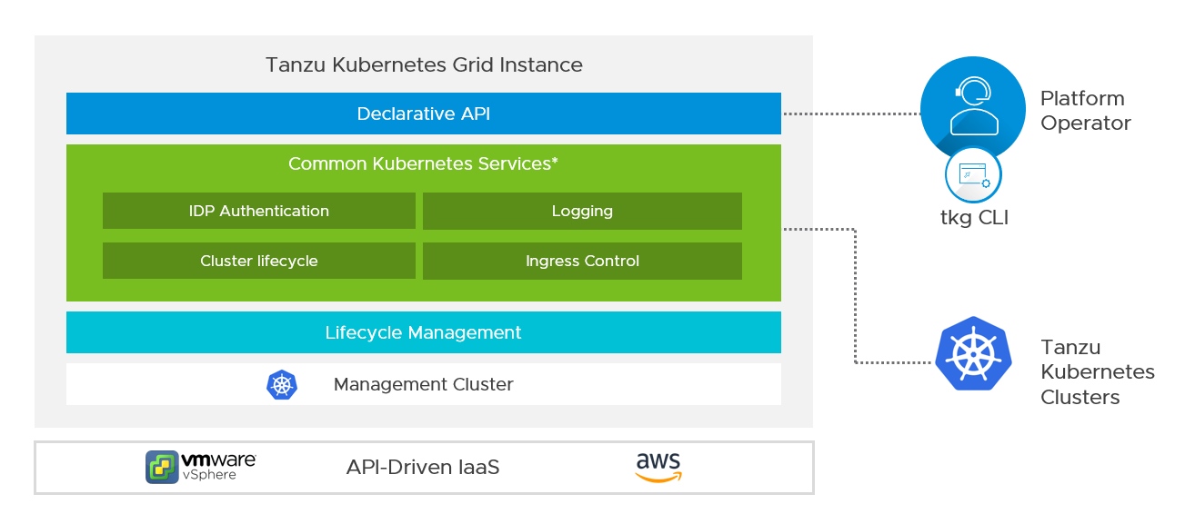
VMware Tanzu Grid Service
Notes:
This is VMWare’s enterprise ready upstream Kubernetes distribution and will be available in different form factors based on end user / customer requirements.
TKG provides enterprises with a consistent, upstream aligned, automated multi-cluster operations across SDDC, Public Cloud, and Edge environments that is ready for end-user workloads and ecosystem integrations. TKG does for Kubernetes what Kubernetes does for your containers.

Slide 26
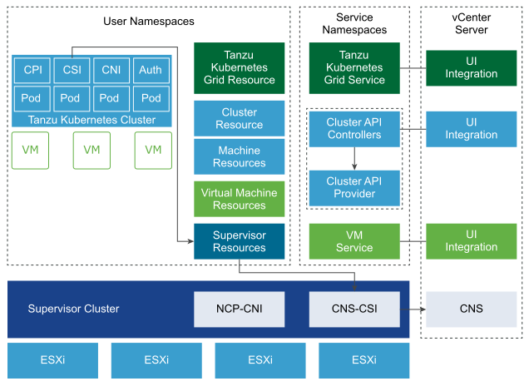
Tanzu Kubernetes Grid Service Architecture and Components
Notes:
https://docs.vmware.com/en/VMware-vSphere/7.0/vmware-vsphere-with-tanzu/GUID-4D0D375F-C001-4F1D-AAB1-1789C5577A94.html

Slide 27


