Slide 1
Unleash The
Power of Container
on Sangfor HCI
Cheney Hu​
HCI Senior Product Manager​
Sangfor Technologies​
​

Slide 2




Digital Transformation is Being Accelerated by COVID-19
Who led the digital transformation of your company？
A
CEO
B
CTO
C
COVID-19
Video chat & online conference
Collaborative tools
Online shopping
Media & entertainment
COVID-19 is driving app usage explosion
Notes:
There’s an image floating around LinkedIn and Twitter asking people what inspired their digital transformation. Was it 1. CEO 2. CTO or 3. Covid-19?
https://www.visualcapitalist.com/covid-19-impact-on-app-popularity/

Slide 3
Applications are Growing Exponentially
5 million
app developers
13.5 million
app developers
2009
2019
2019
2024
335 million apps
792 million apps

Slide 4
Application Architecture is Shifting
Monolithic architecture
Microservices architecture
Presentation layer
Microservice
Microservice
Service layer
Persistence layer
Microservice
Microservice
Microservice
DB
DB
DB
DB
Heavy resource consumption
Difficult to adopt new technology
Not very reliable
Light weight
Built around business capabilities
Designed for failure
From monolith to microservice

Slide 5
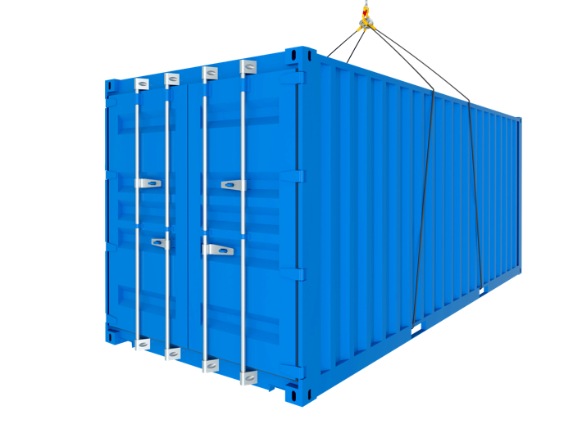
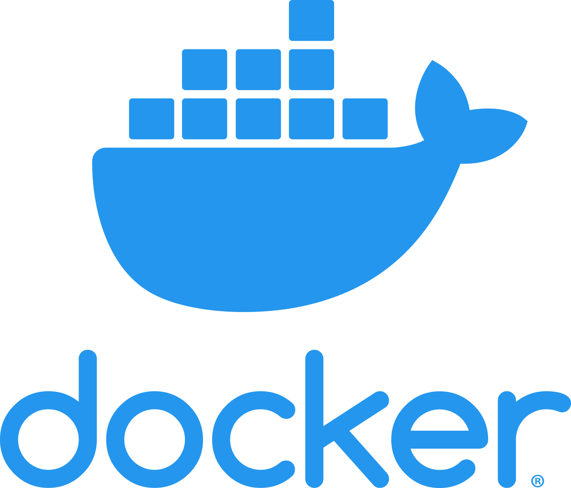


The Future of Applications are Built on Containers

Slide 6
VM v.s. Container
Containerized Applications
Virtual
Machine
Virtual
Machine
Virtual
Machine
App A
App B
App C
App A
App B
App C
App D
App E
App F
Guest Operating
System
Guest Operating
System
Guest Operating
System
Docker
Hypervisor
Host Operating System
lnfrastructure
lnfrastructure
VM
Container
Container is more lightweight and more efficient, more suitable to run microservice.

Slide 7



Container Provides More Flexibility in A Multi-cloud World
Build it once and run anywhere
Notes:
Reverse the animation

Slide 8
Managing Containers Efficiently Could Be Challenging
x86
x86
x86
It’s not uncommon to see hundreds or even thousands of containers running in a single environment

Slide 9
Kubernetes (K8s) Comes to The Rescue
Node
Kubernetes (K8s) is an open-source system for automating deployment, scaling, and management of containerized applications.

Slide 10
K8s Does Many Things
Reducing the Time of
Release Cycles
1
2
Solving
outages
Self Healing
Systems
8
3
Server Usage
Efficiency
Building
decoupled microservice architectures
7
Kubernetes CI/CD
Pipelines
4
Ability to Containerize the code
Abstraction
of lnfrastructure
6
5
Orchestrate Deployment with the Platform

Slide 11



K8s Takes Infrastructure Complexity out of Development
commands
K8s

Slide 12
Why Containers and K8s ?
Scale
Portability
Faster time to market
The community
Cost Savings
The containerized environment allows for easier scalability of the infrastructure
Whether you are thinking multi-cloud hybrid cloud or single cloud, containerization makes it 100 times easier to achieve this strategy
Containerization gives you the agility to move much faster with software devliery
One of the superpowers of containerization is the fantastic community around cloud-native tools
Using containers help you better optimize your infrastructure resources

Slide 13


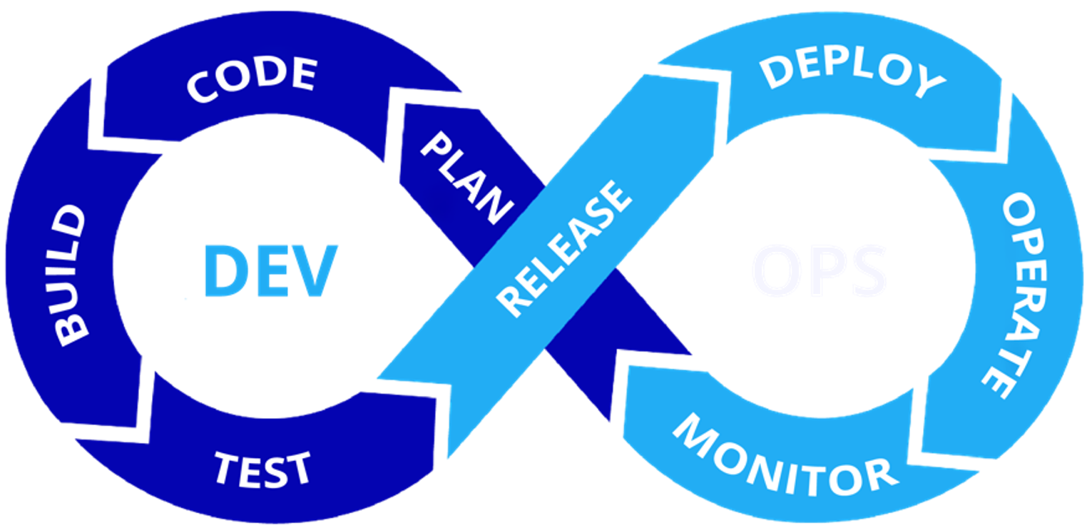
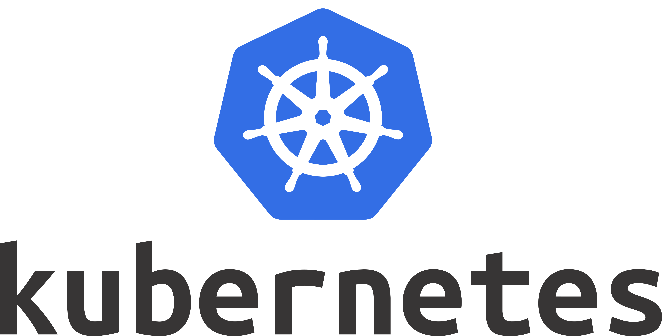
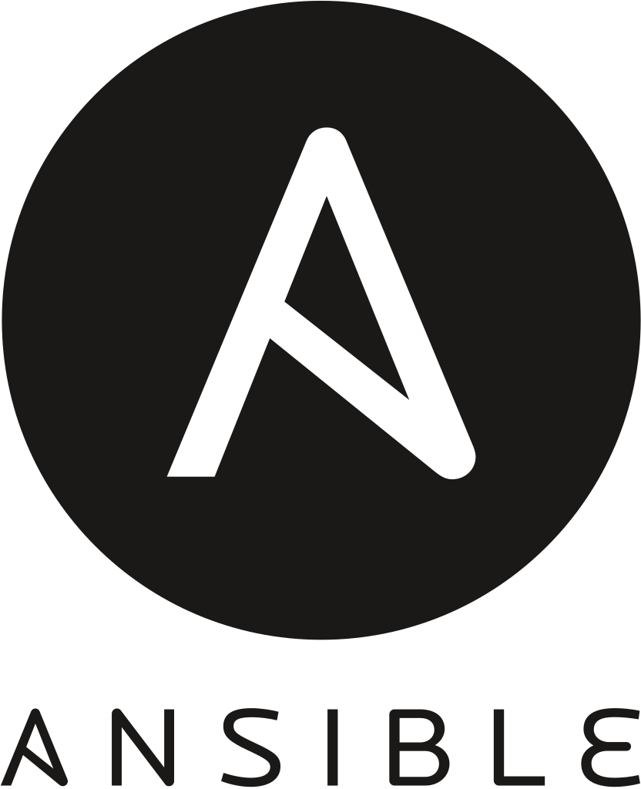

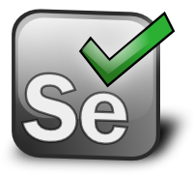


Docker and K8s Make DevOps Possible

Slide 14

Sangfor Enables You A Smooth Transition to Containerization

Slide 15





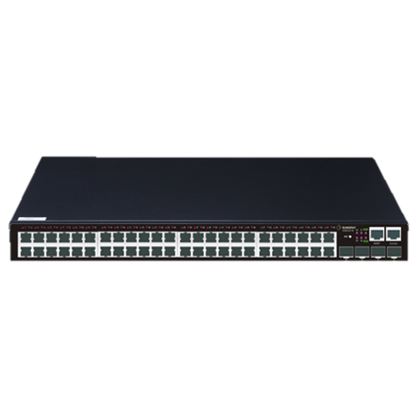
A Recap of Sangfor HCI
Sangfor HCI
Compute
Storage
Network
Security
Management

Slide 16


The Best of Both Worlds
Predictable
Unpredictable
Kubernetes
VM
VM
VM
VM
VM
VM
App
App
App
App
App
App
App
App
App
Docker
Docker
Docker
Highly reliable and performance-optimized virtualization platform for traditional apps
Enterprise-level container platform based on K8s for
cloud-native apps
Sangfor HCI software
+
standard x86 servers
One platform for both types of workloads Shared storage and network resources
Smooth transition to cloud-native

Slide 17
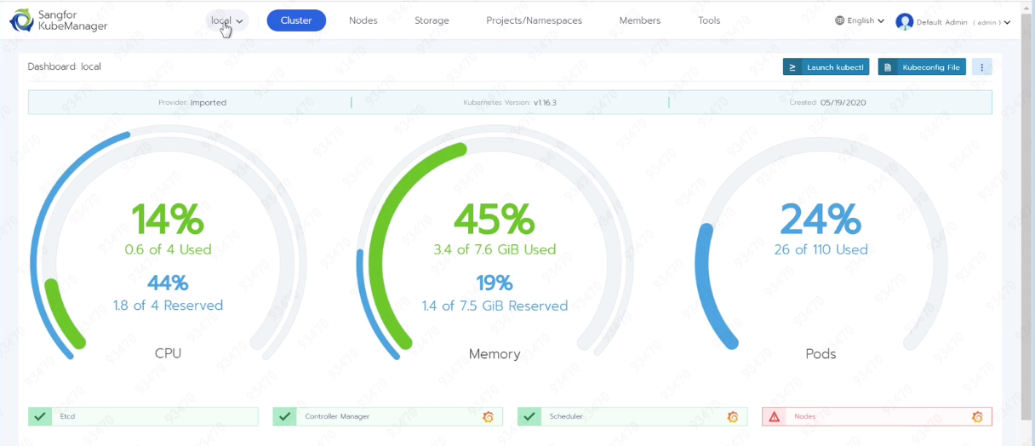
Integrated K8s Management
Management of multiple K8s clusters
Health monitoring and visualized operations
All of K8s components are containeralized and made high available
API Server
Node Agent
Scheduler
Controller
User Pod
User Pod
User Pod
User Pod
Node Agent
Kubelet
Node Agent
Kubelet

Slide 18
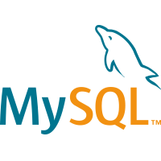







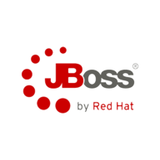

Going Beyond Containers
Service catalog
Service discovery
Service routing
Load balancing
circuit-breaker
O&M
Microservice
governance*
Call chain tracing
Cloud service bus
Performance management
Configuration management
API gateway
Service management
Code registry
Pipeline
Auto testing
Version control
Billing & metering
DevOps*
CI
CD
Artifact Management
Jenkins integration
Quota management
Tenant management
Container scheduling
App management
Auto-scaling
Canary release
Role management
Sangfor
Container
Cloud
Container network
Configuration management
App orchestration
Monitoring & alerting
Permission management
Container storage
Image registry
Tagging
Cluster management
IT governance
Sangfor offers a complete suite of PaaS to enable cloud-native development on HCI
* In future releases

Slide 19






Interconnected network between containers and VMs
Highly secure enterprise-grade image registry
Comprehensive monitoring and logging
Based on
Kubernetes
Canary release
Support CSI
App rolling upgrade

Slide 20



Delivering The Best Ingredients of Containers and VMs Out of The Infrastructure
Unified platform
Lifecycle management
Secure
Affordable

Slide 21


You Can Start from Wherever You are
Build new
cloud-native apps
Refactor traditional apps to cloud-native architecture
Migrate cloud-native apps from public cloud to on-premises cloud
Physical
/
virtual
Public
clouds
Notes:
Different phases to containers, what customers can do, get them move to containers
How can they get started
“Lift and shift” existing applications into modern cloud architectures.
Refactor existing applications for containers.
Develop new container-native applications.
Provide better support for microservices architectures.
Provide DevOps support for continuous integration and deployment (CI/CD).

Slide 22



Some Real World Use Cases of Containers and K8s
The majority of customer-facing applications on Kubernetes
Development benefits: deployments can now be pushed in a few minutes compared to 45 minutes with legacy infrastructure
Business benefits: constantly delivering new features to stay ahead of the curve
First moved their services to Docker, then to Kubernetes.
Development benefits: have removed a lot of manual work without making engineers worry about the underlying infrastructure.
Business benefits: now they can take ideas from ideation to production in a matter of minutes, whereas earlier they used to take hours or even days. They have also cut down so much overhead cost by utilizing Kubernetes.
Airbnb adopted Kubernetes to support their microservice architected platform
Development benefits: over 1,000 engineers concurrently are configuring and deploying over 250 critical services to Kubernetes (at a frequency of about 500 deploys per day on average).
Business benefits: new services can be added at a much faster speed and larger scale to support business needs
Notes:
https://dzone.com/articles/how-big-companies-are-using-Kubernetes
Business benefits
Today the majority of the NYT's customer-facing applications are running on Kubernetes. Legacy deployments that took up to 45 minutes are now pushed in just a few.
Pinterest First moved their services to Docker, then to Kubernetes. Now they can take ideas from ideation to production in a matter of minutes, whereas earlier they used to take hours or even days. They have cut down so much overhead cost by utilizing Kubernetes and have removed a lot of manual work without making engineers worry about the underlying infrastructure.
Airbnb adopted Kubernetes to support over 1,000 engineers concurrently configuring and deploying over 250 critical services to Kubernetes (at a frequency of about 500 deploys per day on average).

Slide 23
THANK YOU
Cheney Hu​
HCI Senior Product Manager​
Sangfor Technologies​
​

