Slide 1


Container:
The Future of Application Development
Cheney Hu
HCI Senior Product Manager
cheney@sangfor.com
www.sangfor.com
Sangfor Technologies Inc.

Slide 2
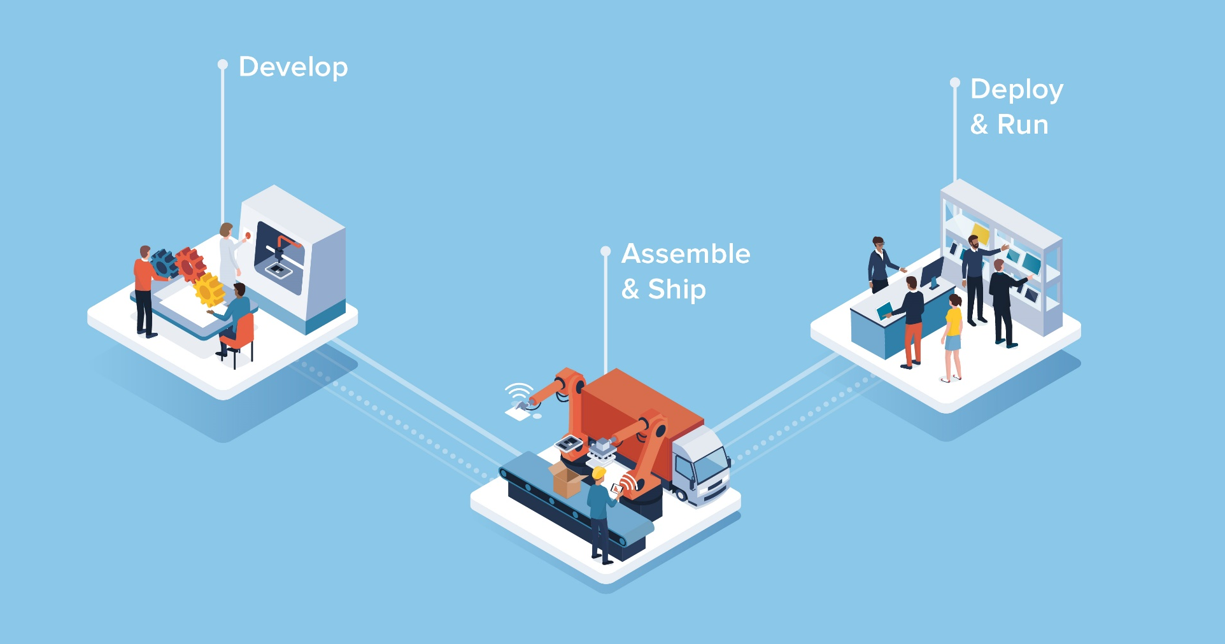
Traditional Software Development and Delivery Process

Slide 3
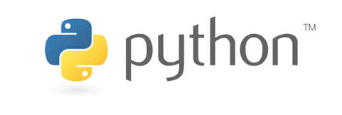




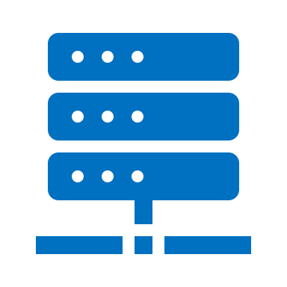

Developers Don’t Care About Infrastructure
Programming
language
v 3.5
v 3.6
v 3.8
OS
Hardware
Development
Testing
Production

Slide 4
So, Is There An Infrastructure Worry-free
Way for Developers?

Slide 5
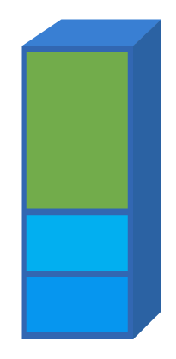
Containerization Is The Way to Go
Convenient package to ship "things"
Open specification
Stackable
Isolated
Portable
Lightweight
App
(e.g. nginx)
Tools
Libs

Slide 6
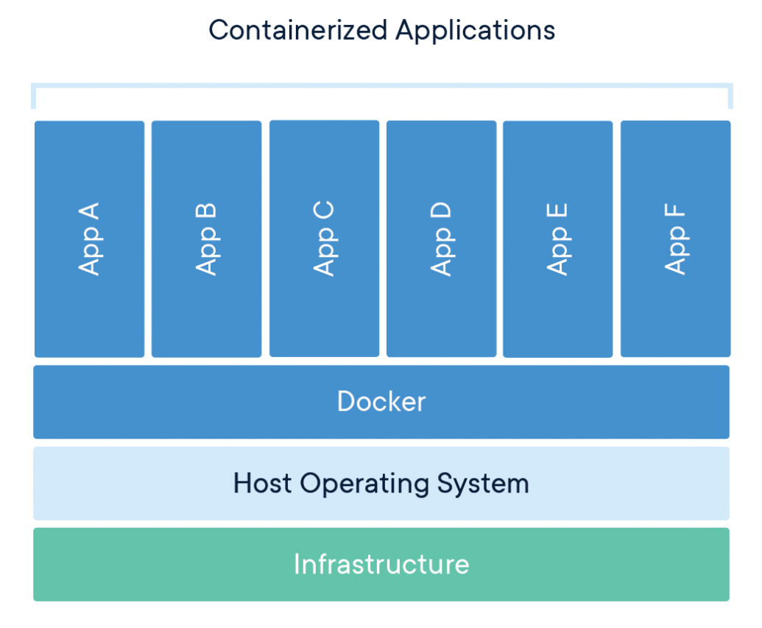
What Are Containers ?
App
A
App
B
App
C
App
D
App
E
App
F
A container is a standard unit of software that packages up code and all its dependencies so the application runs quickly and reliably from one computing environment to another.
Docker
Host Operating System
Infrastructure
Notes:
Containers offer a logical packaging mechanism in which applications can be abstracted from the environment in which they actually run. This decoupling allows container-based applications to be deployed easily and consistently, regardless of whether the target environment is a private data center, the public cloud, or even a developer’s personal laptop.

Slide 7
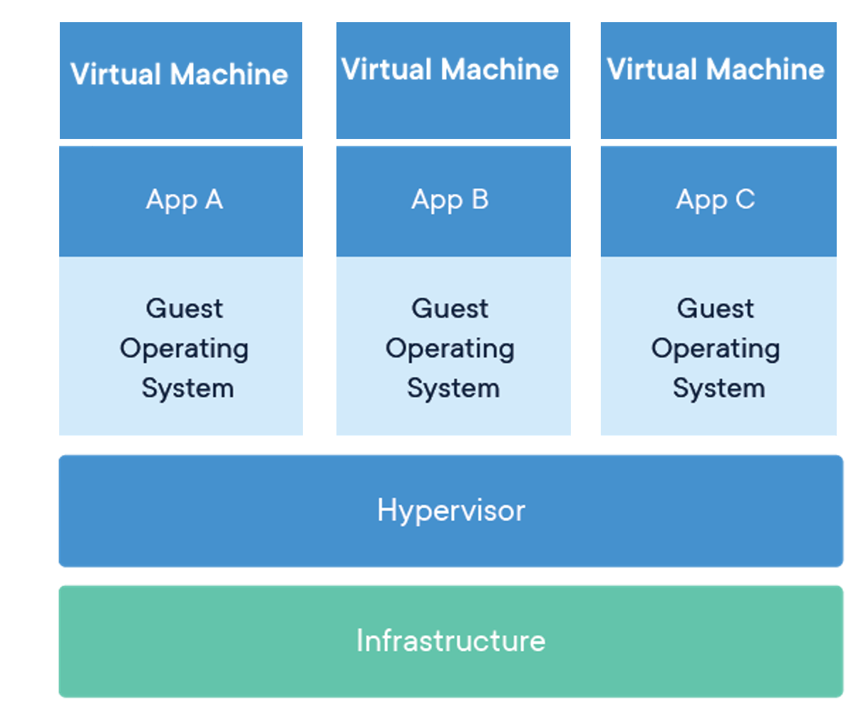
Container v.s. VM
Virtual Machine
Virtual Machine
Virtual Machine
App
A
App
B
App
C
App
D
App
E
App
F
APP A
APP B
APP C
Guest
Operating
System
Guest
Operating
System
Guest
Operating
System
Docker
Hypervisor
Host Operating System
Infrastructure
Infrastructure
Containers are an abstraction at the app layer that packages code and dependencies together.
Virtual machines (VMs) are an abstraction of physical hardware turning one server into many servers.

Slide 8
Container v.s. VM
VMs | Containers
Heavyweight (GBs) | Lightweight (MBs)
Limited performance | Native performance
Each VM runs in its own OS | All containers share the host OS
Hardware-level virtualization | OS virtualization
Startup time in minutes | Startup time in milliseconds
Fully isolated and hence more secure | Process-level isolation, possibly less secure

Slide 9


To Make It Easier to Understand
VM
Container

Slide 10
Containers and VMs Run Together
Virtual Machine
Virtual Machine
Virtual Machine
App
A
App
B
App
C
App
D
App
E
App
F
APP A
APP B
APP C
Guest
Operating
System
Guest
Operating
System
Guest
Operating
System
Docker
Hypervisor
Host Operating System
Infrastructure
Infrastructure
Containers and VMs used together provide a great deal of flexibility in deploying and managing app

Slide 11
A History of Container
FreeBSD
Jails
LXC
(Linux Containers)
Kubernetes
grows up
1979
2004
2013
2000
2008
2017
Unix V7
Solaris
Containers
Docker
Notes:
https://blog.aquasec.com/a-brief-history-of-containers-from-1970s-chroot-to-docker-2016

Slide 12
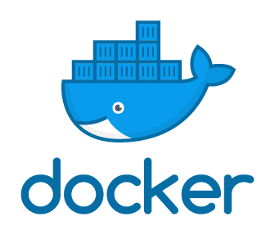
Why Docker ?
made containers easy and safer to deploy and use.
brought standardization to the container community.
Notes:
https://www.zdnet.com/article/what-is-docker-and-why-is-it-so-darn-popular/

Slide 13
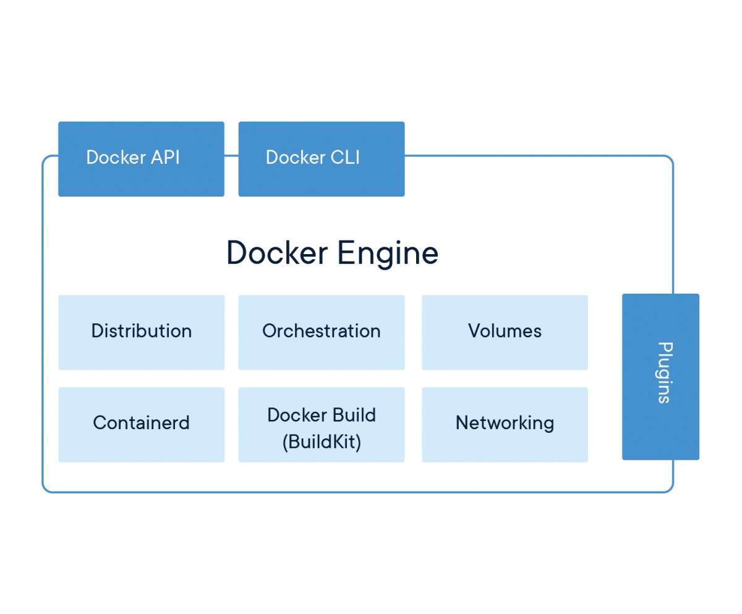
Docker Engine Sparked the Containerization
Movement
Docker Engine is the industry’s de facto container runtime that runs on various Linux and Windows Server operating systems.
Docker creates simple tooling and a universal packaging approach that bundles up all application dependencies inside a container which is then run on Docker Engine.
Docker Engine enables containerized applications to run anywhere consistently on any infrastructure, solving “dependency hell” for developers and operations teams, and eliminating the “it works on my laptop!” problem.
Notes:
The launch of Docker in 2013 jump started a revolution in application development - by democratizing software containers. Docker developed a Linux container technology - one that is portable, flexible and easy to deploy. Docker open sourced libcontainer and partnered with a worldwide community of contributors to further its development. In June 2015, Docker donated the container image specification and runtime code now known as runc, to the Open Container Initiative (OCI) to help establish standardization as the container ecosystem grows and matures.
Following this evolution, Docker continues to give back with the containerd project, which Docker donated to the Cloud Native Computing Foundation (CNCF) in 2017. containerd is an industry-standard container runtime that leverages runc and was created with an emphasis on simplicity, robustness and portability. containerd is the core container runtime of the Docker Engine.

Slide 14
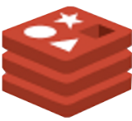

How Docker Works
Client
DOCKER_ HOST
Registry
docker build
Docker daemon
docker pull
Containers
Images
docker run

Slide 15
Docker Makes It Easy to Build And Run Containers,
But…
How about container monitoring, management and orchestration ?
App 1
App 2
App 3
C1a
C2a
C3a
C1b
C2b
C3b
C1c
C2c
C3c
Docker
Docker
Docker
Host OS
Host OS
Host OS
x86
x86
x86
Notes:
Like any other element of your IT infrastructure, containers need to be monitored and controlled. Otherwise, you literally have no idea what's running on your servers.
While the container runtime APIs meet the needs of managing an individual container on one host, they are not suited to managing applications running in multiple containers deployed across multiple hosts. This is where container orchestration tools, such as Kubernetes, are required.
Containers are great. They provide you with an easy way to package and deploy services, allow for process isolation, immutability, efficient resource utilization, and are lightweight in creation.
But when it comes to actually running containers in production, you can end up with dozens, even thousands of containers over time. These containers need to be deployed, managed, and connected and updated; if you were to do this manually, you’d need an entire team dedicated to this.
It’s not enough to run containers; you need to be able to:
Integrate and orchestrate these modular parts
Scale up and scale down based on the demand
Make them fault tolerant
Provide communication across a cluster

Slide 16

Introducing Kubernetes (K8s)
Node
Kubernetes (K8s) is an open-source system for automating deployment, scaling, and management of containerized applications.
Notes:
https://kubernetes.io/
It groups containers that make up an application into logical units for easy management and discovery. Kubernetes builds upon 15 years of experience of running production workloads at Google, combined with best-of-breed ideas and practices from the community.

Slide 17
Architecture of Kubernetes
Kubernetes Master
Controller Manager
API Server
Scheduler
Developer
/ Operator
etcd
users
Kubelet
cAdvisor
Kube-Proxy
Kubelet
cAdvisor
Kube-Proxy
Pod
Pod
…
Pod
…
Pod
Pod
…
Pod
Plugin Network ( eg Flannel, Weavenet, etc）
Kubernetes Node
Kubernetes Node

Slide 18

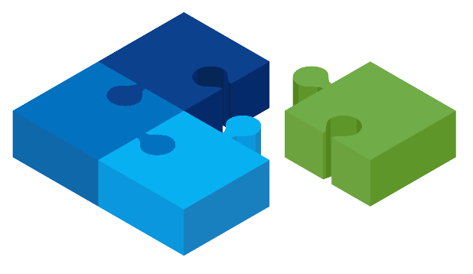

Why Is K8s So Popular ?
DevOps
Innovation
Community
Notes:
Developing modern applications requires different processes than the approaches of the past. DevOps speeds up how an idea goes from development to deployment.
At its core, DevOps relies on automating routine operational tasks and standardizing environments across an app’s lifecycle. Containers support a unified environment for development, delivery, and automation, and make it easier to move apps between development, testing, and production environments.
A major outcome of implementing DevOps is a continuous integration and continuous deployment pipeline (CI/CD). CI/CD helps you deliver apps to customers frequently and validate software quality with minimal human intervention.
Managing the lifecycle of containers with Kubernetes alongside a DevOps approach helps to align software development and IT operations to support a CI/CD pipeline.
With the right platforms, both inside and outside the container, you can best take advantage of the culture and process changes you’ve implemented.

Slide 19
In A Nutshell
Virtualization
Containerization
vSphere
Docker
vCenter
Kubernetes

Slide 20

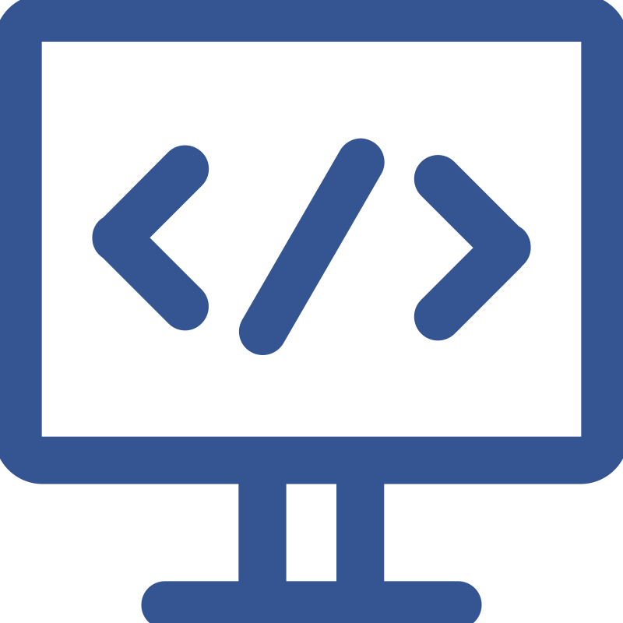


When Should You Use Docker and K8s ?
“Lift and shift” existing applications into modern cloud architectures.
Refactor existing applications for containers.
Develop new container-native applications.
Provide better support for microservices architectures.
Provide DevOps support for continuous integration and deployment (CI/CD).
Notes:
Common ways organizations use containers include:
“Lift and shift” existing applications into modern cloud architectures. Some organizations use containers to migrate existing applications into more modern environments. While this practice delivers some of the basic benefits of operating system virtualization, it does not offer the full benefits of a modular, container-based application architecture.
Refactor existing applications for containers. Although refactoring is much more intensive than lift-and-shift migration, it enables the full benefits of a container environment.
Develop new container-native applications. Much like refactoring, this approach unlocks the full benefits of containers.
Provide better support for microservices architectures. Distributed applications and microservices can be more easily isolated, deployed, and scaled using individual container building blocks.
Provide DevOps support for continuous integration and deployment (CI/CD). Container technology supports streamlined build, test, and deployment from the same container images.

Slide 21



Some Real World Use Cases of Containers and K8s
Today the majority of the NYT's customer-facing applications are running on Kubernetes.
Legacy deployments that took up to 45 minutes are now pushed in just a few.
First moved their services to Docker, then to Kubernetes. Now they can take ideas from ideation to production in a matter of minutes, whereas earlier they used to take hours or even days. They have cut down so much overhead cost by utilizing Kubernetes and have removed a lot of manual work without making engineers worry about the underlying infrastructure.
Airbnb adopted Kubernetes to support over 1,000 engineers concurrently configuring and deploying over 250 critical services to Kubernetes (at a frequency of about 500 deploys per day on average).

Slide 22
So, What’s Sangfor’s Role in The Container World?

Slide 23

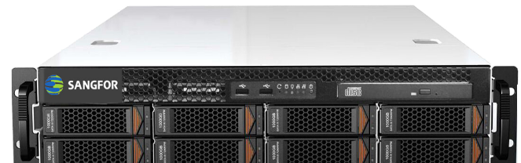
Sangfor KubeManager
Traditional
Cloud-native
Kubernetes
VM
VM
VM
VM
VM
VM
App
App
App
App
App
App
App
App
App
Docker
Docker
Docker
Sangfor HCI software
+
standard x86 servers

Slide 24
THANK YOU
Cheney Hu | HCI Senior Product Manager
cheney@sangfor.com
www.sangfor.com
Sangfor Technologies Inc.

Slide 25







Docker Commands Diagram
commit
images
rmi
tag
history
Container
create
run
start
Running
kill, stop
Stop
cp
files/
folders
files/
folders
unpause
Host
wait
logs
attach
^p, ^q
pause
Pause
inspect
port
top
diff
Ps
rm
Images
>_ exec
import
filesystem
image(s)
export
load
save
Tar files
build
version
info
events
Dockerfile
pull
push
search
login
logout
Registry
Engine

Slide 26
Monolith v.s. Microservice
Presentation layer
Microservice
Microservice
Service layer
Persistence layer
Microservice
Microservice
Microservice
DB
DB
DB
DB
Monolithic architecture
Microservices architecture
Notes:
https://www.geeksforgeeks.org/monolithic-vs-microservices-architecture/

Slide 27
Architecture of Kubernetes
Kubernetes Master
Controller Manager
API Server
Scheduler
Developer
/ Operator
etcd
users
Kubelet
CAdvisor
Kube-Proxy
Kubelet
CAdvisor
Kube-Proxy
Pod
Pod
…
Pod
…
Pod
Pod
…
Pod
Plugin Network ( eg Flannel, Weavenet, etc）
Kubernetes Node
Kubernetes Node

