Slide 1


Sangfor
Intelligent Edge Router (SIER)
Product Introduction
Sangfor SD-WAN Team
www.sangfor.com
Sangfor Technologies Inc.

Slide 2
Contents
PART
1
PART
2
PART
3
PART
4
Background and Trends
SIER
Introduction
Scenarios and Values
Try
SIER

Slide 3
PART 1
Background and
Trends

Slide 4

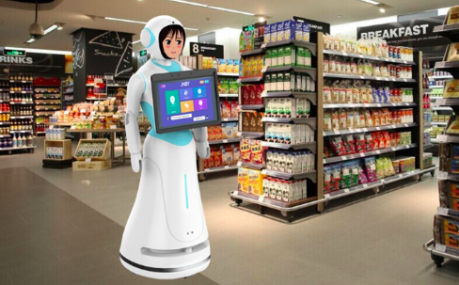




MPLS Network Does Not Support True
Business Change
Apps explosive increase
Business towards to cloud
Bandwidth
Cost
Availability
Experience

Slide 5
Security Events Appear One-by-One
ATP, Ransomware, Data Breaches, etc.
Ransomware
>50 Russian companies infected
APT
PyeongChang Winter Olympics suffered a phishing email attack causing network downtime
Data Breach
Marriott’s 500 million customer data leaked, and its share price fell by 6.9%.
State-Sponsored Attack
SingHealth reported an attack compromising the personal information of 1.5 million patients

Slide 6

Business Expansion Caused Branch Issues
1
2
Deployment
O&M
Time costs
Human costs
Transportation costs
Policy updates
Visualization
Alert

Slide 7
Ideal Future Branch Network Access
Simple
Intelligent
Secure
Cost-Effective

Slide 8
PART 2
Sangfor Intelligent Edge Router
Product Introduction

Slide 9







New IT Architecture for Branch Network Access
Traditional IT Architecture
VPN
Router
Optimizer
WIFI
4G
Firewall
Router
Optimizer
Firewall
SD-WAN
SD-WAN
VPN
AP
SD-WAN Router

Slide 10
Sangfor Intelligent Edge Router (SIER)
Simple
Intelligent
VPN
Router
Optimizer
WIFI
4G
Secure
Firewall
SD-WAN
SD-WAN
Cost-effective

Slide 11
Highlight 1: Simple – Deploy in Minutes
Step 1
Step 2
Step 3
Success
Connect Cable
(WAN/LAN)
Connect PC
to Device
Click Email Link
Connect Device to
Internet and CM
8:00 AM
8:10 AM
8:11 AM
8:15 AM

Slide 12
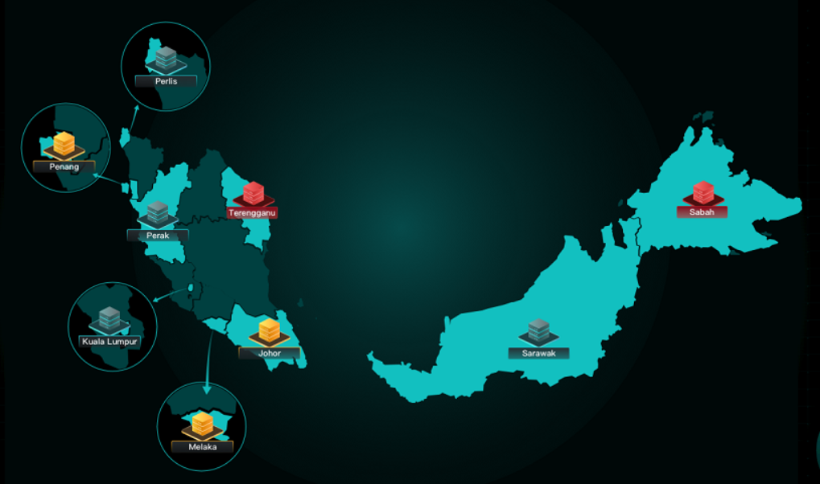
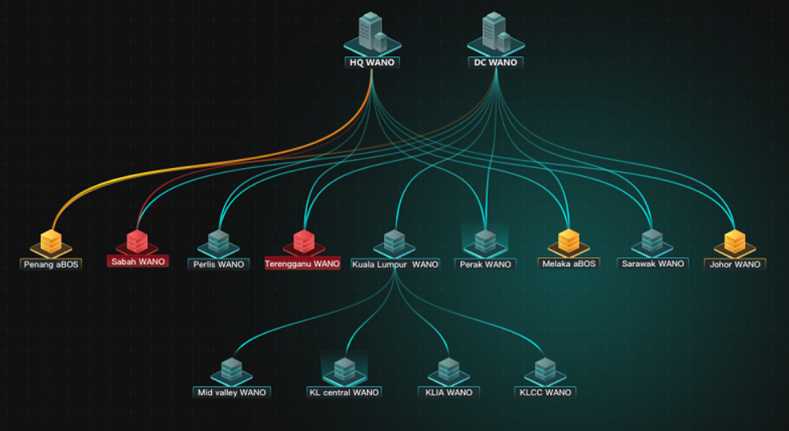
Highlight 1: Simple – Centralized Management
Branches Map
VPN Topology
Map Based Visualization
Intelligent Alerts
Unified Policy Update
Unified License Management
Unified Firmware Upgrade
All devices entrance

Slide 13


Highlight 2: Intelligent & Optimized
Intelligent Identify + Intelligent Path Selection + Intelligent Optimization
Internet
SD-WAN
Identify
Optimize
Identify
Optimize
SD-WAN
LTE
MPLS

Slide 14









Highlight 2: Intelligent & Optimized
Critical Apps
MPLS
or Internet
Lowest Latency
File sharing, SaaS, Internet apps
Load Balancing
MPLS
or Internet
（Active）
Lowest packets loss
Application overlay
Path selection based on Apps SLA and Link QoE

Slide 15















Highlight 2: Intelligent & Optimized - Tunnel Bonding
Tunnel Bonding Maximizes WAN Utilization
MPLS
INTERNET

Slide 16














Highlight 2: Intelligent & Optimized
Intelligent generate
Duplicated and FEC Packets
FEC
Original packets
MPLS
Packets loss
INTERNET
Interactive
Real Time
File Sharing
Restore
Apps overlay
High Packets Loss Network
20%
Reduce VC/VOIP 20% packets loss
50%
Improve OA 50% interaction speed
300%
Improve 300% FTP,
File sharing speed

Slide 17




Highlight 3: Three-Dimensional Security
Malware,
phishing, ransomware website
Network
attack
Data breach,
theft, tampered
forged
INTERNET
Branch User
Data Center
User Security
Network Security
Data Security
Apps DPI: 5000+ rules, 2000+ Apps
Access control: Policy based on Apps DPI and time
URL Filtering: Linked with Sangfor AI-based cloud security Neural-X
Level 3 stateful firewall
SNAT/DNAT
Anti-DoS
Hardware certificate authenticate
Anti-fleeing:
location change block
AES-256 data encryption

Slide 18
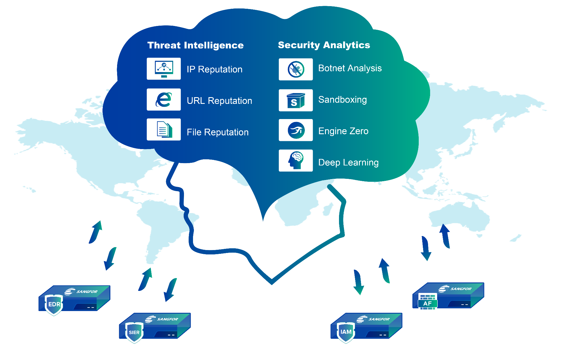
Hight 3: AI-Based Cloud Web Filtering
EDR
NGAF
SIER
IAM

Slide 19
PART 3
Scenarios & Values

Slide 20




Large Scale - Small Footprint
Target Customers:
Retail chain store, Logistics, Real-estate
Utilities: Gas station, Water and electric branches
Sangfor Solution:
Zero-touch provisioning
Centralized Managed
Multi-WANs Network
WIFI + 4G for options
Key Values:
Simple deployment, O&M
Improve business reliability
Reduce bandwidth, human, device costs

Slide 21




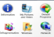
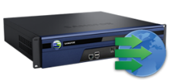


Mixed Network in Multiple Branches and DCs
Target Customers:
Government (national/provincial/city)
Manufactory
Financial
Disaster Recovery Center
Central Manager
Neural-X
Disaster Recovery Center
DB Server
Application Server
MPLS
DB Server
Application Server
Sangfor Solution:
One-stop solution for different size office, different demands
File Server
Backup & Recovery
Backup & Recovery
File Server
4G
MPLS
Internet
MPLS
SIER Values:
Optimized application experience to improve work efficiency
Secure access to internet and data center
Business availability
WIFI + 4G in one to reduce costs
MPLS
VSAT
WANO
SIER
NGAF
Branch Office
Branch Office
Branch Office

Slide 22





Hybrid WAN with MPLS, Internet broadband & LTE
1. Increase Bandwidth 2.Reduce WAN Investment 3. Improve Business Availability
20M
10M
1k
4M
Internet
20M
10M
4M
MPLS
10M
MPLS
20M
4M
X2.4
50% off
Bandwidth
Costs

Slide 23

LTE Only in Distributed Network
Target Customers:
Construction
Mine, Farming
Self-service machine, ATM
Key Values:
Break through link and ISP limitation
Branches rapid online and withdraw
Link backup for fixed line

Slide 24
SIER Key Values Summary
Reduce
50%-80%
Improved by
2-3
Times
Improved
by
2-5 Times
3
Dimensional
Security
80% Reduction in deployment time, O&M
50% reduction in hardware &
bandwidth costs
Business
availability
User productivity
Security
Notes:
简化工作
降低成本
提升业务可靠性
提升工作效率
安全

Slide 25
PART 4
Try SIER

Slide 26
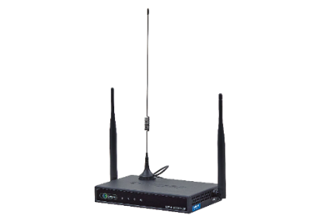
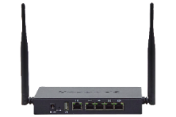
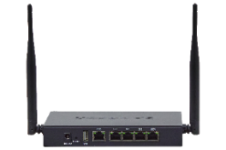
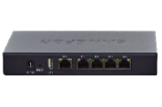
SIER Sizing
 | SDW-R1080 | SDW-R1080-WIFI | SDW-R1080-LTE | SDW-R1080-PRO
VPN Throughput | 100M | 100M | 100M | 100M
Firewall Throughput | 300M | 300M | 300M | 300M
Network Interface | 5*GbE | 5*GbE | 5*GbE | 5*GbE
Max. WAN Port | 4 | 4 | 4 | 4
Embedded WIFI | N/A | YES | N/A | YES
Embedded LTE | N/A | N/A | 2* Embedded LTE | 1* Embedded LTE
Suggested User | 10-30 | 10-30 | 10-30 | 10-30

Slide 27




SIER Current Footprint
SF Express
2000+ SIER
JD Logistic
1200+ SIER
International
Version Launch
2019 Q4
400+
125
Chinese Version Launch
2000+
LG Life
400+ SIER
1200+
TESLA China
125 SIER
Q4 2020

Slide 28
Imagine the Future
5G
High Performance
Cloud
SaaS

Slide 29

Try Sangfor SIER
Contact Us NOW!
marketing@sangfor.com
@

Slide 30
THANK YOU
XXX | Sales Manager
xxx@sangfor.com
www.sangfor.com
Sangfor Technologies Inc.

