Slide 1


Sangfor SD-WAN
Technology Introduction
Vincent
SD-WAN PM
www.sangfor.com
Sangfor Technologies Inc.
PPT_Intro_20190227

Slide 2


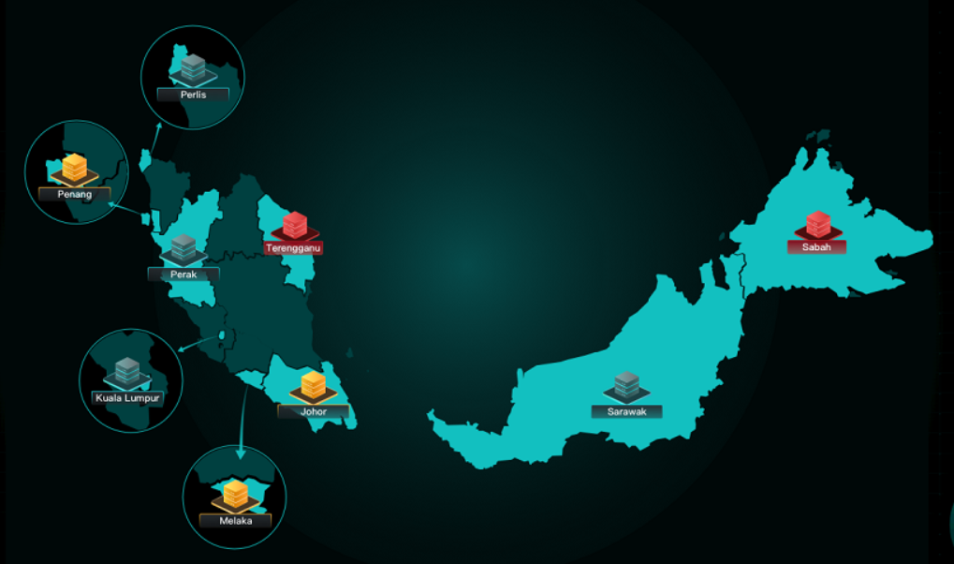
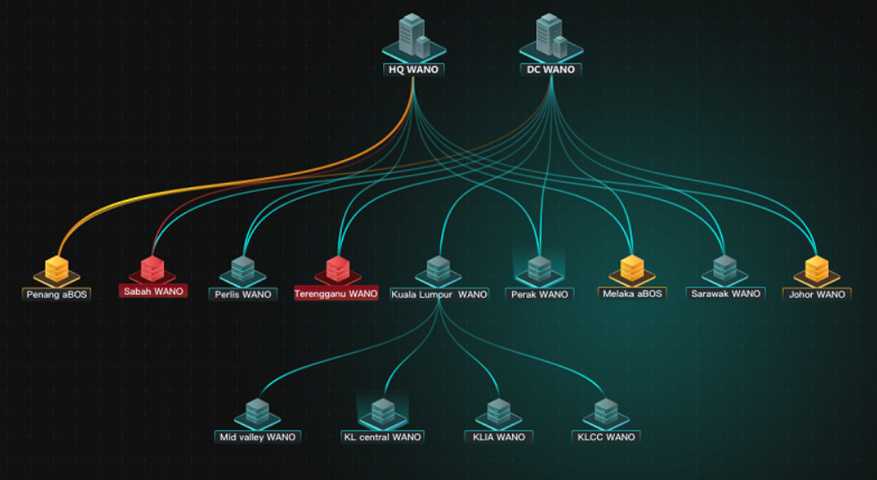

Sangfor SD-WAN Technology Overview
Branch Map
VPN Topology
SD-WAN Controller
VOIP/VC
MPLS
SD-WAN
SD-WAN
Mail/File Sharing
Internet
Branch
(Quick & Simple)
WAN Network
(Stable & Good)
Center
(Easy & Visual)
Email Deployment
Auto VPN
Dynamic Path Selection
VPN Tunnel Bonding
Application Acceleration
Visual Operation
Unified Management
Business Orchestration
Sangfor Technologies
Page

Slide 3
Network for Time to Market
WAN Link Startup
Engineer Onsite Implementation
Sangfor Technologies
Page

Slide 4
Quickly Conduct Branch Business—Email Deployment
Step1:
Power On Device
Step2:
Connect to Device
Step3:
Click Email
Success Deployment
✅Connect to internet
✅Connect to BBC
✅Configuration synchronize from BBC
Sangfor Technologies
Page

Slide 5

Quickly Conduct Branch Business—Auto VPN
Star Network
Full Mesh
Tree Network
IPSec VPN
AUTO VPN
Both side device:
Phase I : VPN model/ Authentication algorithm/Encryption algorithm/DH Group/ISAKMP life time/Pre-shared key/Verify ID
Phase II: Tunnel protocol/PFS/Encryption algorithms/Hash/SA lifetime/Subnet
  BBC:
  Appoint HQ->Set connection address->Specify branch
  ->Synchronize configuration to all device
Sangfor Technologies
Page

Slide 6

How to Choose Your Delivery Method?
4 Hours
Critical Package
KL
HK
7 Days
2T Cargo
Sangfor Technologies
Page

Slide 7
Stable Network—Priority for Critical Apps
HDSL
20M 10USD/M
MPLS
1M 200USD/M
4M 600USD/M
MPLS
SD-WAN
ADSL
10M 10USD/M
Reduce
Bandwidth Costs
Increase Bandwidth
Separate
Traffic
Are You Still Using a Plane to Deliver Massive Cargo?
Sangfor Technologies
Page

Slide 8







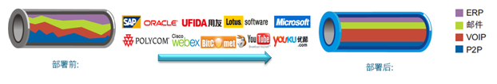



Stable Network—Automatic Fail-over
①File sharing: High bandwidth；
e.g. FTP,CIFS
Internet
Branches
IaaS/SaaS
②Core application: High available, allow a little jitter；
e.g. OA, ERP, CRM
MPLS
③Instant Message application: High experience, 0 packets loss rate, low latency;
e.g. VOIP/VC
HQ
Fail-over in 1 second, user no perceptions !
Sangfor Technologies
Page

Slide 9
Stable Network—VPN Tunnel Bonding
ISP1 10M
ISP3 30M
Branch
HQ
ISP2 20M
ISP4 40M
Bonding
VPN Tunnel1：ISP1<->ISP3 10M
OA Session 1
VPN Tunnel2：ISP1<->ISP4 10M
OA Session 2
Branch
HQ
VPN Tunnel3：ISP2<->ISP3 20M
OA Session 3
VPN Tunnel4：ISP2<->ISP4 20M
OA Session 4
Sangfor Technologies
Page

Slide 10

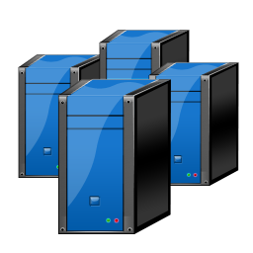

Stable Network—VPN Tunnel Bonding
Packets in one flow
1
3
1
2
3
4
1
2
3
4
2
4
Branch
DC
Sangfor Technologies
Page

Slide 11
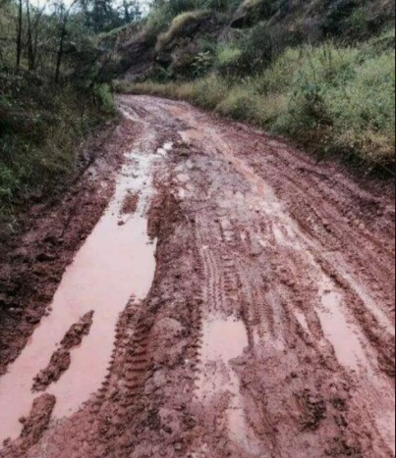
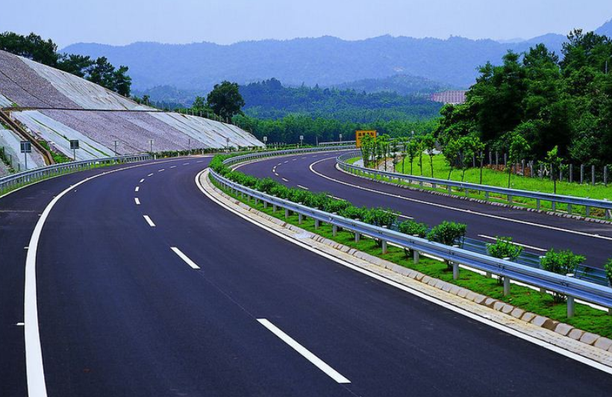


How to Solve Traffic Jam
X 10
Sangfor Technologies
Page

Slide 12


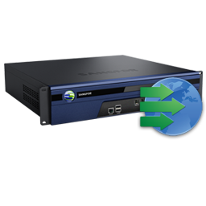



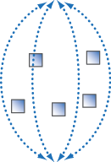

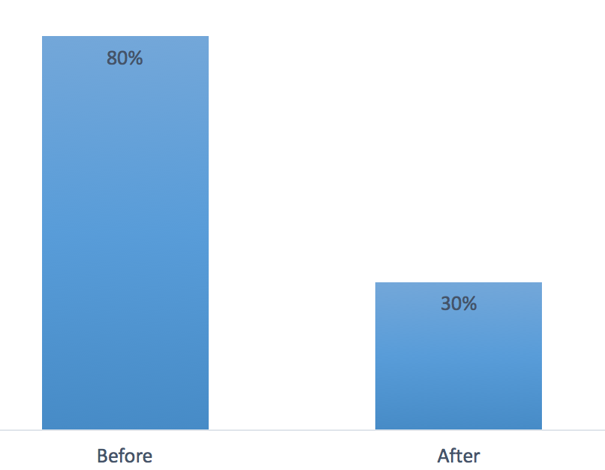
Good User Experience—Byte Cache/De-duplication
Data
Data
Tag
WAN
Date center
Branch Office
A tag can represent up to 4K real data
Decrease link load
Before
After
Sangfor Technologies
Page

Slide 13



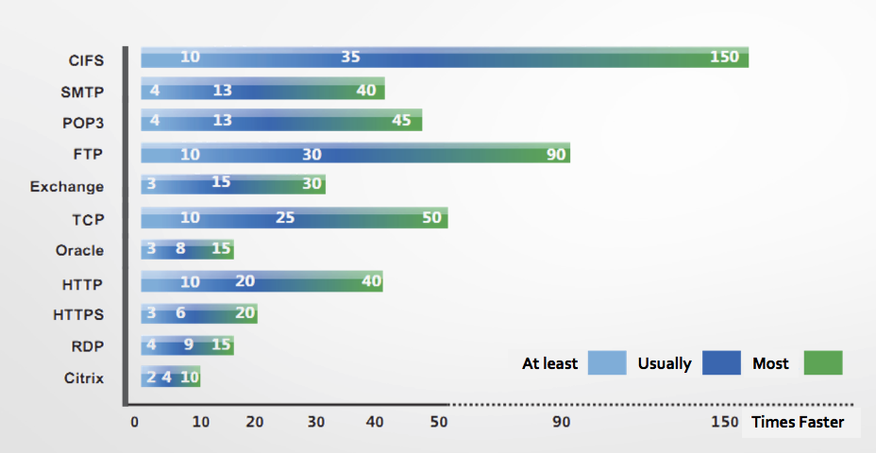
Good User Experience—Application Proxy
Original TCP connection
Transfer Connection
Control
Connection
Control
connection
WAN
WANO
Intercept ‘ACK’
WANO
Local ‘ACK’
Local ‘ACK’
Protocol proxy reduce protocol process.
Overcome the latency
Speed up response time
Sangfor Technologies
Page

Slide 14
Good User Experience—Protocol Optimization
Transmission improve 30%
Packets loss reduce to 1%
Speed
Sangfor High Speed TCP
Common TCP
Time
Sangfor Technologies
Page

Slide 15

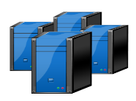


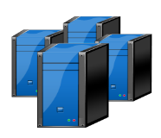



Good User Experience—Packets Lose Optimization
Packets duplication
VOIP flow
2
1
3
4
1
2
3
4
1
2
3
4
1
2
3
4
Branch
DC
Forward Error Correction (FEC)
FTP flow
P
P
1
2
3
4
1
2
3
4
1
2
3
4
Branch
DC
Packets re-transmission
HTTP flow
1
2
3
4
1
2
3
4
1
2
3
4
2
Branch
DC
Sangfor Technologies
Page

Slide 16


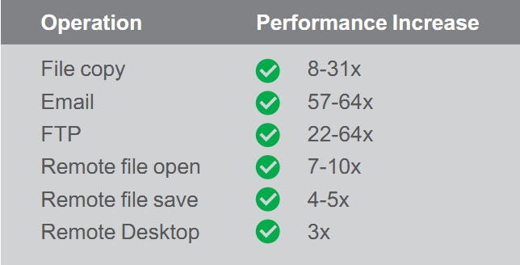
Good User Experience
Acceleration
Build Your Information Highway with Lower Bandwidth Cost
Sangfor Technologies
Page

Slide 17
Easy Operation & Management
Branch Map
VPN Topology
Map Based Visualization
Intelligent Alerts
Unified Policy Update
Unified License Management
Unified Firmware Upgrade
All Device Access
Greatly Decrease Operation Difficulties and Costs
Sangfor Technologies
Page

Slide 18
Sangfor SD-WAN Key Values for Business
Reduce time to market
Improve business reliability
Increase user productivity
Save human & bandwidth costs
for core business
Sangfor Technologies
Page

Slide 19
Boost Your Business with Sangfor SD-WAN
MPLS
Hybrid WAN
WAN Acceleration
Internet
Internet
WAN
Large-Scale Small
Footprint Locations
Global Network
Sangfor Technologies
Page

Slide 20
THANK YOU
Vincent | Product Manager
vincent@sangfor.com
www.sangfor.com
Sangfor Technologies Inc.
PPT_Intro_20190227

