Slide 1
Sangfor aBOS
Makes Your IT Simpler & Scalable
Vincent Wu
Product Manager
Notes:
So Today

Slide 2

01
What is aBOS ?

Slide 3
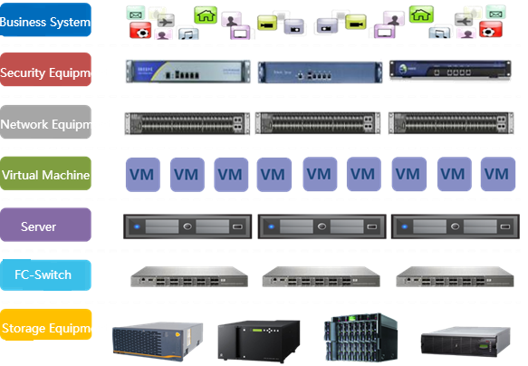
Traditional IT Infrastructure
Complex
Silos
Rigid
Costly
Bottleneck

Slide 4
Challenge #1 High Investment
Requirement:
Purchase:
Manage online user behavior
Internet Proxy device
Network security protection
Next-Gen Firewall device
Accelerate application
WAN Opt device
Local App system
Server

Slide 5

Challenge #2: Complexity of Operation & Maintenance
Limited IT operation resource
Require specialist
Long time product learning
Overload!

Slide 6
Challenge #3: IT Resource Optimization
Business Application
CRM/ERP
Low utilization of computing, storage and
network resource
Difficult to reuse IT resources
Waste of investment
Management Service
Server
Security Service
Network
Storage

Slide 7



Software-Defined IT Infrastructure
Internal IT is delivered as Service
Hardware-Defined
IT Infrastructure
Software-Defined
IT Infrastructure

Slide 8






“Hyper-Converged Infrastructure”
The Best Practice of “Software-Defined”
1st Phase of HCI
2nd Phase of HCI
3rd Phase of HCI
Compute
Storage
Network
Security
The First 3rd Phase HCI in The world

Slide 9





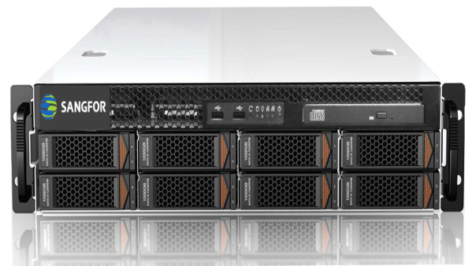
What we offer?
NFV
Storage
Virtualization
Network
Virtualization
Server
Virtualization

Slide 10
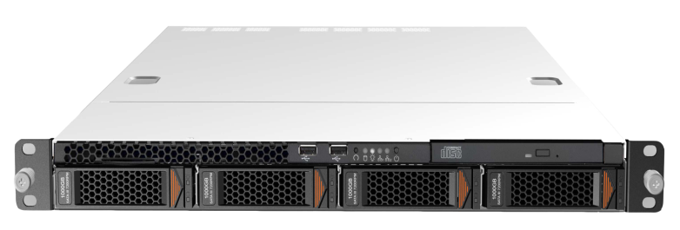
Mini HCI--aBOS
NFV
Business
Server
NFV
vIAM
vNGAF
vWANO
+
+
Server
Virtualization
…
App Server
FTP Server
Makes Your IT Simpler & Scalable

Slide 11

















Traditional Architecture
aBOS
Internet
Internet
IAM
File Sharing
Email
File Sharing
OA
Printer Service
OS
OS
OS
OS
OS
WIFI
FW
Printer
OA
FTP
VS
HTTP
Email
CIFS
File
WIFI
Desktop
Complexity High
Slow Application Deployment
Lots of SPOF
Complexity Low
Fast Application Deployment
Highly Stable

Slide 12
02
Highlights of aBOS

Slide 13




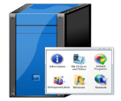
Highlight 1: All in One
Gateway, Server, User Security
User & Traffic Management
Full Optimization
Business Apps Server
Save More Money !

Slide 14
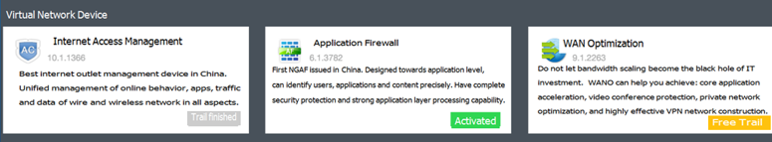
Highlight 2: Pay as You Grow
1. NFV Deploy On Demand
2. Performance Extension (2019 Q2)
50M
License
100M
License
More
High Flexible & Scalable !

Slide 15

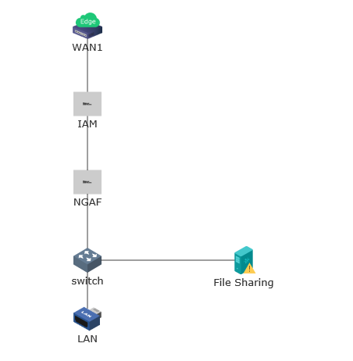
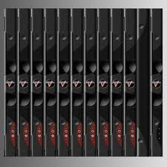
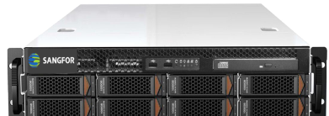
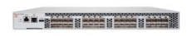
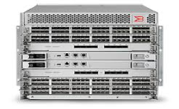
Highlight 3: One Click Deploy
Network Specialist
Internet
Server Specialist
IT Generalist
Storage Specialist
Easy Management & Operation !

Slide 16
Highlight 4: Data 2 Copies
Memory
Data
Data Disk 1
Data Disk 2
Data High Secure !

Slide 17



Why Sangfor aBOS ?
High scalability for future
Extremely competitive TCO
Simplify deployment and management
Moreover…

Slide 18
03
Scenarios of aBOS

Slide 19





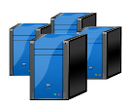


Scenario 1: Enterprise Elastic Network
Firewall
aBOS
vNGFW
aBOS
vNGFW
aBOS
vIAM
vIAM
vSwitch
Virtual
Machine
vSwitch
vSwitch
Virtual
Machine
Virtual
Machine
Best Choice for Big Branch or Small Data Center !

Slide 20
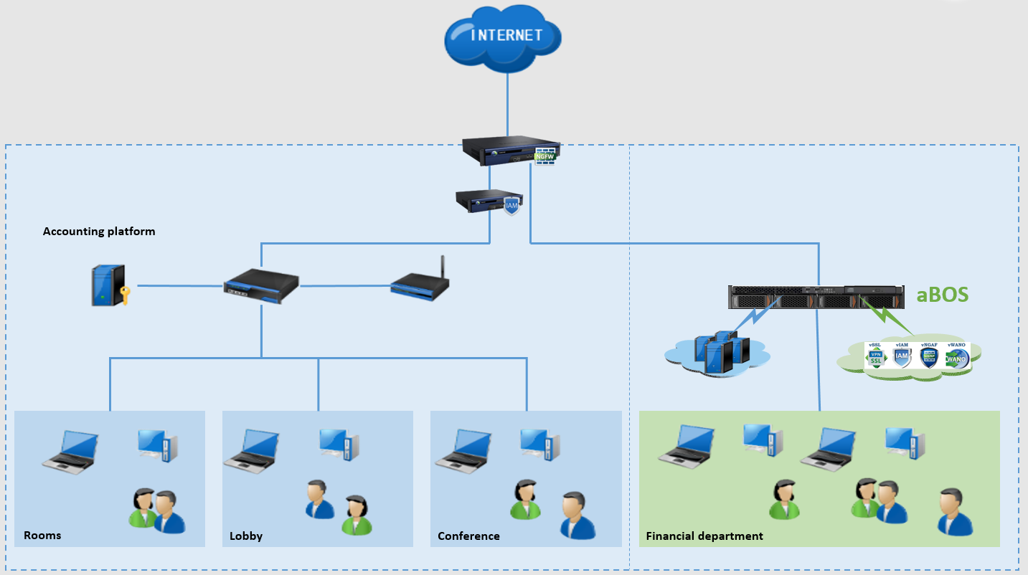
Case: Macau Science Centre
Customer Background:
Macao Science Center (MSC) aims to promote science popularization and education among local adolescents, compliment tourism development in Macao and provide a regional platform for science education, convention and exhibition.
Challenges:
Budget concern.
Centre management.
Independent financial server.
High Availability

Slide 21
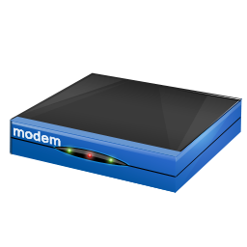




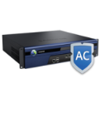

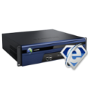

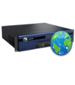
Scenario 2: Elastic SD-WAN
BBC
(Branch Business Center)
、
Business orchestration
Unified management
Full visualization
aBOS
aBOS
aBOS
aBOS
aBOS: Sangfor SD-WAN uCPE

Slide 22




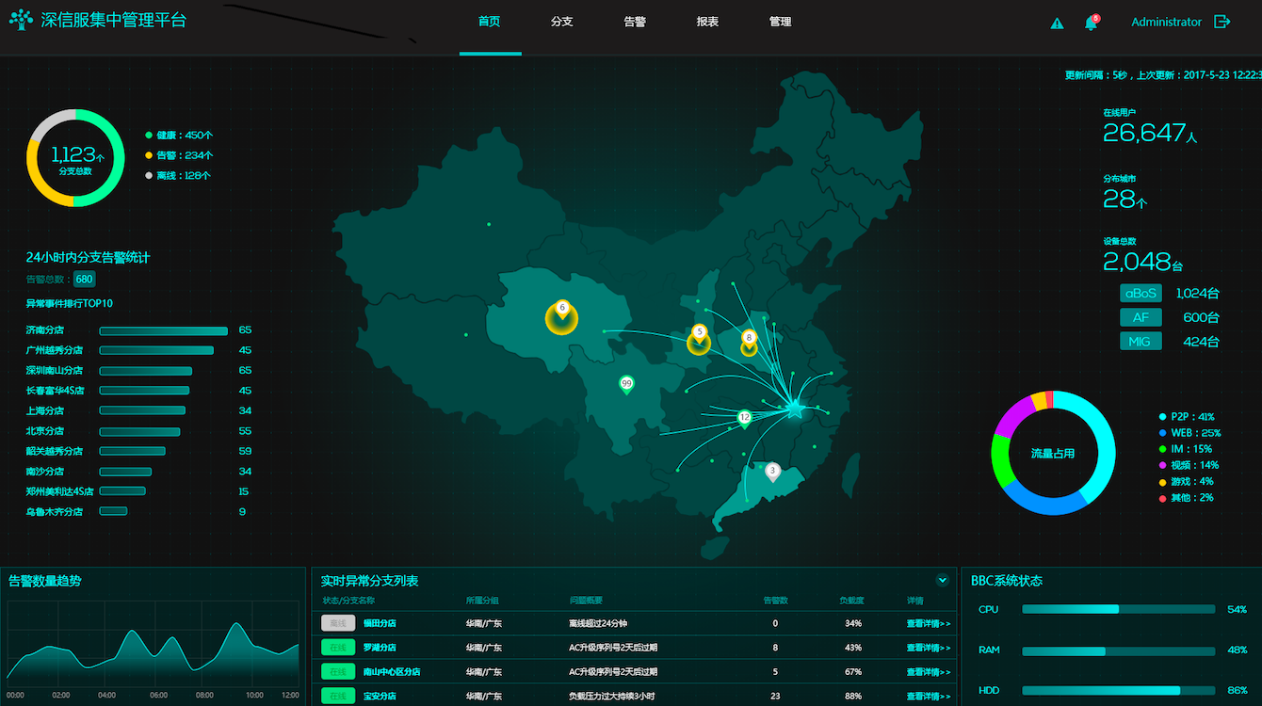




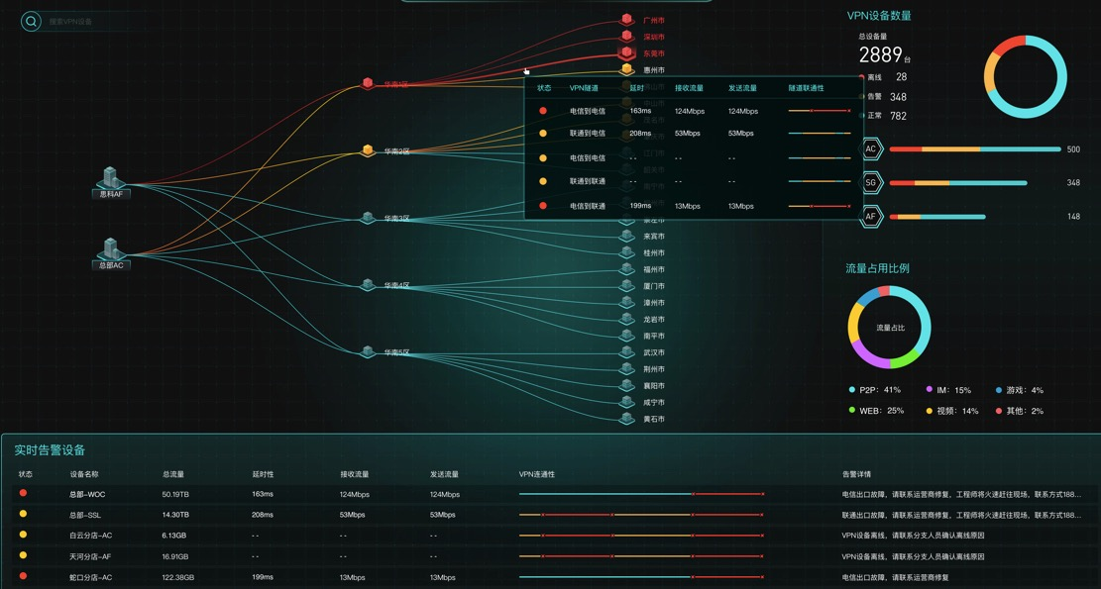


Case: UnionPay
Sangfor provides 2*aBOS HA + 1*BBC in Shanghai data center, 2*aBOS in Beijing data center, 29*aBOS in 29 branches over the world SD-WAN solution. Help branches quickly build reliable connections to data center, protect network security and make user activities compliance through vNGFW+vIAM in aBOS, simplify operation and management through BBC map based full visualization.
Mobile
Data Center
Branch office
aBOS(HA)
Core Switch
Branch office
aBOS
Branch Office
aBOS
aBOS
BBC
Notes:
UnionPay, is a Chinese financial services corporation. It provides bank card services and a major card scheme. UnionPay is the only interbank network in China that links all the ATMs of all banks throughout the country. It is also an electronic funds transfer at point of sale (EFTPOS) network. It is the largest card payment organization in the world offering mobile and online payments based on total value of payment transactions, ahead of Visa and Mastercard.

Slide 23
04
Sizing & Quotation

Slide 24
Sizing
Appliance
Model | aBOS-1000 | aBOS-2000 | aBOS-3000
User | 200 | 600 | 1000
Bandwidth | 50~100M | 50~300M | 50~500M
Maximum NFV | 2 | 3 | 3
Maximum VM &NFV | 3 | 6 | 9

Slide 25
Quotation
Hardware
aBOS Server
Cache Disk
Data Disk
Software
aBOS HA Module
vIAM
vNGAF
vWANO
Service
Software & Technical service
Hardware service

Slide 26
05
FAQ

Slide 27
FAQ
1. Does aBOS support third-party hardware ?
Answer: No, to guarantee system reliability and compatibility.
2. Does customer must buy NFV ?
Answer: Yes, at least buy one (vNGFW/vIAM/vWANO), we suggest HCI for server virtualization only scenario.
3. What is the difference between appliance and NFV ?
Answer: Core features are the same, but NFV software version upgrades may later than appliance software.

Slide 28


Notes:
Thank you for listening

