Slide 1


Gain Certain Confidence with Business
Continuity in Uncertain Times
Sangfor HCI Data Protection & Disaster Recovery Solution
Cheney Hu
cheney@sangfor.com
www.sangfor.com
Sangfor Technologies Inc.

Slide 2



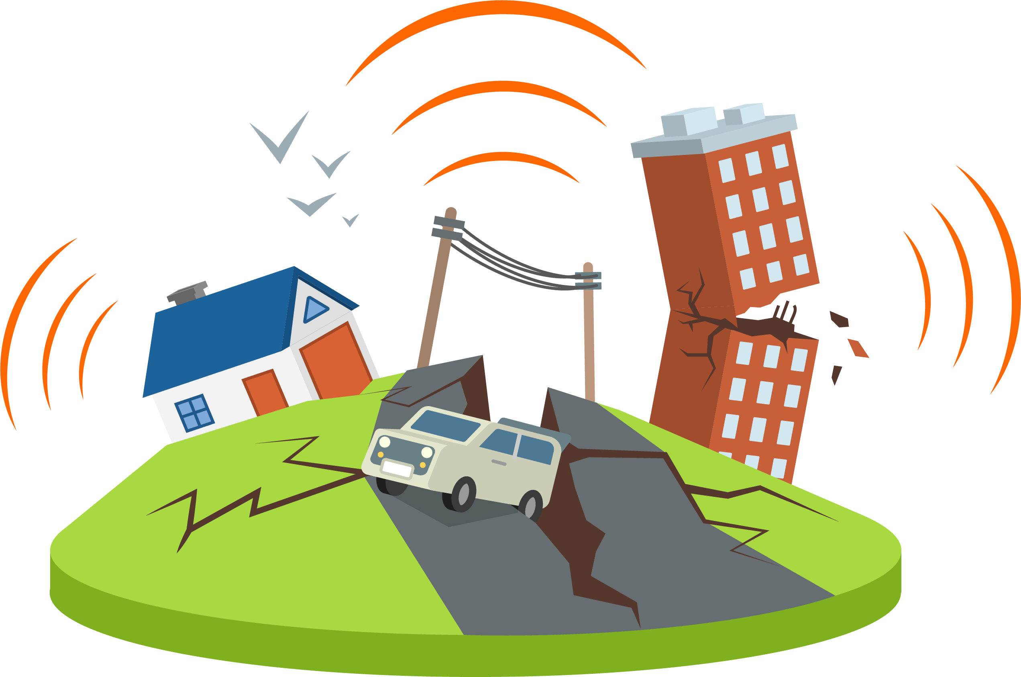

The World Is Full of Unexpected
Tornado
Fire
Earthquake
Flood

Slide 3
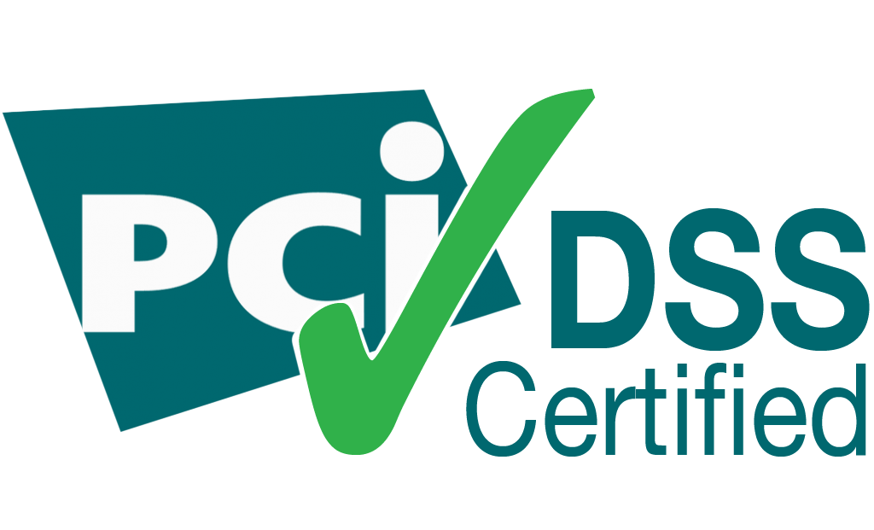
Governments And Industry Regulation Bodies
Are Getting Ready
Data Protection
Officer (DPO)
Compliance
25 May 2018
Data Breaches
Personal Data

Slide 4
When It Comes to Data Center Infrastructure
Two aspects are most concerned and prioritized by CIO/CTO
The integrity of data
The continuity of business
Data protection
HA/DR

Slide 5
Data Protection

Slide 6
Why Do We Need Data Protection ?
“Everything fails, all the time.”
-Werner Vogels, VP&CTO, Amazon
Hardware failure
Human error
Malicious attack

Slide 7
Data Protection Comes in Different Levels
VM/App
Backup
Cluster-level protection
Hypervisor/SDS
Data copy
Erasure coding
Node-level protection
Server
RAID
Disk-level protection

Slide 8
How Sangfor HCI Does It

Slide 9
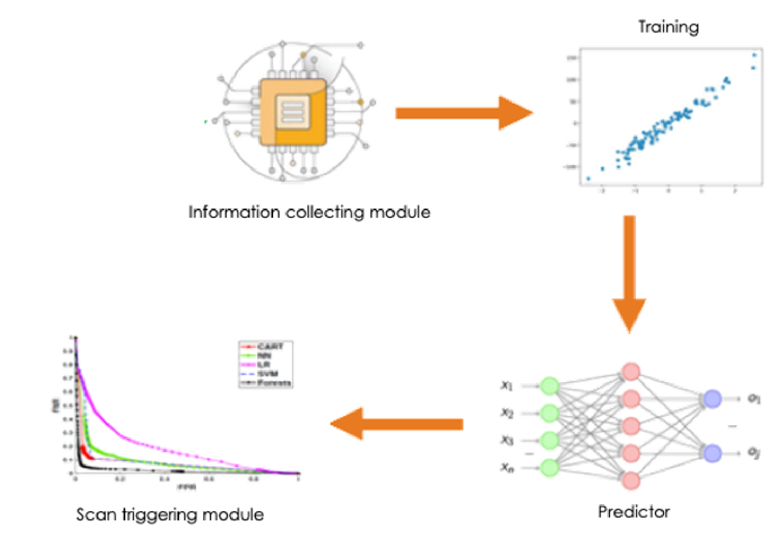
Disk Bad Sector Prediction And Repair (with aSAN)
Prediction
Scanning
Repair
SMART data
Training
Performance
parameter
Logs
Result output:
A bad sector will occur on disk A in 7 days
Disk A will be scanned in priority in the daily scanning task
Data is repaired once the bad sector is confirmed
……
Information collecting module
The time it takes to discover bad sector is reduced
from weeks to 1day, minimizing data loss risk.
Scan triggering module
Predictor

Slide 10







Data Copy Based Redundancy
2 copies: tolerate 1 node failure without data loss
3 copies: tolerate 2 nodes failure without data loss
VM-based data redundancy policy

Slide 11
Integrated Backup & Archiving
Free of charge
Min. 1 hour RPO
VM-level backup & archiving
Forever incremental or periodic full backup

Slide 12





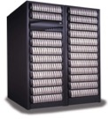
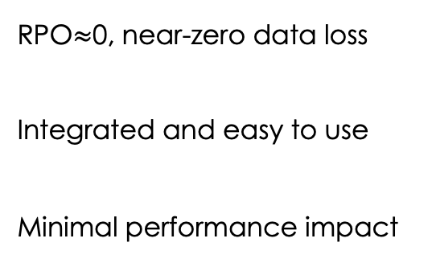
Continuous Data Protection
RPO$≈$0, near-zero data loss
Integrated and easy to use
Minimal performance impact
Hypervisor
IO Mirror
Hypervisor
aSV（Hypervisor）
IO Logs
NAS
SAN

Slide 13





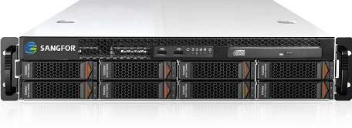
More Automated Protection from Ransomware
Internet
Cyber Command
NGAF
NGAF
In ransomware scenario, CC leverages the storage snapshot API of HCI to take snapshot of the infected VM to minimize data loss.
NGAF
NGAF
Sangfor HCI
VM
VM
Receive threat data
Send execution command

Slide 14
The Most Comprehensive Data Protection Suite
aSAN
aSAN
aSAN
SSD
SSD
SSD
SSD
SSD
SSD
HDD
HDD
HDD
HDD
SAN/NAS
HDD
HDD
HDD
HDD
HDD
HDD
HDD
HDD
HDD
HDD
HDD
HDD
HDD
HDD
Data copy
Data copy
Backup & CDP

Slide 15
HA/DR

Slide 16
Why Do We Need HA/DR?
Simply put, unplanned service disruption costs, A LOT
According to studies, this is the cost of service downtime:
ITIC: $100,000 per hour for 98% of businesses
Gartner: $5,600 per minute or $300k per hour.
Avaya: $140k per incident for the average company. $540k per incident for the financial sector.
IDC: $1.25 billion to $2.5 billion per year for Fortune 1000 companies with $1.39 billion revenue.
IHS: $700 billion per year for North American companies, according to IT decision-makers at 400 medium and large organizations in North America that use information and communication technology.

Slide 17



Business Continuity In Different Levels
Local HA
Cross-site HA/DR

Slide 18
How Sangfor HCI Does It

Slide 19

Local High Availability
Financial
ERP
E-mail
E-mail
ERP
Web
Financial
Forum
OS
OS
OS
OS
OS
OS
OS
OS
aSV（Hypervisor）
Natively built-in high availability, automatic business failover in the event of node failure
(shared storage required, either aSAN or external storage)

Slide 20

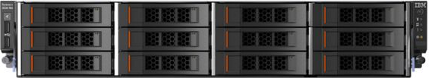
Active-passive Disaster Recovery
Main SCP
Standby SCP
VM
VM
VM
VM
VM
VM
VM
VM
VM
VM
Virtual network
Virtual network
Integrated and easy to use
Local backup + remote replication
Flexible RPOs, min. 1s
Backup storage pool
Backup storage pool
Production storage
pool
Backup
CDP
Production storage
pool
Instant recovery
HCI
HCI
Sync data to
DR site
Failback to production site
Site A
Site B

Slide 21
Active-active Stretched Cluster
Witness
Site C
App1
App2
App3
App4
App5
App6
HCI
HCI
HCI
HCI
HCI
HCI
10Gbps fiber
RTT<=5ms
Site A
Site B
Automatic failover
Minimal downtime
0 data loss
Easy to deploy and manage

Slide 22
Choose The Business Continuity Solution
That Suits Your Need
Solution | RPO | RTO | Bandwidth | Distance
Local HA | 0 | 30s | 1Gbps mgmt. | N/A
Disaster recovery | Min. 1s | Mins | Based on RPO and IO speed | No limitation
Stretched cluster | 0 | 30s | 1Gbps fiber/10Gbps fiber, RTT<=5ms | <=100km
DR
Site 1
Site 2
Site 3
SC
City A
City B

Slide 23





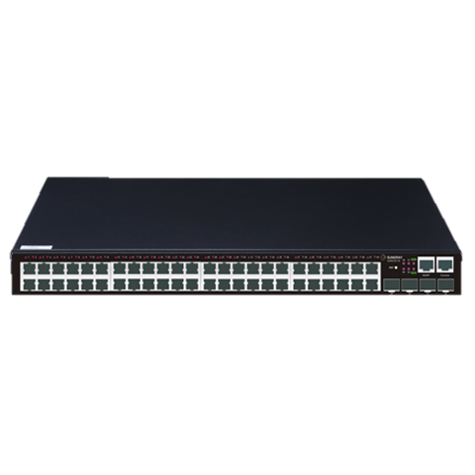
One Platform to Unify Your Protection
Sangfor HCI
Disk bad sector
prediction & repair
Multiple data copies
Integrated backup
CDP
High availability
Disaster recovery
Stretched cluster
Compute
Storage
Network
Security
Management

Slide 24



Technology Evolution for Reliability Innovation
Improve
Reliability
Business Continuity
Sub-health Detection and Automatic Repair
Active-active Stretched Cluster & Remote DR Solution
Rapid Business Recovery & Rapid Data Rebuild
Reduce
Distributed Architecture &
Multi-Copy Mechanism
Rapid Data Backup & Continuous Data Protection
RTO & RPO
Disaster Loss
ITOM Complexity
Phase
1
Phase 2
Phase 3
Phase 4
Phase 5
Technology Breakthrough

Slide 25
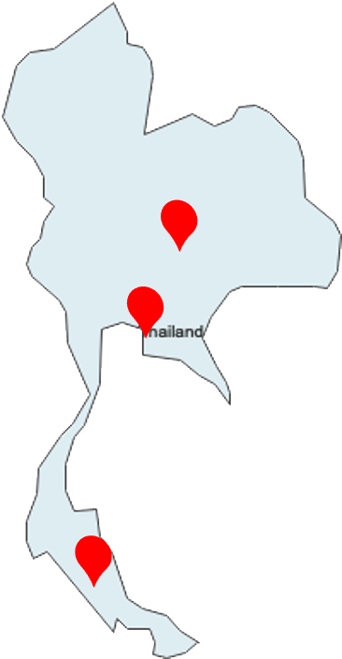
A Manufacturer’s Story
Original requirements
Build SAP ERP at the two factory sites
Provide HA and maximum data protection
Provide Business Continuity plan between 3 sites to meet regulations of public listed companies
Sangfor Solution
HCI + aDR (CDP) + vAF + SD-WAN + IAM
Benefits
One-stop solution to offer a complete infrastructure stack
Maximum protection with CDP, file-level recovery for file server
Simplified and flexible disaster recovery solution to meet
regulatory requirement
SD-WAN is leveraged to reduce DR traffic over the links

Slide 26

THANK YOU
Cheney Hu
HCI Senior Product Manager
Sangfor Technologies
cheney@sangfor.com
Make IT Simpler, More Secure and Valuable

