Slide 1


What's New with SCP(aCMP)
& HCI(aCloud) 6.1.0
Cheney Hu
cheney@sangfor.com
www.sangfor.com
Sangfor Technologies Inc.

Slide 2

Name Change
aCloud -> HCI (Hyper-converged Infrastructure)
aCMP -> SCP (Sangfor Cloud Platform)

Slide 3
HCI
Notes:
我们已经覆盖了全国6千家客户，遍布各个行业，包括政府、医疗、教育、企业、金融、部委等等。

Slide 4

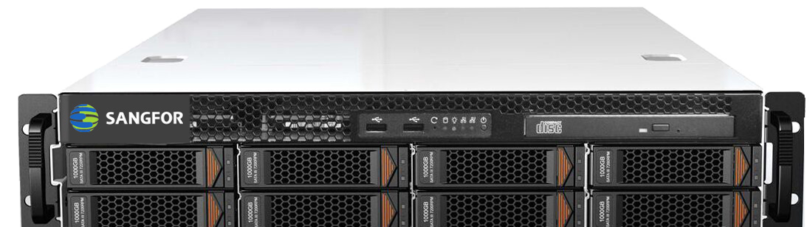
Security Correlation
NGAF
Core switch
Cyber Command
Security devices are good at risk detection and response in the network traffic, that’s good, but wouldn’t it be even better if they can work in conjunction with HCI ?
Access switch

Slide 5






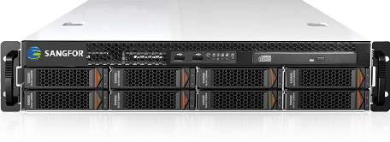
Work Together with Cyber Command
Internet
CC detects security threats through network traffic analysis, NGAF and ES, and then takes action based on different threats:
For scenarios like zombie network, CC works with distributed firewall to quarantine infected cloud host automatically
In ransomware scenario, CC leverages storage snapshot API to take snapshot of the infected VM to minimize loss
For mining scenario, CC sends command to power off/ suspend the mining VM to avoid unnecessary resource consumption
Manual/automated policy: policy can be issued manually on CC.
Cyber Command
NGAF
NGAF
NGAF
NGAF
Sangfor HCI
VM
VM
Receive threat data
Send execution command

Slide 6
How Does It Work ?
3rd party program
(Send requests)
Cyber Command
How it works
Cyber Command sends request through 4433 port.
The request is received by HCI Apache front end.
API gateway provides a series of authentication mechanisms including permission verification and license verification.
Backend service sends the result back to the program
Front end
(Receive requests)
API gateway
(Authentication)
HCI
Backend service
(Send results)

Slide 7
Key-free Licensing
USB key is no longer mandatory for the activation of HCI software license.
Sales order
Order system
HCI deployment
Licensing system
License ID
Device ID
License file
POC
W3
HCI deployment
Licensing system
License ID
Device ID
License file
* Sangfor is responsible for generating the key-free license file.

Slide 8
Key-free Licensing Upgrade
For existing customers who are using HCI licensed with USB key, they can continue to use it that way.
If they want to upgrade to key-free licensing, the physical USB key must be returned to Sangfor, Sangfor will generate the key-free license based on actual projects.
To Sangfor internal staff, to generate the key-free license for existing customers, please send an email detailing the project background to Liu Min and copy to Cheney Hu.

Slide 9
IPv6 Support
Virtual router:
IPv6 address configuration
IPv6 layer-3 routing
DHCPv6
IPv6 static routing
IPv6 policy-based routing
Virtual machine:
Static and dynamic IPv6 address configuration
IPv6 address automatically obtained by GuestOS
Support both IPv4 and IPv6 by the same vNIC
IPv6 address display
IPv6 troubleshooting:
IPv6 packet capture
IPv6 connectivity testing
IPv6 NFV support:
vAF
vAD
Not supported IPv6 features:
DNS6
IPv6-based distributed firewall
SCP (aCMP)

Slide 10
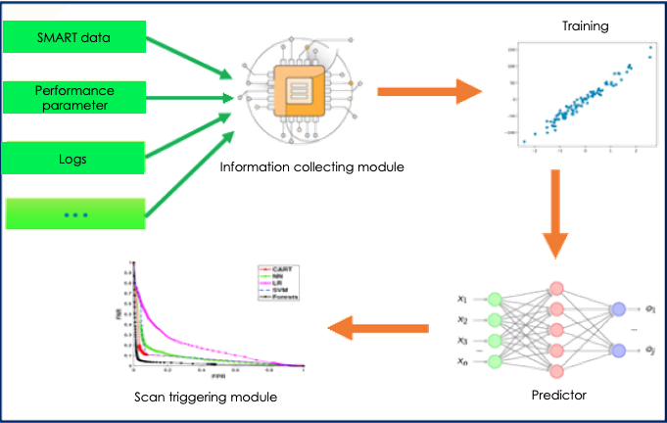
Disk Bad Sector Prediction And Repair (with aSAN)
Prediction
Scanning
Repair
Result output:
A bad sector will occur on disk A in 7 days
Disk A will be scanned in priority in the daily scanning task
Data is repaired once the bad sector is confirmed
The time it takes to discover bad sector is reduced from weeks to 1 day, minimizing data loss risk.

Slide 11
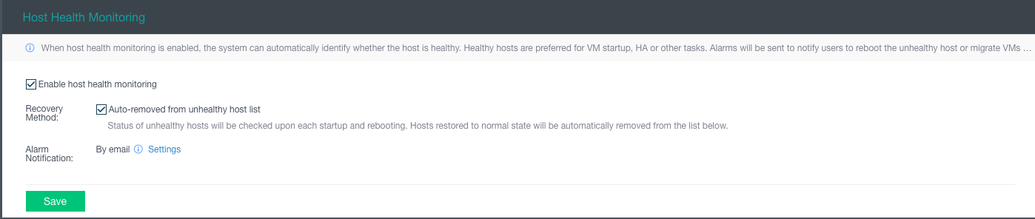
Host Health Monitoring
Detection
Dispose
Release
OS disk
Lifespan < 12%
Bad sectors & blocks
Read-only
RAM
ECC 1024 errors/24hrs
Uncorrectable ECC
Alarms
Host is added to sub-health list
Dispose suggestion
Sub-health list
Sub-health host will not be put in priority when it comes to HA and VM placement
Manual
Automatic
The host will be scanned every time when it’s rebooted

Slide 12
SCP

Slide 13


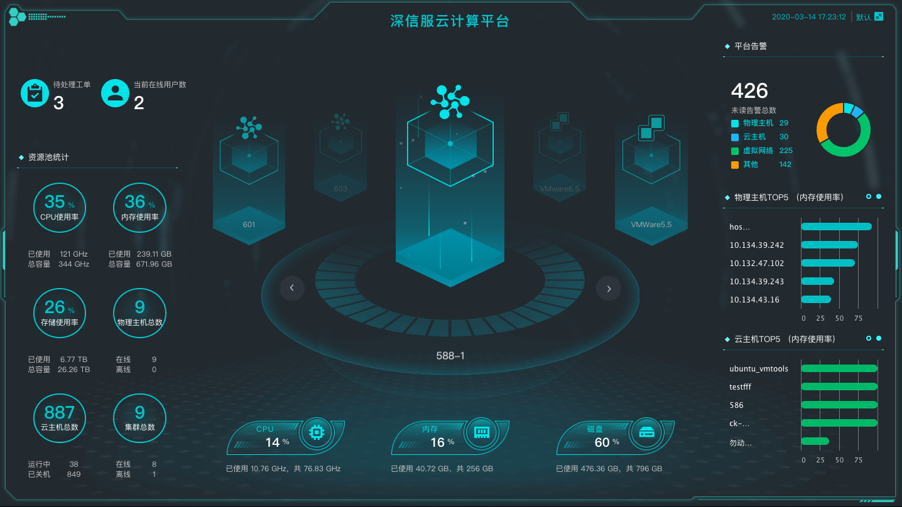








Multi-version Management
SANGFOR CLOUD
Unified resource mgmt.
Internet
Internet
AD
Unified monitoring & alert
NGAF
IAM
Cloud services
Unified O&M
Cloud DC
5G+Fiber
Role-based access
WAN
All-in-one delivery
XX primary school
XX middle school
XX primary school
XX middle school
Centralized display

Slide 14
Scenarios
1:
SCP6.1.0
HCI5.8.8
HCI5.8.8
HCI6.1.0
Customer has an existing HCI cluster, buys another HCI cluster, uses SCP to unify the management.
2:
SCP6.0.0
SCP6.1.0
Customer has multiple HCI clusters, uses SCP for management. They want to upgrade one of the clusters first, see how it works and then upgrade the others.
HCI5.8.8
HCI5.8.8
HCI5.8.8
HCI6.1.0

Slide 15
Scenarios
3:
SCP6.1.0
HCI5.8.8
HCI5.8.8
Encourage customer to try SCP, no need to upgrade HCI.
4:
SCP6.0.0
SCP6.1.0
HCI5.8.8
HCI5.8.8
With SCP, customer wants to try some of the new features of SCP without upgrading HCI

Slide 16
Managed by SCP But Independently Licensed
SCP
HQ cluster 1
HQ cluster 2
HQ cluster 3
Branch cluster 1
Branch cluster 1
Licensed by SCP
Independently licensed
Independently licensed

Slide 17


Unified Management for Physical, AWS and HCI
Tenant 1
Tenant 2
Unified mgmt. for hybrid cloud and multi-cloud:
Consistent IaaS user experience between physical, private cloud and public cloud.
Each tenant can only see and manage its own cloud resource, simplified O&M with guaranteed isolation
Server
VM
VM
Server
VM
VM
Physical
Physical
SANGFOR CLOUD
User
HCI
Physical
AWS

Slide 18
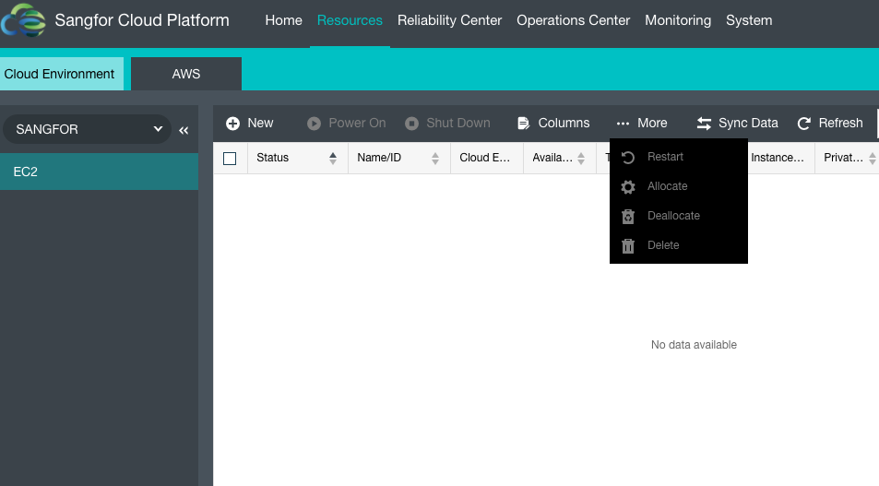
AWS Instance Operations on SCP
EC2 instance
Create, Connect, Power on, Shut down, Allocate

Slide 19
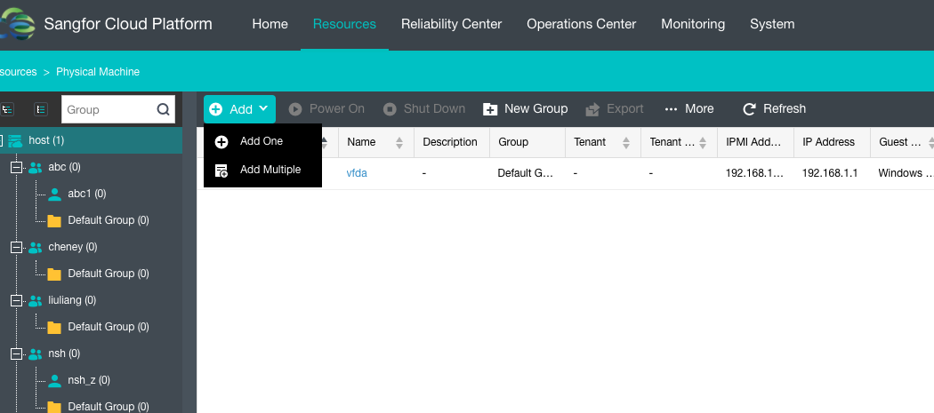
Physical Machine Operations on SCP
Physical machines
Add, Power on, Shut down, Allocate

Slide 20
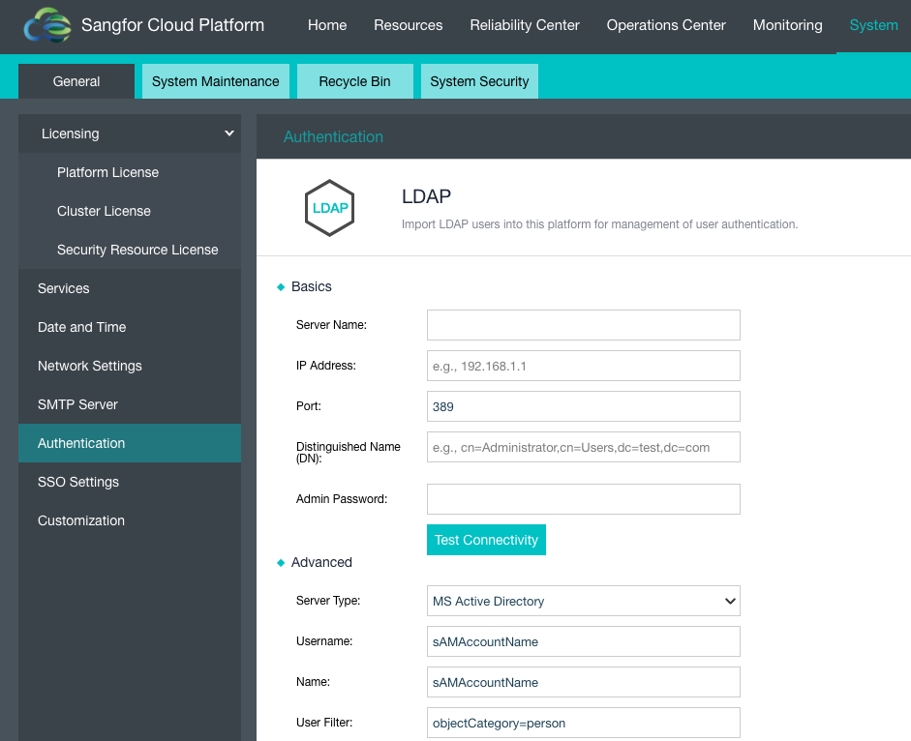
Linux LDAP and Microsoft AD Support
For large corporates where Linux LDAP and Microsoft AD are used for unified authentication, the account hierarchy can be imported to SCP. After LDAP is configured on SCP, the role of users (tenant and tenant user) can be set in batch.

Slide 21
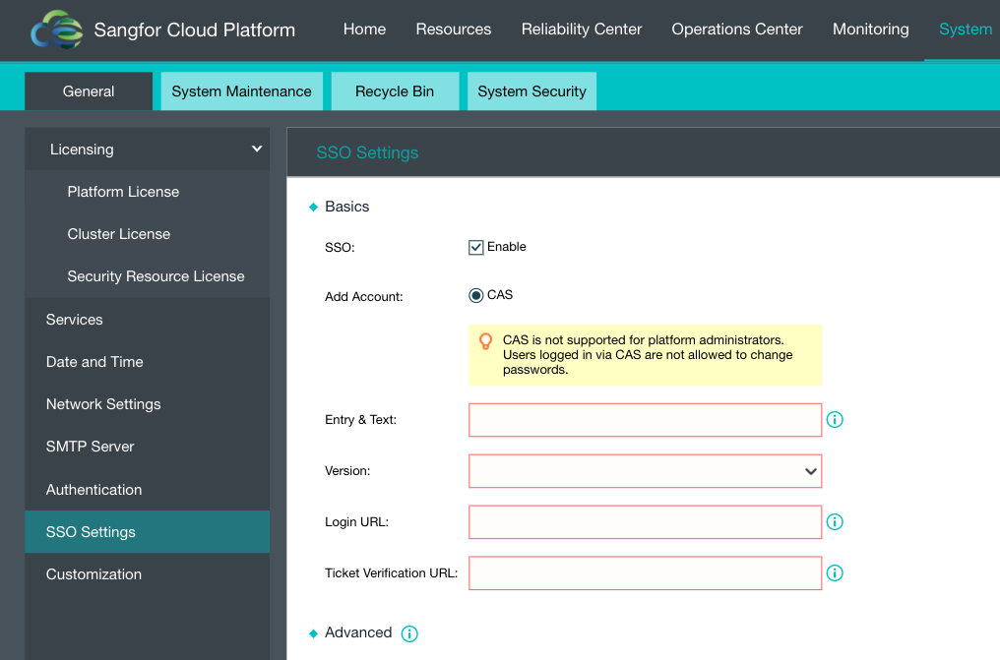
Single Sign-On (based on CAS)
Only tenant and tenant user are mapped to CAS.
The information synced to SCP does not include CAS account password, that means CAS user’s password is not stored locally, thus changing CAS password is doable not on SCP.

Slide 22
Other Improvements
OpenStack API
Both VPC and classic network deployment are supported on SCP
SCP customization (including logo and certificate)
Forget my password (for tenant and tenant user)
Multi-currency support
Flexible pricing (resource pool-based and tenant-based )
Corporate leased line ( ≈ AWS Direct Connect)
Shared bandwidth
Stronger Login Policies
Time-based DR link flow control
…

Slide 23
Three More Licenses Are Available
aHCM-AWS (hybrid cloud management)
Enable the license when AWS management is required.
aHCM-Physical
Enable the license when physical machine management is required.
aAPI
Enable the license when Cyber Command security correlation is needed.

Slide 24
More cloud-ready
More secure
More customer-oriented

Slide 25
Demo

Slide 26

THANK YOU
Cheney Hu | HCI Senior Product Manager
Cheney@sangfor.com

Slide 27
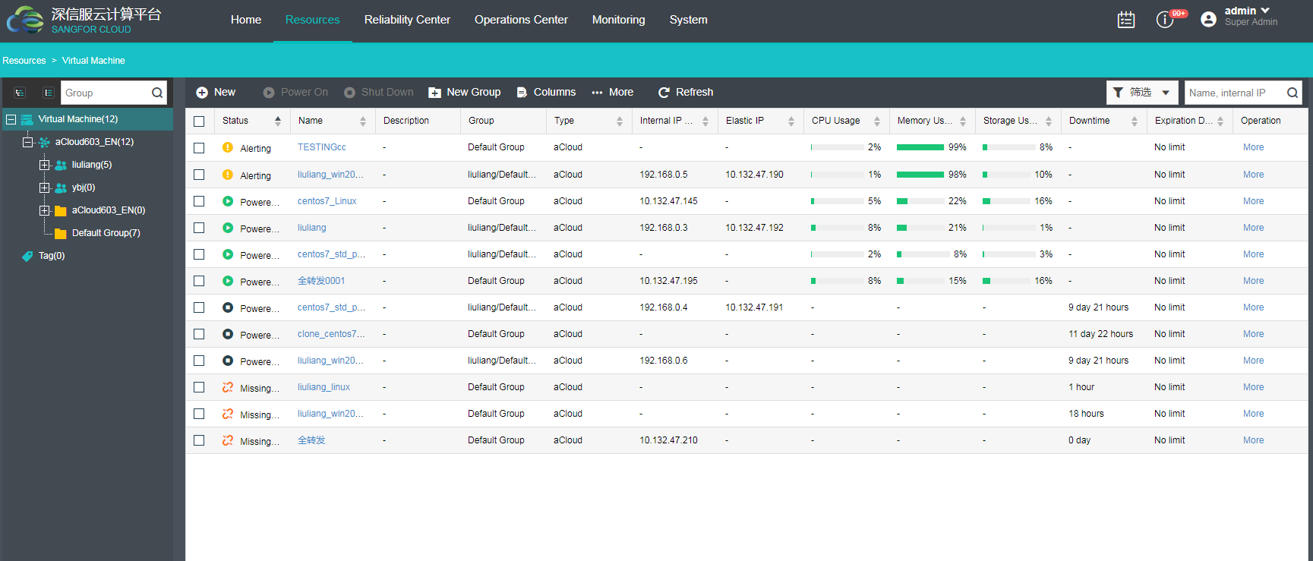
Unified Management for Hosts of Different Versions

Slide 28


















AWS Management Architecture
SANGFOR CLOUD
Direct Connect/VPN
VPC
AWS
EIP
Account Cloud VPC subnet
HCI
IGW
EC2
ELB
S3
Alibaba
Cloud
HCI Environment
Customer on-prem DC
ECS
VPC
SLB
OSS

