Slide 1

Sangfor’s Threat Identification, Analysis and Risk Assessment (TIARA) & Managed Detection and Response (MDR) Service
Jeffrey Lee
Security Services Product Manager cum. Cyber Security Consultant
CREST Registered Tester (CRT),
Offensive Security Certified Professional (OSCP),
CompTIA Pentest+, Certified Ethical Hacker (CEH)
www.sangfor.com
Sangfor Technologies Inc.

Slide 2





CISO Fears & Concerns
Out of control situation due to hidden malwares & ransomware
No kill chain & attack path determination may cause it team not sure where to investigation and lead to unnecessary works with no result
Attacks bypass existing security controls / Insufficient security controls lead to regulatory compliance violation
Legal issue due to customer data leakage / DDOS Attack from internal compromised machine (zombie) to external
Internal insecure practices and abnormal traffics that could introduce more attack surfaces for attackers

Slide 3

What CISO Want?
Attacks bypassed existing defense?
Know everything in network
Hidden threats?
Potential data leakage? Outbound attack traffics?
Meet regulatory compliances
Long-term Improvement Plan
Minimize Unnecessary Workloads
No Event-Based Remediation Methods

Slide 4
Security Capability Maturity Model (CMM)
Ⅴ Offensive Defense
（offensive defensive capability as the core）
TIARA
&
MDR
Ⅳ Proactive Defense
（security operation as the core）
Ⅲ Systematically Control
（compliance system as the core）
Single point of protection products
Ⅱ Basic Defense
（security products as the core）
I Basic Protection
（perimeter defense as the core）
* Accelerate the process in advancing into next CMM level *

Slide 5
Why Sangfor’s TIARA & MDR Service?
Help customers who lack of security experts in identifying root cause and provide long term improvement plan, instead of focus on event by event remediation methods
Business impact analysis on critical assets
Lightweight risk assessment on network (Avoidance / Acceptance / Mitigation / Transfer)
Identify potential threats before it turns into security incidents
Rich experience in different industries and experience in handling different security incidents

Slide 6
Why Sangfor’s TIARA & MDR Service?
Hidden Malware Analysis
Prevent legal issue
Prevent malware spreading
Root Cause Analysis
Reduce unnecessary workloads
Remediate security incident in short time
Vulnerability Assessment
Continuous vulnerability assessment analysis on traffics
Misconfiguration and dangerous settings detection
Abnormal Behavior Analysis
Uncover internal incompliance actions
Identify internal suspicious and malicious activities
Threat Analysis Report
Technical report for IT team
Executives summary presentation for management

Slide 7
How Sangfor Different From Others?
✓
Security Posture Assessment on Organization’s Environment
Not Ordinary VAPT
✓
Asset Management + System Vulnerabilities + Network Vulnerabilities and Threats + Abnormal Behaviors
Not limit to System Vulnerability ONLY
Expensive Third Party & More Time for Consultation Work
✓
Inexpensive & Less Time Required
✓
Focus on Root Cause Analysis and provide long term improvement plans
Event by Event Remediation Methods

Slide 8




How it Benefits
Root-Cause Analysis
For security incident such as ransomware infected, TIARA/MDR will focus on full traffic analysis and attack path restoration / kill chain determination. We can identify hidden threats that are causing you long-term problems and remove them from the source.
Comprehensive Threat Analysis
With big data analysis and security expert analysis, TIARA/MDR can identify hidden virus events, vulnerability events and attack events found in your network, and we have a strong monitoring mechanism for security events
Remediation Assistance
The security consultant will provide the remediation assistance service to customer based on the threats detected. On premise service can be done if necessary.
Threat Analysis Reports (TARs)
In addition to providing analysis and disposal services, TIARA/MDR will also provide you with threat analysis reports. The TARs summarize the discoveries in your network, and help your teams and executives understand and evaluate your organization’s current threat level

Slide 9
How it Benefits
Continuous Vulnerability Assessment
Continuous vulnerability assessment on all traffics allow customer to identify existing vulnerabilities on servers, endpoints, web application and software installed in ongoing basis, without the need of engage third party to conduct VA frequently.
Review of Existing Security Controls
With traffic monitoring and logs correlation, TIARA/MDR can identify if current security controls are properly in place.
Security Awareness
The traffic analysis could alert customers on abnormal behaviors. With proper internal policy and training, the security awareness among employees will increase.
Risk Alertness
Hidden risks will be predicted, discovered and recommendations on risk avoidance, risk reduction and risk mitigation will be provided.

Slide 10
What is TIARA?
Threat Identification, Analysis and Risk Assessment (TIARA)
preliminary lightweight security posture assessment service
Assess Internal Security Status
Improvement Plans and Recommenda-tions
Increase Overall Security Status

Slide 11
What is MDR?
Managed Detection and Response (MDR)
Threat Analysis & Event Diagnosis
Assess Internal Security Status
Improvement Plans and Recommendations
Increase Overall Security Status
Network traffic analysis & threat hunting

Slide 12
Differences Between TIARA & MDR
 | TIARA | Onsite MDR | Cloud MDR
Service Count | 1 time | Recurring Service | Recurring Service
Service Duration | < 4 weeks | 3 months(Quarterly) 6 months (Half-yearly) 12 months (Yearly) | Real-Time Service
Service Mode | Onsite | Onsite | Onsite + Cloud
Service Scope | Malware Event Analysis, Attack Event Analysis, Vulnerability Event Analysis, Abnormal Behavior Analysis | Malware Event Analysis, Attack Event Analysis, Vulnerability Event Analysis, Abnormal Behavior Analysis, Service Components Health Check, Latest Threat Intelligence Alert | Malware Event Analysis, Attack Event Analysis, Vulnerability Event Analysis, Abnormal Behavior Analysis, Service Components Health Check, Latest Threat Intelligence Alert， Incident Response Threat Remediation Service
Service Approach | Detection + Analysis + Recommendation | Detection + Analysis + Recommendation | Detection + Analysis + Response + Recommendation
Deliverables | Threat Analysis Report, Executives Presentation | First Threat Analysis Report, Quarterly Threat Analysis Reports, Executives Presentation, Latest Threat Intelligence Report, Delivery Plan | Threat Analysis Report, Quarterly Threat Analysis Reports, Executives Presentation, Latest Threat Intelligence Report, Delivery Plan, Threat Remediation Report
Availability | Yes | Yes | Limited Customers

Slide 13
TIARA POV Process Flow (< 4 weeks)
Sales, Presales
Presales
Presales,
Security Consultant
As Arranged
Week 1
Week 2
Week 3
Week 4
Collect Requirements from Customers
Kick Off Meeting
Mounting of Service Components
Collection of Network Traffics and Security Logs
Threat Identification and Analysis
Fine Tuning of Policies
Events Diagnosis
Presentation
Recommenda-tion and Improvement Plans
Gap Analysis
Hardening Suggestions
Project Closure
Unmounting of Service Components
Business Impact Analysis
Discussion on Findings
Report Preparation
IT Manager
IT Team
IT Team
Sales, Presales, Security Consultant
Sales, Presales
Executives,
IT Manager
IT Team

Slide 14
Service Scopes (VAPMA)
ransomware, mining virus, worms, epidemic virus, CnC communication, file infection, trojan, outgoing DDOS traffic
Malware Events
Attack Events
Vulnerability Events
Abnormal Behavior Events
Protocol Audit
Check if there port in use is secure or high risks and perform auditing to the ports
DDOS traffic, webshell, web attack, brute force, others
default share, scanning events, abnormal traffic, others
outdated/unsupported software version, misconfigurations, others

Slide 15
Service Scopes
VAPMA
Service Components Health Check
Latest Threat Intelligence Alert
Incident Response
Threat Remediation Service
ensure the performance optimization of service components, such as CPU, memory, rules bases, software version and licenses
NGAF: apply ACL, block port & CnC
ES: quarantine, scan, kill process
Available to limited customers
Partially available
send email / notification to contact person regarding latest threat that might affect the organization
remote incident response on help customers in solving the incidents

Slide 16
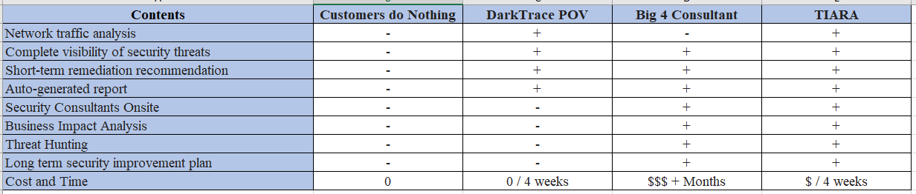
Competitive Advantages

Slide 17
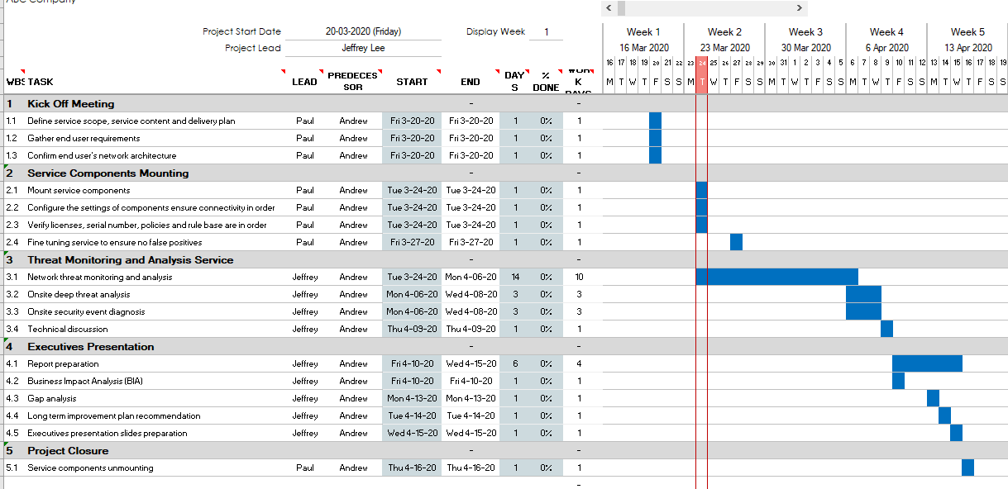
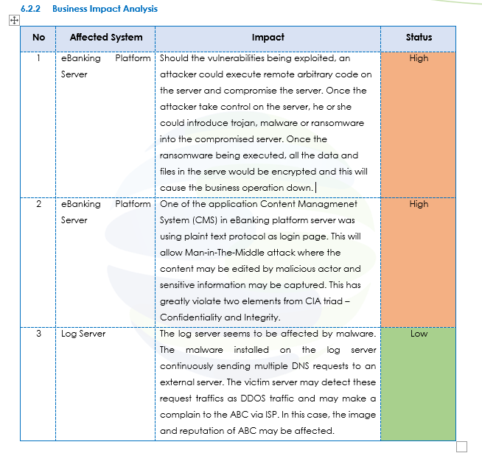
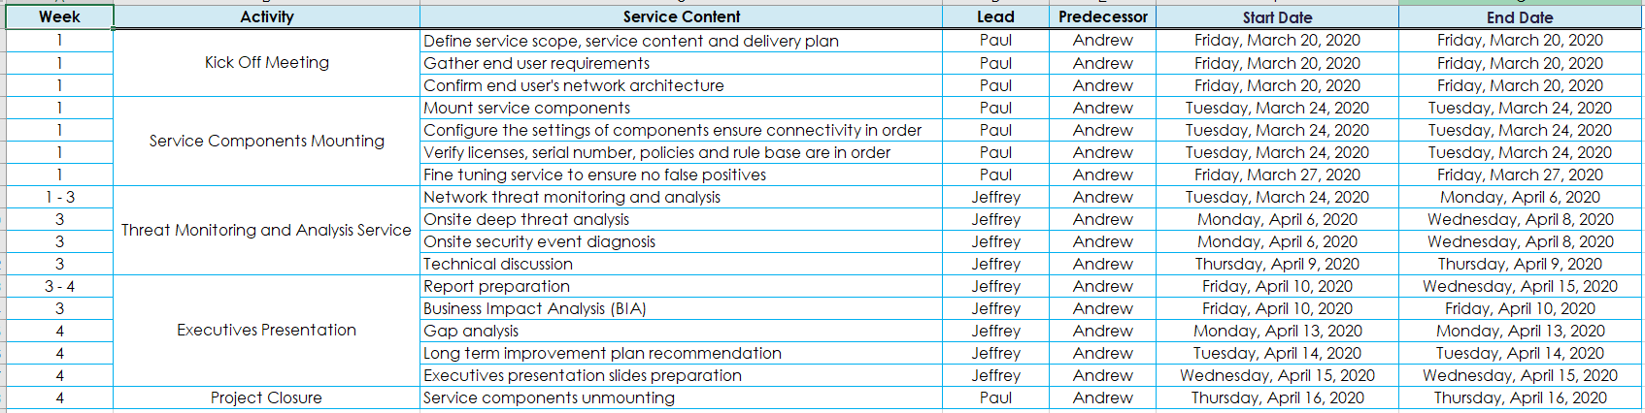
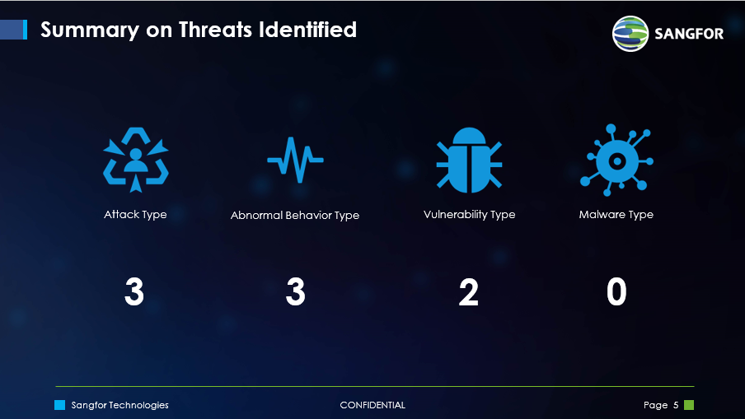
Sample Deliverables

Slide 18




How TIARA Works
Before
DMZ
Data Center
Workstations

Slide 19











How TIARA Works
After 2 Weeks
Compromised users from VPN
Unpatched servers
DMZ
VPN
Ghost VMs
Data Center
Self-Propagating warms
Unknown/Unmanaged Endpoints
Mobile
Printer
IoTs
Slow & Stealth Attacks

Slide 20




How TIARA Works

Slide 21
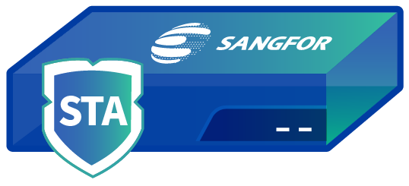
How Stealth Threat Analytics (STA) Helps in TIARA?
AD Domain Protocol Audit
Mail Protocol Audit
SMB Protocol Audit
DNS Protocol Audit
Http Protocol Audit
Unauthorized / Risky Access
Normally Access
Comprehensive detection of hacker attacks and user behavior
Business Weakness Discovery
Botnet Detection
Exploitation Attack Detection
Website Attack Detection

Slide 22

How Cyber Command Helps in TIARA?
Automatic Correlated Response
Attack Scenario Restore
Kill-chain Trace Back
Outgoing Attack Monitoring
Lateral Attack Monitoring
Overall Threat Monitoring
Real-time monitoring and special monitoring
Behavior Analysis
Intelligence Analysis
Attack restoration and trace back
Threat Analysis
Vulnerability Assessment
IT Assets Management

Slide 23

Key Takeaway
Key to Unlock Customers’ Heart
TIARA
Creation of Product BOs
Build Customers’ and Partner’s Confidence on Sangfor

Slide 24

Key Takeaway
Close Products’ Gap
MDR
Complete Solution That Cover Detect, Prevent, Response, Predict
Long term improvement plan in improving security posture

Slide 25
THANK YOU
Jeffrey Lee
Security Services PM cum. Cyber Security Consultant
CREST Registered Tester (CRT),
Offensive Security Certified Professional (OSCP),
CompTIA Pentest+, Certified Ethical Hacker (CEH)
www.sangfor.com
Sangfor Technologies Inc.

