Slide 1

Sangfor’s Threat Identification, Analysis and Risk Assessment (TIARA) & Managed Detection and Response (MDR) Service
Jeffrey Lee
Security Services Product Manager cum. Cyber Security Consultant
CREST Registered Tester (CRT),
Offensive Security Certified Professional (OSCP),
CompTIA Pentest+, Certified Ethical Hacker (CEH)
www.sangfor.com
Sangfor Technologies Inc.

Slide 2
Agenda
1
CISO Fears & Concerns
2
How to Help CISO?
3
TIARA Values
4
Sales Guide on TIARA
5
Thank You

Slide 3
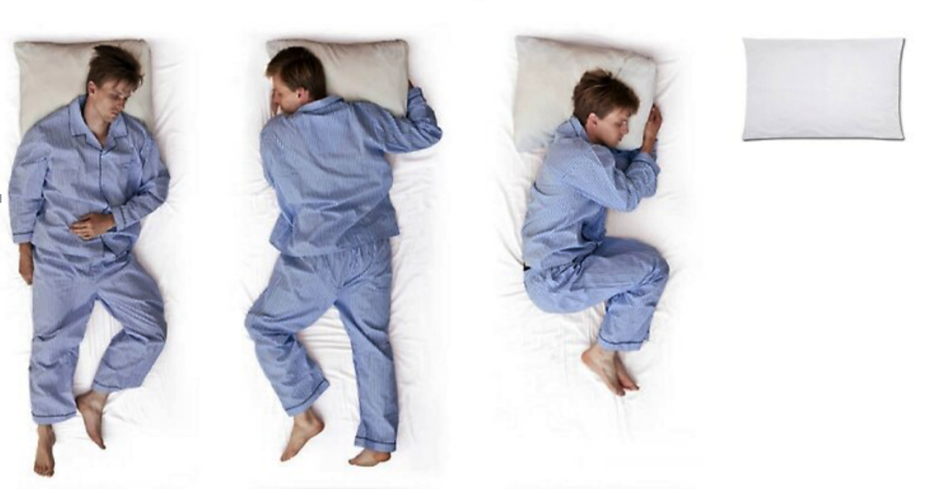
Sleeping Position
CEO
CFO
COO
CISO

Slide 4





CISO Fears & Concerns
Out of control situation due to hidden malwares & ransomware
No kill chain & attack path determination may cause it team not sure where to investigation and lead to unnecessary works with no result
Attacks bypass existing security controls / Insufficient security controls lead to regulatory compliance violation
Legal issue due to customer data leakage / DDOS Attack from internal compromised machine (zombie) to external
Internal insecure practices and abnormal traffics that could introduce more attack surfaces for attackers

Slide 5

What CISO Want?
Attacks bypassed existing defense?
Know everything in network
Hidden threats?
Potential data leakage? Outbound attack traffics?
Meet regulatory compliances
Long-term Improvement Plan
Minimize Unnecessary Workloads
No Event-Based Remediation Methods

Slide 6

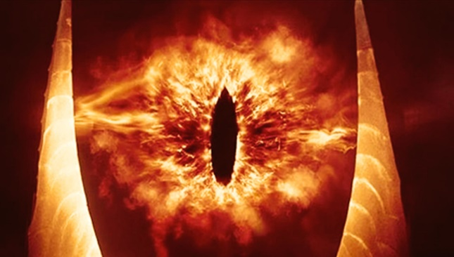



How to Meet What CISO Want?
All Necessary Security Controls in Place
Perform Gap Analysis
Visibility on network threats
Effective & Efficient Daily Operation
Meet Industry Best Practice & Regulatory Compliance

Slide 7
Why Sangfor’s TIARA Service?
Help customers who lack of security experts in identifying root cause and provide long term improvement plan, instead of focus on event by event remediation methods
Business impact analysis on critical assets
Lightweight risk assessment on network (Avoidance / Acceptance / Mitigation / Transfer)
Identify potential threats before it turns into security incidents
Rich experience in different industries and experience in handling different security incidents

Slide 8
Business Values
Business Impact Analysis
Shareholders’ Confidence Level
Customers’ Satisfaction
Return on Investment
Peer Respect and Goal
Notes:
BIA – know which systems and assets are critical, asset priority and management
Shareholders confidence level – trust that organization is secure and less chance for attackers to attack
Customer satisfaction – efficient and effective operation, lesser down time
ROI – identify flaws and root cause, reduce workload, time and resources with the service, no need spend more expenses on this and that

Slide 9
Technical Values
Comprehensive Threat Analysis and Asset Identification
Identify root cause and attack path
Reduce in unnecessary workload/resources
Ensure Effectiveness and Efficiency of Security Controls
Increase security awareness & risk awareness
Risk Mitigation & Overall Security Posture Improvement

Slide 10
What is TIARA?
Threat Identification, Analysis and Risk Assessment (TIARA)
preliminary lightweight security posture assessment service
Assess Internal Security Status
Improvement Plans and Recommenda-tions
Increase Overall Security Status

Slide 11
Value Added to Sales Team
Increase customers’ trust and expand customer’s visibility and exposure
Increase recognition on Sangfor’s security capabilities
Establish trusted advisor in long term
Uncover customer’s threats, boost confidence level
Future investment
Higher chance for customer to purchase Sangfor’s product
Understand customer’s security posture, better than anyone else
Convert customer’s problem to BO then to PO

Slide 12
Go To Market Strategy
Medium & Large Enterprise with Budget
Small & No Budget
Organization who would like to find out if there’s hidden or non-hidden malwares in the network
> We can uncover malwares, identify the lateral movement traffic, identify the kill chain, and find out the root cause how the malware come into network.
Organization who would like to identify internal threats and risks, mitigate them and enhance their current security posture
> We can identify vulnerabilities, malwares, attacks, abnormal behaviors and misuse protocols.
> Once analyze the root cause and mitigated most risks, the security status would be increased as attack surfaces would be reduced.
> Not only that, the effectiveness and efficiency in daily operation would be increased
> Increased in security awareness of employees

Slide 13
When TIARA? When MDR?
When?
TIARA
Customers who being attacked by ransomware before and worry on hidden malware that could affect business operations again
Customers who have plan and budget to purchase Cyber Command (POC)
MDR
Closed-loop solutions for security products such as Cyber Command and NGAF
Customers who care about security and require external security teams for to expand security capabilities (24x7 optional)
Customers have budget to purchase product, but do not know what to purchase

Slide 14
TIARA Package
 | Package-1000 | Package-2000 | Package-3000
Cyber Command Model | CC-1000 CPU 16 core, Physical memory 96G, System disk SSD 128G, Data hard drive capacity SATA 4T*8. | CC-2000 CPU 16 core, Physical memory 128G, System disk SSD 128G, Data hard drive capacity SATA 4T*10. | CC-3000 CPU 20 core, Physical memory 256G, System disk SSD 128G, Data hard drive capacity SATA 4T*12.
Deliverables | Threat Analysis Report, Executives Presentation Slides | Threat Analysis Report, Executives Presentation Slides | Threat Analysis Report, Executives Presentation Slides
Refer to country manager for the pricing.
However, we give the flexibility for sales to decide if this should be charged or free, depends on customer’s budget, importance of customer and chances in purchasing our products

Slide 15
Why Charge?
Involve Business Impact Analysis
Involve long term improvement plan
Threat Analysis Report is not a simple report that exported by Cyber Command
Involve executives presentation
Involve gap analysis

Slide 16
Security Capability Maturity Model (CMM)
Ⅴ Offensive Defense
（offensive defensive capability as the core）
TIARA
&
MDR
Ⅳ Proactive Defense
（security operation as the core）
Ⅲ Systematically Control
（compliance system as the core）
Single point of protection products
Ⅱ Basic Defense
（security products as the core）
I Basic Protection
（perimeter defense as the core）
* Accelerate the process in advancing into next CMM level *

Slide 17

Key Takeaway
Key to Unlock Customers’ Heart
TIARA
Creation of Product BOs
Build Customers’ and Partner’s Confidence on Sangfor

Slide 18

Key Takeaway
Close Products’ Gap
MDR
Complete Solution That Cover Detect, Prevent, Response, Predict
Long term improvement plan in improving security posture

Slide 19
THANK YOU
Jeffrey Lee
Security Services PM cum. Cyber Security Consultant
CREST Registered Tester (CRT),
Offensive Security Certified Professional (OSCP),
CompTIA Pentest+, Certified Ethical Hacker (CEH)
www.sangfor.com
Sangfor Technologies Inc.

