Slide 1
Sangfor SSL VPN
Unified Remote Access Platform

Slide 2
Agenda
1
BOYD , opportunity and challenge
2
Sangfor SSL VPN: Rapid, Secure, Simple
3
Scalable Technology Solution
4
Case Study and Practice

Slide 3


BYOD
Any
Time
Any
Location
Any
Device
Notes:
It is without doubt that BYOD is the obvious trend.
For me , I often use Sangfor native app to deal with internal process, such as book a meal, book the massage, ask for leave, etc.
I can also run some business process via my phone.
BYOD is changing the way we are living and working and make our life and work easier and more productive.

Slide 4

Business Becomes More Mobile
Quicker Response
Better Productivity
Better Satisfaction

Slide 5
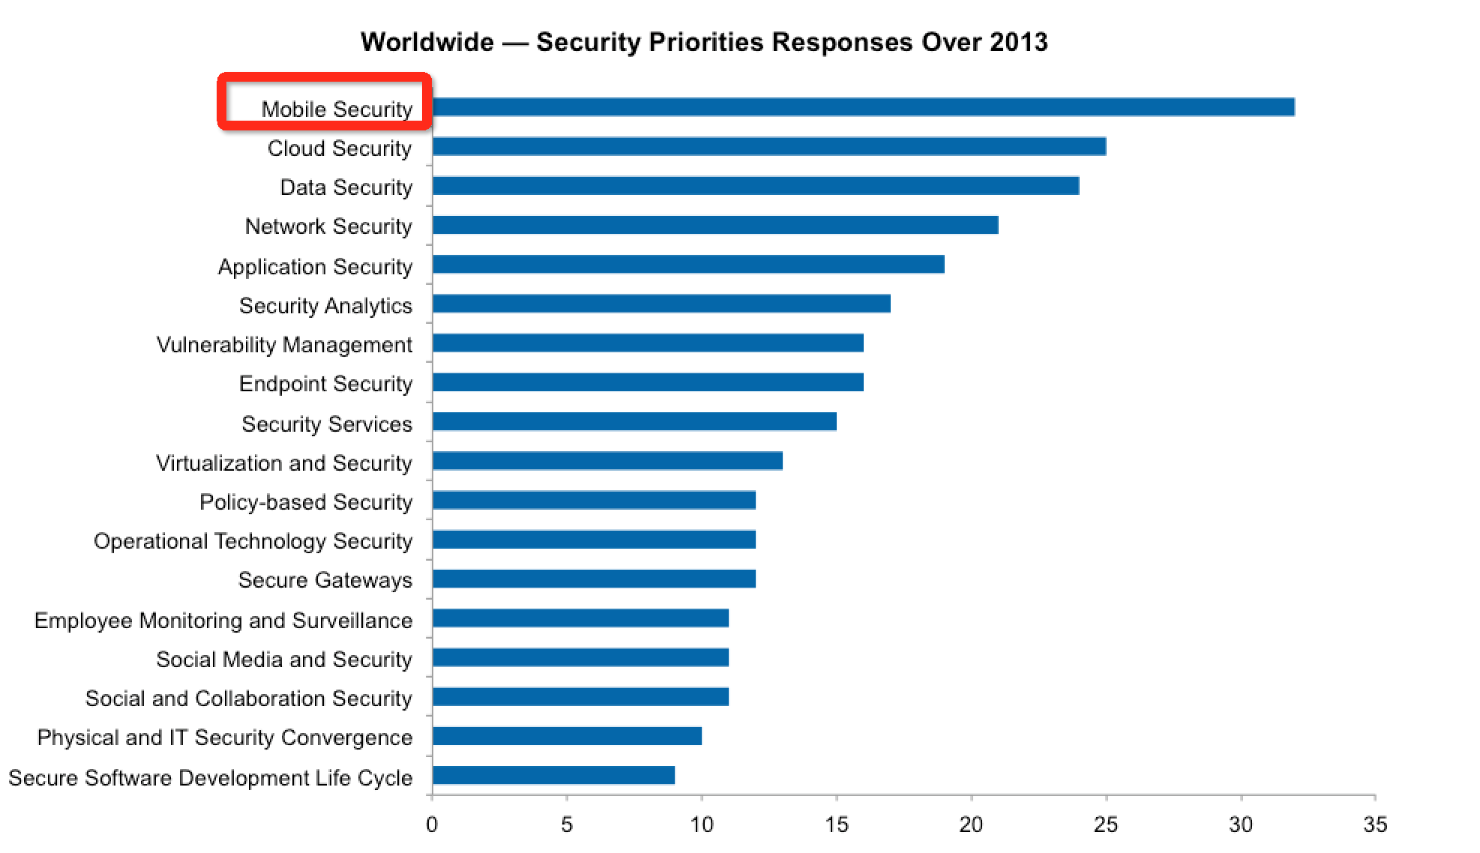
New challenge comes
From Gartner

Slide 6

One more entry to the internal sever
Illegal users
The missing
devices
Sensitive on the mobile device
Plaintext
Data transmission
Hack for the access account

Slide 7

User experience must be concerned
Speed
Ease to use

Slide 8
Agenda
1
BOYD , opportunity and challenge
2
Sangfor SSL VPN: Rapid, Secure, Simple
3
Scalable Technology Solution
4
Case Study and Practice

Slide 9



Sangfor SSL VPN Solution
Secure
Rapid
Simple
Notes:
All-around protection to ensure secure connectivity of accessing business data
Satisfied access experience and improved productivity of remote workforce
Easy-to-use for end users, easy-to-maintenance for IT administrator

Slide 10
Protect your business sever
Protect sensitive data
Sever isolation
All protection from client to sever
Reduce maintenance on secure issue

Slide 11




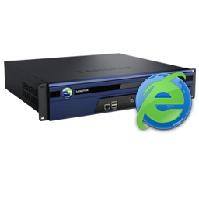
All-round Security Protection
Application sever
User
Access point
Transmission
Access
Audit
Internet
Identification
Authentication
Health check
Encryption
Authority
SSO
Firewall module
Audit
External report center

Slide 12








Secure Identity
2 factor
Authentication
LDAP
Radius
HW ID
SMS
USB
Dynamic
Token
ID/PW
CA
Up to 8 types of authentication methods
“And” “Or” combination

Slide 13

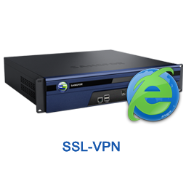





Secure Host Checker
Check security status of host prior to user login, and during the SSL VPN session
Dynamic privilege
Operating system, registry file, process, personal firewall, anti-virus files, login time, line IP, user IP, user-customized security rules…
Meet policy condition 1&2&3
Resource 1
Meet policy condition 2&3
Failed to meet any policy
Resource 2

Slide 14
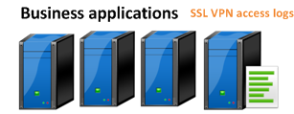
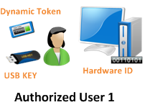



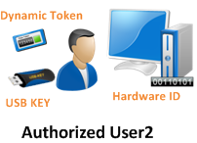
SSL VPN Protects Business Data Security
Host Checker
Application account of user 1
Bind SSL VPN account
and application account
Robust security protection:
Tunnel Encryption;
Resource Path Hiding
Cache Cleanup
Man-in-the-middle Attack Detection
Dedicated SSL VPN Tunnel •
Tunnel isolation
Host Checker

Slide 15
Sangfor SSL VPN Solution
Secure
Rapid
Simple
Notes:
All-around protection to ensure secure connectivity of accessing business data
Satisfied access experience and improved productivity of remote workforce
Easy-to-use for end users, easy-to-maintenance for IT administrator

Slide 16
All-around Optimization
Link
Intelligent link selection
Protocol
SRAP
Application
Data
Byte cache
HTP
Data Compression
Web optimization

Slide 17
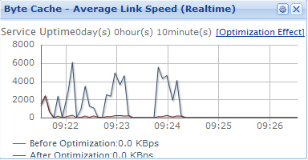
Smooth Access Even Only with a Small Bandwidth
Byte cache chokes the data into data tags at byte level and applies cache policies, ensure any redundant data is not transferred, even for a single file
7
0
5
9
2
7
6
2
5
4
3
8
4
2
3
4
4
1
2
1
0
7
1
9
4
7
3
7
2
2
Source: Sangfor Lab Test, 2012
1
7
5
1
8
1
2
3
4
5
6
7
Less data need to be transferred, as a result, accessing speed can be boosted significantly
  Higher accessing experience
  Higher productivity

Slide 18
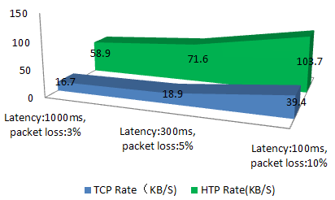

Streamline Transmission in Harsh Network Environment
Sangfor HTP, High-speed Transfer Protocol, minimize negative impact of packet loss and high latency.
Congestion Control optimization
  TCP: “Fast expending and gradual narrowing”
  HTP: “Fast expending and gradual narrowing
Window Processing optimization
  Window enlargement;
  Selective/fast retransmission of lost packets;
Speed/kbps
HTP
TCP
T
    Transmitted data = Speed * Time
Time/s
Sangfor Lab Test, 2012

Slide 19
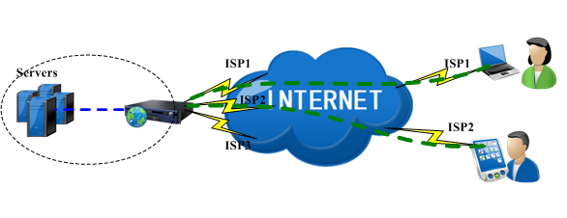
Intelligent Link Selection
Intelligent link selection guarantee link performance and stability when there have multiple links

Slide 20
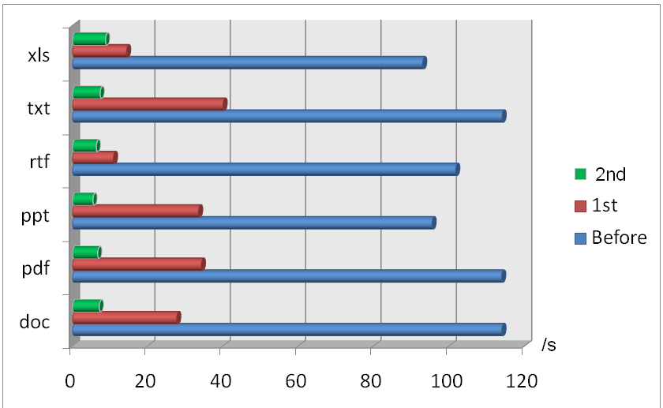
Optimization Benefits
File size: 10M
Bandwidth: 2Mbps
Latency: 100ms
Packet loss: 1%

Slide 21
Sangfor SSL VPN Solution
Secure
Rapid
Simple
Notes:
All-around protection to ensure secure connectivity of accessing business data
Satisfied access experience and improved productivity of remote workforce
Easy-to-use for end users, easy-to-maintenance for IT administrator

Slide 22

Easy-to-use
Mobile user
Browser-based access, no client needed
Custom portal
SSO
Compatibility
…
Intuitive to use, low learning curve for end user
Friendly interface
Easy to authentication
Multi-platform
…

Slide 23

Easy-to-manage
Administrator
Online message broadcasting ;
External report center;
Cluster Cloud;
Hierarchical administration;
…
Easy to broadcast message to users
Provides necessary management
Easy to expend the performance
Proper authority to different administrator
…

Slide 24




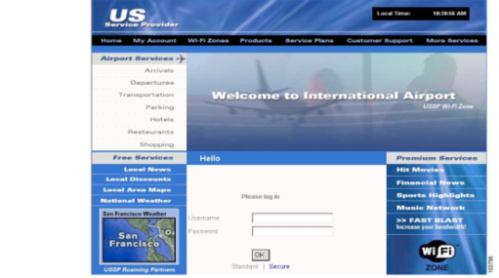
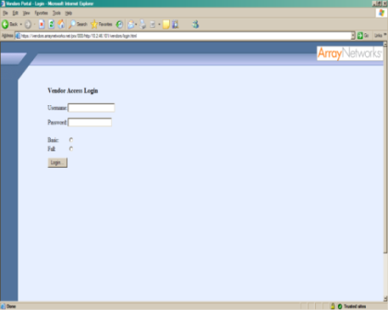
Virtual Secure Portal
Different user groups are able to enjoy different SSL VPN access addresses, authentication methods, application resource, administrators, for ease and security of management. Support creating 253 VSPs
Employee
Partner
Customer
URL:https://app.mobile.com
URL:https://app.partner.com
URL:https://app.customer.com
Login methods M
Login page M
Published resource M
Administrator M
Login methods P
Login page P
Published resource P
Administrator P
Login methods C
Login page C
Published resource C
Administrator C
Virtual Secure Portal
Notes:
the virtual secure portal is to visualize one SSL VPN box into multiple SSL VPN boxes. i.e. A organization has three kinds of mobile users: Internal mobile user, partner, customer; these three kinds of user group have different security requirement levels and access needs. For example, the entrance portal/address for customer is almost public, but the internal’s SSL VPN address need to be hidden; you may push a theme like “thank u for ur purchasing” to the customer, but “thank u for ur partnership” to ur partners on the login page… so do u need to deploy three boxes for the three user group? The SSL VPN VSP is to perfectly meet with the requirement of the situation；with the VSP function enabled, different user group can enjoy the independent access URL, login page, published resource, administrator and the login methods, etc. For customer and partners group, u can also choose the hide the IP address of the released resource to prevent security risks.

Slide 25
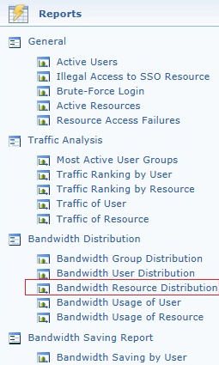
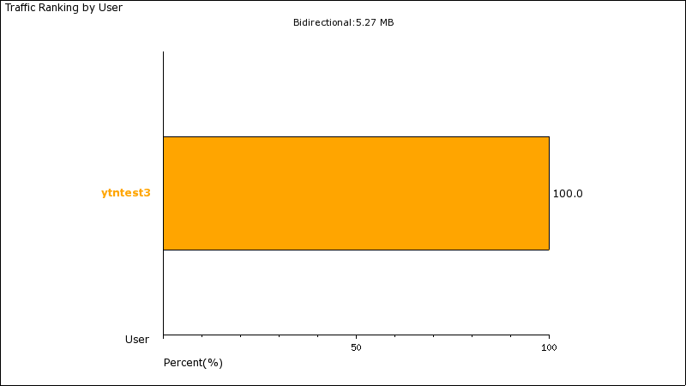
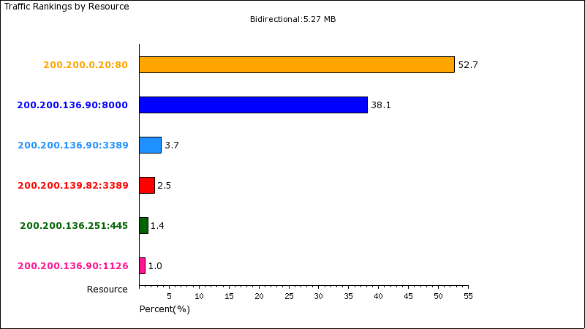

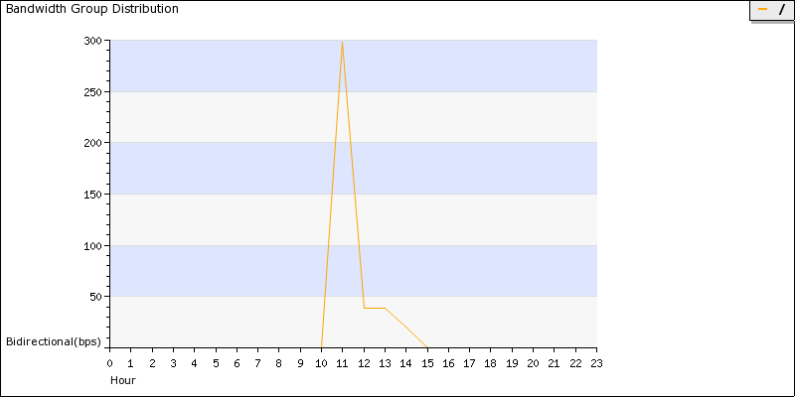
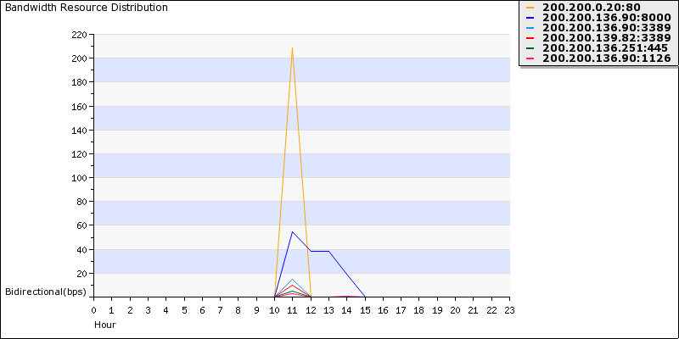
Analyzing Reports
Reports to show who accesses which resource at when, and for productivity analysis purposes

Slide 26
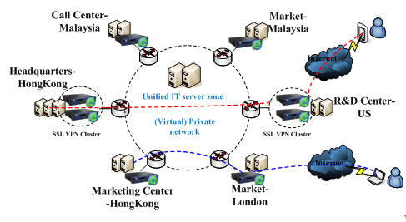
Cluster Cloud
The Cluster Cloud assign the SSL VPN requests to the fastest and healthy appliance when the SSL VPNs are deployed into corporate’s multiple data centers that located in different locations.
Benefits:
Unified access portal for mobile users;
SSL VPN service availability by fail-over mechanism;
Fastest access route for the SSL VPN requests;
Centralized configuration to the SSL VPN devices

Slide 27
Agenda
1
BOYD , opportunity and challenge
2
Sangfor SSL VPN: Rapid, Secure, Simple
3
Scalable Technology Solution
4
Case Study and Practice

Slide 28


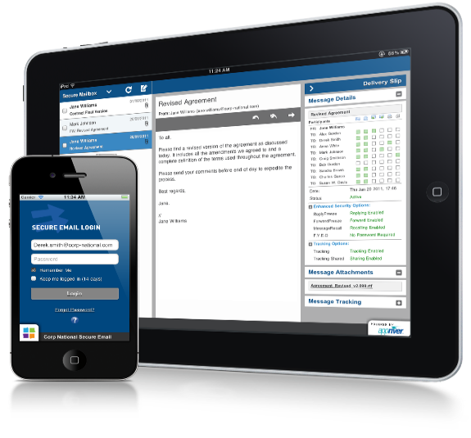
Migration to Mobile Device
Notes:
For enterprises which want to catch up with this trend, they must offer native applications to their employees.
As we all know, most of customers have application designed for PC, but we cannot directly open it on our mobile phone. We will encounter a lot compatibility issues.
That’ why Migration is necessary.
If customers want to do a full migration to mobile office, this is not a shot-term work. A lot of things must be taken into account.
Here let me show you SANGFOR solution which can easily help you migrate the application from PC to mobile devices.

Slide 29

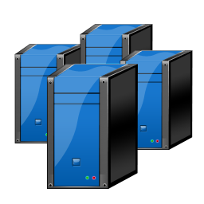








EasyConnect
Virtualization Solution
Application Image
SSL VPN
Mouse Command
No need for
re-development on APP
Migration
within one day
Secure
Low cost
Notes:
Easy connect . Easy connect is a application virtualization solution which belongs to Sangfor SSL VPN product.
Customers can use this module to migrate PC application to mobile device with several advantages.
Firstly: speed, EC just deliver the application via virtualized interface. All the operations is done in the server site.
So we needn’t to worry about packet loss , latency and protocol chattiness ,
Second advantage is secure. All applications data are stored in the cloud . and all data transfer in the link are encrypted. Plus, combined with SSL VPN various authentication and other secure feature , we can make it much secure environment for application.
Lastly, the most important is that migration work can be done within one day. For the customer , they can quickly to use the application via iPhone or android phone.
This feature is suitable for customer with low budget, time and energy to re-develop a native app.
Actually EC is a temporary solution for enterprises who do not have any specific native app.

Slide 30






Easy to connect
Any time, Any location,
Any device
PC
IOS/Android
Thin client
Laptop

Slide 31

Easy to share file
Cloud-based story sever
Refined- apriority
IOS
Android
Windows
……
PC
Thin client
……
Sharing file between different platform
Company-owned device
Private device

Slide 32
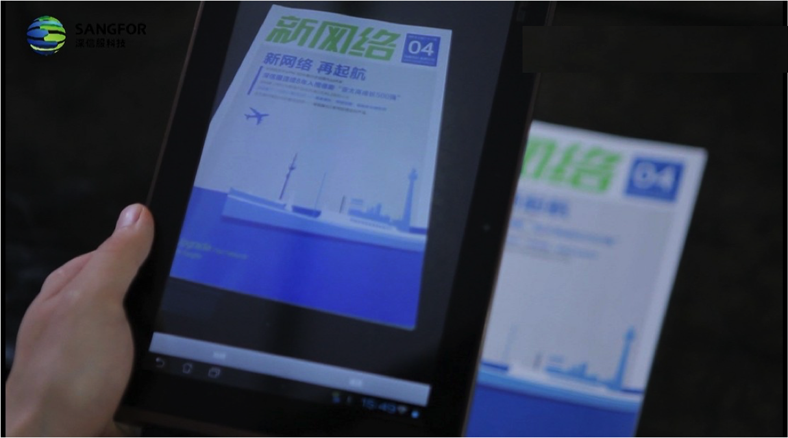
Easy to call device camera and file

Slide 33
Cost-effective
EasyConnect
Native APP
One day
+
One time lower investment
=
Migration app to all Phone
1month -6month
+
Higher investment
=
ISO APP
Android APP
Notes:
我们看到虚拟化和APP开放的优劣势。

Slide 34
Agenda
1
BOYD , opportunity and challenge
2
Sangfor SSL VPN: Rapid, Secure, Simple
3
Scalable Technology Solution
4
Case Study and Practice

Slide 35
Sangfor SSL VPN Customers
Education | Government | Finance
P.R.C. Computer Network Information Center | P.R.C Supreme People's Court | People's Bank of China
Zhejiang University | P.R.C Information Center of the Ministry of Agriculture | Bank of China
People’s University of China | P.R.C National Education Examinations Authority | Agricultural Bank of China
Sun Yat-Sen University | P.R.C Health Supervision Center of the Ministry of Health | Bank of China
University of Electronic Science and Technology of China | P.R.C Foreign Trade Centre | China Merchant Bank
China University of Political Science and Law | P.R.C General Administration of Civil Aviation | Industrial Bank
Central Radio and Television University | P.R.C Maternal and Child Health Center | China Unionpay
Communication University of China | P.R.C Environmental Monitoring Station | China Life Insurance
East China University of Science and Technology | National Forest pest control Terminus | Taikang Life Property and Casualty Insurance
Jilin University | National Pharmacopoeia Commission | New China Life Insurance
East China Jiaotong University | P.R.C Disabled Persons' Federation | Huaxia Fund Management

Slide 36
Sangfor SSL VPN Customers
Power & Energy | ISP & Carrier | Enterprise
China National Offshore Oil | Headquarters Of China Mobile Communications | China Ocean Shipping Group
China Guodian Group | China Mobile Shaanxi Province Branch | China Aerospace Science and Technology Corporation
China Power Investment Group | China Mobile Sichuan Province Branch | China Post Group
China Huaneng Group | China Mobile Yunnan Province Branch | China Electronic Information Industry Group
China Datang Group | China Telecom Shandong Province Branch | China Post & Telecommunication appliance
China Huadian Group | China Telecom Hunan Province Branch | China Aviation Supplies Group
State Grid Corporation | China Telecom Sichuan Province Branch | China National Gold Group Corporation
China Southern Power Grid | China Telecom Guangxi Province Branch | China Gezhouba Group
China Hydropower Engineering Consulting Group | China Telecom Shanxi Province Branch | China Changjiang National Shipping Group
Guangdong Province, the Guangdong Power Group | China Unicom Hebei Branch | China Merchants Group
Guangxi Power Grid Corporation | China Unicom Liaoning Branch | Aluminum corporation of China

Slide 37
Sangfor SSL VPN
$
Solution utilization;
Unified business resource delivery and protection;
Low TCO;
IT Integration and utilization;
Stability and performance;
Low maintenance load;
No help desk needed;
Security;
Rapidity;
Resource/ platform compatibility;
Application delivery capability
Business Value
Function,
Capability
Maintenance, Management
Business Solution

