Slide 1


What‘s New with aCloud 6.0.0 &
aCMP 6.0.10R1 ？
Cheney Hu
Sr. Cloud Product Manager
cheney@sangfor.com
www.sangfor.com
Sangfor Technologies Inc.

Slide 2
aCloud

Slide 3


Overview
AI-enhanced database performance optimization
Performance
Host memory resource over-commitment
Self-defined backup retention
Periodic full backup
Archiving to secondary storage
UPS integration
Reliability
VMware vm tools auto installation
Easy & safe OS disk replacement
Network port multiplexing for management, business and VxLAN
Operability
…

Slide 4
AI-Enhanced Database Performance Optimization
How did we do it?
Self-adaptive performance optimization engine.
Business detection capability
Detect and adapt to current core resource requirements
Detect and adapt to eliminate resource bottlenecks
Performance optimization model construction
Construct performance optimization model based on historic resource tags
Self-adaptive performance optimization architecture
Recommend optimal configuration based on resource tags
Recommend optimal scheduling policy based on resource tags

Slide 5

How it Works
Host
HW resource
Business performance metric extraction
Characteristics extraction
speedup
speedup
Behavioral modeling
Time
Resource contention status
HW differences
Data congregation
VM resource
Cluster
speedup
speedup
Rule generation
Information Update
Configuration
Cluster resource
Optimize rule library
Monitor
Optimizer
Behavior comparison
Business
APP fingerprints | Scheduling | Resource distribution
M1,M2,… | 1 | 3
M1,M2,… | 1 | 2
M1,M2,… | 1 | 1
Apply rules
Time

Slide 6
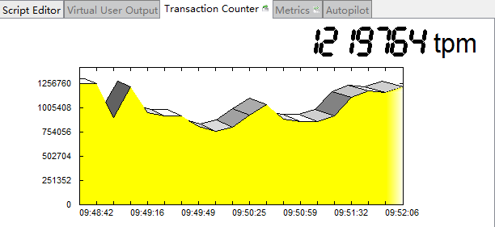
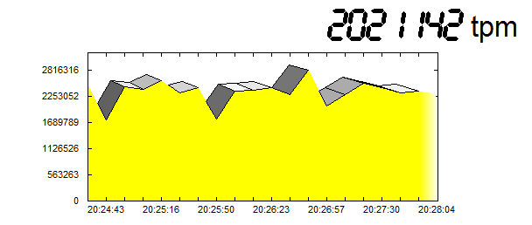
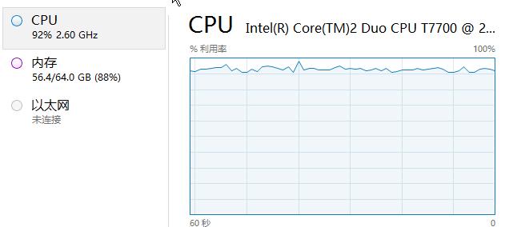
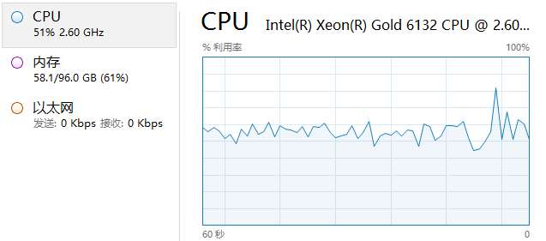
SQL Server Optimization Comparison
Before
After
RAM
Usage Rate
RAM
Usage Rate
Ethernet
Not Connected
Ethernet
Send:
Receive:
High performance clock must be enabled
24c 96G 500G data warehouse 100 users: performance improved & CPU usage dropped

Slide 7
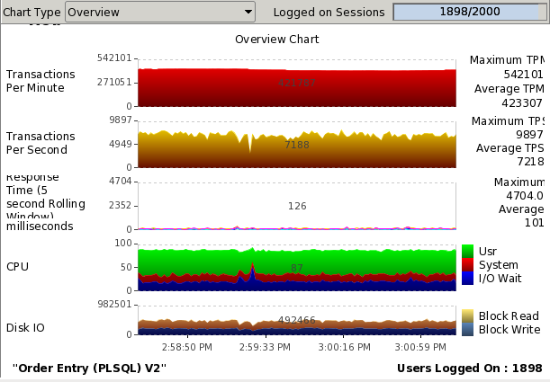
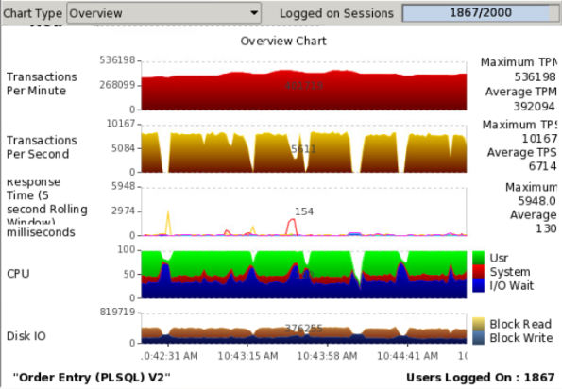
Oracle Performance Comparison vs. VMware
Swingbench results under 2000 concurrency
aCloud
VMware
The Oracle DB performance on aCloud is much more stable than on VMware

Slide 8
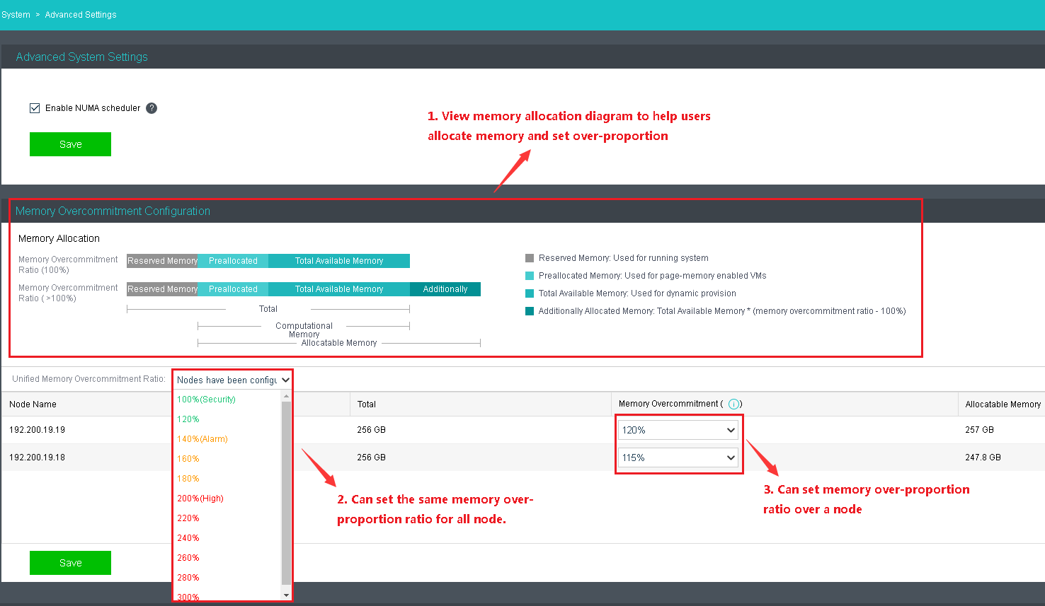
Host Memory Over Commitment
What is it？
Memory over commitment is a concept in computing that covers the assignment of more memory to virtual computing devices (or processes) than the physical machine they are hosted or running on, actually has.
Notes:
This is possible because virtual machines (or processes) do not necessarily use as much memory at any one point as they are assigned, creating a buffer.
If four virtual machines each have 1 GB of memory on a physical machine with 4 GB of memory, but those virtual machines are only using 500 MB, it is possible to create additional virtual machines that take advantage of the 500 MB each existing machine is leaving free.

Slide 9
Backup Optimization
What’s new？
Self-defined backup cleaning policy & no limit on backup retention period
Periodic full-backup.
Archive backup files to secondary storage with backup cleaning policy and retention period also defined by user
VMs can be restored directly from archived files
Value
More comprehensive backup and archiving policies to meet regulation and compliance standards
Faster restoration based on periodic full-backup via shortened backup chain

Slide 10
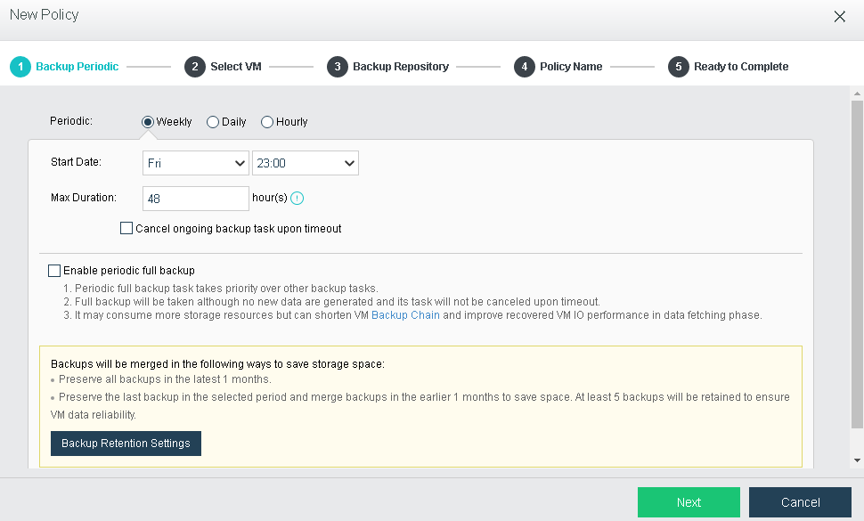
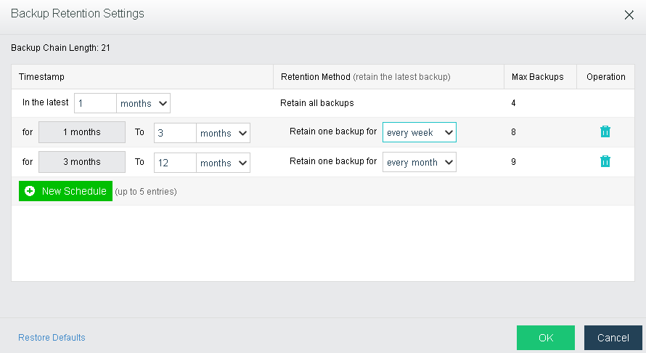
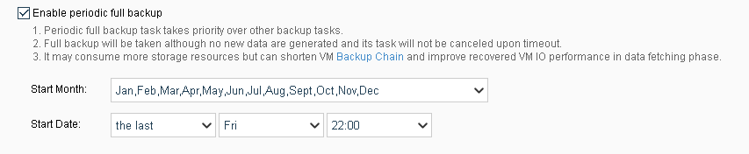
Backup Screenshots

Slide 11
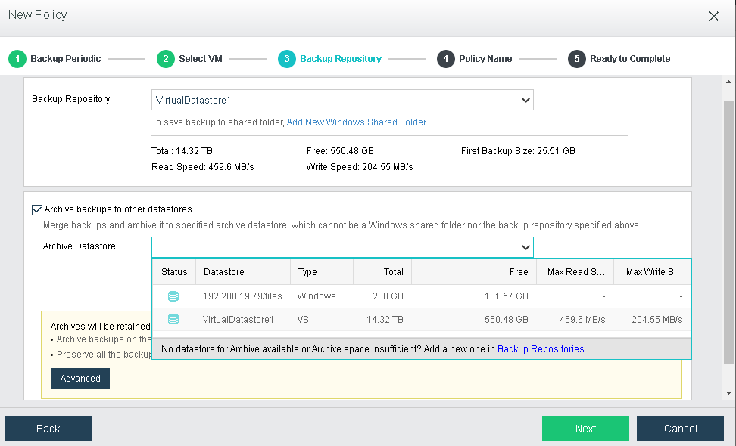
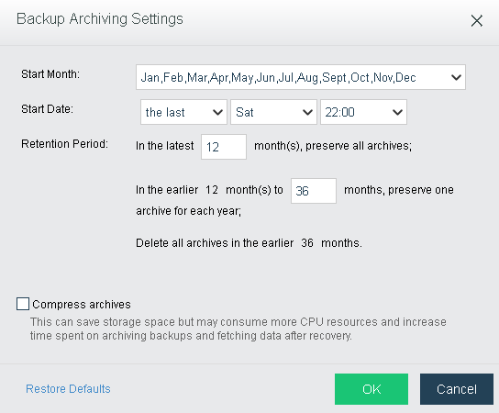
Archiving Screenshots

Slide 12
UPS Integration
What is it?
If the power grid goes down, aCloud will shut down the VMs, using the electricity from the UPS to protect VMs.
How is it done?
aCloud integrates with UPS through SNMP (simple network management protocol). The UPS vendor provides the OID (object identifier) library, and through SNMP protocol, aCloud receives the UPS battery usage status and takes action when the battery usage is below a certain threshold.
Note:
Current version can only support standard MIB library and APC MIB library. If other brands of UPS are required, customization can easily be made.
Notes:
More about OID and MIB
https://www.networkmanagementsoftware.com/snmp-tutorial-part-2-rounding-out-the-basics/

Slide 13
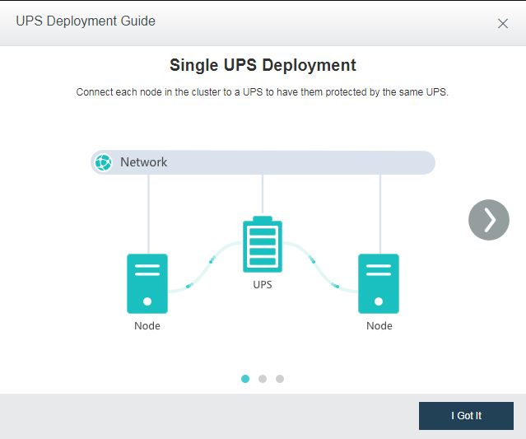
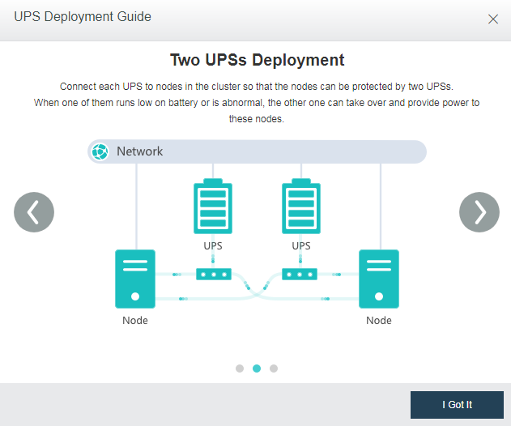
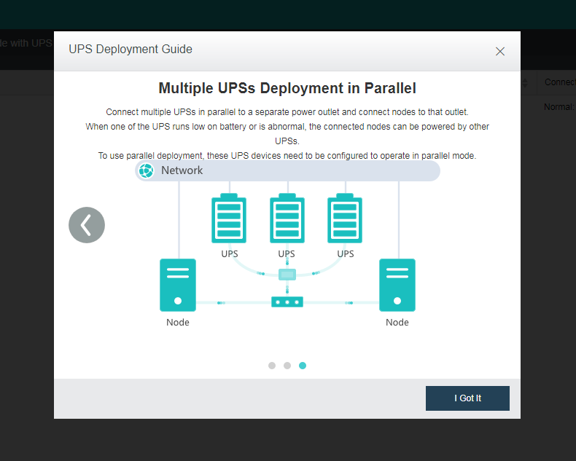
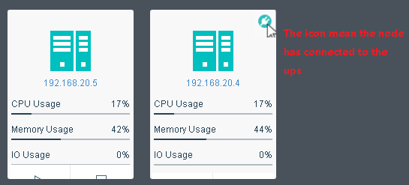
UPS Deployment Guide
Notes:
More about OID and MIB
https://www.networkmanagementsoftware.com/snmp-tutorial-part-2-rounding-out-the-basics/

Slide 14
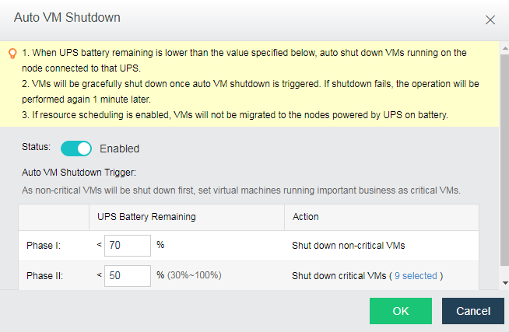
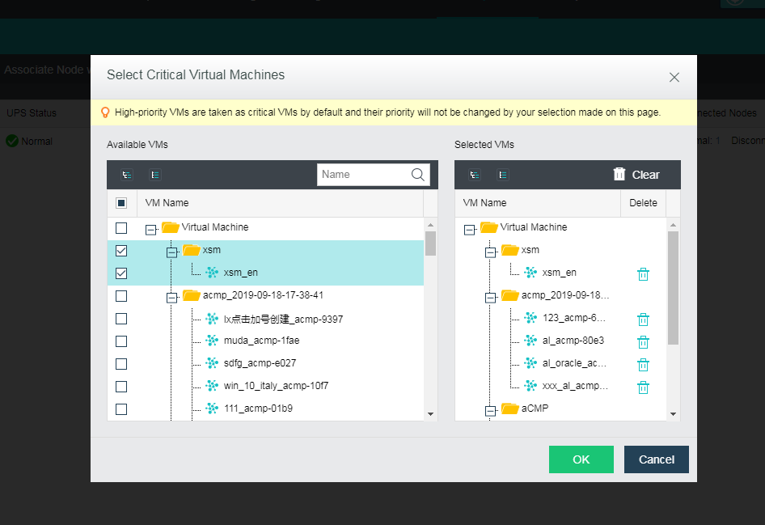
UPS-Powered VM Shut Down Policy
Shut down the VMs according to UPS battery usage and VM priority
Notes:
More about OID and MIB
https://www.networkmanagementsoftware.com/snmp-tutorial-part-2-rounding-out-the-basics/

Slide 15
Other Enhancements
Network multiplexing for management, business and VxLAN
Support network port multiplexing for any of the 3 network traffic types (management & business, VxLAN & business or VxLAN & business & management).
Network QoS can be applied to traffic
Easy & safe OS disk replacement
Migrate VMs -> maintenance mode & system config backup -> host power-off & OS disk replacement -> ISO guided OS re-installation

Slide 16
Precautions
Database performance testing
Hosts with RAM greater than 256GB are recommended
Memory over-commitment
Not recommended unless necessary, as memory over-commitment could have a negative impact on performance.
When the actual consumed memory of VMs is nearing the physical memory of the host, memory swap occurs and performance of VMs is degraded. When SWAP is used up, low priority VMs will be killed off.
VMware VM IP address automatic acquisition
When migrating/restoring VMware VMs to aCloud, IP addresses of the VMs can be automatically obtained as long as the source VMs have VMware Tools installed.
Upgrade
Live upgrade is supported by 5.8.6 and later versions

Slide 17
aCMP

Slide 18
Overview
VPC (virtual private cloud) network
Elastic IP
Intra-tenant access control
1 step closer to a true private cloud

Slide 19

Recap on aCMP + aCloud Private Cloud Architecture
Internet
Bind EIP
Router
VPC 1
VPC 2
VPC n
VPC
Tenant 1
Tenant 2
…
Tenant n
Tenant
aCloud Cluster 1
VMware Cluster
aCloud Cluster 2
Shared resource pool
Dedicated resource pool
Note: resource pool was previously called availability zone

Slide 20
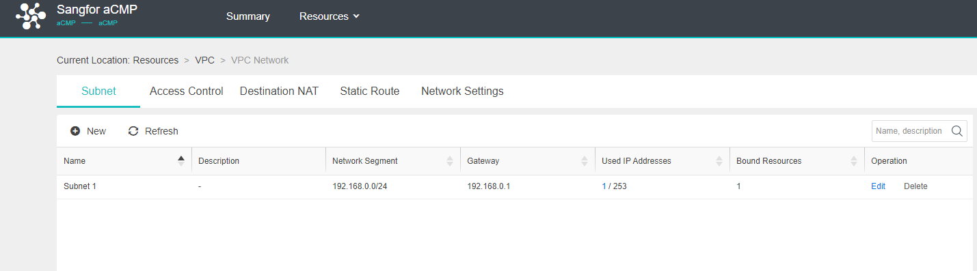
VPC
What is it?
A virtual private cloud (VPC) is an on-demand configurable pool of shared computing resources, allocated within a public cloud environment, providing a certain level of isolation between the different organizations using the resources. The isolation between one VPC user and all other users of the same cloud (other VPC users as well as other public cloud users) is normally achieved through allocation of a private IP subnet and a virtual communication construct (such as a VLAN or a set of encrypted communication channels) per user.
What do we have?
When a tenant is created by admin, aCMP will automatically assign a VPC to the tenant. The VPC is logically segregated from other VPCs.
IP subnets can be created inside the VPC.

Slide 21
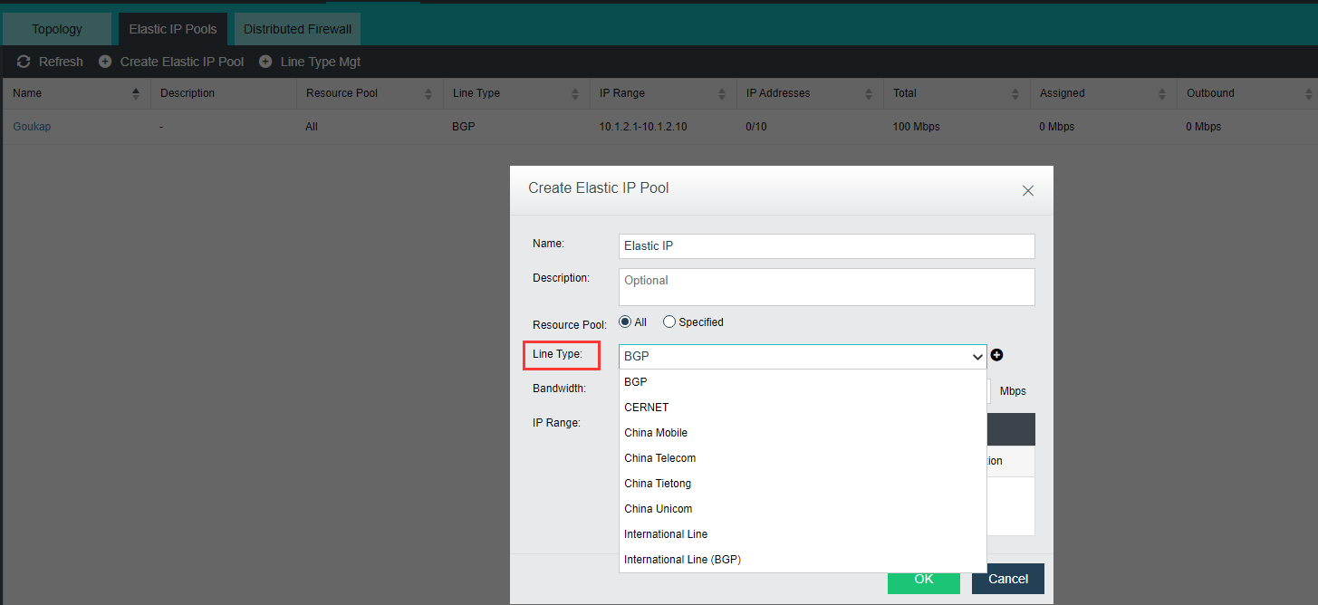
Elastic IP
What is it?
An IP address pool created by admin that can communicate with an external environment is called an elastic IP (EIP).
An EIP pool can be assigned to multiple resource pools (previously called availability zones). A resource pool can also be associated with multiple EIP pools.
The EIP pools are visible to all the VPCs under the resource pool.
EIP can be applied to cloud hosts and routers, ensuring that these virtual devices can communicate with the external network.
Availability zone 1
VPC 1
EIP pool 1
VPC 2
Tenant A
Availability zone 2
VPC 3
EIP pool 2
Tenant B
VPC 4

Slide 22
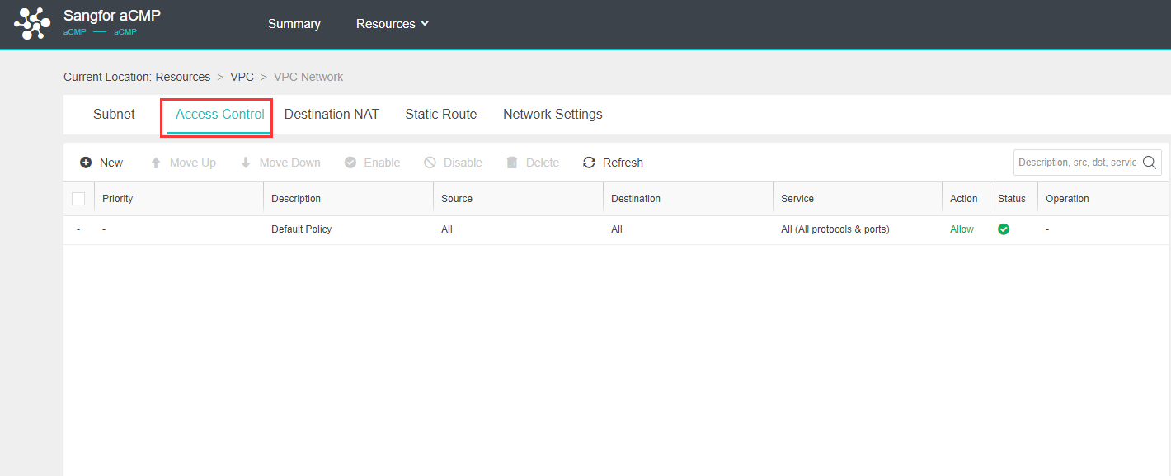
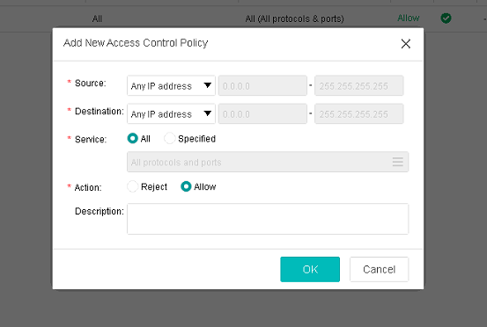
Intra-Tenant Access Control
What is it?
Access control inside VPC, tenant is able to apply access rules to VMs inside the VPC to realize east-west protection.

Slide 23
Summary
Better Performance
AI-enhanced DB performance optimization
Memory isolation
Network plane flow control
Better Reliability
Enhanced backup with periodic full backup
Archive to secondary storage
UPS integration
VPC and intra-tenant access control
Better Operability
Network port multiplexing
VMware vmtools auto installation
Easy & safe OS disk replacement
Elastic IP
The most advanced aCloud version !

Slide 24
Demo

Slide 25
THANK YOU
Cheney Hu
www.sangfor.com
Sangfor Technologies Inc.

