Slide 1
What’s New with aCloud 5.8.7R1 & aCMP 5.8.6R1
Cheney Hu
Sangfor IMD

Slide 2
An Overview of What’s New
Stretched Cluster
Sangfor’s active-active data center solution based on aCloud, able to achieve zero data loss and near-zero downtime in the event of a site failure. The distance between 2 sites is restricted.
GPU support
NVDIA GPU, pass-through and vGPU. For graphics-intensive and deep learning workloads
Reporting
Exporting reports of resource usage status of specified VMs and hosts
“Seed backup”
Exporting data to portable disk and transport it to secondary site to save time for first time full backup
…

Slide 3
Stretched Cluster

Slide 4
Stretched Cluster (aCloud 5.8.7R1)
What is it?
Stretched cluster extends the aCloud cluster from a single data site to two sites for a higher level of availability and intersite load balancing. Stretched clusters are typically deployed in environments where the distance between data centers is limited, such as metropolitan or campus environments.
VMware vSAN stretched cluster

Slide 5
Stretched Cluster (aCloud 5.8.7R1)
Scenarios
You can use stretched clusters to manage planned maintenance and avoid disaster scenarios, because maintenance or loss of one site does not affect the overall operation of the cluster. In a stretched cluster configuration, both data sites are active sites. If either site fails, aSAN uses the storage on the other site. aSV HA restarts any VM that must be restarted on the remaining active site.
Values
RPO = 0
RTO = minutes (HA reboot time, apps that support A-A can achieve zero downtime.)
Key words:
Zero data loss, minimal business downtime, starts small with 4 nodes

Slide 6



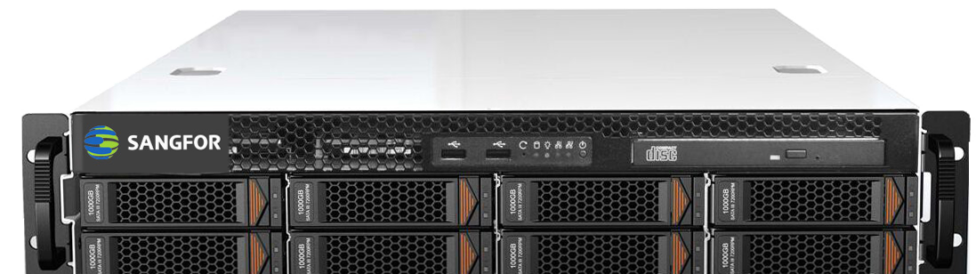
Sangfor aCloud Stretched Cluster
Witness node
Witness link
Site link
Primary site
Secondary site
Site link:
10Gbps bare fiber is recommended, RTT<=1ms
1Gbps is supported for small deployment (4-6 nodes)
Witness link:
Recommended RTT<=1ms (fluctuation within 5ms is accepted)
100Mbps is recommended
Deployment scale:
Only 1 stretched virtual volume is supported by 1 cluster
Starts with 4 nodes, maximum 24 nodes
Supported scenarios
Different floors inside the same building
2 adjacent buildings
Inside the same campus
Scenarios to be supported
3 centers across 2 cities (unified mgmt. by aCMP, by the end of 2019)
Metropolitan active-active (roughly 2019)

Slide 7
Business A-A and Data A-A
Business Active-active
Data Active-active
Oracle 1
RAC
Oracle 2
App
Primary fault domain
Secondary fault domain
Primary fault domain
Secondary fault domain
Business is running concurrently at 2 sites
When a site fails, business is switched over to the other site by load balancer
RPO=0, RTO≈0
Business applications must support active-active mode, typical example is Oracle RAC
Higher complexity
Business is running at one of the fault domains
When primary site fails, App VM is rebooted at the other site by HA
RPO=0, RTO=minutes
No requirements for business apps
Lower complexity

Slide 8
Licensing for Stretched Cluster
How to License
Additional license called aSC, aSV and aSAN are prerequisite
Licensed by the number of physical CPU sockets
Scenario 1
New construction, 1 stretched cluster with 20 physical CPU sockets, 1 traditional cluster with 40 CPU sockets, totally 60 sockets
Scenario 2
Construction in phases, primary DC at the 1st phase with 20 CPUs, add another 20 CPUs at the 2nd phase in secondary site to build a stretched cluster
Cluster Type | Licenses for aSV &aSAN | Licenses for aSC
Stretched cluster | 20 | 20
Traditional cluster | 40 | 0
Total | 60 | 20
Cluster Type | Licenses for aSV &aSAN | Licenses for aSC
Phase 1 | 20 | 0
Phase 2 | 20 | 40
Total | 40 | 40

Slide 9
A Typical Use Case of aCloud Stretched Cluster
Customer’s requirements
  Customer has 2 server rooms at floor 1 and floor 2, they expect to deploy nodes at the 2 server rooms and build a stretched cluster across to handle availability in the case of server room failure
  Normally, 2 server rooms are running different business workloads simultaneously
  The devices in the server room at floor 2 are newer and more reliable than the ones at floor1, customer expects to put important workloads in the new server room
Room 1
Room 2
Room 1
Room 1
Room 2
Room 2
Campus

Slide 10
Polling 1:
Do you have any requirement for active-active data centre solution?
A. Yes, the server rooms are located on different floors in the same building
B. Yes, the server rooms are located in 2 buildings side by side
C. Yes, the server rooms are located in 2 buildings in the same campus
D. Yes, 2 sites are located in the same city but dozens of kilometres away from each other
E. No, never had requirement for such a high level protection

Slide 11
GPU Support

Slide 12
GPU Support (aCloud 5.8.7R1)
What is GPU?
A graphics processing unit (GPU) is a specialized electronic circuit designed to rapidly manipulate and alter memory to accelerate the creation of images in a frame buffer intended for output to a display device.
Characteristics of GPU Computing
High concurrency, high density, massive and parallel

Slide 13
GPU Support (aCloud 5.8.7R1)
Applications that require GPU
GIS (geographic information system), graphics rendering system, deep learning system, computer-aided engineering, etc
Scenarios
Video transcoding and streaming, graphics rendering, labs for deep learning and big data applications
GIS
CAE

Slide 14
aCloud vGPU Solution
VM
VM
VM
VM
VM
License
Server
VM
Logically partition a physical GPU into multiple vGPUs for multiple VMs to use
Server hardware must be installed with NVDIA GPU cards that support vGPU
NVIDA vGPU manager is embedded in the hypervisor, it takes charge of virtualizing physical GPU into vGPUs
GPU drivers must be installed on VMs
NVIDIA Driver
NVIDIA Driver
NVIDIA Driver
NVIDIA Driver
NVIDIA Driver
aCloud
NVIDIA vGPU Manager
vGPU
vGPU
vGPU
vGPU
vGPU
NVIDIA GPU
Server

Slide 15
GPU Support (aCloud 5.8.7R1)
Pain points
Existing applications supported by physical GPUs need to be supported by virtualization platform in virtualization transformation
When GPUs are deployed in a large scale, it’s very difficult to match GPU resource with business requirements, thus leading to unbalanced utilization and resource waste
GPU management in large scale environment could be very complicated
Values of aCloud vGPU solution
Visualized GPU resource utilization, simplified deployment & management
Pooling of GPU resource for multiple VMs to maximize GPU utilization

Slide 16
vGPU v.s. Physical GPU (In Large Scale)
 | Physical servers + GPU | Virtualization + vGPU
Batch deployment | Bad | Good
Resource utilization | Low | High
Mgmt. | Per server | Unified and visualized
GPU Specs | Fixed per card | Flexible configuration of GPU memory based on needs

Slide 17
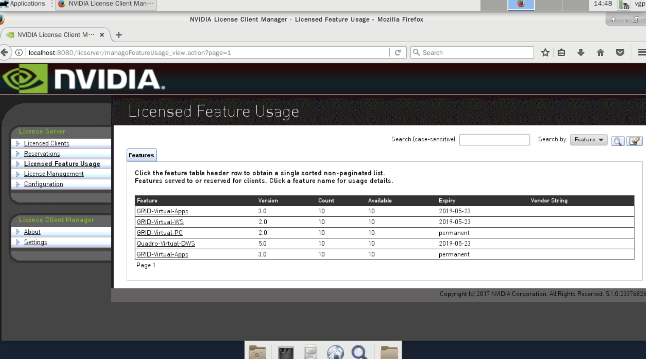
Licensing for vGPU
1. vGPU support requires license from NVIDIA, it’s licensed by the the number of concurrent vGPU VMs
2. GPU pass-through requires no license from NVIDIA
3. No license from Sangfor for both modes
Licensing procedure
1. Upload licensing server template to aCloud
2. Configure IP and import license file
3. Input licensing server’s IP on the GPU driver of vGPU VM
There are 3 types of vGPU licenses from NVIDIA: vPC, vDWS and EDU. vDWS has better performance than vPC, EDU is a promotion for education sector, it shares the same functionalities with vDWS, but has a lower price as vPC, only schools have the right to purchase it

Slide 18
Differences between vGPU Solutions on aCloud and aDesk
What aCloud has but aDesk doesn’t:
Support GPU for Linux
Support launching VM console directly from the web UI
Support vGPU mode for NVIDIA P40
Optimization on UI details

Slide 19
Some Caveats
Not every server can support GPU installation, our previous aServer models can’t support GPU. If customer has existing GPU servers, reusing those servers is a good option; Dedicated GPU aServer models (aServer-G350 or G650) are needed for new construction scenarios.
Only 1 graphics card (passthrough or vGPU) can be attached to a VM, this is limited by NVIDIA technology

Slide 20
Polling 2:
Are you looking for GPU solutions and for what workloads?
A. Yes, graphic rendering
B. Yes, deep learning and data analysis
C. Yes, video transcoding
D. No, never had such requirement

Slide 21

Seed Backup (aCMP 5.8.6R1)
Introduction
Seed backup is a complementary feature for off-site DR scenario. User can use this feature to make a seed file based on selected VM’s backup and export it to external storage (USB flash drive or portable disk), the storage device is then transported to the secondary site and VM will have related backup on the secondary site after the seed file is imported. In a word, seed backup is a way to replace network-based data transfer with physical transportation.
Targeted customer
Customer has requirement for DR, but the link bandwidth between the 2 sites is very narrow (due to limitations on budget or physical environment).
It’s more suitable for scenarios with new secondary site construction because first-time full backup can be very time-consuming.
Wants off-site DR
First-time full backup is too big
Data transfer takes too long
Narrow bandwidth
Targeted customer

Slide 22
Reporting & Others
Reporting (aCMP 5.8.6R1)
Reports can be generated and exported based on selected metrics (CPU, RAM, IOPS, latency and throughput) of specified VMs and hosts
Support Importing VMs in OVF, MF and VMDK formats (aCloud 5.8.7R1)
Italian keyboard support (aCloud 5.8.7R1)
VM scheduling: affinity & anti-affinity (aCloud 5.8.7R1)
Affinity and anti-affinity rules allow you to spread a group of virtual machines across different hosts or keep a group of virtual machines on a particular host
Support CPU and memory automated hot add for Windows Server 2012, 2012R1 and 2016 VMs (aCloud 5.8.7R1)
…

Slide 23
Q&A

Slide 24
Thank You

