Slide 1


Your One Stop Branches
Access Network Solution
Sangfor Next Generation SD-WAN Solution
Vincent Wu / Product Manager
www.sangfor.com
Sangfor Technologies Inc.
PPT_SD-WAN_20190311

Slide 2


1 PART
Background and
Challenges
Sangfor Technologies
CONFIDENTIAL
Page

Slide 3



Background
Distributed Organization Minimize Costs and Increase Sales Opportunities
But Bring Big Challenges for Branches Access Network
Low labor costs, Close to raw materials region
Limited budget
Production server security risk
Production system interruption risk
Factory
Factory
Large-market city
Limited budget
Business interruption
Small office
DR RTO/RPO
Expensive bandwidth
Connectivity
Low work efficiency
Network security risk
Business interruption
Low tax logistics center
Inventory system interruption risk
Warehouse
1k
Regular Office
Poor experience
Limited bandwidth
Expensive bandwidth
Warehouse
DRC
Data Center
Cloud
Large-market city
No IT guys in store
Hard to deploy and management
Limited budget
POS machine/Order system interruption risk.
Remote Office
Poor experience
Limited bandwidth
Expensive bandwidth
Store
Store
Distributor
Oversea Office
Sangfor Technologies
CONFIDENTIAL
Page

Slide 4

Traditional Network Solutions
Traditional Network Solution is Difficult to Satisfy Customer’s Need
MPLS/IPVPN
How to balance link costs/quality/bandwidth/stability ?
How to guarantee user and server security ?
How to improve user application experience and work efficiency ?
High quality
Expensive and limited bandwidth
Internet VPN
Cheap and high bandwidth
Low quality and unstable
Sangfor Technologies
CONFIDENTIAL
Page

Slide 5
2 PART
Sangfor Next Generation
SD-WAN Solution
Sangfor Technologies
CONFIDENTIAL
Page

Slide 6
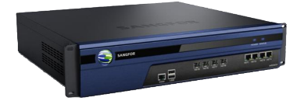
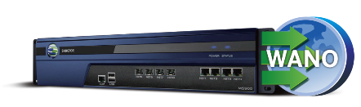
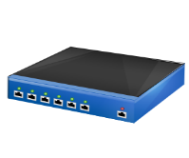


Sangfor Next Generation SD-WAN Family
Centralized Management Platform
Full Branches Visualization
Unified Firmware Upgrade
Branches Policy Management
Unified License Management
Intelligent Alerts
Unified Entrance for All Branches Device
Unified Policy Update
Email Deploy
Auto VPN
SD-WAN Path Selection
policy
BBC
(Branch Business Center)
Small Office/Store
Medium/Large Office
Large Branch/
Small Data Center
(Limited budget;
User<10;
VPN Throughput <30Mb)
Acceleration
Application Acceleration
Link Optimization
Transmission Time Reduction
Traffic Reduction
(One aBOS is better than
Buy server/WANO/NGFW/IAM more than 2
in the same time)
WANO
(WAN Optimization)
Full Security
IPS/IDS
WAF
Anti-Virus
APT
Security Visibility
MIG
(Multi-Functional Integration Gateway)
NGFW
(Next Generation Firewall)
Mini Secure Gateway
Routing
Bandwidth Management
URL Filtering
Application Access control
Anti-Dos
ARP Protection
aBOS
(a Box of Sangfor)
Granular Management
Full Authentication
Detail Reporting
Granular AC/BM
Audit
IAM
(Internet Access Management)
Elastic SD-WAN
vWANO/vNGFW/vIAM Deploy On-demand
Server Virtualization
Sangfor Technologies
CONFIDENTIAL
Page

Slide 7
Sangfor Next Generation SD-WAN solution
a highly secure, excellent-experienced next-generation SD-WAN flexible branches network access solution
for enterprise branches' different needs
Sangfor Next Generation SD-WAN Solution
Quickly Deployment
Secure
Transmission
Optimization
MIG
aBOS
+
Basic
SD-WAN
WANO
BBC
Easy Management and Operation
IAM
Reliable
Connections
Security
NGFW
Sangfor Technologies
CONFIDENTIAL
Page

Slide 8
Different Requirements Branches Match Different Solution
OA/VC/VOIP
Core Business
Database
Backup and Recovery Apps
NGFW
WANO
BBC
OA/VC/VOIP
Core Business
Database
Backup and Recovery Apps
NGFW
WANO
OA/VC/VOIP
Core Business
Database
Backup and Recovery Apps
vWANO
Head Office / Data Center
Disaster Recovery Center
Public Cloud
Internet
MPLS/IPVPN
VSAT
OA/VC/VOIP
Core Business
Internet Apps
OA/VC/VOIP
Core Business
Internet Apps
NGFW
WANO
IAM
Virtual Machine
vNGFW/vIAM
vWANO
OA/VC/VOIP
Core Business
Internet Apps
OA/VC/VOIP
Core Business
Internet Apps
MIG
aBOS
WANO
WANO
Small Office
Regular Office
Large Office
Oversea Office
Remote Office
Sangfor Technologies
CONFIDENTIAL
Page

Slide 9









Highlight 1: Hybrid WAN
Hybrid WAN Replace Single WAN Is The Inexorable Trend
Internet 2
WAN
WAN
MPLS
SD-WAN
MPLS
Internet 1
1M MPLS 200USD/Month
20M Internet 20USD/Month
4M MPLS 600USD/Month
Reduce Bandwidth Cost
Increase Bandwidth
Business and Internet Traffic Separation
Business High Availability
Sangfor Technologies
CONFIDENTIAL
Page

Slide 10

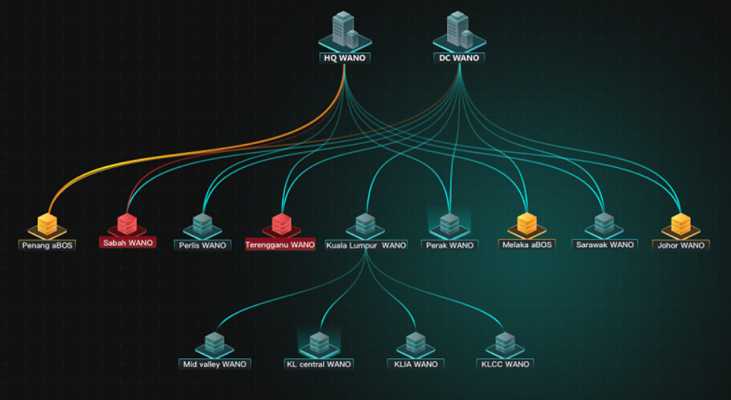
Highlight 2: Quickly Deploy
Any One in Branch Office Can Quickly Finish Deployment Work
Reduce Business Cycle and Deployment Costs
1. Email deployment
Step 1
Step 2
Step 3
Success
Connect Cable
(WAN/LAN)
Connect PC
to Device
Click Email Link
Device Connect to
Internet and BBC
8:00 AM
8:10 AM
8:11 AM
8:15 AM
2. Auto VPN
VPN Topology
Full Mesh
Tree Network
Sangfor Technologies
CONFIDENTIAL
Page

Slide 11







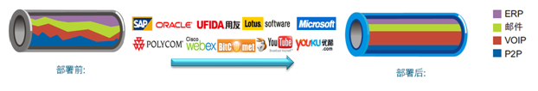



Highlight 3: Business High Reliability
Business Continuous and Steady Operation
1
File sharing: High bandwidth；
e.g. FTP,CIFS
Internet
IaaS/SaaS
Branches
2
Core application: Highavailable, allow a little jitter；e.g. OA, ERP, CRM
MPLS
Instant Message application: High experience, 0 packets loss rate, low latency; e.g. VOIP/VC
HQ
3
Fail-over without user perceptions !
Sangfor Technologies
CONFIDENTIAL
Page

Slide 12
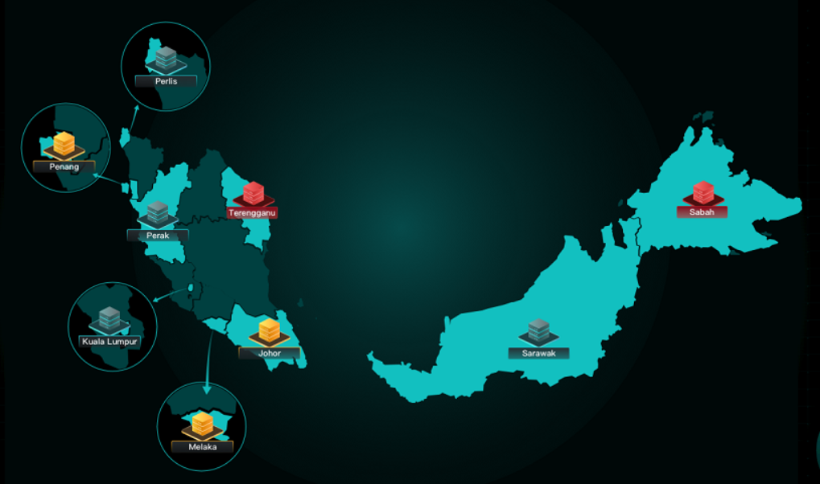
Highlight 4: Easy Management and Operation
Greatly Decrease Operation Difficulties and Costs
Branches Map
VPN Topology
Map Based Visualization
Intelligent Alerts
Unified Policy Update
Unified License Management
Unified Firmware Upgrade
All devices entrance
Sangfor Technologies
CONFIDENTIAL
Page

Slide 13


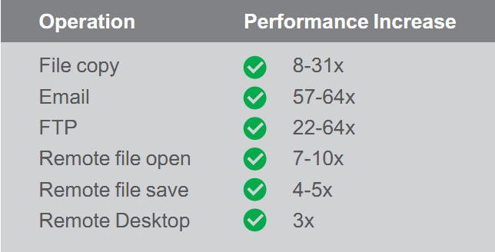
Highlight 5: Optimization
Best User Application Experience with Lower Bandwidth Costs
Byte Cache
FEC
Dynamic Compression
Windows Slides
Optimization
Optimization
Key Technology
Application
Proxy
Quickly
Re-transmit
IP Traffic
Compression
Protocol Optimization
Sangfor Technologies
CONFIDENTIAL
Page

Slide 14

Highlight 6: Elastic Security
All Round Protect Your Network Security
Internet
Security
Server
Security
Internet
Branch Office
Data Center
None-Server Office
(Basic Security)
Access control
URL filtering
Anti-Dos
ARP protection
Server Office
(Full Security)
IDS/IPS
WAF
Anti-virus/APT
Scanner
Transmission Security
Sangfor Technologies
CONFIDENTIAL
Page

Slide 15
3 PART
Why Sangfor
Sangfor Technologies
CONFIDENTIAL
Page

Slide 16
Sangfor SD-WAN Technology Accumulation Over 17 Years
2002
2005
2007
2011
2018
IPSec VPN
#1 vendor in the China market
IAM
#1 vendor in the China market
WANO
#1 vendor in the China market
NGFW
ICSA Labs certificated
OWASP 4 stars
Next Generation
SD-WAN
China SD-WAN
Standard-Setter
Sangfor Technologies
CONFIDENTIAL
Page

Slide 17


SD-WAN Main Components Are In Gartner Magic Quadrant
WANO
VPN
Magic Quadrant
IAM
NGFW
Sangfor Technologies
CONFIDENTIAL
Page

Slide 18
One Stop Solution
Different Branches, Different Requirements
Network Access
Network Security
Network Optimization
Sangfor Technologies
CONFIDENTIAL
Page

Slide 19




Strong Technical Support
250 Seat CTI
Local Technical Support
Multilingual Call Center in Malaysia
Native Language Service
Local Spare Part Warehouse
Industry Leading SLA
24x7 Remote Support
Livechat Response Within 2 mins
ISO9001 Certified
Sangfor Technologies
CONFIDENTIAL
Page

Slide 20
4 PART
Brand and Case Study
Sangfor Technologies
CONFIDENTIAL
Page

Slide 21


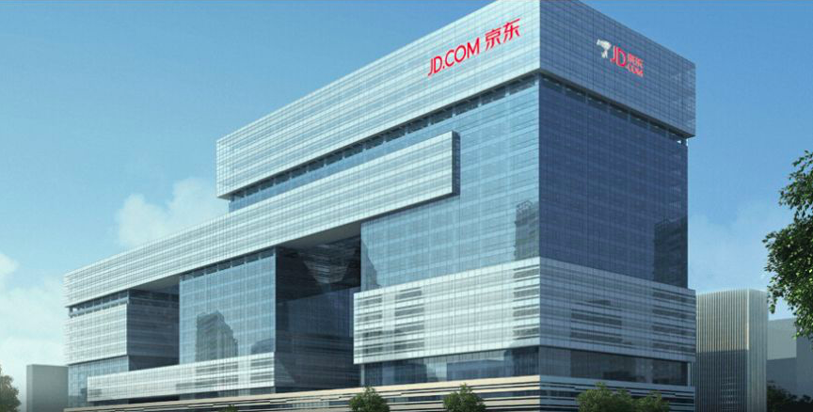

JD Logistics
JD Logistics, a business group under JD.com, which leverages the company’s advanced technology and logistics expertise to provide smart supply chain and logistics services to businesses across a wide range of industries.JD.com operated 14 “Asia No. 1” projects, which are among the largest and most automated smart fulfillment centers in Asia. JD.com also leverages a network of over 500 warehouses with a total of 11.6 million square meters.
Quickly Deployment
Three steps quickly finish deploy via email deployment, satisfy store quickly expansion requirements.
Business High Availability
Easy O&M
Three data center, multi WAN solution makes it high availability for logistic data synchronization
About 10,000 MIG unified management and full visualization
Sangfor Technologies
CONFIDENTIAL
Page

Slide 22

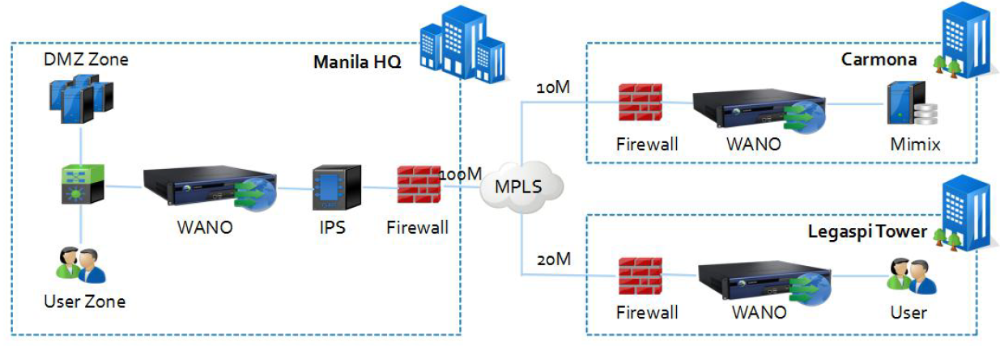
Strong Technical Support
Maybank is Malaysia's largest bank and one of the largest banks in Southeast Asia, with total assets exceeding US $165 billion and a net profit of US$1.75 billion (2015).Maybank Philippines has an extensive network of 79 branches which are strategically located in key cities national wide. These branches provide a wide range of financial products and services to meet the needs of the retail and business segments.
Challenges:
Maybank Philippines use 10Mbps bandwidth and IBM Mimix to synchronize banking data between Carmona and Manila HQ. Because of the limited bandwidth and expensive MPLS bandwidth cost, synchronizations start from 12PM to 12AM the next day, user cannot use the latest data when they go to work in the morning.
The speed from some branches to HQ server like Legaspi Tower is very slow, which effects users’ work efficiency when they access core bank systems (Image Checking System/Collection System/GDS/LOS), Maybank Online Branch Report, Anti-Money-Laundry System, etc.
Values:
Save synchronization time
Reduce MPLS bandwidth upgrade cost
Improve user work efficiency and productivity
Improve MPLS throughput
System | Expected Traffic Reduction Rate
IBM Mimix | 90% Mimix Transfer Time Original: 12am – 12 pm After Optimization: 12am – 6am
Anti-Money-Laundry System | 70%
Image Checking System | 94%
Collection System | 93%
GDS | 90%
LOS | 70%
Maybank Online Branch Report System | 36%
Sangfor Technologies
CONFIDENTIAL
Page

Slide 23




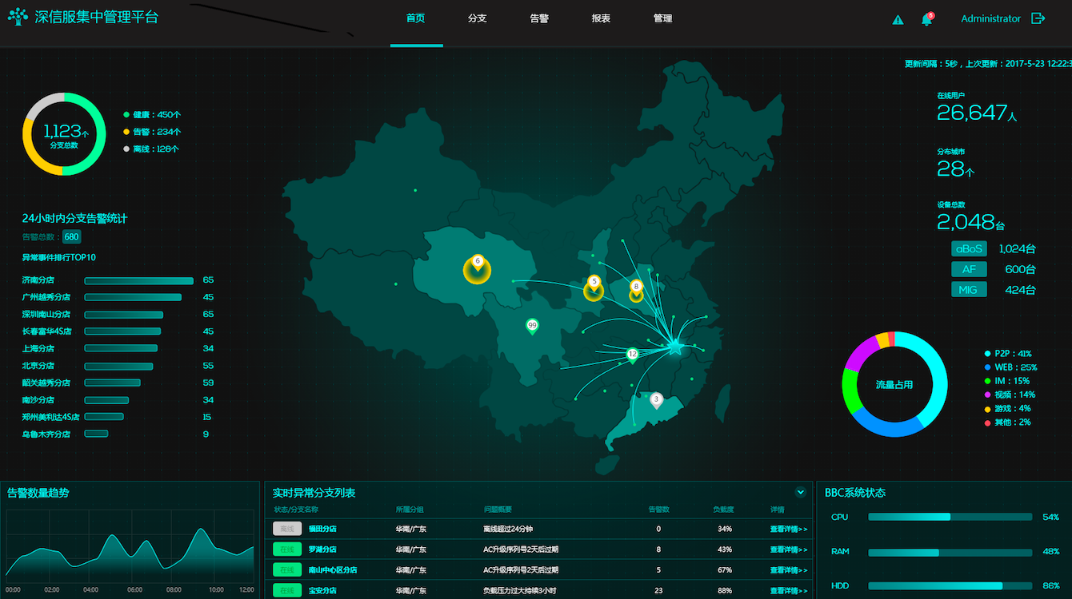




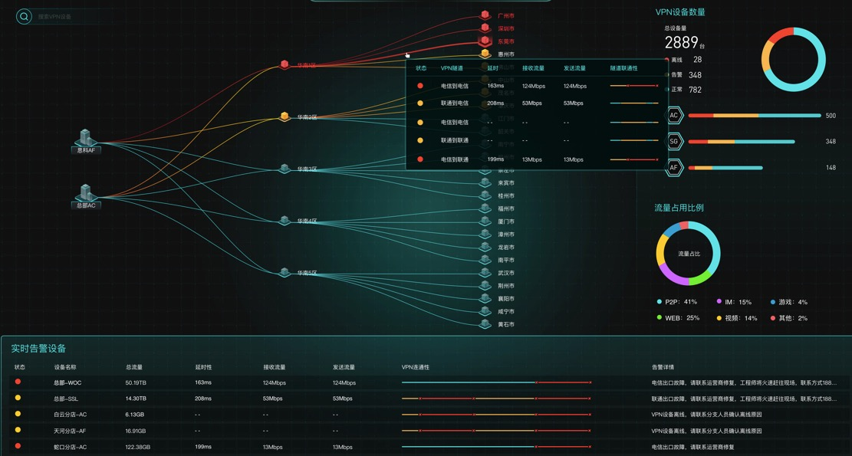


UnionPay
UnionPay, is a Chinese financial services corporation. It provides bank card services and a major card scheme. UnionPay is the only interbank network in China that links all the ATMs of all banks throughout the country. It is also an electronic funds transfer at point of sale (EFTPOS) network. It is the largest card payment organization in the world offering mobile and online payments based on total value of payment transactions, ahead of Visa and Mastercard.
Sangfor provides 2*aBOS HA + 1*BBC in Shanghai data center, 2*aBOS in Beijing data center, 29*aBOS in 29 branches over the world SD-WAN solution. Help branches quickly build reliable connections to data center, protect network security and make user activities compliance through vNGFW+vIAM in aBOS, simplify operation and management through BBC map based full visualization.
Mobile
Data Center
Branch office
aBOS(HA)
Core Switch
Branch office
aBOS
Branch Office
aBOS
aBOS
BBC
Sangfor Technologies
CONFIDENTIAL
Page

Slide 24
THANK YOU
Vincent Wu
Product Manager
Sangfor Technologies Inc.
Block A1, Nanshan iPark, No.1001 Xueyuan Road, Nanshan District,
Shenzhen, Guangdong Province, P. R. China (518055)
(+86) 755 86560605
sales@sangfor.com
www.sangfor.com

