Slide 1

What’s New with HCI 5.8.3
SANGFOR TECHNOLOGIES
Notes:
Bangkok summit.
20minutes to share cloud computing market trend, sangfor product and opportunities.
Today, My topic is: Step into cloud era together”.

Slide 2
Agenda
Questions during webinar can be submitted via Q&A
Sales Updates
  Built-in CDP with Near 0 RPO
  VMware Backup
  Licensing
  Launch Plan
  Online community
Technical theory and configuration guide
Today’s presentation is Confidential

Slide 3

Speaker introduction
Polling Question: Where are you from?
Jason Yuan
VP of product & marketing

Slide 4
What’s New in HCI 5.8.3
  CDP – Effortless near-0 RPO data protection
  VMware management – Simply Manage vCenter from Sangfor HCI management console
  VMware bi-directional migration – Easy migration between VMware and Sangfor HCI
  VMware backup – Simplified backup solution for VMware
  Instant recovery – Significant RTO reduction
  iSCSI server – Enhanced stability and performance
  Virtual volumes on aSAN – Create storage volumes on aSAN based on performance and capacity
  vSSL VPN integration – NFV on HCI gets more comprehensive
  Intel Xeon Scalable processors support
Notes:
Need a one line description for each of them☺

Slide 5
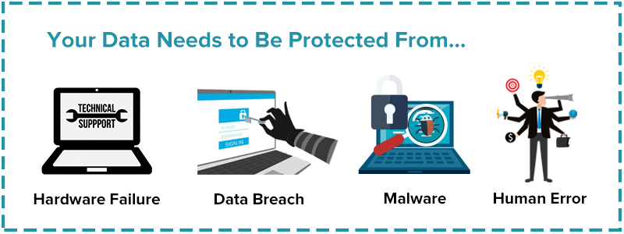
Data protection is critical for enterprises

Slide 6
Traditional backup is not enough for critical applications
Traditional backup solution will impact system performance and increase management overhead
Minutes or hours of RTO is not acceptable to business-critical applications
Notes:
Traditional backup is limited. Critical applications requires high level of data protection. Customer demands granular level of data protection for is customer and enterprise data. However, typical backup inteval ranges either from minutes to hours. The built-in back-up from VMware was 24 hours. Financial data, online transactions, manufacturing data, or transportation data can all be lost in that interval.

Slide 7
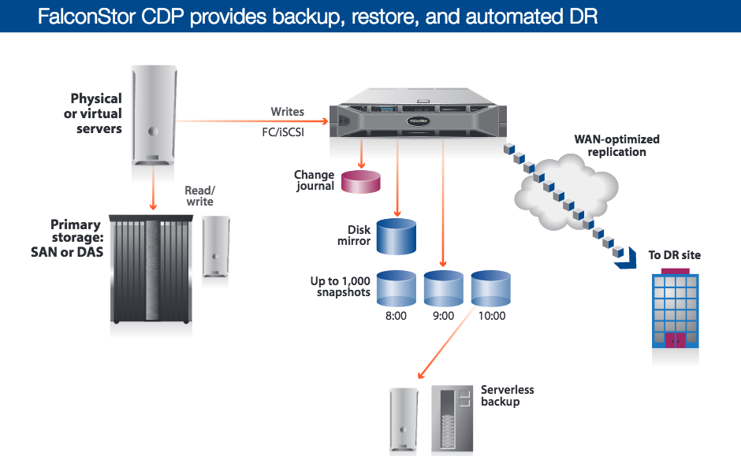
3rd party CDP is complicated
Challenge
Additional server required
Need agent in primary server, need reconfigure network
Management silos
Notes:
Here is one of the leading vendor from FalconStor
What’s the complexity?
-Need to buy an appliance or HW
-some times an agent might be required on all VMs
-adding software, service and yet another vendor
-FalconStor charges by volume of storage
-backup policies are to be defined and tuned
-experience: requires backup experts

Slide 8



First HCI with built-in CDP
IO Mirror
Hypervisor
aSV（Hypervisor）
IO Log
NAS
SAN
Built-in CDP with near-0 RPO and instant recovery
Notes:
Sangfor introduces built-in CDP
-It delivers near zero RPO
-Unified management

Slide 9













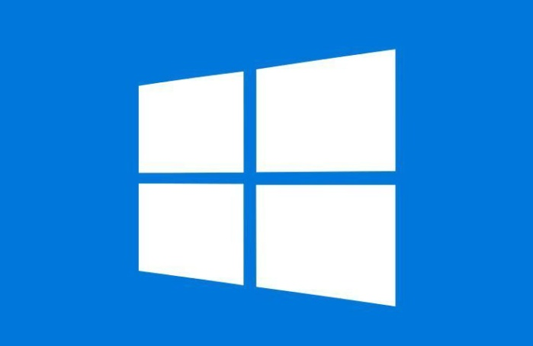


Targeting audience
Applications
Operating
Systems
Notes:
Where should we be looking for opportunities?
As long as these customers uses these business critical applications
This applies to all industries
Manufacturing:
-MES (Manufacturing Execution System),
-Manufacturing Resource Planning (MRP)
Healthcare
-Hospital Information System
Financial services
-order processing
-online banking
All industries Office
-ERP
-CRM

Slide 10
Customer Benefits with Sangfor CDP
Minimized RPO : Near 0 Data Lost
Support vary hardware & guest OS: Windows, red hat, Ubuntu
Built-in CDP within HCI. Only need license. Easy to set up
Unified Management : Lower operational cost

Slide 11
Qualification Questions for CDP
Sales
  What are your critical data that need protection? What’s the business impact if they are not backed up in time?
  What is the data backup regulation in your organization?
  What is the current backup solution? How do you protect critical application data today (Application, RPO/RTO, vendors)
  What are your challenges for data backup?
Sales engineer
  What is the environment of your applications? ( Virtual? Guest OS? Database? )
  Which applications need high backup priority and what is the RTO/RPO requirement?
  What is the detail networking and how you manage the solution?

Slide 12






Built-In VMware Management & Backup
Production
Backup Site
VMware Cluster
Sangfor HCI Cluster
Data Flow
Built-in VMware lifecycle management
Bi-directional migration
Build-in backup from VMware to Sangfor & instant recovery
Notes:
While HCI’s CDP is designed to protect data for applications on our own HCI systems, we are also introducing another back-up for customers who are running their applications on VMware
Pain point:
1, Lots of customers are using VMware, but they are lacking multi hypervisor management & backup solution,
2，Few enterprises adopt VMware native backup, (WHY?) they buy 3rd party software. But not easy to use, and hard for migration back after DC failed.
Additional highlight:
1, Instant recovery: can boot VM on Sangfor Cluster with only 3 minutes, and reach peak performance in 15 minutes. This will help enterprise to quickly recover there applications.
2, Migration is totally done by API, without V2V tools. (What’s the significance?) So migration back can be done automatically after failure.
Reference:

Slide 13
Opportunities at existing VMware customers
VMware replacement
VMware backup
Data Center expansion
Unified management for transition period
Start with less priority applications to build up customer’s confidence
Easy to migrate workloads with almost live migration
Agentless backup eliminating 3rd party backup software
Fine-grained backup frequency
Scheduled backup policy
Instant recovery
Effortless management
Shared storage to improve reliability
Linear expansion of performance and capacity
Future-proof evolution
Notes:
What are the business reasons behind these replacement and expansion?
VMware replacement
-in the past, customers don’t have confidence with Sangfor, and had to use V2V tools to convert. Many VMs have to be shut down. The POC process could take hours or days depending on number of VMs and size. Lost many opportunities.
-we can now directly connect VCenter to our Sangfor’s management console, we can now see all VMs, and start migrate.
If VMware’s capacity is running out, Sangfor’s HCI can be expanded.
Another scenario is that customer could be running just ESX, not external storage. After connecting to our HCI, they have access to our aSAN for full-featured storage system

Slide 14
Qualification Questions for VMware install-base
Sales
  What are your major hypervisors in data center? (Potential answer: VMware)
  What applications require back up? And what is the business impact during crisis if there is no backup?
  What is your solution for VMware backup (if there is VMware)
  Do you have plans to implement Hyper-Converged?
  What is the current storage solution?
Sales Engineer
  How do you manage multiple hypervisors? And what are the issue when you manage multi hypervisors?
  How you use 3rd party software to manage VMware backup?
  What is the challenge for your existing storage system? (Potential answer: performance issue, expansion issue)

Slide 15
Licensing
3 new licenses
aHM (VMware backup license): per VMware VM, the aSV equivalent number of VMs are licensed for free, say customer purchased 4 aSV licenses, then they can get 4 aHM licenses for free
CDP (base software license): one per cluster (one license is enough for multiple clusters after aCMP is released), mandatory for CDP function, it includes a quota of 5 VMs to be protected by CDP
CDP VM License: per VM to be protected by CDP, CDP base software is a prerequisite for this license
Example
Say Customer A has existing VMware environment with 8 VMs that need to be backed up to Sangfor HCI, customer has already bought 6 CPU licenses for aSV and aSAN, and they’d also like to enable CDP for 6 VMs running on the HCI platform, how many more licenses should they buy?
Answer
2*aHM license, 1*CDP base software license and 1*CDP VM license
Notes:
How does this licensing compare to competition?

Slide 16









References
Online Retailers
Enterprise
Gov & Edu

Slide 17
Marketing Launch Activities at a Glance
Pre-launch
Launch Date
Post Launch
  New Presentation (available now)
  New brochure (available now)
  Updated pricelist
  Updated competitive guide
  Whitepapers
  Online Community
  Updated Website (going live March 28)
  General Availability
  Download and demo (going live March 28)
  Sales training (today)
  Press Release (selective regions – contact us if you need it in your region)
  Updated videos
  Media Coverage or Interviews (Contact Sangfor Marketing)
  Roadshows (April-May)
  eDMs (Contact Sangfor Marketing)

Slide 18
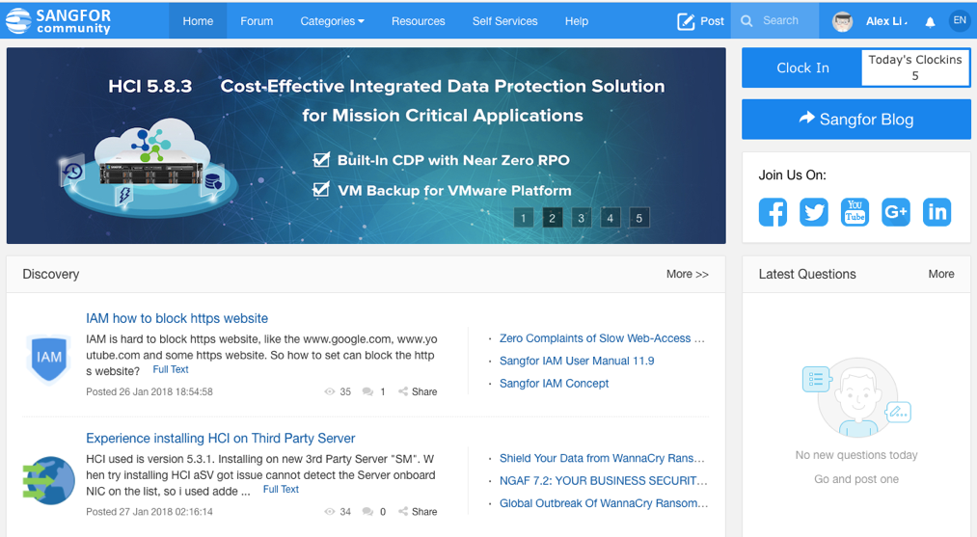
Sangfor Online Community
http://community.sangfor.com/
Key Features
  Knowledge center
  Online quick interaction
  Self-service

Slide 19
Next Steps
Questions and Answers
Upsell to existing HCI Customers
Explore new opportunities
Notes:
What Opportunities Do You See
What HCI Opportunity Do You See? (Select all that applies)
Data Center Consolidation
Enterprise Applications
Cloud Transformation
CDP Opportunity for Sangfor HCI
VMware Replacement
VMware Backup

Slide 20
Agenda
New sales scenarios enabled
  Near 0 RPO: Build-in CDP
  VMware Backup
  Licensing
  Online community
Technical theory and configuration guide

Slide 21

Speaker introduction
Cheney Hu
Sangfor Senior Product Manager

Slide 22
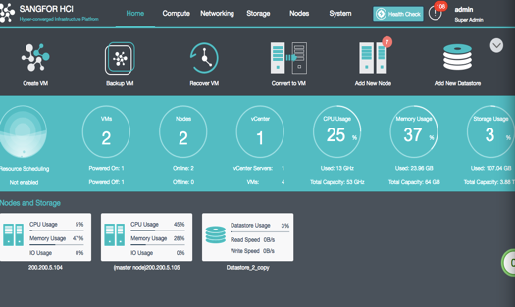
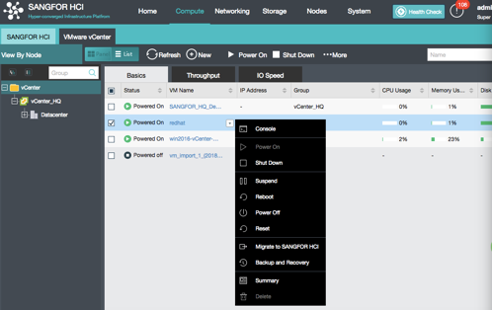
VMware Management
Unified management
  vCenter can be added to Sangfor management platform to achieve unified management
  Basic VM administrations can be operated on Sangfor management platform directly like open console, power on/off, deploy template VMs, view summary, etc.

Slide 23
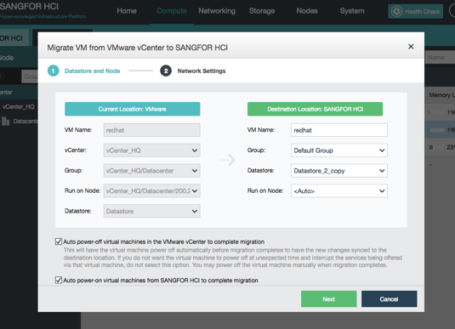
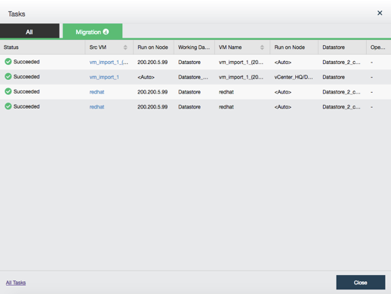
VMware Management
Bi-directional migration
  VMs can be migrated between Sangfor and VMware in a near-live fashion
  VMs need to be rebooted to complete migration, this reboot process can be set automatically

Slide 24
Bi-directional Migration
VMware to HCI
VMware
Sangfor HCI
1. Link to vCenter
3. Continuously backup from
VMDK to QCOW2, first time full copy, then incrementally
2. A target VM is created on HCI
VMDK
QCOW2
4. Shut down the source VM when incremental data is small enough (256MB), finish the final incremental backup
5. Start target VM
The same process in reverse applies to HCI to VMware migration

Slide 25
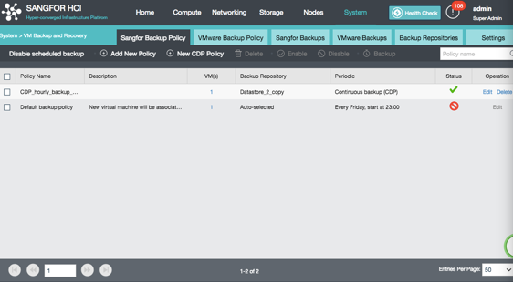
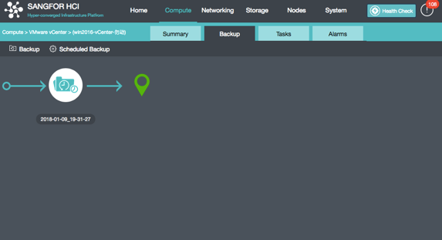
VMware Backup and Restore
Built-in backup and restore
  VMs in VMware environment can be backed up to Sangfor HCI with no requirement for 3rd party backup software
  Manual backup and scheduled backup policy are both supported, minimum interval for scheduled backup is 10 mins

Slide 26
VMware Backup and Restore
Backup
VMware
Sangfor HCI
1. Link to vCenter
Get the source VM information by vm_moid through vSphere web API
Enable CBT for the VM, take a snapshot, ensure consistency among all disks
Copy the snapshot data to HCI through VDDK API, save as QCOW2 file format on HCI.
Snapshots will be merged and deleted on the source VM to avoid any performance impact
2. Take a snapshot of the source VM
3. Backup changed blocks to HCI through VDDK API
VMDK
QCOW2
4. Delete the source VM snapshot
First time full copy, subsequent copies are incremental. Minimum backup interval is 10 mins, however due to mergence and deletion of snapshot data on source VM, pragmatic RPO is around 15 mins.

Slide 27
VMware Backup and Restore
Restore to VMware
VMware
Sangfor HCI
1. Link to vCenter
2. Create a new VM
3. Copy data from HCI to VMware through VDDK API
VMDK
QCOW2
No instant recovery for restoration on VMware

Slide 28
VMware Backup and Restore
Restore to HCI
Sangfor HCI
(restore target)
Sangfor HCI
(backup repository)
RTO is about 15 mins with instant recovery
To avoid IP collision with production VM, restored VM will not connect to virtual network automatically. Network can be connected after restored data is confirmed valid.
1. Create a new VM with the backup config file
2. Restore from backup file
QCOW2
QCOW2
3. Start VM
Note: Backup VMs can only be restored to VMware if NFS or Windows shared folder is used as backup repository.

Slide 29
VMware-related FAQ
Supported versions: vSphere 5.0 and later
Is remote backup and restore supported? Same building and same floor are definitely supported, off-site backup and restore has certain requirement on the link bandwidth, technically, it’s supported. More information (such as business data capacity, incremental size, bandwidth, etc.) is required to determine the feasibility.
How’s the license work? The license is called aHM, and it’s based on how many VMware VMs are to be backed up to HCI, the vCenter heterogeneous management feature (including bi-directional migration, etc.) comes at no cost.

Slide 30
CDP
Overview
Just another feature on HCI, no need for any plugin or 3rd party software, all-in-one VM-level CDP solution
Every IO is recorded, VM can be recovered at any IO record points, RPO= 5 seconds
Instant file browsing and download
Values
Near-zero RPO, CDP is only a license away, easy to use
Target Customer
Customers with business-critical applications such as database, ERP, etc.

Slide 31
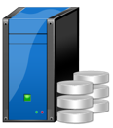

CDP: How it works
IO record
aSV
VM
VM
I/O
I/O
CDP IO log, every log recorded
aSAN
SAN/aSAN
After CDP is enabled, IO logs will be written into dedicated memory and then written to backup storage asynchronously. No impact on VM performance.
CDP will consume very little CPU resource and 2GB dedicated memory. After CDP is enabled for a VM, HCI platform will add extra 2GB to this VM from available host memory resource.

Slide 32
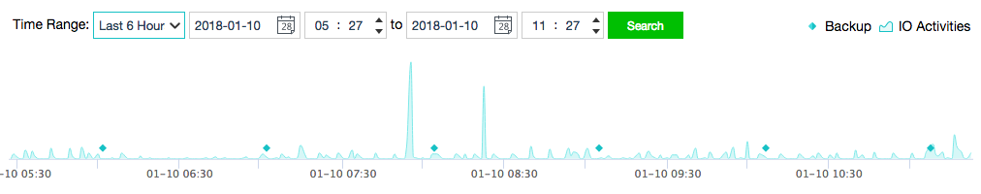
CDP: How it works
Recovery point
A full backup will be executed when CDP is enabled for the first time, all the recovery points will be based on this full backup
A recovery point will be created every 5 seconds
An incremental backup will be implemented every 1 hour or so (backup interval can be adjusted)
When recovering based on a certain recovery point, all the IO records between this recovery point and the latest backup point as well as all the prior backup versions will be merged.
RP

Slide 33
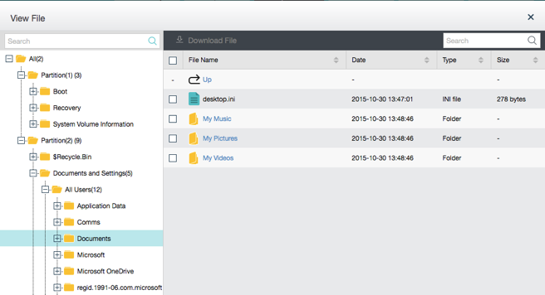
CDP: How it works
Instant file recovery
BPs (backup point) and RPs (recovery point) are merged and packaged as a file, the file is displayed by being mounted to HCI’s catalog
Choose the file that needs to be recovered and you can download it right away.
Note: this feature is only supported by NTFS and FAT32 on Windows

Slide 34
CDP: How to calculate capacity
The average number of VMs protected by CDP should not exceed 3 on each server node, and each server should have more than 128GB memory
CDP target storage can be set on iSCSI/FC SAN or aSAN
How to calculate CDP storage capacity
  Business data capacity + average hourly data increments * 96 (latest 3 months, hourly ) + IO log maximum capacity
How to calculate IO log maximum capacity
  Average data increment per second (MB/s) * 3600 (1 hour) * retention period (hours) (if this data can’t be acquired, take 800GB as the default IO log capacity )
Backup storage approach
  It’s recommended to store CDP IO Log and backup data separately, put backup data on external storage and IO Log on aSAN or external storage

Slide 35
CDP: Some Cautions
VMs with raw device mapping (RDM) cannot be protected by CDP. For example, CDP cannot be enabled for Oracle RAC using RDM as shared disk.
VMware VMs cannot be protected by CDP.
After enabling CDP, a full backup will be executed, it might take several hours or even dozens of hours depending on VM size. During this period, IO logs cannot be viewed on the interface, after the full backup is completed, IO logs will be displayed on the timeline.
If CDP is interrupted due to storage issues or VM/host reboot, a backup (incremental or full) will be executed after restarting CDP.
Be cautious of changing backup repository since change of backup storage will cause a full backup next time,.

Slide 36
Instant Recovery
Applies to all backups on HCI, be it VMware backup, HCI backup or CDP
When recovering, VMs can be booted up within 3 minutes and climb to normal performance within 15 minutes.
Significant RTO reduction compared to previous backup recovery
VM QEMU
Host H
Read only
Read/Write
Copy
Vacant VM QCOW2 Image
Incremental backup
…
Incremental backup
Full backup
Storage A
Storage B

Slide 37
iSCSI Server Enhancements
aSAN iSCSI virtual disks can be mounted to VMware hosts, faster and more reliably
Support high availability and load balancing for VMware host iSCSI connection, no more SPOF and performance bottleneck
iSCSI Server now can be presented through storage network instead of management network for higher bandwidth
VMware host
iSCSI Virtual Disk
HCI cluster

Slide 38
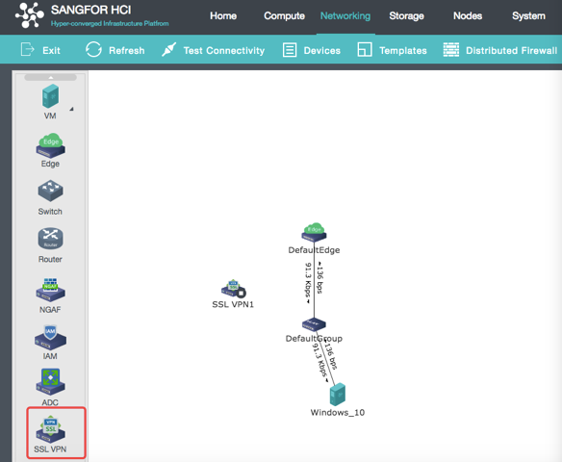
vSSL VPN Integration
vSSL VPN now is fully optimized on HCI, it can be configured on “what you draw is what you get” page. With this update, NFV on HCI now expands to vAF, vIAM, vAD and vSSL VPN.

Slide 39
Creating Virtual Storage Volumes on aSAN
Virtual storage volumes can be created based on hosts with different disk performance and capacity.
  Each volume is a physically isolated storage pool
  Users can choose which volume to run VMs on according to performance and capacity requirements
  At least 3 physical nodes are needed to support a virtual volume, that said, cluster under 6 nodes can only create one single volume which is the same as before
VM running priority: host with the data copy -> host within the volume -> cross-volume host
VM
VM
VM
Volume 1 _ high performance
Volume 2 _ large capacity
SSD
SSD
…
SSD
SSD
SSD
…
SSD
SSD
SSD
…
SSD
HDD
HDD
…
HDD
HDD
HDD
…
HDD
HDD
HDD
…
HDD
HCI cluster（compute resource）
Virtual storage volume
A
Virtual storage volume B

Slide 40
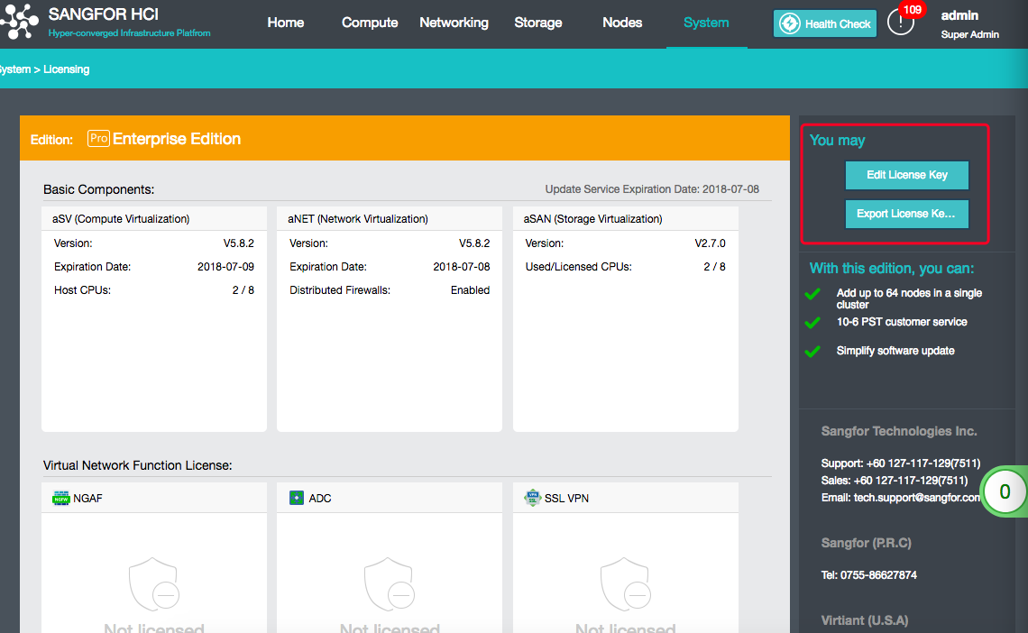
Licensing UI Change

Slide 41
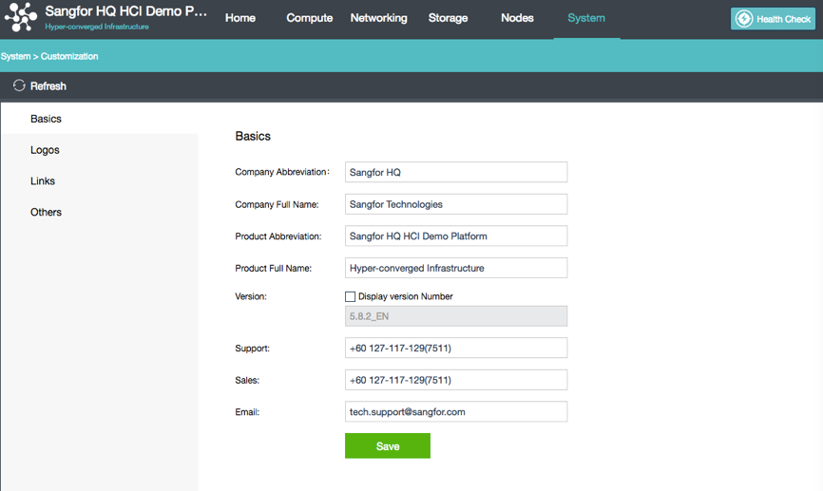
One more thing…
Customization

Slide 42

One Last Thing…
Intel Xeon Scalable Processors will be supported on HCI 5.8.3, and our HCI appliance hardware platform will also shift to SP CPU platform starting in the middle of 2018.

Slide 43
QA & Survey Form
http://cn.mikecrm.com/o1BGc84

Slide 44
Thank You !
SANGFOR TECHNOLOGIES

