Slide 1

aCloud Disaster Recovery Solution for Technical Discussion

Slide 2
DR overview: Business prioritization
Business systems in data center are varying, so are the priorities. Considering O&M complexity, investment and system architecture, DR solutions for different business systems can differ. A good DR solution must be designed based on business architecture and priority.
Business types and corresponding DR solutions are divided as below:
Business type | Description | Requirement | DR solution
Core business | Type A business, most business-critical applications such as ERP, finance, order system, etc. | RPO= seconds or 0, RTO= seconds or 0 | Provide local backup + off-site DR solution with minutes RTO and seconds RPO, or active active solution with RPO=0 and RTO=0
Major business | Type B business, improve employees’ efficiency and support internal process, such as email, BI, OA, etc. | RPO= minutes, RTO= minutes | Provide local backup + off-site DR solution with minutes RTO and minutes RPO
Common business | Type C business, no big impact on production when failure occurs, examples are knowledge base, online learning system, testing business and such | RPO= hours RTO= hours | Provide local backup + off-site DR solution with hours RTO and hours RPO

Slide 3
DR overview: Solution sizing
Minimum RPO and RTO that a DR solution is able to achieve can be known based on the resource types and technology characteristics on production and DR sites. However best outcome is not guaranteed under all circumstances. Generally speaking, RPO can be configured on DR management software, the factors that are actually influence RPO are always network bandwidth and data change rate within a RPO period
The table below shows some major DR types, users can choose the right DR solution considering RPO, RTO, manageability, bandwidth requirement and cost
DR type | Target | Technology characteristics | Min. RPO | Min. RTO | Manageability | Bandwidth requirement | Cost
aCloud to aCloud | Application and middleware VM, and database VM | Local backup – offsite DR based on VM-level insant backup and CDP | 1 second | 5 mins | Easy to use, unified management | Low | Low, based on VM quantity
 | Oracle、Oracle RAC10g and above | Oracle DataGuard | 0 | 2 mins | Difficult to use, complex configuration with CLI | Low | Low, built in database
VMware to aCloud | Application and middleware VM, and standalone database VM | CBT based on VMware API | 10 mins | 5 mins | Easy to use, unified management | Medium high | Low, based on VM quantity
Active-active | Application, middleware and database all support clustering | Data sync technology based on traditional storage | 0 | 0 | Many middlewares with management silos, automatic failover | Very high | High cost, storage gateway needs ate least 2 high bandwidth links
 | Application, middleware and database all support clustering | Data sync technology based on aCloud virtual storage | 0 | 0 | Unified management with automatic failover | Very high | High cost from virtual storage license and high bandwidth links
Physical to aCloud | Windows and Linux systems, depending on compatibility list of DR software | DR technology based on 3rd party DR software | Seconds-level |  | Relatively easy, separate DR management platform | Low | High cost from DR software licenses

Slide 4



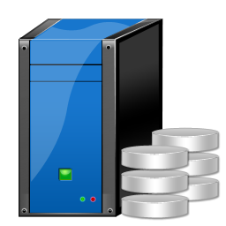
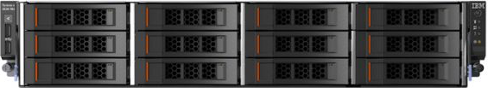

aCloud to aCloud DR: Network architecture
Link
Core switch
DC A
DC B
Core switch
Local backup
aCloud
aCloud
10Gbps switch
10Gbps switch
10Gbps switch
10Gbps switch

Slide 5


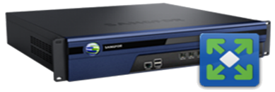
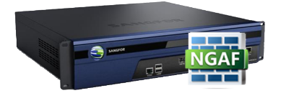
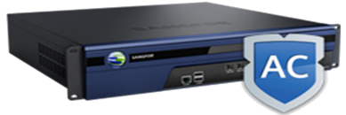
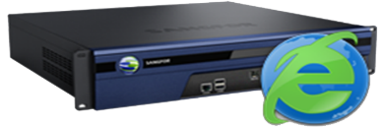

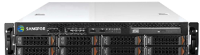
OA
VPN
Finance system
VPN
Order system
VPN
... ...
Email system
VPN
aCloud to aCloud DR: Network architecture
aCloud DR network architecture
DC A
DC B
DC gateway
DC gateway
AD
AD
NGAF
NGAF
IAM
IAM
Core switch zone
Core switch zone
SSL VPN
SSL VPN
SSL VPN
SSL VPN
AD
Core switch
Core switch
AD
AD
Core switch
Core switch
AD
External storage zone
Business zone
Management switch
Business zone
Management switch
Business switch
Business switch
VM
VM
VM
VM
VM
VM
VM
VM
VM
VM
VM
VM
VM
VM
VM
VM
VM
VM
VM
VM
VM
VM
VM
VM
VM
VM
VM
VM
Storage
Storage
VXLAN switch
Storage switch
VXLAN switch
Storage switch

Slide 6

aCloud to aCloud DR: Solution introduction
3. DR monitoring center
Provide DR monitoring, displaying DR status of all sites and protected VM groups with detailed alarms for fast troubleshooting
1. Local backup/CDP
Support scheduled backup for VMs, backup interval can be set on hourly, daily and weekly basis
Support CDP for VMs to record every IO and roll back to any point of time in seconds granularity
Solution highlights:
Integrated in the platform, no need for additional software, 1 click to enable VM-level DR solution
Adopted “local backup – offsite DR”DR solution, instant recovery from local CDP with seconds-level continuous protection. A variety of RPOs (1s, 10s, 10mins, 30mins, 1h, 2h, 4h, 8h, 12h, 1d, 2d, weekly) for offsite DR based on aCloud
Save bandwidth consumption by features like continuous backup from breakpoint and compressed replication
Provide 1-click failover to DR site, network can be preconfigured to minimize RTO to 10 mins
Provide 1-click failback to production site from DR site
Provide main aCMP and standby aCMP for eliminate single point failure of aCMP
Provide visualized DR monitoring with detailed running status and alarms
Easy to use, no learning curve
Main aCMP
Standby aCMP
4. Retrieve files
Able to directly retrieve files from local backup data (Windows) without recovering a whole VM
VM
VM
VM
VM
VM
VM
VM
VM
standby
VM
standby
VM
standby
6. Failover to DR site
Failover VMs to DR site for fast business recovery in the event of disaster or planned maintenance
Virtual network
Virtual network
5. VM recovery
Able to recover a whole VM directly from local backup data
Production storage pool
Backup storage pool
Production storage pool
Backup storage pool
BackupCDP
Instant recovery
aCloud
aCloud
Data syncs to DR site
2. Data replication
Sync the VM data to target aCloud cluster according to configured RPO
Failback to main site
7. Failback to production site
Failback VMs back to production site with only differential data transmitted
DC A
DC B

Slide 7
aCloud to aCloud DR: Solution introduction
Main aCMP
Standby aCMP
Restrictions
DR is not supported for peripherals such as GPU and USB devices
Only support DR for QCOW2 files, physical disks for VMs (disks directly mapped to VMs or shared disk) are not supported by DR
When failover, the configuration of CPU, RAM, network and peripherals is based on specs of standby VMs on DR site
aCloud DR will sync data inside QCOW2 virtual disk, data in RAM or cache inside VM may not have been flushed to QCOW2 which will not be synced to DR site, this data cannot be recovered in failover.
The VMs recovered in DR site are exactly the same as those in production site, including hardware info, MAC and IP, please ensure these VMs do not run in the same network to avoid IP collision
VM
VM
VM
VM
VM
VM
VM
VM
VM
VM
Virtual network
Virtual network
Production storage pool
Backup storage pool
Production storage pool
Backup storage pool
BackupCDP
Instant recovery
aCloud
aCloud
Sync data to DR site
Failback to production site
DC A
DC B

Slide 8





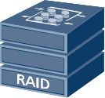
aCloud to aCloud DR: Solution introduction (with clustered DB)
Internet
DC A
DC B
SANGFOR VPN
（IPSEC VPN）
DB Sync
Business
DB Cluster
DB Cluster
Business
DR Mgmt
Configuration sync
DR Mgmt
aCloud cluster
Local backup
VM data sync
aCloud cluster
For DB VMs running on aCloud with mapped raw disk (such as Oracle RAC shared disk), Data Guard is recommended for DR

Slide 9
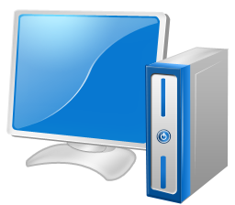
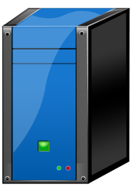
aCloud to aCloud DR: Solution introduction (with clustered DB)
DC A
DC B
Oracle Data Guard ensures high availability, data protection, and disaster recovery for enterprise data. Data Guard provides a comprehensive set of services that create, maintain, manage, and monitor one or more standby databases to enable production Oracle databases to survive disasters and data corruptions. Data Guard maintains these standby databases as transactionally consistent copies of the production database. Then, if the production database becomes unavailable because of a planned or an unplanned outage, Data Guard can switch any standby database to the production role, minimizing the downtime associated with the outage. Data Guard can be used with traditional backup, restoration, and cluster techniques to provide a high level of data protection and data availability.
In some cases, business can’t tolerate any data loss. However in other cases, some applications need optimal DB performance while some data loss can be tolerated. Oracle Data Guard offers 3 types of data protection modes to meet different requirements
Client
Client
Client
Client
Mode | Characteristics | Sync type | Scenarios
Maximum protection | Zero data loss, might affect DB performance | Sync | Transactional business, sensitive to data security
Maximum performance | Offering maximum protection without affecting DB availability | Sync | Business continuity in priority
Maximum availability | No impact on DB performance, might have some data loss | Async | Business with high concurrency but can tolerate small data loss
RAC node 1
RAC node 2
RAC node 1
RAC node 1
Data Guard
Primary Database
Standby Database

Slide 10
VMware to aCloud DR: Network architecture
Link
Core switch
DC A
DC B
Core switch
VMware platform
aCloud platform
FC switch
FC switch
10G switch
10G switch
External storage
External storage

Slide 11
VMware to aCloud DR: Solution introduction
Solution highlights
Integrated in the platform, no need for additional software, 1 click to enable VMware VM-level DR
Integrated with standard API provided by VMware, keep track of CBT data by snapshot and offer various DR intervals (10mins, 20mins, 30mins, hours and days). Only incremental data is copied.
Provide 1-click failover, network can be preconfigured, RTO can be as minimum as 10mins
Provide 1-click failback to main site, only differential data is transmitted
Provide aCMP to not only configure VMware DR, but also do lifecycle management for VMware VMs
Provide visualized DR monitoring with detailed running status and alarms
Easy to use, no learning curve
vCenter
aCMP
VM
VM
VM
VM
VM
VM
VM
VM standby
VM standby
VM standby
2. Failover to DR site
VMware VMs can be fast pulled up on aCloud to resume business in the event of disaster or planned maintenance
Bridge to network gateway
1. Data DR
Sync data from VMware to aCloud according to DR plan
Virtual network
Storage pool
Production storage
Backup storage
Instant recovery
VMware
aCloud
Sync data to DR site
Failback to main site
3. Failback to main site
VMs can be migrated back to main site with only differential data transmitted
Restrictions
If NFS and Windows shared folder are used as backup repository, VMware VMs can only be recovered to VMware because aCloud doesn’t support to run VMs on NFS or Windows shared folder.
DC A
DC B

Slide 12

A-A stretched cluster based on aCloud: Network architecture
Exit
DC A
DC B
Exit
Core switch
Core switch
Responsible for data sync of management and VxLAN traffic between 2 sites
aCloud
aCloud
The virtual storage is stretched across sites to provide unified storage pool
DC interconnect
IP switch
IP switch
Virtual storage interconnect
Storage switch
Storage switch
Storage switch
Storage switch

Slide 13
A-A stretched cluster based on traditional storage: Network architecture
Exit
DC A
DC B
Exit
Core switch
Core switch
Responsible for data sync of management and VxLAN traffic between 2 sites
aCloud
aCloud
Virtual storage gateway controls IO for the 2 external storage devices to achieve local read and write sync. For applications above, it’s a single storage volume
DC interconnect
IP switch
IP switch
Storage gateway interconnect
Virtual storage gateway
FC switch
3rd party DC
External storage
External storage
Storage for arbitration

Slide 14
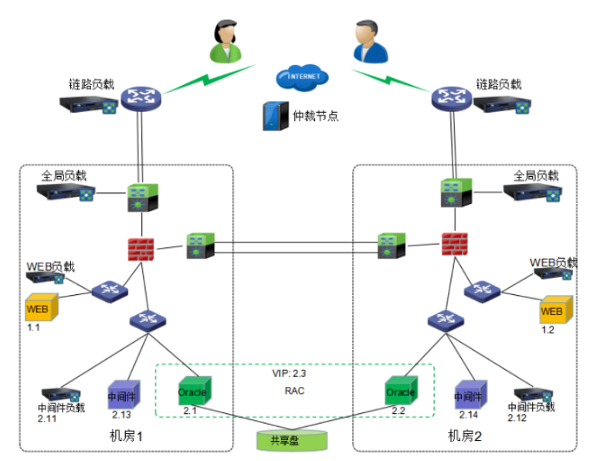
A-A stretched cluster based on aCloud: Solution introduction
7. Active-active
VMs for active-active applications are distributed across 2 fault domains, when either fault domain fails, VMs on the other fault domain will take over the business and ensure continuity
6. DRS
When a host in one fault domain is overloaded, VMs on this host will be live migrated to another host in the other fault domain to make sure host resources utilisation across fault domains are load balanced
5. HA
When a host in one fault domain fails, the VMs on that host will be rebooted on another host in the other fault domain to restore compute. The access traffic will be redirected to other active VMs to ensure business continuity
aCMP
HA/live migration
VM
VM
VM
VM
VM
VM
VM
VM
VM
VM
Virtual network
4. Stretched network
Network orchestration can be done on the unified WYDIWYG page
Storage pool
2. Fault domain
A aCloud cluster in each site is considered as a fault domain, VMs are running in a active-active manner on 2 fault domains, obeying mutex rule, there’s no single point of failure
3. Stretched storage
Provide unified storage access route for upper applications based on stretched storage, one data has 2 copies at 2 sites. When application writes IO, it will be copied into 2 replicas and writes to both sites, only acknowledgements are received from both sites will be counted as write succeeds to ensure data consistency
aCloud
1. Stretched aCloud
A logical aCloud cluster across 2 sites for unified compute, storage and network resources
DC A
DC B

Slide 15
Thank YOU

