Slide 1


Secure Users And
Productivity with Sangfor IAG
April 2023
Eugene Yew | Product Marketing Manager
eugene.yew@sangfor.com
Sangfor Technologies
www.sangfor.com
Sangfor Technologies Inc.

Slide 2
Version
Date | Remarks | Author
12-Apr-2023 | Revamp whole IAG main slides with focus only on use case | Eugene Yew
Notes:
You may remove and replace any slide that you deem appropriate for your presentation style.

Slide 3
Agenda
PART
1
Security Challenges and Current SIA Solutions
PART
2
Technical Working Principles
PART
3
Use Cases and Marketplace
PART
4
Competitiveness Motions
PART
5
Takeaways

Slide 4
User and Network Management Challenges
Risk of unauthorized internet access
Poor endpoint visibility and control
Performance problems with network and key applications
Asset breaches landscape
Productivity loss
Corporate Internet compliance
Exposure to viruses
59% cannot see attempted connections from other devices
Highly elusive recreation traffic
Unable to determine the root cause
18% and 39% of breaches originate from insider and partner threats respectively
Lower barrier to entry
Source: Illumio
Source: TechRepublic

Slide 5

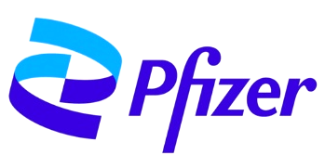


User and Network Management Challenges
The entry points of most breaches are on endpoints.
The size of the company does not matter.
Security risks come from human factors.
Source: Cybersecurity Insiders – 2021 and Insider Threat Report 2021

Slide 6




The Right Approach
What can you do?
Manage user internet access across the network
What are the risks?
Control and manage high risk behavior
01
03
Who are you?
Identify users and endpoints
What have you done?
Monitor user access on the whole network
02
04

Slide 7







Current SIA Offering
Branch Office
Secure Internet
Access
Web and SaaS Applications
Headquarters

Slide 8

















Current SIA Offering
Compliance
SSL Decryption
Audit
Reporting
Visibility
Users
Branch Office
Data
Analytics
Endpoints
SANGFOR IAG
ldentity
Analytics
Integration
loT
Web and SaaS Applications
Control
Headquarters
Applications
Bandwidth
Management
SaaS

Slide 9
Current SIA Offering
Compliance
SSL Decryption
Audit
SWG Replacement
User and Application Bandwidth Management
Centralized Authentication
ICAP Integration
Proxy Avoidance Protection
Endpoint Risk and Asset Management
Reporting
Visibility
Users
Data
Analytics
Endpoints
SANGFOR IAG
ldentity
Analytics
Integration
loT
Control
Applications
Bandwidth
Management
SaaS

Slide 10
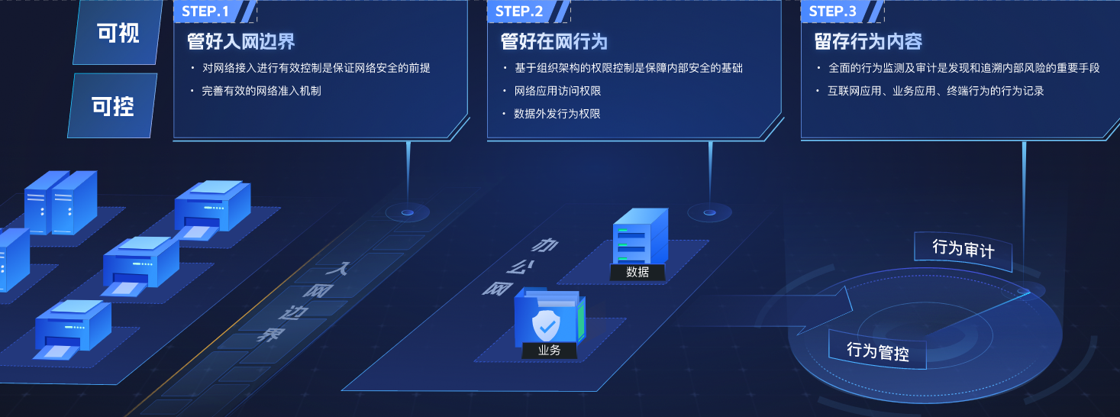
IAG Positioning Statement
Sangfor IAG is the ultimate solution for businesses seeking to secure both internal and internet access. With a focus on large organizations that pursue high productivity and compliance requirements, Sangfor IAG offers unmatched insights across visibility, identity, control and analytics to offer more secure and efficient workforce environments. With Sangfor IAG, organizations can not only significantly improve their productivity but also safeguard confidential data and business operations against cyber threats and compliance risks.
Visibility
Manage the network perimeter
Manage the network behavior
Keep track of your behavior and data
Network security is improved via efficient network control.
Reliable network access mechanism.
Network behavior security is supported by access control based on organizational structure.
Monitor application access and outbound confidential data.
Discover, audit and trace internal network risks
Behavior records of Internet applications, endpoint and internal applications.
Control
Audit Management
Network Behavior
Data
Network Perimeter
Data
Behavior
Behavior Management
Business
Business
Behavior
Traffic

Slide 11



Does your current SWG fulfil your purpose?
Optimize Internet access for web applications
Improve employee productivity and reduce maintenance costs
Secure users and endpoints
Safeguard users and endpoints by preventing security risks from entering your network
Wide range of network management and control
Onboard users with various authentication mechanisms, content inspection, granular policy enforcement, etc.
Leverage comprehensive application identification
Keep pace with top used web applications and control unproductive recreation traffic
Reduce up to 30% acquisition and maintenance cost
Take advantage of latest technologies with constant optimization

Slide 12
Technical Working Principle
Endpoint
Internet Access
Data
Authentication
Application Identification
Audit
Baseline Check
SSL Decryption
Control
Traffic Control

Slide 13
Technical Working Principle
Authentication
Various authentication methods, including SSO, social media, captive portal, wireless authentication, self-service, dumb endpoint, two-factor authentication
Endpoint
Baseline check
Agent-based and agentless for endpoint security posture
Control
Prevent bypassing of security controls and unauthorized device control
Application Identification
Identify and control applications. 6000+ applications with weekly update .
Internet Access
SSL Decryption
Uncover and inspect content hiding in your internet traffic via Man-In-The-Middle and ingress client decryption
Traffic Control
Intelligent P2P Traffic Control, Dynamic Traffic Control and user quota for bandwidth management
Data
Audit
Protect your business from financial loses and legal issues via outgoing channel audit and control

Slide 14

Endpoint - Authentication
MAB (MAC Authentication Bypass)
Method
Captive Portal
Employee, guest, contractor, dumb endpoints (bind IP-MAC), computers, smartphones, laptops
Scenario
IoT, dumb endpoints
Without credentials and verify system present to allow/block access
Landing page for user verification
Credentials, SMS, QR code
Mechanism

Slide 15


Endpoint – Baseline Check
Method
Ingress Client (Agent-based)
Network Traffic (Agentless)
Employee with windows 7 and above
Small footprint – 10Mb size, 8Mb memory, 2% CPU
IAG captive portal, patch management, windows update
Guest, contractor and dumb endpoints do not require agent installation
Scenario
Utilize Windows system interface:
Process, registry, files, antivirus software, operating system patch, etc
Utilize passive identification and active discovery - detect heartbeat rate of antivirus
Mechanism

Slide 16


Endpoint – Control
Method
Prevent bypass of security controls
Device control
Using unauthorized system to disable and enable functionality
Using unauthorized devices to disable and enable functionality
Scenario
Strictly enforce and prohibit endpoint from accessing unauthorized resources
Mechanism
Granular control over external and storage devices

Slide 17
Internet Access – Application Identification
Application And Data Characteristics
Intelligence Recognition
Applied Rule Recognition
Associated Link Identification
1
2
3
4
10 packets of TCP/UDP i.e. port, IP, URL, etc.
Monitor interaction behavior of network traffic i.e. application type, non-standard port applications
Track users’ previous application history across network traffic
Identify applications by modeling analysis statistics

Slide 18
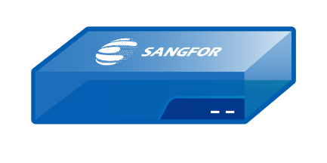



Internet Access – SSL Decryption
IAG Decryption
Ingress Client Decryption
1
2
1
2
Internet
Internet
Client
Man-in-the-middle
Server
Client
Sangfor
Ingress Client
Server
Solution benefits:
No need to install ingress client
Solution benefits:
Performance gain on IAG
Content audit capabilities
Ingress client comes with certificate distribution
*Comes with Essential bundle license

Slide 19
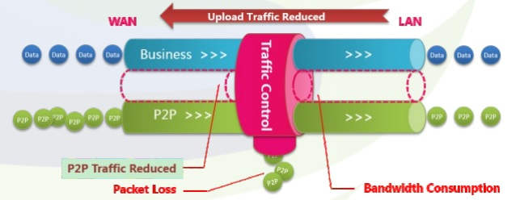
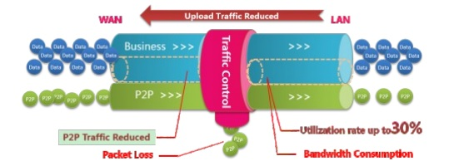
Internet Access – Traffic Control
Method
Intelligent P2P Traffic Control
Dynamic Traffic Control
Scenario
Free up resources for critical business applications
Prevent waste of bandwidth
Mechanism
Accurately control P2P traffic by restraining the upload traffic
Use idle bandwidth to improve user experience and utilization

Slide 20
Data - Audit
Full-path outgoing channel audit and control
Channel
Audit
External Device
Channel
Control
Device Control
Outgoing Control
USB drive, Printer, HDD, Bluetooth, etc.
SaaS Application
Office365, OneDrive, Lark, etc.
Security Baseline Check
Anti-virus, Patch, System, File, process, etc.
Client Server Application
WeChat, Zalo, Skype, QQ, etc.
External Device Control
Operation and Maintenance
Printer, USB, Camera, Bluetooth, etc
RDP, TeamViewer, Xshell, Pshell, etc.
Https
Outreach Control
Https upload, outsending, etc.
Dual NIC, illegal WIFI, 4G card, etc.

Slide 21
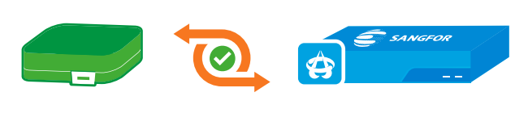
Use Case – SWG Replacement
SWG Replacement
Swap out existing SWG with Sangfor IAG for better security and control
Background
Sangfor Competitive Advantage
Key Benefits
Current vendor is weak at providing technical support resources and advisory guidance.
Support contract termination due to EOL/EOS
Superior local support and guidance
Consistent enhancement and strengthening of solution capabilities
Enhance user productivity
Simplify network management and control
Keep good traffic and remove bad traffic

Slide 22


Case Study
Challenges
Solution Value Proposition
Increase uptime by 30% and accessibility of critical applications
More efficient control with less policies
Ensure quality voice and video conferencing
Productivity loss due to delay and intermittent Internet access
Labor costs involved to maintain complex policies
Connectivity loss of voice and video conferencing

Slide 23

Use Case – User and Application Bandwidth Mgmt.
User and Application Bandwidth Management
Uncover bandwidth-hogging user behavior and apps to secure productivity
Background
Sangfor Competitive Advantage
Key Benefits
Concern about user behaviour for all critical application usage, bandwidth utilization and internet usage violation
Acquired a solution with limited development
Visibility and control over user internet access activities
Maintain performance of users and mission-critical applications
Unmatched application classification and application component breakdown
Enhance user productivity
Simplify network management and control
Keep good traffic and remove bad traffic

Slide 24


Case Study
Challenges
Computer Crime Law mandates Internet activities to be recorded
Separate user management between wired and wireless environment
Adding bandwidth does not continuously scale as usage increases
Solution Value Proposition
Protect and audit user cyber activities with data retention of 90 days
Centralized management and user control
Stop recreational traffic (approximately 40% of total) and fair allocation of bandwidth to users with protection of key campus applications

Slide 25
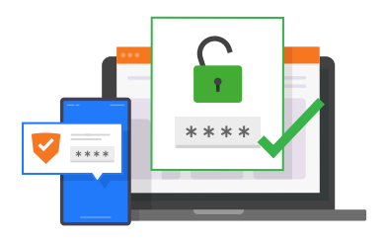
Use Case – Centralized Authentication
Centralized Authentication
Remove authentication silos and gain complete control over user access management
Background
Sangfor Competitive Advantage
Key Benefits
Lack of IT personnel and siloed user authentication in branches
High maintenance workload and concerns about cost effectiveness
User roaming and network connectivity within headquarters and branches
Fast and easy to setup
Zero dependencies on other vendors
Simplified access by eliminating the need for multiple logins
Streamlining access to resources and reducing time for authentication

Slide 26


Case Study
Challenges
Limited IT personnel at branches
Constant changes cause IT burden
3. Slow Internet access and delayed work
Solution Value Proposition
Regain control and manage from single pane of glass
Eliminate around 50% labor cost and time on branches
One policy for one identity per branch and HQ

Slide 27
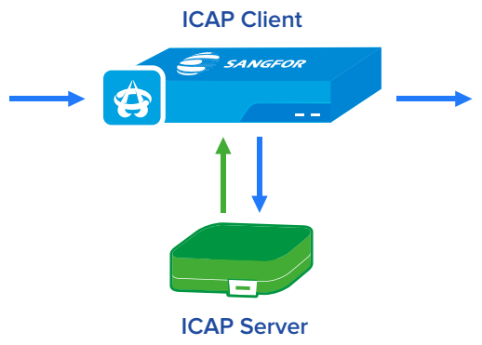
Use Case – ICAP Integration
ICAP Integration
Integrates seamlessly with existing cybersecurity solution via a standardized protocol
Background
Sangfor Competitive Advantage
Key Benefits
Invested heavily in existing cybersecurity solutions
Only integrate with ICAP server capable solutions
Lack of centralized operation and control
ICAP integration is optimized and easy to operate with strong compatibility
Performance limitation is based on ICAP server capacity
Integrates with your existing security stack
Scale and improve user online experience

Slide 28

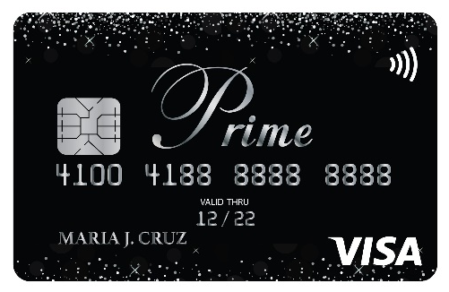
Case Study
Challenges
Solution Value Proposition
Constant disruption when files are being inspected and transferred to security systems
Constant troubleshooting causes large IT burden
Lack of support from existing vendor
Improve online user experience by automating and scaling security systems
Enhance existing security investment with minimal changes
Remove 50% of overlapping policies to reduce troubleshooting time

Slide 29

Use Case – Proxy Avoidance Protection
Proxy Avoidance Protection
Stop users from bypassing your Internet access controls
Background
Sangfor Competitive Advantage
Key Benefits
Bandwidth hogging impacts critical business applications
Possibility of malware brought in by users accessing infected websites
Continuously update VPN and proxy avoidance applications with local support
Support detection and blocking via web-based, locally installed application, and browser plug-in
Promote productivity and good online experience
Secure user traffic from viruses and malicious content

Slide 30


Case Study
Challenges
Solution Value Proposition
Bypassed company security perimeter
Bandwidth abuse
Undetectable access to malicious content e.g. virus infected and illegal website, etc.
Users are safe from malicious content
Unmask user traffic and control by eliminating tunneled proxy avoidance applications
Ensure users comply with Internet policy with a 30% productivity increase

Slide 31

Use Case – Endpoint Risk and Asset Management
Endpoint Risk and Asset Management
Ensure endpoints are safe and compliant before connecting into network
Background
Sangfor Competitive Advantage
Key Benefits
Unable to determine compliant and non-compliant endpoints
Heavy workload and complexity on the endpoint management
Gain visibility and control over onboarding endpoints
Prevent unauthorized internet access
Save time and resources with automatic updates of connected devices
Reduce attack surface and the risk of malware propagation
Detect and identify unmanaged or rogue endpoints

Slide 32


Case Study
Challenges
Unauthorized access to Internet without permission by dumb endpoint
Unable to control user access into unauthorized internal servers
Waste of labor time consumed in manual checking of endpoint compliance
Solution Value Proposition
Enforce users to have access to appropriate internal servers
Ensure only compliant endpoints with associated users can access authorized servers
Increase visibility and control of endpoints by 30% when in network
Challenges
Unauthorized access to Internet without permission by dumb endpoint
Unable to control user access into unauthorized internal servers
Waste of labor time consumed in manual checking of endpoint compliance
Solution Value Proposition
Enforce users to have access to appropriate internal servers
Ensure only compliant endpoints with associated users can access authorized servers
Increase visibility and control of endpoints by 30% when in network

Slide 33

BFSI - Marketplace
Background
Pain Points/Requirements
Concerns about network uptime and stability
Implementation and changes need to be kept to a minimum
Investigation tools for critical applications
Premises with 200 – 5000 people
Managing and engaging with different teams
Handle multiple vendors and require consistent strong support
Use Cases
Solution Benefits
SWG Replacement
ICAP Integration
Data security
Ensure application availability and uptime
Achieve audit compliance
Simple deployment with minimal changes

Slide 34















BFSI Customers

Slide 35

Government - Marketplace
Background
Pain Points/Requirements
Lack of bandwidth allocation to deal with bandwidth hogging
Low efficiency due to dealing with multiple vendors
Need to justify daily productivity and bandwidth expenses
Premises with 200 – 2000 people
Small network and security team
IT personnel hold multiple hats
Use Cases
Solution Benefits
Ensure application availability and uptime
Achieve internet and audit compliance
Simply deployment with minimal changes
SWG Replacement
User and Application Bandwidth Management

Slide 36















Government Customers

Slide 37

Education - Marketplace
Background
Pain Points
Premises with 500 – 2000 people, and campus with 2000 – 5000 people
Small network and security team
User roaming
Difficult to onboard users to internet access
Siloed user authentication
High recreation traffic
Use Cases
Solution Benefits
User and Application Bandwidth Management
Centralized Authentication
Proxy Avoidance Protection
Easy user provisioning
Resource allocation by user role
Increased internet speed without adding bandwidth

Slide 38















Education Customers

Slide 39






Competitiveness Motions
Mature
Sangfor IAG Competitiveness
Opportunities
Common Shortcomings
Unmatched application signatures and visibility
Extensive user and application bandwidth management
Dedicated reporting and HCI/hypervisor for multi-tenancy
Weak support assistance and lack of development
Decent user and application bandwidth management
Minimal use of common enterprise application classifications

Slide 40

Takeaways
01
02
Use case solutions coverage
Discover
in-depth
use cases
03
04
Sharing of case studies and others
Secure your business and customers

Slide 41
THANK YOU!
Eugene Yew | Product Marketing Manager
eugene.yew@sangfor.com
Sangfor Technologies
www.sangfor.com
Sangfor Technologies Inc.

Slide 42
Secure Users And
Productivity with Sangfor IAG
April 2023
Eugene Yew | Product Marketing Manager
eugene.yew@sangfor.com
Sangfor Technologies
www.sangfor.com
Sangfor Technologies Inc.

Slide 43
Version
Date | Remarks | Author
12-Apr-2023 | Revamp whole IAG main slides with focus only on use case | Eugene Yew
Notes:
You may remove and replace any slide that you deem appropriate for your presentation style.
Customer persona, buyer persona and competitiveness motions are recommended for partner enablement.

Slide 44
Agenda
PART
1
Security Challenges
andCurrent SIA Solutions
PART
4
Persona
PART
2
PART
5
Technical Working Principles
Competitiveness Motions
PART
3
PART
6
Use Cases and Marketplace
Takeaways

Slide 45
User and Network Management Challenges
Risk of unauthorized internet access
Poor endpoint visibility and control
Performance problems with network and key applications
Asset breaches landscape
Productivity loss
Corporate Internet compliance
Exposure to viruses
59% cannot see attempted connections from other devices
Highly elusive recreation traffic
Unable to determine the root cause
18% and 39% of breaches originate from insider and partner threats respectively
Lower barrier to entry
Source: Illumio
Source: TechRepublic

Slide 46
User and Network Management Challenges
The entry points of most breaches are on endpoints.
The size of the company does not matter.
Security risks come from human factors.
Source: Cybersecurity Insiders – 2021 and Insider Threat Report 2021

Slide 47
The Right Approach
What can you do?
Manage user internet access across the network
What are the risks?
Control and manage high risk behavior
01
03
Who are you?
Identify users and endpoints
What have you done?
Monitor user access on the whole network
02
04

Slide 48
Current SIA Offering
Branch Office
Secure Internet
Access
Web and SaaS Applications
Headquarters

Slide 49
Current SIA Offering
Compliance
SSL Decryption
Audit
Reporting
Visibility
Users
Branch Office
Data
Analytics
Endpoints
SANGFOR IAG
ldentity
Analytics
Integration
loT
Web and SaaS Applications
Control
Headquarters
Applications
Bandwidth
Management
SaaS

Slide 50
Current SIA Offering
Compliance
SSL Decryption
Audit
SWG Replacement
User and Application Bandwidth Management
Centralized Authentication
ICAP Integration
Proxy Avoidance Protection
Endpoint Risk and Asset Management
Reporting
Visibility
Users
Data
Analytics
Endpoints
SANGFOR IAG
ldentity
Analytics
Integration
loT
Control
Applications
Bandwidth
Management
SaaS

Slide 51
IAG Positioning Statement
Sangfor IAG is the ultimate solution for businesses seeking to secure both internal and internet access. With a focus on large organizations that pursue high productivity and compliance requirements, Sangfor IAG offers unmatched insights across visibility, identity, control and analytics to offer more secure and efficient workforce environments. With Sangfor IAG, organizations can not only significantly improve their productivity but also safeguard confidential data and business operations against cyber threats and compliance risks.
Visibility
Manage the network perimeter
Manage the network behavior
Keep track of your behavior and data
Network security is improved via efficient network control.
Reliable network access mechanism.
Network behavior security is supported by access control based on organizational structure.
Monitor application access and outbound confidential data.
Discover, audit and trace internal network risks
Behavior records of Internet applications, endpoint and internal applications.
Control
Audit Management
Network Behavior
Data
Network Perimeter
Data
Behavior
Behavior Management
Business
Business
Behavior
Traffic

Slide 52
Does your current SWG fulfil your purpose?
Optimize Internet access for web applications
Improve employee productivity and reduce maintenance costs
Secure users and endpoints
Safeguard users and endpoints by preventing security risks from entering your network
Wide range of network management and control
Onboard users with various authentication mechanisms, content inspection, granular policy enforcement, etc.
Leverage comprehensive application identification
Keep pace with top used web applications and control unproductive recreation traffic
Reduce up to 30% acquisition and maintenance cost
Take advantage of latest technologies with constant optimization

Slide 53
Technical Working Principle
Endpoint
Internet Access
Data
Authentication
Application Identification
Audit
Baseline Check
SSL Decryption
Control
Traffic Control

Slide 54
Technical Working Principle
Authentication
Various authentication methods, including SSO, social media, captive portal, wireless authentication, self-service, dumb endpoint, two-factor authentication
Endpoint
Baseline check
Agent-based and agentless for endpoint security posture
Control
Prevent bypassing of security controls and unauthorized device control
Application Identification
Identify and control applications. 6000+ applications with weekly update .
Internet Access
SSL Decryption
Uncover and inspect content hiding in your internet traffic via Man-In-The-Middle and ingress client decryption
Traffic Control
Intelligent P2P Traffic Control, Dynamic Traffic Control and user quota for bandwidth management
Data
Audit
Protect your business from financial loses and legal issues via outgoing channel audit and control

Slide 55
Endpoint - Authentication
MAB (MAC Authentication Bypass)
Method
Captive Portal
Employee, guest, contractor, dumb endpoints (bind IP-MAC), computers, smartphones, laptops
Scenario
IoT, dumb endpoints
Without credentials and verify system present to allow/block access
Landing page for user verification
Credentials, SMS, QR code
Mechanism

Slide 56
Endpoint – Baseline Check
Method
Ingress Client (Agent-based)
Network Traffic (Agentless)
Employee with windows 7 and above
Small footprint – 10Mb size, 8Mb memory, 2% CPU
IAG captive portal, patch management, windows update
Guest, contractor and dumb endpoints do not require agent installation
Scenario
Utilize Windows system interface:
Process, registry, files, antivirus software, operating system patch, etc
Utilize passive identification and active discovery - detect heartbeat rate of antivirus
Mechanism

Slide 57
Endpoint – Control
Method
Prevent bypass of security controls
Device control
Using unauthorized system to disable and enable functionality
Using unauthorized devices to disable and enable functionality
Scenario
Strictly enforce and prohibit endpoint from accessing unauthorized resources
Mechanism
Granular control over external and storage devices

Slide 58
Internet Access – Application Identification
Application And Data Characteristics
Intelligence Recognition
Applied Rule Recognition
Associated Link Identification
1
2
3
4
10 packets of TCP/UDP i.e. port, IP, URL, etc.
Monitor interaction behavior of network traffic i.e. application type, non-standard port applications
Track users’ previous application history across network traffic
Identify applications by modeling analysis statistics

Slide 59
Internet Access – SSL Decryption
IAG Decryption
Ingress Client Decryption
1
2
1
2
Internet
Internet
Client
Man-in-the-middle
Server
Client
Sangfor
Ingress Client
Server
Solution benefits:
No need to install ingress client
Solution benefits:
Performance gain on IAG
Content audit capabilities
Ingress client comes with certificate distribution
*Comes with Essential bundle license

Slide 60
Internet Access – Traffic Control
Method
Intelligent P2P Traffic Control
Dynamic Traffic Control
Scenario
Free up resources for critical business applications
Prevent waste of bandwidth
Mechanism
Accurately control P2P traffic by restraining the upload traffic
Use idle bandwidth to improve user experience and utilization

Slide 61
Data - Audit
Full-path outgoing channel audit and control
Channel
Audit
External Device
Channel
Control
Device Control
Outgoing Control
USB drive, Printer, HDD, Bluetooth, etc.
SaaS Application
Office365, OneDrive, Lark, etc.
Security Baseline Check
Anti-virus, Patch, System, File, process, etc.
Client Server Application
WeChat, Zalo, Skype, QQ, etc.
External Device Control
Operation and Maintenance
Printer, USB, Camera, Bluetooth, etc
RDP, TeamViewer, Xshell, Pshell, etc.
Https
Outreach Control
Https upload, outsending, etc.
Dual NIC, illegal WIFI, 4G card, etc.

Slide 62
Use Case – SWG Replacement
SWG Replacement
Swap out existing SWG with Sangfor IAG for better security and control
Background
Sangfor Competitive Advantage
Key Benefits
Current vendor is weak at providing technical support resources and advisory guidance.
Support contract termination due to EOL/EOS
Superior local support and guidance
Consistent enhancement and strengthening of solution capabilities
Enhance user productivity
Simplify network management and control
Keep good traffic and remove bad traffic

Slide 63
Case Study
Challenges
Solution Value Proposition
Increase uptime by 30% and accessibility of critical applications
More efficient control with less policies
Ensure quality voice and video conferencing
Productivity loss due to delay and intermittent Internet access
Labor costs involved to maintain complex policies
Connectivity loss of voice and video conferencing

Slide 64
Use Case – User and Application Bandwidth Mgmt.
User and Application Bandwidth Management
Uncover bandwidth-hogging user behavior and apps to secure productivity
Background
Sangfor Competitive Advantage
Key Benefits
Concern about user behaviour for all critical application usage, bandwidth utilization and internet usage violation
Acquired a solution with limited development
Visibility and control over user internet access activities
Maintain performance of users and mission-critical applications
Unmatched application classification and application component breakdown
Enhance user productivity
Simplify network management and control
Keep good traffic and remove bad traffic

Slide 65
Case Study
Challenges
Computer Crime Law mandates Internet activities to be recorded
Separate user management between wired and wireless environment
Adding bandwidth does not continuously scale as usage increases
Solution Value Proposition
Protect and audit user cyber activities with data retention of 90 days
Centralized management and user control
Stop recreational traffic (approximately 40% of total) and fair allocation of bandwidth to users with protection of key campus applications

Slide 66
Use Case – Centralized Authentication
Centralized Authentication
Remove authentication silos and gain complete control over user access management
Background
Sangfor Competitive Advantage
Key Benefits
Lack of IT personnel and siloed user authentication in branches
High maintenance workload and concerns about cost effectiveness
User roaming and network connectivity within headquarters and branches
Fast and easy to setup
Zero dependencies on other vendors
Simplified access by eliminating the need for multiple logins
Streamlining access to resources and reducing time for authentication

Slide 67
Case Study
Challenges
Limited IT personnel at branches
Constant changes cause IT burden
3. Slow Internet access and delayed work
Solution Value Proposition
Regain control and manage from single pane of glass
Eliminate around 50% labor cost and time on branches
One policy for one identity per branch and HQ

Slide 68
Use Case – ICAP Integration
ICAP Integration
Integrates seamlessly with existing cybersecurity solution via a standardized protocol
Background
Sangfor Competitive Advantage
Key Benefits
Invested heavily in existing cybersecurity solutions
Only integrate with ICAP server capable solutions
Lack of centralized operation and control
ICAP integration is optimized and easy to operate with strong compatibility
Performance limitation is based on ICAP server capacity
Integrates with your existing security stack
Scale and improve user online experience

Slide 69
Case Study
Challenges
Solution Value Proposition
Constant disruption when files are being inspected and transferred to security systems
Constant troubleshooting causes large IT burden
Lack of support from existing vendor
Improve online user experience by automating and scaling security systems
Enhance existing security investment with minimal changes
Remove 50% of overlapping policies to reduce troubleshooting time

Slide 70
Use Case – Proxy Avoidance Protection
Proxy Avoidance Protection
Stop users from bypassing your Internet access controls
Background
Sangfor Competitive Advantage
Key Benefits
Bandwidth hogging impacts critical business applications
Possibility of malware brought in by users accessing infected websites
Continuously update VPN and proxy avoidance applications with local support
Support detection and blocking via web-based, locally installed application, and browser plug-in
Promote productivity and good online experience
Secure user traffic from viruses and malicious content

Slide 71
Case Study
Challenges
Solution Value Proposition
Bypassed company security perimeter
Bandwidth abuse
Undetectable access to malicious content e.g. virus infected and illegal website, etc.
Users are safe from malicious content
Unmask user traffic and control by eliminating tunneled proxy avoidance applications
Ensure users comply with Internet policy with a 30% productivity increase

Slide 72
Use Case – Endpoint Risk and Asset Management
Endpoint Risk and Asset Management
Ensure endpoints are safe and compliant before connecting into network
Background
Sangfor Competitive Advantage
Key Benefits
Unable to determine compliant and non-compliant endpoints
Heavy workload and complexity on the endpoint management
Gain visibility and control over onboarding endpoints
Prevent unauthorized internet access
Save time and resources with automatic updates of connected devices
Reduce attack surface and the risk of malware propagation
Detect and identify unmanaged or rogue endpoints

Slide 73
Case Study
Challenges
Unauthorized access to Internet without permission by dumb endpoint
Unable to control user access into unauthorized internal servers
Waste of labor time consumed in manual checking of endpoint compliance
Solution Value Proposition
Enforce users to have access to appropriate internal servers
Ensure only compliant endpoints with associated users can access authorized servers
Increase visibility and control of endpoints by 30% when in network
Challenges
Unauthorized access to Internet without permission by dumb endpoint
Unable to control user access into unauthorized internal servers
Waste of labor time consumed in manual checking of endpoint compliance
Solution Value Proposition
Enforce users to have access to appropriate internal servers
Ensure only compliant endpoints with associated users can access authorized servers
Increase visibility and control of endpoints by 30% when in network

Slide 74
BFSI - Marketplace
Background
Pain Points/Requirements
Concerns about network uptime and stability
Implementation and changes need to be kept to a minimum
Investigation tools for critical applications
Premises with 200 – 5000 people
Managing and engaging with different teams
Handle multiple vendors and require consistent strong support
Use Cases
Solution Benefits
SWG Replacement
ICAP Integration
Data security
Ensure application availability and uptime
Achieve audit compliance
Simple deployment with minimal changes

Slide 75
BFSI Customers

Slide 76
Government - Marketplace
Background
Pain Points/Requirements
Lack of bandwidth allocation to deal with bandwidth hogging
Low efficiency due to dealing with multiple vendors
Need to justify daily productivity and bandwidth expenses
Premises with 200 – 2000 people
Small network and security team
IT personnel hold multiple hats
Use Cases
Solution Benefits
Ensure application availability and uptime
Achieve internet and audit compliance
Simply deployment with minimal changes
SWG Replacement
User and Application Bandwidth Management

Slide 77
Government Customers

Slide 78
Education - Marketplace
Background
Pain Points
Premises with 500 – 2000 people, and campus with 2000 – 5000 people
Small network and security team
User roaming
Difficult to onboard users to internet access
Siloed user authentication
High recreation traffic
Use Cases
Solution Benefits
User and Application Bandwidth Management
Centralized Authentication
Proxy Avoidance Protection
Easy user provisioning
Resource allocation by user role
Increased internet speed without adding bandwidth

Slide 79
Education Customers

Slide 80
Customer Persona (Building Portfolio)
Role | Target Characteristics | Target Market | Challenge | Value | Competitive Tactics
Director | Business decision maker i.e. CTO, VP, CM (C-Level) | Government Enterprise BFSI Education | Reduce admin Bandwidth cost/control Reputation damage Protect resources Internet compliance (AUP) | Reduce risk/cost User productivity Meet company compliance/regulation Performance/protection ROI | Purchase discounts Relationship Deals below the tender budget Misinformation

Slide 81
Customer Persona (Building Portfolio)
Role | Target Characteristics | Target Market | Challenge | Value | Competitive Tactics
Network Architect | Technical decision maker i.e. Security expert, administrator, security specialist, network operation and management | Government Enterprise BFSI Education | Desired operational control Visibility/awareness Handling exceptions Trend analysis/reporting Web threats | Visibility and control Threat protection Identity control Bandwidth allocation/prioritization | Third party validation report Demo Product suites Focus on one/specific advantage

Slide 82

Buyer Persona - Director
Influence
Goals
Reports to CIO
Works with IT Architecture
Plan the future of network team and IT organization
Keep network connectivity up
Consolidate security capabilities
Enable growing productivity and IT efficiency
Bio
Name: Sean
Title: Director, Network Operations
Roles in purchase
Challenges
Buyer
Defers technical selection to subordinates
Relationships
Who is using what?
Getting management onboard to recognize the importance of IT
First to take blame (downtime/breach)
Complexity and networks are constantly changing

Slide 83
Buyer Persona - Director
Qualifying Questions
What are the current use cases in your current environment? What about in the future?
Is your current solution adding value to your business?
Do your current controls reduce your exposure or risk despite your investment?
Sangfor Claims
Elevator Pitch
Bio
Name: Sean
Title: Director, Network Operations
Full visibility and promote productivity across your environment
Ensure minimal downtime
Stop bad behavior, not performance
With Sangfor IAG, you can slash the effort it takes to secure your users’ productivity and networks from a single pane of glass.
We give you complete power to instantly throw bad behavior out and keep the good behavior in.

Slide 84

Customer Persona – Network Security Architect
Influence
Goals
Influences director/equivalent
Final say on technologies
Usually the first person to convince
Usually leads technical evaluation
Heads design and planning for security and networking infrastructure
Block bad stuff and keep the network flowing
Roles in purchase
Challenges
Bio
Name: Sean
Title: Network Security Architect
Handling users who want to bypass security controls
Prevent finger pointing whenever there is a connectivity problem
Connectivity is still more important than security
Influence operations
Asked for a second opinion by management
Part of decision maker

Slide 85
Customer Persona – Network Security Architect
Qualifying Questions
How is your overall network performance and uptime? How do you handle user complaints?
What is your current user Internet experience and overall application accessibility like?
Are you constantly baffled with having to justify the network?
Sangfor Claims
Elevator Pitch
With Sangfor IAG, you can slash the effort it takes to secure your users’ productivity and networks from a single pane of glass.
We give you complete power to instantly throw bad behavior out and keep the good behavior in.
Bio
Name: Sean
Title: Network Security Architect
Full visibility and promote productivity across your environment
Ensure minimal downtime
Stop bad behavior, not performance

Slide 86
Competitiveness Motions
Mature
Sangfor IAG Competitiveness
Opportunities
Common Shortcomings
Unmatched application signatures and visibility
Extensive user and application bandwidth management
Dedicated reporting and HCI/hypervisor for multi-tenancy
Weak support assistance and lack of development
Decent user and application bandwidth management
Minimal use of common enterprise application classifications

Slide 87


Competitiveness Motions (Broadcom)
 | Sangfor | Broadcom (Symantec/Bluecoat)
Current Offering | Sangfor Internet Access Gateway (IAG) Business Intelligence (BI) | Symantec Secure Web Gateway (SSP/ProxySG/Advanced Secure Gateway/Web Security Service/Content Analysis System) Symantec Reporter
Competitive Edge and Positioning | Unmatched application signatures and visibility Extensive user and application bandwidth management HCI/hypervisor for multi-tenancy Inbuilt reporting Granular control with augmented audits Superior in technical support and advisory guidance | Higher scalability and performance Strong integration with third-party and other ecosystems Broad feeds/IOC/intelligence from Symantec Global Intelligence Network

Slide 88


Competitiveness Motions (Allot)
 | Sangfor | Allot (PacketShaper Replacement)
Current Offering | Sangfor Internet Access Gateway (IAG) Business Intelligence (BI) | Application Control Gateway (ACG) Secure Service Gateway (SSG) Service Gateway (SG)
Competitive Edge and Positioning | Unmatched application signatures and visibility Extensive user and application bandwidth management HCI/hypervisor for multi-tenancy Inbuilt reporting Granular control with augmented audits Superior in technical support and advisory guidance | High capacity Moderate classification of anonymous proxy, recreational, P2P applications User subscriber management

Slide 89

Competitiveness Motions (Forcepoint)
 | Sangfor | Forcepoint (Websense)
Current Offering | Sangfor Internet Access Gateway (IAG) Business Intelligence (BI) | Forcepoint One (client) Forcepoint Web Security Gateway
Competitive Edge and Positioning | Unmatched application signatures and visibility Extensive user and application bandwidth management HCI/hypervisor for multi-tenancy Inbuilt reporting Granular control with augmented audits Superior in technical support and advisory guidance | Strong DLP Smartedge agent (on-premises SWG on endpoint) WCCP

Slide 90

Competitiveness Motions (Trellix)
 | Sangfor | Trellix (McAfee)
Current Offering | Sangfor Internet Access Gateway (IAG) Business Intelligence (BI) | McAfee Web Gateway (Mivision) McAfee ePO (Mvision)
Competitive Edge and Positioning | Unmatched application signatures and visibility Extensive user and application bandwidth management HCI/hypervisor for multi-tenancy Inbuilt reporting Granular control with augmented audits Superior in technical support and advisory guidance | Strong anti-malware and Threat Intelligence WCCP WAN optimization Support HSM SSL decryption performance

Slide 91

Competitiveness Motions (GFI)
 | Sangfor | GFI (Exinda)
Current Offering | Sangfor Internet Access Gateway (IAG) Business Intelligence (BI) | GFI SD-WAN GFI Exinda NetworkOrchestrator
Competitive Edge and Positioning | Unmatched application signatures and visibility Extensive user and application bandwidth management HCI/hypervisor for multi-tenancy Inbuilt reporting Granular control with augmented audits Superior in technical support and advisory guidance | High capacity Strong presence in education sector, mainly application and performance monitoring Holistic solution in WAN optimization, caching and acceleration

Slide 92

Competitiveness Motions (Sandvine)
 | Sangfor | Sandvine (Procera)
Current Offering | Sangfor Internet Access Gateway (IAG) Business Intelligence (BI) | PacketLogic Insights Data Storage Deep insights, Active Logics, TCP Accelerator
Competitive Edge and Positioning | Unmatched application signatures and visibility Extensive user and application bandwidth management HCI/hypervisor for multi-tenancy Inbuilt reporting Granular control with augmented audits Superior in technical support and advisory guidance | High capacity Strong presence in ISP sector, mainly application and performance monitoring Excels in high grade performance insights and QOE Contextual data for ISP to make intelligent actions

Slide 93
Takeaways
01
02
Use case solutions coverage
Discover
in-depth
use cases
03
04
Sharing of case studies and others
Secure your business and customers

Slide 94
THANK YOU!
Eugene Yew | Product Marketing Manager
eugene.yew@sangfor.com
Sangfor Technologies
www.sangfor.com
Sangfor Technologies Inc.

